Slide 1
CHAPTER 1: Picturing Distributions with Graphs
Basic Practice of Statistics
7th Edition
Lecture PowerPoint Slides

Slide 2
In chapter 1 we cover …
Individuals and variables
Categorical variables: pie charts and bar graphs
Quantitative variables: histograms
Interpreting histograms
Quantitative variables: stemplots
Time plots

Slide 3
Statistics
Statistics is the science of data.
The first step in dealing with data is to organize your thinking about the data:
Individual: an object described by a set of data
Variable: characteristic of the individual

Slide 4
When planning a study …
Or simply exploring data from someone else’s work, ask yourself these questions:
Who? What individuals do the data describe?
What? How many and what are the exact definitions of the variables in the data?
Where? The context of the data collection is always important.
When? See previous point.
Why? Were the data collected just to describe those individuals or to represent a larger group?

Slide 5
Types of variables
Categorical variable: places individuals into one of several groups or categories
Quantitative variable: takes numerical values for which arithmetic operations make sense (usually recorded in a unit of measurement)

Slide 6
Exploratory Data Analysis
An exploratory data analysis is the process of using statistical tools and ideas to examine data in order to describe their main features.
Exploring Data
Begin by examining each variable by itself. Then move on to study the relationships among the variables.
Begin with a graph or graphs. Then add numerical summaries of specific aspects of the data.

Slide 7
Distribution of a Variable
DISTRIBUTION OF A VARIABLE
The distribution of a variable tells us what values it takes and how often it takes these values.
The values of a categorical variable are labels for the categories. The distribution of a categorical variable lists the categories and gives either the count or the percent of individuals who fall in each category.

Slide 8
Categorical Data
The distribution of a categorical variable lists the categories and gives the count or percent of individuals who fall into that category.
Pie Charts show the distribution of a categorical variable as a “pie” whose slices are sized by the counts or percents for the categories.
Bar Graphs represent each category as a bar whose heights show the category counts or percents.

Slide 9
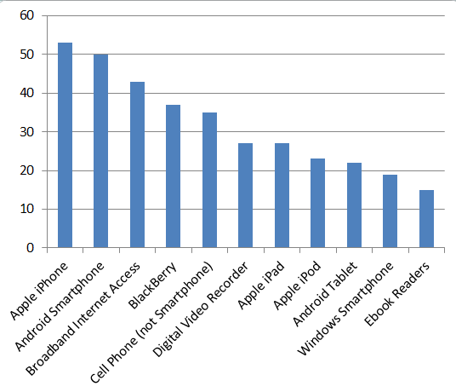
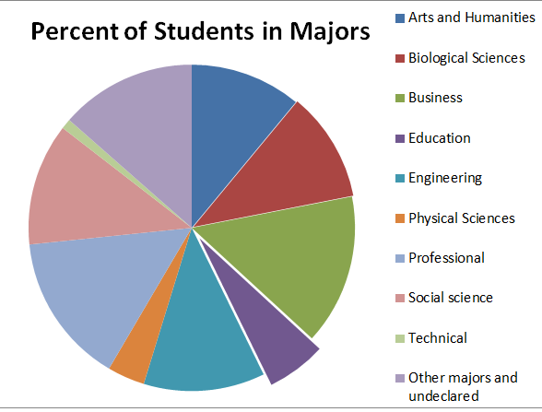
Pie Charts and Bar Graphs
Field of Study
Field | Percent of students
Arts and humanities | 10.6
Biological sciences | 14.7
Business | 14.5
Education | 5.2
Engineering | 11.2
Health professions | 12.8
Math and computer science | 3.7
Physical sciences | 2.4
Social sciences | 10.1
Other majors | 14.9
Total | 100.1
Note: for bar graphs, percents don’t necessarily add to 100.
← Rounding error

Slide 10
Quantitative data
The distribution of a quantitative variable tells us what values the variable takes on and how often it takes those values.
Histograms show the distribution of a quantitative variable by using bars whose height represents the number of individuals who take on a value within a particular class.
Stemplots separate each observation into a stem and a leaf that are then plotted to display the distribution while maintaining the original values of the variable.

Slide 11
Histograms
Appropriate for quantitative variables that take many values and/or large datasets.
Divide the possible values into classes (equal widths).
Count how many observations fall into each interval (may change to percents).
Draw picture representing the distribution―bar heights are equivalent to the number (percent) of observations in each interval.

Slide 12
Histograms
Example: Freshman Graduation Rate, or FGR, Data for 2010-2011

Slide 13
Interpreting Histograms
EXAMINING A HISTOGRAM
In any graph of data, look for the overall pattern and for striking deviations from that pattern.
You can describe the overall pattern by its shape, center, and variability. You will sometimes see variability referred to as spread.
An important kind of deviation is an outlier, an individual that falls outside the overall pattern.

Slide 14
Describing Distributions
A distribution is symmetric if the right and left sides of the graph are approximately mirror images of each other.
A distribution is skewed to the right (right-skewed) if the right side of the graph (containing the half of the observations with larger values) is much longer than the left side.
It is skewed to the left (left-skewed) if the left side of the graph is much longer than the right side.
Symmetric
Skewed-left
Skewed-right

Slide 15
Stemplots (Stem-and-Leaf Plots)
STEMPLOT
To make a stemplot:
Separate each observation into a stem, consisting of all but the final (rightmost) digit, and a leaf, the final digit. Stems may have as many digits as needed, but each leaf contains only a single digit.
Write the stems in a vertical column with the smallest at the top, and draw a vertical line at the right of this column. Be sure to include all the stems needed to span the data, even when some stems will have no leaves.
Write each leaf in the row to the right of its stem, in increasing order out from the stem.

Slide 16
Stemplots (Stem-and-Leaf Plots)
If there are very few stems (when the data cover only a very small range of values), then we may want to create more stems by splitting the original stems.
Example: If all of the data values were between 150 and 179, then we may choose to use the following stems:
15 15 16 16 17 17
Leaves 0-4 would go on each upper stem (first “15”), and leaves 5-9 would go on each lower stem (second “15”).

Slide 17
Stemplots
Example: Weight Data – Introductory Statistics Class
10 0166
11 009
12 0034578
13 00359
14 08
15 00257
16 555
17 000255
18 000055567
19 245
20 3
21 025
22 0
23
24
25
26 0
5
2
2
Key
20|3 means 203 pounds
Stems = 10’s Leaves = 1’s
Stems
Leaves

Slide 18
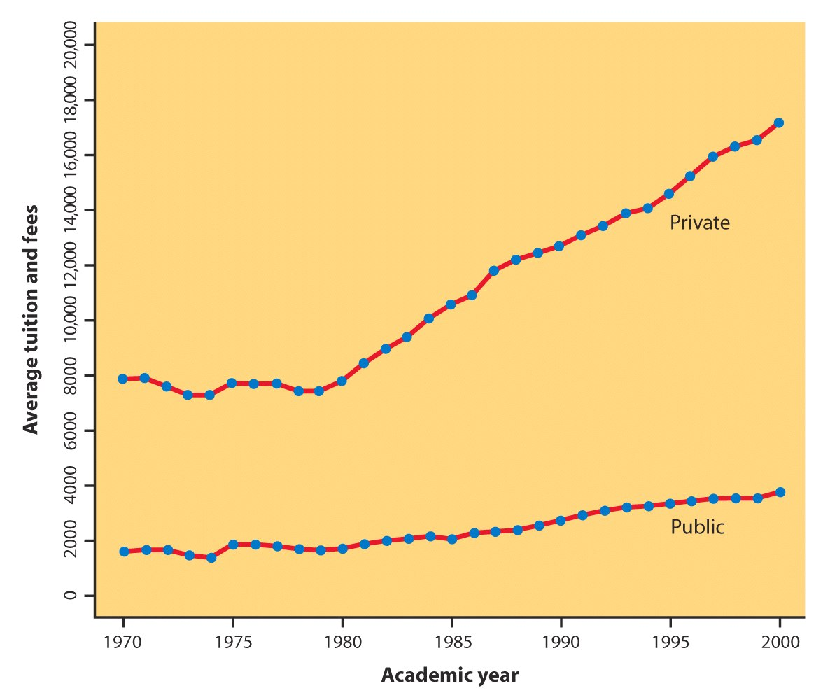
Time Plots
A time plot shows behavior over time.
Time is always on the horizontal axis, and the variable being measured is on the vertical axis.
Look for an overall pattern (trend), and deviations from this trend. Connecting the data points by lines may emphasize this trend.
Look for patterns that repeat at known regular intervals (seasonal variations).

