Slide 1
CHAPTER 3: The Normal Distributions
Basic Practice of Statistics
7th Edition
Lecture PowerPoint Slides

Slide 2
In Chapter 3, We Cover …
Density curves
Describing density curves
Normal distributions
The 68-95-99.7 rule
The standard Normal distribution
Finding Normal proportions
Using the standard Normal table
Finding a value given a proportion

Slide 3
Density Curves
We now have a toolbox of graphical and numerical methods for describing distributions. What is more, we have a clear strategy for exploring data on a single quantitative variable.
Exploring a distribution
Always plot your data: Make a graph, usually a histogram or a stemplot.
Look for the overall pattern (shape, center, and variability) and for striking deviations such as outliers.
Calculate a numerical summary to briefly describe center and variability.
Now we add one more step to this strategy:
Sometimes, the overall pattern of a large number of observations is so regular that we can describe it by a smooth curve.

Slide 4
Density Curves
Example: Here is a histogram of vocabulary scores of 947 seventh graders.
The smooth curve drawn over the histogram is a mathematical model for the distribution.

Slide 5
Density Curves
The areas of the shaded bars in this histogram represent the proportion of scores in the observed data that are less than or equal to 6.0. This proportion is equal to 0.303.
Now the area under the smooth curve to the left of 6.0 is shaded. If the scale is adjusted so that the total area under the curve is exactly 1, then this curve is called a density curve. The proportion of the area to the left of 6.0 is now equal to 0.293.

Slide 6
Density Curves
Density curve
A density curve is a curve that:
is always on or above the horizontal axis.
has an area of exactly 1 underneath it.
A density curve describes the overall pattern of a distribution. The area under the curve and above any range of values on the horizontal axis is the proportion of all observations that fall in that range.
Caution: No set of real data is exactly described by a density curve!

Slide 7
Describing Density Curves
7
Median and Mean of a Density Curve
The median of a density curve is the equal-areas point, the point that divides the area under the curve in half.
The mean of a density curve is the balance point, at which the curve would balance if made of solid material.
The median and the mean are the same for a symmetric density curve. They both lie at the center of the curve. The mean of a skewed curve is pulled away from the median in the direction of the long tail.

Slide 8
Density Curves
The mean and standard deviation computed from actual observations (data) are denoted by x and s, respectively.
The mean and standard deviation of the actual distribution represented by the density curve are denoted by µ (“mu”) and σ (“sigma”), respectively.

Slide 9
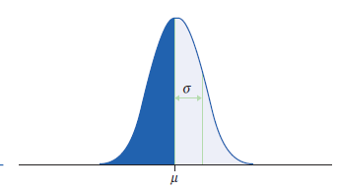
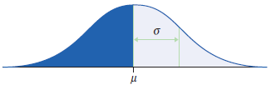
Normal Distributions
One particularly important class of density curves are the Normal curves, which describe Normal distributions.
All Normal curves are symmetric, single-peaked, and bell-shaped
Any specific Normal curve is described by giving its mean µ and standard deviation σ.

Slide 10
Normal Distributions
Unlike most distributions, any particular Normal distribution is completely specified by two numbers: its mean µ and standard deviation σ:
The mean is located at the center of the symmetric curve and is the same as the median. Changing µ without changing σ moves the Normal curve along the horizontal axis without changing its variability.
The standard deviation σ controls the variability of a Normal curve. When the standard deviation is larger, the area under the normal curve is less concentrated about the mean.
The standard deviation is the distance from the center to the change-of-curvature points on either side.

Slide 11
Normal Distributions
Normal Distributions
A Normal distribution is described by a Normal density curve. Any particular Normal distribution is completely specified by two numbers: its mean µ and standard deviation σ.
The mean of a Normal distribution is at the center of the symmetric Normal curve. The standard deviation is the distance from the center to the change-of-curvature points on either side.

Slide 12
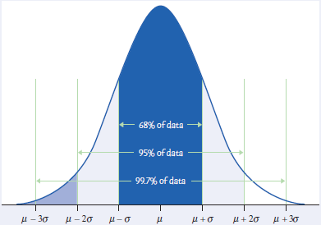
The 68-95-99.7 Rule
The 68-95-99.7 Rule
In the Normal distribution with mean µ and standard deviation σ:
Approximately 68% of the observations fall within σ of µ.
Approximately 95% of the observations fall within 2σ of µ.
Approximately 99.7% of the observations fall within 3σ of µ.

Slide 13
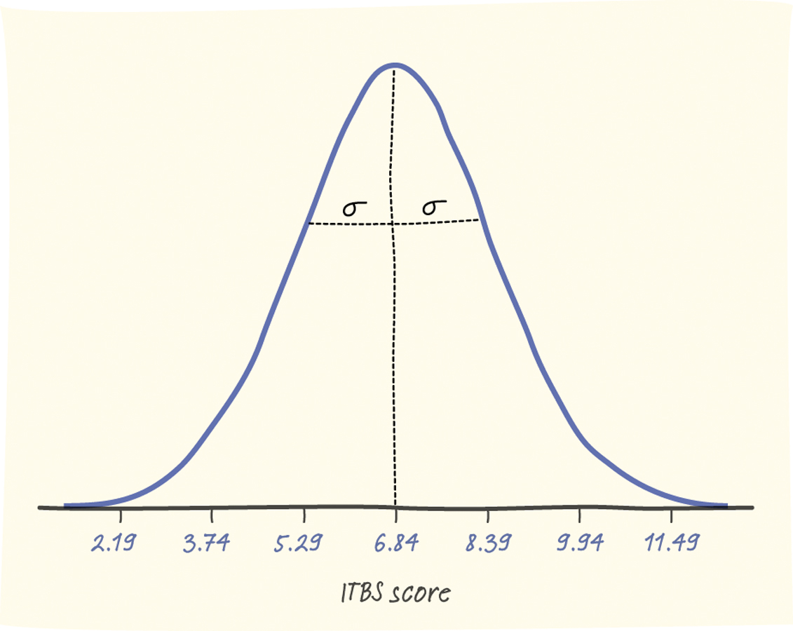
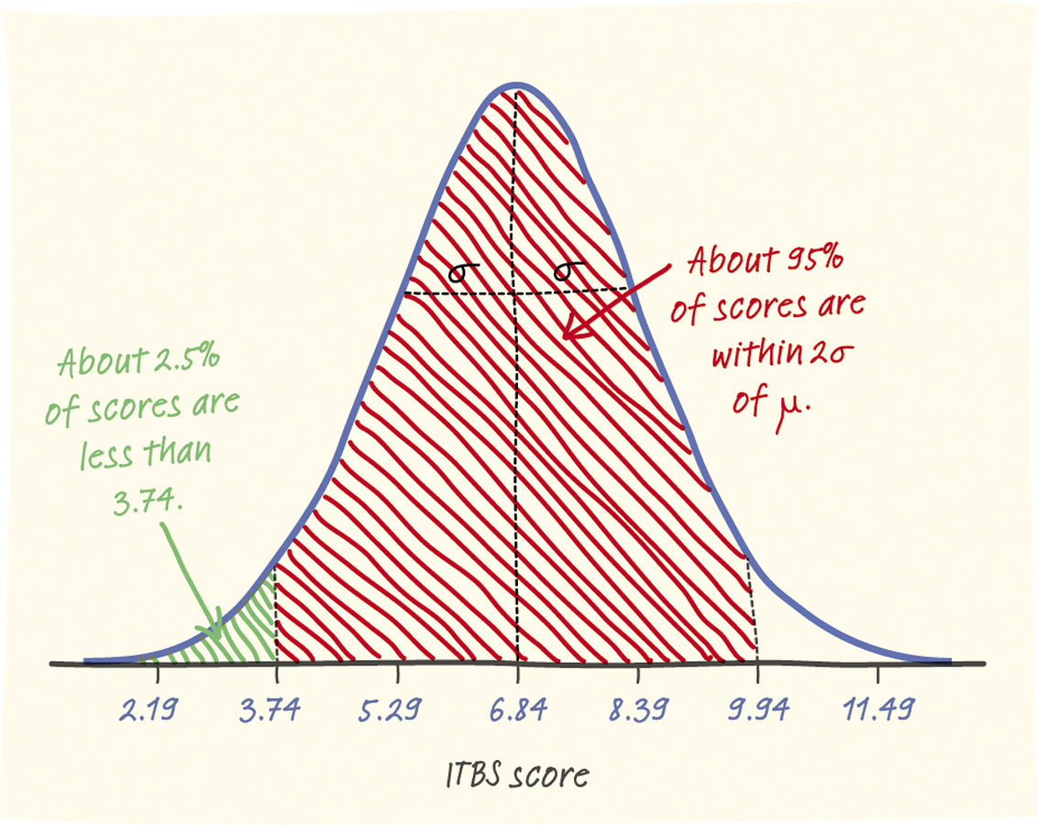
Normal Distributions
The distribution of Iowa Test of Basic Skills (ITBS) vocabulary scores for seventh-grade students in Gary, Indiana, is close to Normal. Suppose the distribution is N(6.84, 1.55).
Sketch the Normal density curve for this distribution.
What percent of ITBS vocabulary scores is between 3.74 and 9.94?
What percent of the scores is above 5.29?

Slide 14
Standardizing
All Normal distributions are the same if we measure in units of size σ from the mean µ as center.
Changing to these units is called standardizing.
STANDARDIZING AND z-SCORES
If x is an observation from a distribution that has mean and standard deviation σ, the standardized value of x is
z = x − µ/σ
A standardized value is often called a z-score.

Slide 15
Standardizing
Example:
The heights of women aged 20 to 29 in the United States are approximately Normal with µ = 64.2 and σ = 2.8 inches. The standardized height is
z = height − 64.2/2.8
A woman's standardized height is the number of standard deviations by which her height differs from the mean height of all women aged 20 to 29. A woman 70 inches tall, for example, has standardized height
z = 70 − 64.2/2.8 = 2.07
or 2.07 standard deviations above the mean.
Similarly, a woman 5 feet (60 inches) tall has standardized height
z = 60 − 64.2/2.8 = −1.50
or 1.5 standard deviations less than the mean height.

Slide 16
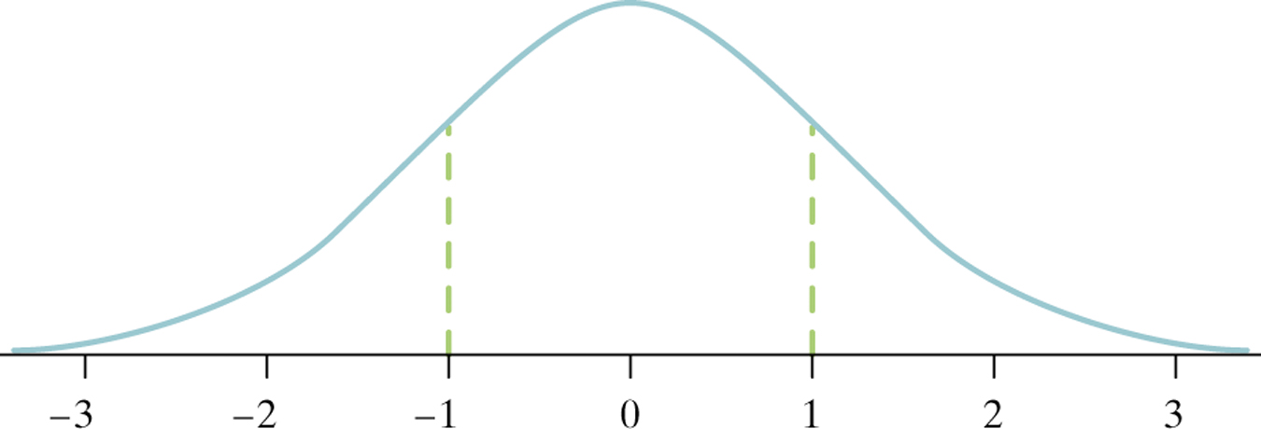
The Standard Normal Distribution
standard Normal distribution
The standard Normal distribution is the Normal distribution with mean 0 and standard deviation 1.
If a variable x has any Normal distribution N(µ,σ) with mean µ and standard deviation σ, then the standardized variable
z = x − µ/σ
has the standard Normal distribution, N(0,1).

Slide 17
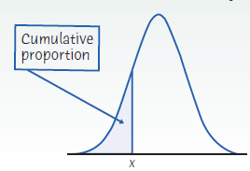
Cumulative Proportions
Cumulative proportions
The cumulative proportion for a value x in a distribution is the proportion of observations in the distribution that are less than or equal to x.

Slide 18
Cumulative Proportions—Example
Example: Who qualifies for college sports?
The combined scores of the almost 1.7 million high school seniors taking the SAT in 2013 were approximately Normal with mean 1011 and standard deviation 216. What percent of high school seniors meet this SAT requirement of a combined score of 820 or better?
Here is the calculation in a picture:
So about 81% qualified for college sports.

Slide 19
Cumulative Proportions—Example
Example: Normal calculation using software
To find the numerical value 0.1873 of the cumulative proportion in our college sports example using software, plug in mean 1010 and standard deviation 214 and ask for the cumulative proportion for 820. Software often uses terms such as “cumulative distribution” or “cumulative probability.”
Minitab’s output:

Slide 20
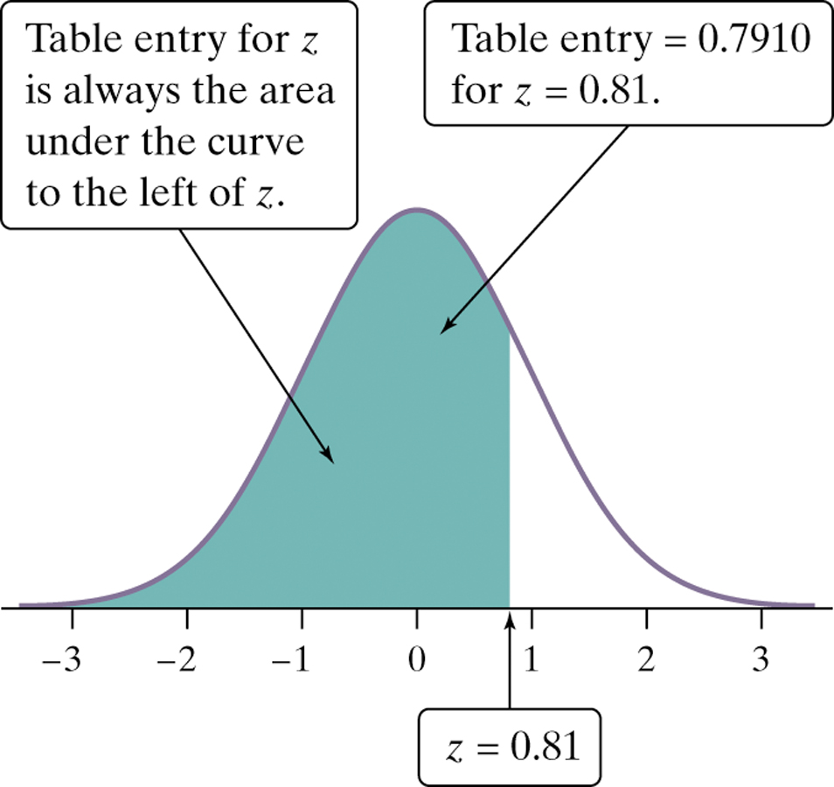
The Standard Normal Table
Because all Normal distributions are the same when we standardize, we can find areas under any Normal curve from a single table.
The Standard Normal Table
Table A is a table of areas under the standard Normal curve. The table entry for each value z is the area under the curve to the left of z.
Suppose we want to find the proportion of observations from the standard Normal distribution that are less than 0.81.
We can use Table A:
P(z < 0.81) =
.7910
Z | .00 | .01 | .02
0.7 | .7580 | .7611 | .7642
0.8 | .7881 | .7910 | .7939
0.9 | .8159 | .8186 | .8212

Slide 21
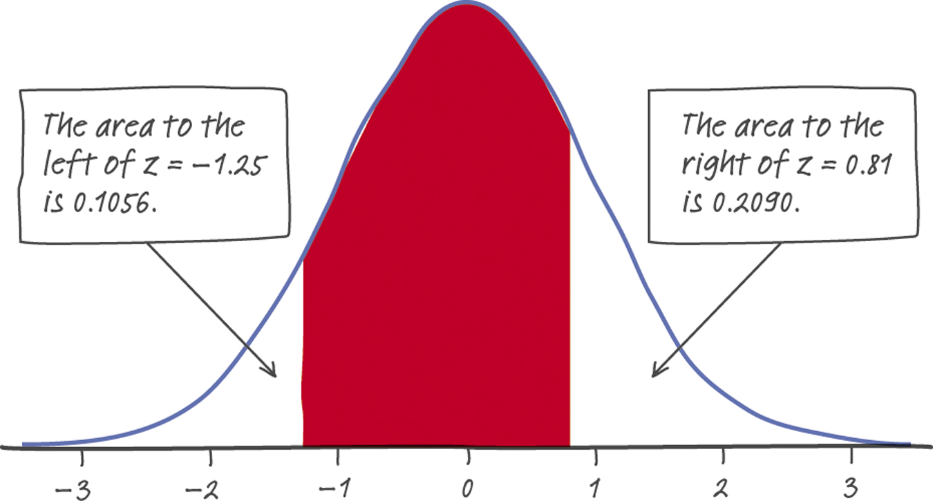
Normal Calculations
Find the proportion of observations from the standard Normal distribution that are between –1.25 and 0.81.
Can you find the same proportion using a different approach?
1 – (0.1056+0.2090) = 1 – 0.3146
= 0.6854

Slide 22
Normal Calculations
Using Table A to find Normal proportions
Step 1. State the problem in terms of the observed variable x. Draw a picture that shows the proportion you want in terms of cumulative proportions.
Step 2. Standardize x to restate the problem in terms of a standard Normal variable z.
Step 3. Use Table A and the fact that the total area under the curve is 1 to find the required area under the standard Normal curve.

Slide 23
Finding a Value Given a Proportion
SAT reading scores for a recent year are distributed according to a N(504, 111) distribution.
How high must a student score in order to be in the top 10% of the distribution?
We’ll look at the same two approaches we did for finding Normal proportions—using software, and then using table A.

Slide 24
Finding a Value Given a Proportion
Example: using software
How high must a student score in order to be in the top 10% of the distribution?
We want to find the SAT score x with area 0.1 to its right under the Normal curve with mean µ = 504 and standard deviation σ = 111. That’s the same as finding the SAT score x with area 0.9 to its left. Most software will tell you x when you plug in mean 504, standard deviation 111, and cumulative proportion 0.9. Here is Minitab’s output:

Slide 25
Normal Calculations
SAT reading scores for a recent year are distributed according to a N(504, 111) distribution.
How high must a student score in order to be in the top 10% of the distribution?
In order to use table A, equivalently, what score has cumulative proportion 0.90 below it?
N(504, 111)
.90
.10
504 ?

Slide 26
Normal Calculations
How high must a student score in order to be in the top 10% of the distribution?
.10
Look up the closest probability (closest to 0.10) in the table.
Find the corresponding standardized score.
The value you seek is that many standard deviations from the mean.
504 ?
z | .07 | .08 | .09
1.1 | .8790 | .8810 | .8830
1.2 | .8980 | .8997 | .8015
1.3 | .8147 | .8162 | .8177
z = 1.28

Slide 27
Normal Calculations
How high must a student score in order to be in the top 10% of the distribution?
.10
z = 1.28
504 ?
We need to “unstandardize” the z-score to find the observed value (x):
x = 504 + z(111)
= 504 + [(1.28 ) × (111)]
= 504 + (142.08) = 646.08
A student would have to score at least 646.08 to be in the top 10% of the distribution of SAT reading scores for this particular year.

Slide 28
“Backward” Normal Calculations
Using Table A Given a Normal proportion
Step 1. State the problem in terms of the given proportion. Draw a picture that shows the Normal value, x, you want in relation to the cumulative proportion.
Step 2. Use Table A, the fact that the total area under the curve is 1, and the given area under the standard Normal curve to find the corresponding z-value.
Step 3. Unstandardize z to solve the problem in terms of a non-standard Normal variable x.

