Slide 1
CHAPTER 4: Scatterplots and Correlation
Basic Practice of Statistics
7th Edition
Lecture PowerPoint Slides

Slide 2
In Chapter 4, We Cover …
Explanatory and response variables
Displaying relationships: scatterplots
Interpreting scatterplots
Adding categorical variables to scatterplots
Measuring linear association: correlation
Facts about correlation

Slide 3
Explanatory and Response Variables
RESPONSE VARIABLE, EXPLANATORY VARIABLE
A response variable measures an outcome of a study. An explanatory variable may explain or influence changes in a response variable.

Slide 4
Scatterplot
The most useful graph for displaying the relationship between two quantitative variables is a scatterplot.
SCATTERPLOT
A scatterplot shows the relationship between two quantitative variables measured on the same individuals. The values of one variable appear on the horizontal axis, and the values of the other variable appear on the vertical axis. Each individual in the data appears as the point in the plot fixed by the values of both variables for that individual.
Always plot the explanatory variable, if there is one, on the horizontal axis (the x-axis) of a scatterplot. As a reminder, we usually call the explanatory variable x and the response variable y. If there is no explanatory-response distinction, either variable can go on the horizontal axis.

Slide 5
Scatterplot
Making the scatterplot in the context of our four-step process:
STATE: The research question of interest as a statement (or query about a statement) of the association between two variables in your data.
PLAN: The solution of your problem by plotting the variables according to the guidelines on the previous slide.
SOLVE: Examine the scatterplot, taking note of any relationship present.
We will explore the CONCLUDE step later.

Slide 6
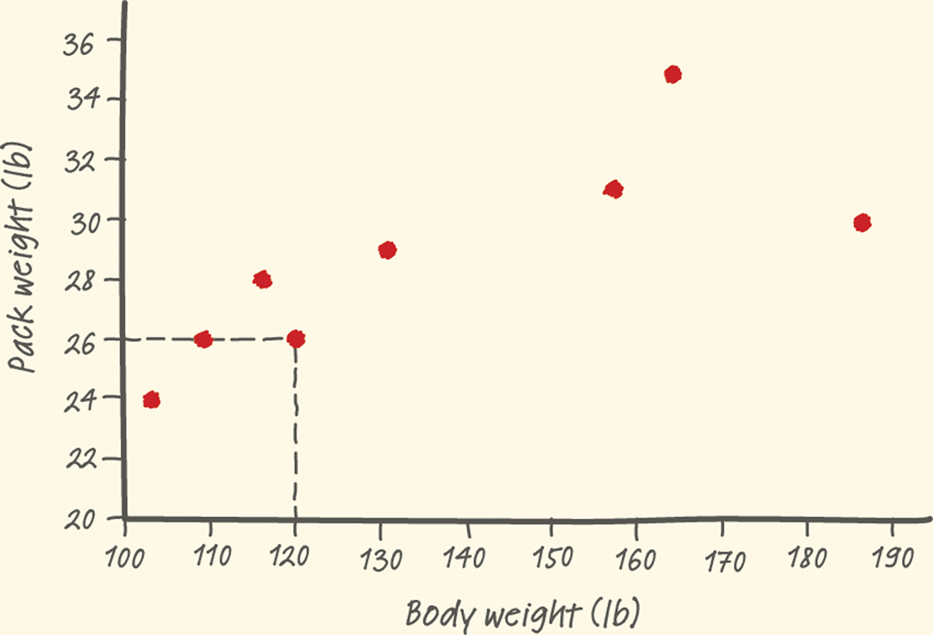
Scatterplot
Example: Make a scatterplot of the relationship between body weight and backpack weight for a group of hikers.
Body weight (lb) | 120 | 187 | 109 | 103 | 131 | 165 | 158 | 116
Backpack weight (lb) | 26 | 30 | 26 | 24 | 29 | 35 | 31 | 28

Slide 7
Interpreting Scatterplots
To interpret a scatterplot, follow the basic strategy of data analysis from Chapters 1 and 2. Look for patterns and important departures from those patterns.
HOW TO EXAMINE A SCATTERPLOT
As in any graph of data, look for the overall pattern and for striking deviations from that pattern.
You can describe the overall pattern of a scatterplot by the direction, form, and strength of the relationship.
An important kind of departure is an outlier, an individual value that falls outside the overall pattern of the relationship.

Slide 8
Direction of Association
POSITIVE ASSOCIATION, NEGATIVE ASSOCIATION
Two variables are positively associated when above-average values of one tend to accompany above-average values of the other, and below-average values also tend to occur together.
Two variables are negatively associated when above-average values of one tend to accompany below-average values of the other, and vice versa.

Slide 9
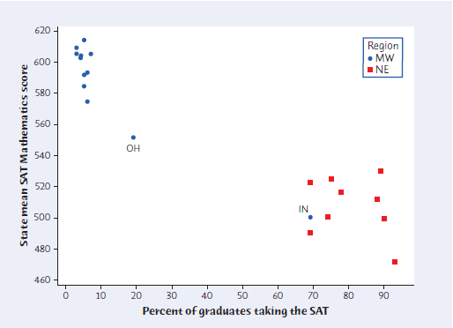
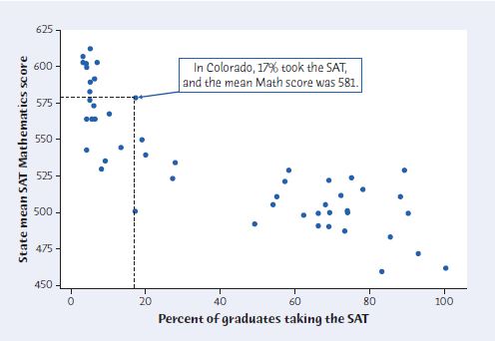
Adding Categorical Variables
Consider the relationship between mean SAT verbal score and percent of high-school grads taking SAT for each state.
To add a categorical variable, use a different plot color or symbol for each category.
Mean SAT Mathematics score and percent of high school graduates who take the test for only the Midwest (blue) and Northeast (red) states.

Slide 10
Measuring Linear Association
A scatterplot displays the strength, direction, and form of the relationship between two quantitative variables.
The correlation, r, measures the strength of the linear relationship between two quantitative variables.
shorter form:

Slide 11
Facts about Correlation
Correlation makes no distinction between explanatory and response variables.
r has no units and does not change when we change the units of measurement of x, y, or both.
Positive r indicates positive association between the variables, and negative r indicates negative association.
The correlation r is always a number between –1 and 1.

Slide 12
Facts about Correlation
Cautions:
Correlation requires that both variables be quantitative.
Correlation does not describe curved relationships between variables, no matter how strong the relationship is.
Correlation is not resistant. r is strongly affected by a few outlying observations.
Correlation is not a complete summary of two-variable data.

