Slide 1
CHAPTER 5: Regression
Basic Practice of Statistics
7th Edition
Lecture PowerPoint Slides

Slide 2
In chapter 5, we cover …
Regression lines
The least-squares regression line
Using technology
Facts about least-squares regression
Residuals
Influential observations
Cautions about correlation and regression
Association does not imply causation

Slide 3
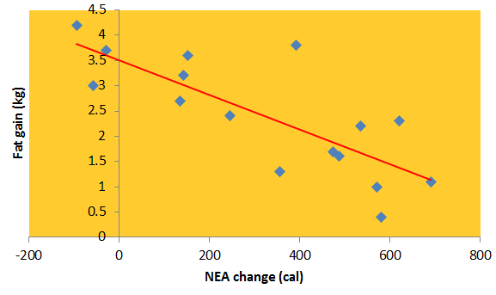
Regression line
A regression line is a straight line that describes how a response variable y changes as an explanatory variable x changes. We often use a regression line to predict the value of y for a given value of x. when we believe the relationship between $y$ and $x$ is linear.
Example: Predict the gain in fat (in kg) based on the change in Non-Exercise Activity (NEA change, in calories).
If the NEA change is 400 calories, what is the expected fat gain?
This regression line describes the overall pattern of the relationship

Slide 4
Regression line
Review of straight lines
Suppose that $y$ is a response variable (plotted on the vertical axis) and $x$ is an explanatory variable (plotted on the horizontal axis). A straight line relating $y$ to $x$ has an equation of the form
$$y=a+bx$$
In this equation, $b$ is the slope, the amount by which $y$ changes when $x$ increases by one unit. The number $a$ is the intercept, the value of $y$ when $x = 0$.
To plot the line on the scatterplot, use the equation to find the predicted $y$ for two values of $x$, one near each end of the range of $x$ in the data. Plot a line each $y$ above its $x$-value, and draw the line through the two points.

Slide 5
The least-squares regression line
Least-squares regression line
The least-squares regression line of y on x is the line that makes the sum of the squares of the vertical distances of the data points from the line as small as possible.
Equation of the Least-squares regression line
We have data on an explanatory variable x and a response variable y for n individuals. From the data, calculate the means $\overline{x}$ and $\overline{y}$ and the standard deviations $s_{x}$ and $s_{y}$ of the two variables and their correlation r. The least-squares regression line is the line
$\hat{y}=a+bx$,
with slope
$b=r\frac{s_{y}}{s_{x}}$ ,
and intercept,
$$a=\overline{y}−b\overline{x}$$

Slide 6
Prediction via regression line
For the non-exercise activity example, the least-squares regression line is: $\hat{y}= 3.5051−0.0034x$
$\hat{y }$is the predicted fat gain (in kg) with x calories of Non-Exercise Activity
Suppose we know someone has an increase of 400 calories of NEA. What would we predict for fat gain?
For someone with 400 calories of NEA, we would predict fat gain of:
This is the predicted response for someone with an of 400 calories of NEA
$$3.5051−0.0034\left(400\right)=2.1451 \text{kg}$$

Slide 7
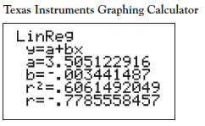
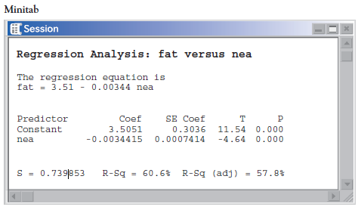
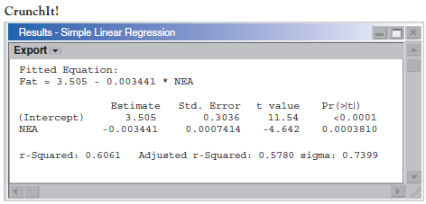
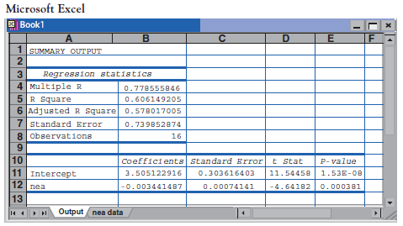
Using technology
Figure 5.3

Slide 8
Facts about least-squares regression
The distinction between explanatory and response variables is essential in regression.
There is a close connection between correlation and the slope of the least-squares line. The slope is
$$b=r\frac{s_{y}}{s_{x}}$$
The slope b and correlation r always have the same sign.
Along the regression line, a change of one standard deviation in $x$ corresponds to a change of $r$ standard deviations in $y$.
The least-squares regression line always passes through ($\overline{x}$,$\overline{y}$) on the graph of y against x.
The square of the correlation, r², is the fraction of the variation in the values of y that is explained by the least-squares regression of y on x.

Slide 9
Residuals
Represent “leftover" variation in the response after fitting the regression line
Residuals
A residual is the difference between an observed value of the response variable and the value predicted by the regression line. That is, a residual is the prediction error that remains after we have chosen the regression line:
$$\begin{matrix}\text{r}\text{esidual} & = & \text{observed} y−\text{predicted} y \\ & = & y−\hat{y}\end{matrix}$$

Slide 10
Residuals
The residuals from the least-squares line have a special property: the mean of the least-squares residuals is always zero.
Residual plots
A residual plot is a scatterplot of the regression residuals against the explanatory variable. Residual plots help us assess how well a regression line fits the data.
Look for a “random” scatter around zero.

Slide 11
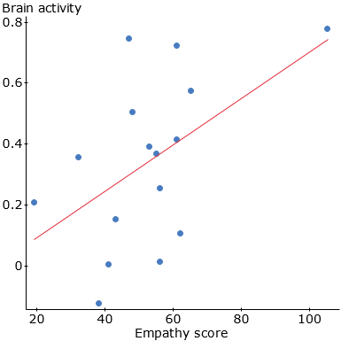
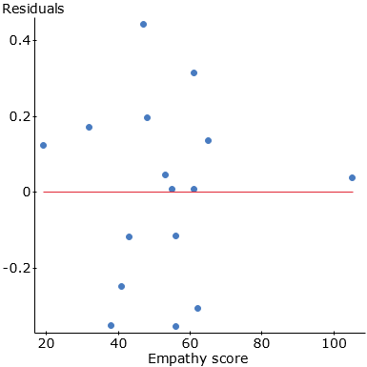
Residual plot
Empathy score and brain activity

Slide 12
Influential Observations
INFLUENTIAL OBSERVATIONS
An observation is influential for a statistical calculation if removing it would markedly change the result of the calculation.
The result of a statistical calculation may be of little practical use if it depends strongly on a few influential observations.
Points that are outliers in either the $x$ or the$y$ direction of a scatterplot are often influential for the correlation. Points that are outliers in the $x$ direction are often influential for the least-squares regression line.

Slide 13
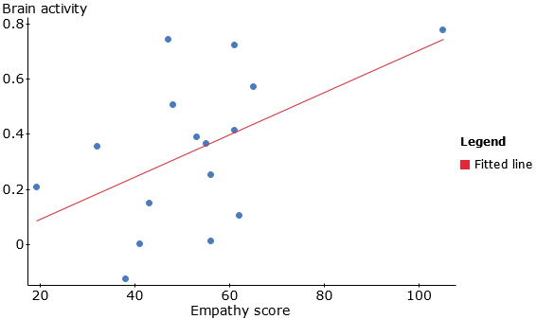
Outliers and influential points
Empathy score and brain activity
After removing observation 16
r² = 33.1%
From all of the data
r² = 51.5%

Slide 14
Cautions about correlation and regression
Correlation and regression lines describe only linear relationships.
Correlation and least-squares regression lines are not resistant.
Beware ecological correlation, or correlation based on averages rather than individuals.
Beware of extrapolation—predicting outside of the range of x.
Beware of lurking variables—these have an important effect on the relationship among the variables in a study, but are not included in the study.
Correlation does not imply causation!

Slide 15
Caution: beware of extrapolation
Sarah’s height was plotted against her age.
Can you predict her height at age 42 months?
Can you predict her height at age 30 years (360 months)?

Slide 16
Caution: beware of extrapolation
Regression line: $\hat{y}$ = 71.95 + .383 x
Predicted height at age 42 months? $\hat{y}$ = 88
Predicted height at age 30 years? $\hat{y}$ = 209.8
She is predicted to be 6’10.5” at age 30!

Slide 17
Example: Meditation and Aging (Noetic Sciences Review, Summer 1993, p. 28)
Caution: beware of lurking variables
Explanatory variable: observed meditation practice (yes/no)
Response variable: level of age-related enzyme
General concern for one’s well-being may also be affecting the response (and the decision to try meditation).

Slide 18
Correlation does not imply causation
Even very strong correlations may not correspond to a real causal relationship (changes in x actually causing changes in y).
Correlation may be explained by a lurking variable
Social Relationships and Health
House, J., Landis, K., and Umberson, D. “Social Relationships and Health,” Science, Vol. 241 (1988), pp 540-545.
Does lack of social relationships cause people to become ill? (There was a strong correlation.)
Or, are unhealthy people less likely to establish and maintain social relationships? (reversed relationship)
Or, is there some other factor that predisposes people both to have lower social activity and become ill?

Slide 19
Evidence of causation
A properly conducted experiment may establish causation.
Other considerations when we cannot do an experiment:
The association is strong.
The association is consistent.
Higher doses are associated with stronger responses.
Alleged cause precedes the effect in time.
Alleged cause is plausible (reasonable explanation).

