Slide 1
CHAPTER 9: Producing Data— Experiments
Basic Practice of Statistics
7th Edition
Lecture PowerPoint Slides

Slide 2
In Chapter 9, we cover …
Observation versus experiment
Subjects, factors, treatments
How to experiment badly
Randomized comparative experiments
The logic of randomized comparative experiments
Cautions about experimentation
Matched pairs and other block designs

Slide 3
Observation versus experiment
In contrast to observational studies, experiments don’t just observe individuals or ask them questions. They actively impose some treatment in order to measure the response.
An observational study observes individuals and measures variables of interest but does not attempt to influence the responses. The purpose of an observational study is to describe some group or situation.
An experiment, on the other hand, deliberately imposes some treatment on individuals to observe their responses. The purpose of an experiment is to study whether the treatment causes a change in the response.
When our goal is to understand cause and effect, experiments are the only source of fully convincing data.
The distinction between observational study and experiment is one of the most important in statistics.

Slide 4
Confounding
A lurking variable is a variable that is not among the explanatory or response variables in a study but that may influence the response variable.
Confounding
Two variables (explanatory variables or lurking variables) are confounded when their effects on a response variable cannot be distinguished from each other.
Observational studies of the effect of one variable on another often fail because of confounding between the explanatory variable and one or more lurking variables.
Well-designed experiments take steps to avoid confounding.

Slide 5
Subjects, factors, treatments
An experiment is a statistical study in which we actually do something (a treatment) to people, animals, or objects to observe the response. Here is the basic vocabulary of experiments.
Subjects, factors, treatments
The individuals studied in an experiment are often called subjects, particularly when they are people.
The explanatory variables in an experiment are often called factors.
A treatment is any specific experimental condition applied to the subjects. If an experiment has more than one factor, a treatment is a combination of specific values of each factor.

Slide 6
How to experiment badly
Experiments don’t guarantee good data.
Good designs are essential for effective experiments, just as they are for sampling.
Example: A college regularly offers a review course to prepare students for the GMAT. This year, it will offer only an online version of the course.
Students → Online Course → GMAT Scores
Suppose the results were 10% higher than the long-time average for those who took the classroom review course.
Can we conclude that the online course is more effective?

Slide 7
How to experiment badly
Many laboratory experiments use a design like the one in the online GMAT course example:
In the laboratory environment, simple designs often work well.
Field experiments and experiments with animals or people deal with more variable conditions.
Outside the laboratory, badly designed experiments often yield worthless results because of confounding.
Subjects
Treatment
Measure Response

Slide 8
Randomized comparative experiments
The remedy for confounding is to perform a comparative experiment in which some individuals receive one treatment and similar units receive another. Most well-designed experiments compare two or more treatments.
Some experiments may include a control group that receives an inactive treatment or an existing baseline treatment.
RANDOMIZED COMPARATIVE EXPERIMENT
An experiment that uses both comparison of two or more treatments and random assignment of subjects to treatments is a randomized comparative experiment.

Slide 9
Randomized comparative experiments
Comparison alone isn’t enough. If the treatments are given to groups that differ greatly, bias will result. The solution to the problem of bias is random assignment.
In an experiment, random assignment means that individuals are assigned to treatments at random, that is, using some sort of chance process.
COMPLETELY RANDOMIZED DESIGN
In a completely randomized experimental design, all the subjects are allocated at random among all the treatments.
Group 1
Treatment 1
Random Assignment
Compare Results
Experimental Units
Group 2
Treatment 2

Slide 10
The logic of randomized comparative experiments
Random assignment of subjects forms groups that should be similar in all respects before the treatments are applied.
A comparative experiment with randomization ensures that influences other than the experimental treatments operate equally on all groups.
Therefore, differences in average response must be due either to the treatments or to the play of chance in the random assignment of subjects to the treatments.

Slide 11
The logic of randomized comparative experiments
PRINCIPLES OF EXPERIMENTAL DESIGN
The basic principles of statistical design of experiments are
Control the effects of lurking variables on the response, most simply by comparing two or more treatments.
Randomize – use chance to assign subjects to treatments.
Replication – use enough subjects in each group to reduce chance variation in the results.
Statistical Significance
An observed effect so large that it would rarely occur by chance is called statistically significant.
A statistically significant association in data from a well-designed experiment does imply causation.

Slide 12
Cautions about experimentation
The logic of a randomized comparative experiment depends on our ability to treat all the subjects the same in every way except for the actual treatments being compared.
double-blind experiments
In a double-blind experiment, neither the subjects nor those who interact with them and measure the response variable know which treatment each subject is receiving.
Even these have been criticized for lack of realism.

Slide 13
Matched pairs
The idea of this experimental design is to create or use matching pairs of similar experimental units for comparing two treatments.
A matched-pairs design is a randomized experimental design in which—within each matching pair of similar subjects—chance is used to determine which subject gets each treatment.
Sometimes, a “pair” in a matched-pairs design consists of a single unit that receives both treatments. Since the order of the treatments can influence the response, chance is then used to determine which treatment is applied first for each unit.

Slide 14
Block design
Matched pairs are one kind of block design, with each pair forming a block.
Block design
A block is a group of individuals that are known before the experiment to be similar in some way that is expected to affect the response to the treatments.
In a block design, the random assignment of experimental units to treatments is carried out separately within each block.
Form blocks based on the most important unavoidable sources of variability (lurking variables) among the experimental units.
Randomization will average out the effects of the remaining lurking variables and allow an unbiased comparison of the treatments.

Slide 15
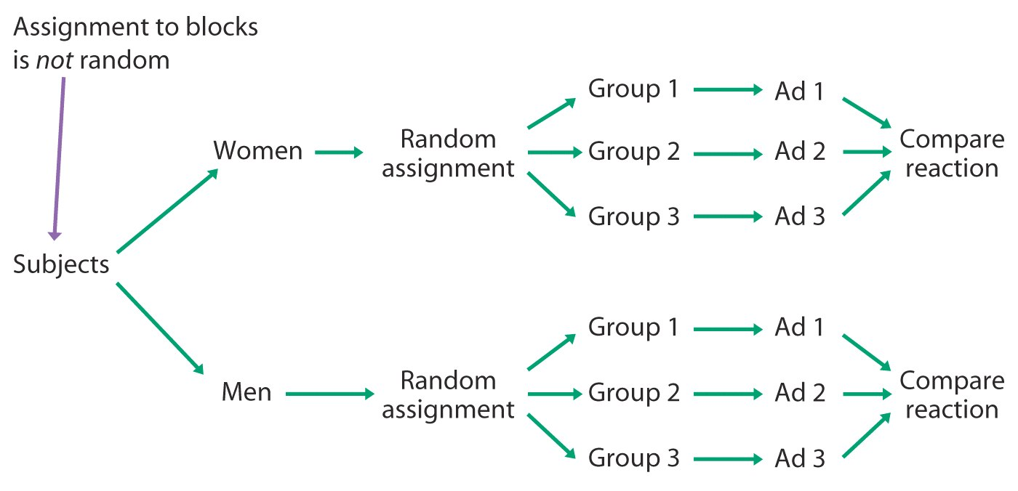
Blocked design—illustration

