Slide 1
CHAPTER 12: Introducing Probability
Basic Practice of Statistics
7th Edition
Lecture PowerPoint Slides

Slide 2
In Chapter 12, we cover …
The idea of probability
The search for randomness*
Probability models
Probability rules
Finite and discrete probability models
Continuous probability models
Random variables
Personal probability*

Slide 3
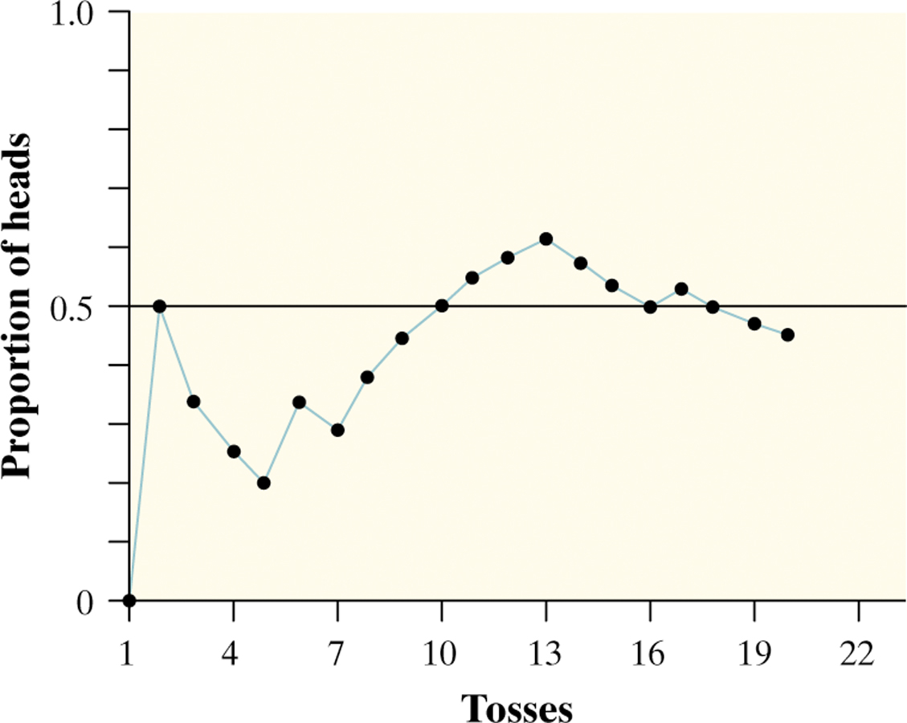
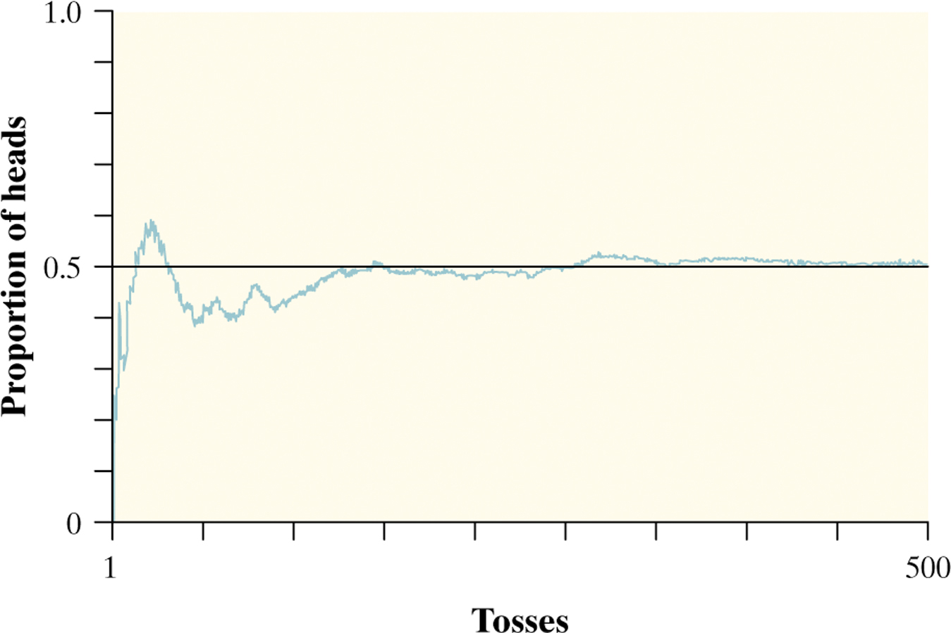
The idea of probability
Chance behavior is unpredictable in the short run, but has a regular and predictable pattern in the long run.
Randomness and probability
We call a phenomenon random if individual outcomes are uncertain but there is nonetheless a regular distribution of outcomes in a large number of repetitions.
The probability of any outcome of a random phenomenon is the proportion of times the outcome would occur in a very long series of repetitions.

Slide 4
Search for randomness*
Computer programs, including applets
Random number table
Physical means, such as tossing coins or rolling dice
“Chaos theory”
Quantum mechanics

Slide 5
Probability models
Descriptions of chance behavior contain two parts: a list of possible outcomes and a probability for each outcome.
Probability models
The sample space S of a random phenomenon is the set of all possible outcomes.
An event is an outcome or a set of outcomes of a random phenomenon. That is, an event is a subset of the sample space.
A probability model is a mathematical description of a random phenomenon consisting of two parts: a sample space S and a way of assigning probabilities to events.

Slide 6
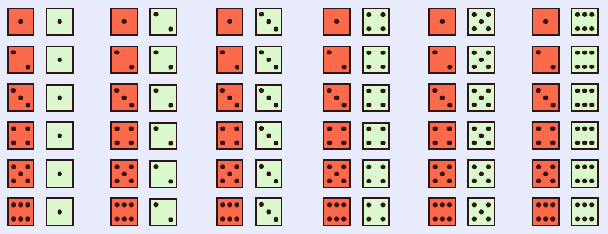
Probability models
Example: Give a probability model for the chance process of rolling two fair, six-sided dice―one that’s red and one that’s green.
Sample Space
36 Outcomes
Since the dice are fair, each outcome is equally likely.
Each outcome has probability 1/36.

Slide 7
Probability rules
Any probability is a number between 0 and 1. Any proportion is a number between 0 and 1, so any probability is also a number between 0 and 1.
All possible outcomes together must have probability 1. Because some outcome must occur on every trial, the sum of the probabilities for all possible outcomes must be exactly 1.
If two events have no outcomes in common, the probability that one or the other occurs is the sum of their individual probabilities.
The probability that an event does not occur is 1 minus the probability that the event does occur. The probability that an event occurs and the probability that it does not occur always add to 100%, or 1.

Slide 8
Probability rules

Slide 9
Probability rules—example
First digits of numbers in legitimate financial records often follow a model known as Benford’s law. Call the first digit of a randomly chosen record X—Benford’s law gives this probability model for X:
First digit, X: | 1 | 2 | 3 | 4 | 5 | 6 | 7 | 8 | 9
Probability | 0.301 | 0.176 | 0.125 | 0.097 | 0.079 | 0.067 | 0.058 | 0.051 | 0.046
Show that this is a legitimate probability model.
Find the probability that the first digit for the chosen number is not a 9.
Each probability is between 0 and 1 and 0.301 + 0.176 + … + 0.046 = 1
P(not 9) = 1 – P(9)
= 1 – 0.046 = 0.954

Slide 10
Finite and discrete probability models
One way to assign probabilities to events is to assign a probability to every individual outcome, then add these probabilities to find the probability of any event. This idea works well when there are only a finite (fixed and limited) number of outcomes.
Finite probability model
A probability model with a finite sample space is called finite.
To assign probabilities in a finite model, list the probabilities of all the individual outcomes. These probabilities must be numbers between 0 and 1 that add to exactly 1. The probability of any event is the sum of the probabilities of the outcomes making up the event.
Discrete probability models include finite models as well as sample spaces that are infinite and equivalent to the set of all positive integers.
The Benford’s law probability model was finite.

Slide 11
Continuous probability models
Suppose we want to choose a number at random between 0 and 1, allowing any number between 0 and 1 as the outcome.
We cannot assign probabilities to each individual value because there is an infinite interval of possible values.
continuous probability model
A continuous probability model assigns probabilities as areas under a density curve. The area under the curve and above any range of values is the probability of an outcome in that range.
Example: Find the probability of getting a random number that is less than or equal to 0.5 OR greater than 0.8.
$P\left(X≤0.5 \text{or} X>0.8\right)$
$=P\left(X≤0.5\right)+P\left( X>0.8\right)$
$=0.5+0.2=0.7$
Uniform
Distribution

Slide 12
Normal probability models

Slide 13
Random variables
random variable
A random variable is a variable whose value is a numerical outcome of a random phenomenon.
The probability distribution of a random variable X tells us what values X can take and how to assign probabilities to those values.
Random variables that have a finite list of possible outcomes are called discrete.
Random variables that can take on any value in an interval, with probabilities given as areas under a density curve, are called continuous.

Slide 14
Personal probability*
Personal probability
A personal probability of an outcome is a number between 0 and 1 that expresses an individual’s judgment of how likely the outcome is.
To be legitimate, must obey Rules 1–4 of probability.
May not match another individual’s personal probability of an event.
Notes:
Instructor may wish to point out that some otherwise perfectly rational people do not have personal probabilities obeying rules 1–4. Example: gambling decisions, including playing the lottery. The advanced probability topic that takes this into account is the Bayesian notion of a “utility function.”

