Slide 1
CHAPTER 13: General Rules of Probability
Basic Practice of Statistics
7th Edition
Lecture PowerPoint Slides

Slide 2
In chapter 13, we cover …
Independence and the multiplication rule
The general addition rule
Conditional probability
The general multiplication rule
Independence again
Tree diagrams

Slide 3
Probability rules
Everything in this chapter follows from the four rules we learned in Chapter 12:
Rule 1. For any event A, 0 ≤ P(A) ≤ 1.
Rule 2. If S is the sample space, P(S) = 1.
Rule 3. Addition rule: If A and B are disjoint events,
P(A or B) = P(A) + P(B).
Rule 4. For any event A,
P(A does not occur) = 1 – P(A).

Slide 4
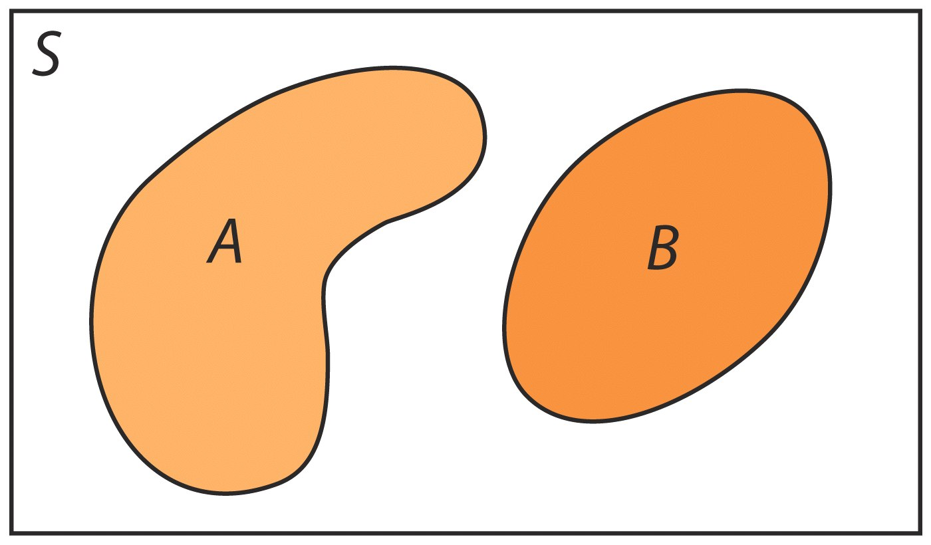
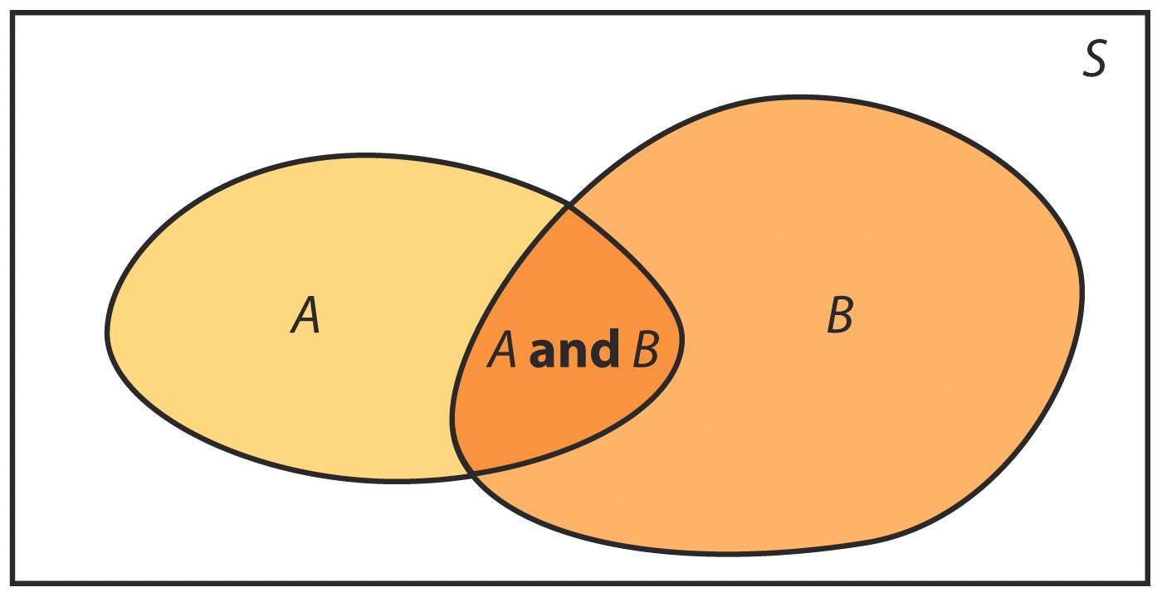
Venn diagrams
Sometimes it is helpful to draw a picture to display relations among several events. A picture that shows the sample space S as a rectangular area and events as areas within S is called a Venn diagram.
Two disjoint events:
Two events that are not disjoint, and the event {$A$ and $B$} consisting of the outcomes they have in common:

Slide 5
Multiplication rule for independent events
If two events A and B do not influence each other; that is, if knowledge about one does not change the probability of the other; then the events are said to be independent of each other.
Multiplication Rule for Independent Events
Two events A and B are independent if knowing that one occurs does not change the probability that the other occurs. If A and B are independent:
P(A and B) = P(A) × P(B)

Slide 6
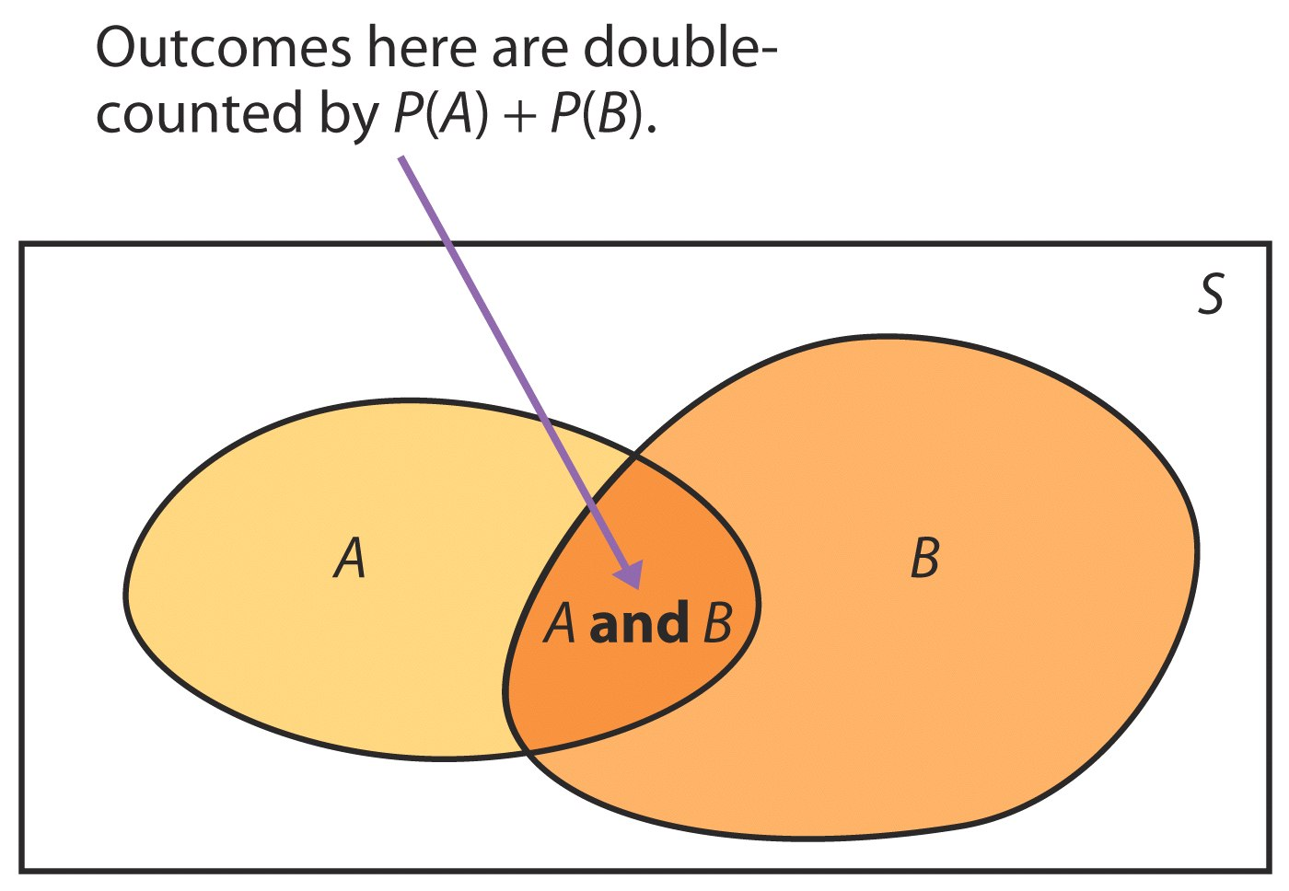
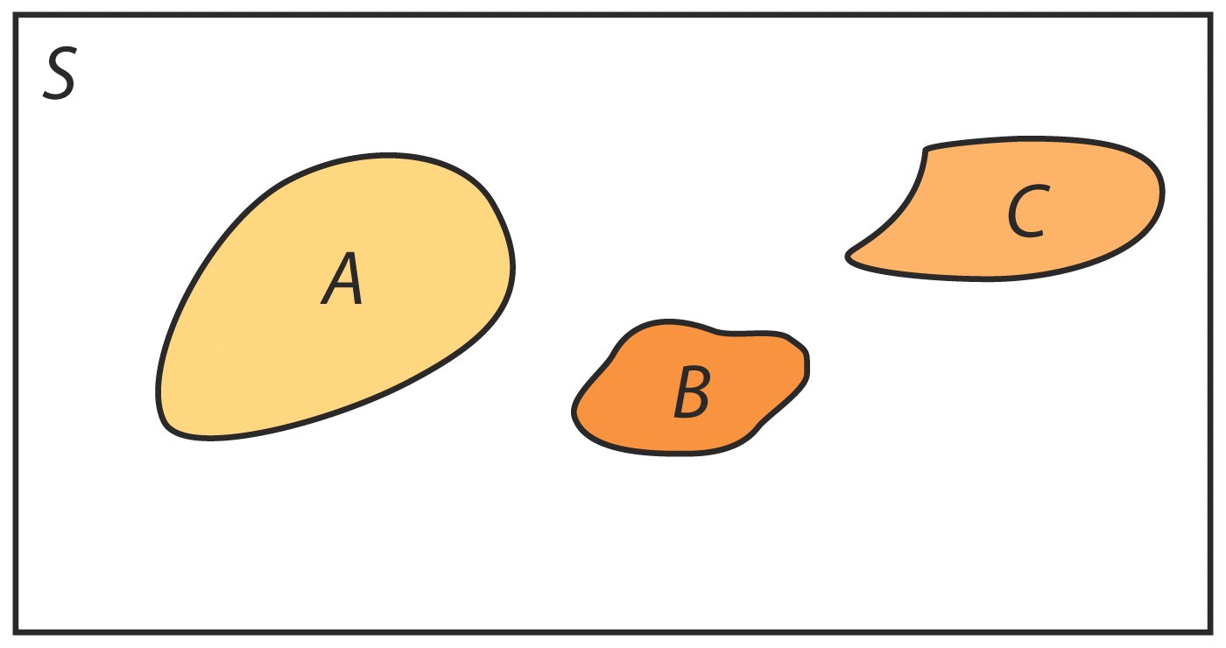
The general addition rule
We know if A and B are disjoint events,
P(A or B) = P(A) + P(B)
Addition Rule for Any Two Events
For any two events A and B:
P(A or B) = P(A) + P(B) – P(A and B)

Slide 7
Conditional probability
The probability we assign to an event can change if we know that some other event has occurred. This idea is the key to many applications of probability.
When we are trying to find the probability that one event will happen, given the information that the other event is already known to have occurred, we are trying to determine a conditional probability.
conditional probability
When P(A) > 0, the conditional probability of B given A is:
$$P\left(B|A\right)=\frac{P\left(A \text{and} B\right)}{P\left(A\right)}$$

Slide 8
The general multiplication rule
The definition of conditional probability reminds us that in principle all probabilities, including conditional probabilities, can be found from the assignment of probabilities to events that describes a random phenomenon.
More often, however, conditional probabilities are part of the information given to us in a probability model. The definition of conditional probability then turns into a rule for finding the probability that both of two events occur.

Slide 9
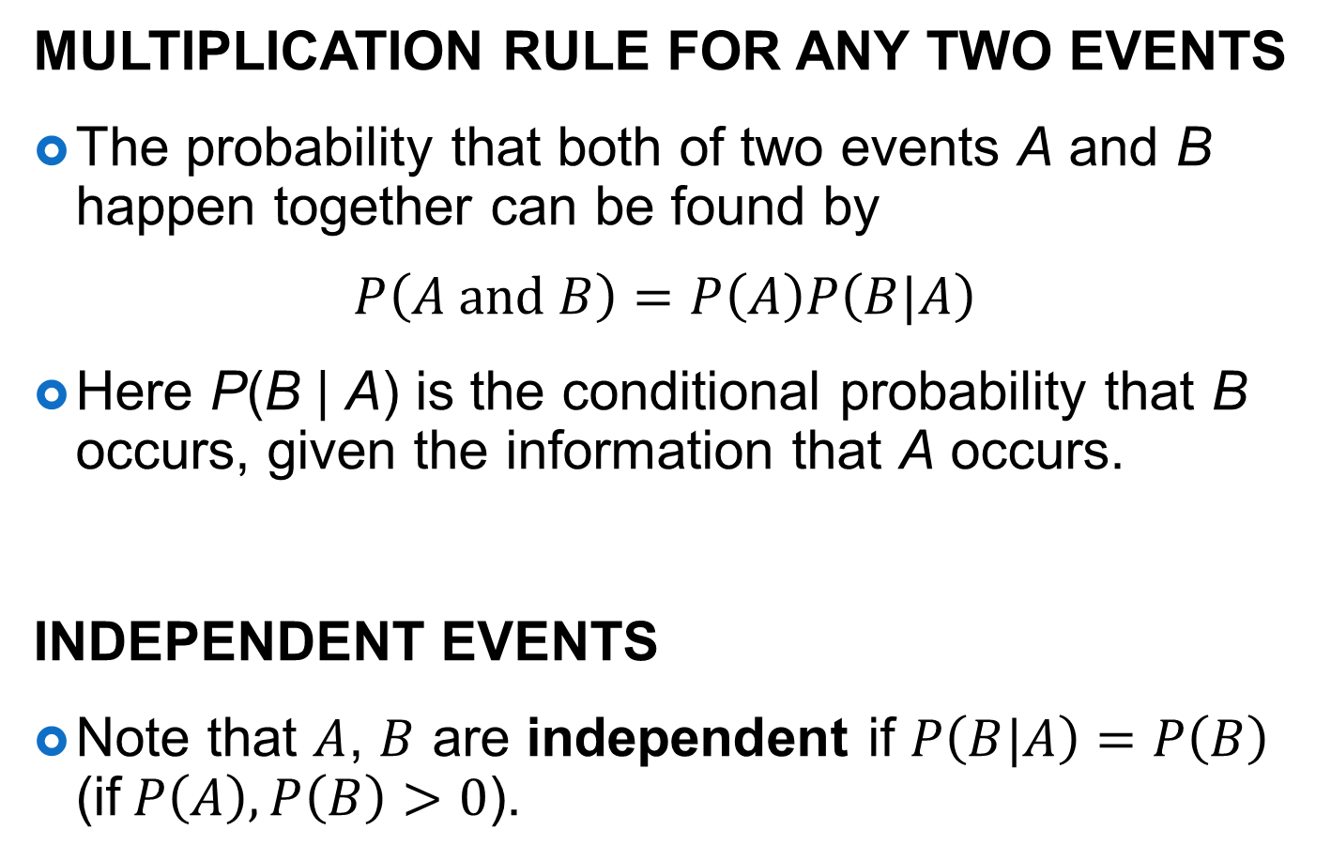
The general multiplication rule, independence again
Multiplication Rule for Any Two Events
The probability that both of two events A and B happen together can be found by
$$P\left(A \text{and} B\right)=P\left(A\right)P\left(B|A\right)$$
Here P(B | A) is the conditional probability that B occurs, given the information that A occurs.
Independent events
Note that $A$, $B$ are independent if $P\left(B|A\right)=P\left(B\right)$ (if$P\left(A\right),P\left(B\right)>0$).

Slide 10
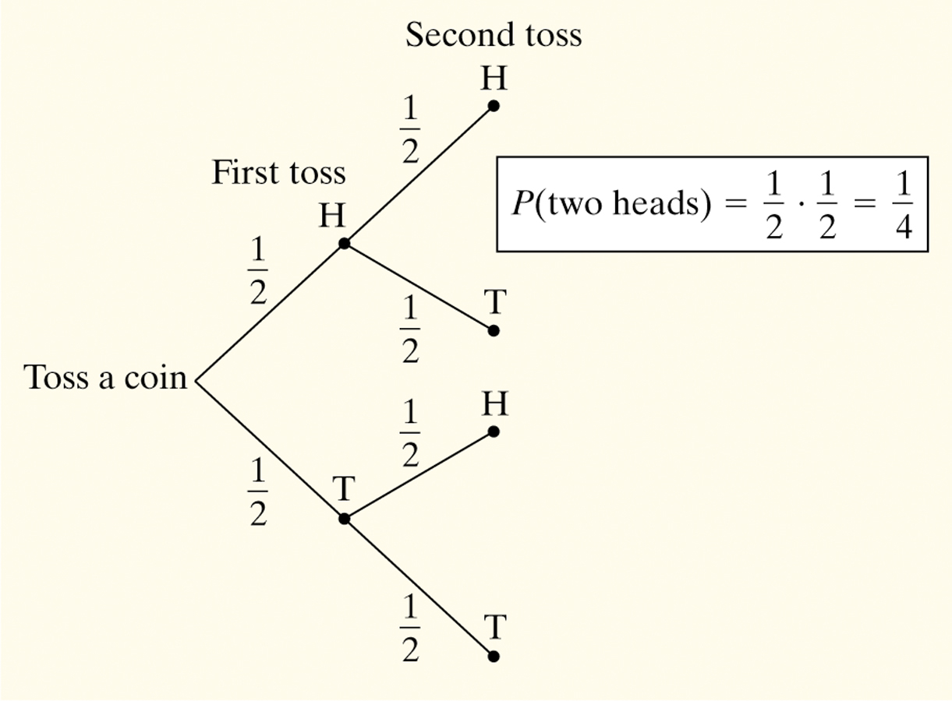
Tree diagrams
We learned how to describe the sample space S of a chance process in Chapter 10. Another way to model chance behavior that involves a sequence of outcomes is to construct a tree diagram.
Consider flipping a coin twice.
What is the probability of getting two heads?
Sample Space:
HH HT TH TT
So, P(two heads) = P(HH) = 1/4

Slide 11
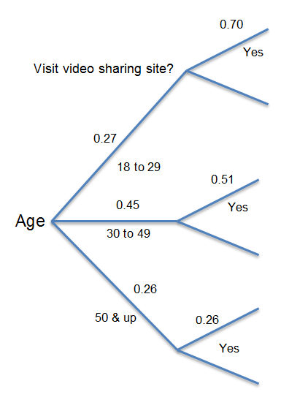
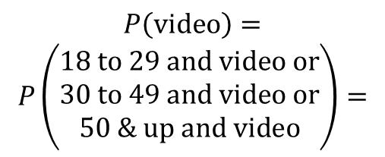
Example
Let’s look only at adult Internet users, age 18 and over. About 27% of adult Internet users are 18 to 29 years old, another 45% are 30 to 49 years old, and the remaining 28% are 50 and over. The Pew Internet and American Life Project finds that 70% of Internet users aged 18 to 29 have visited a video sharing site, along with 51% of those aged 30 to 49 and 26% of those 50 or older.
What percent of all adult Internet users visit video sharing sites?
$→P\left(18 \text{to} 29\right)=0.27$,$P\left(\text{video}|18 \text{to} 29\right)=0.70$
$$P\left(18 \text{to} 29 \text{and} \text{video}\right)=$$
$P\left(18 \text{to} 29\right)P\left(\text{video}|18 \text{to} 29\right)$=
$$\left(0.27\right)\left(0.70\right)=0.1890$$
$$P\left(\text{video}\right)=$$
$$P\left(\begin{aligned}18 \text{to} 29 \text{and} \text{video} \text{or} \\ 30 \text{to} 49 \text{and} \text{video} \text{or} \\ 50 \text{&} \text{up} \text{and} \text{video}\end{aligned}\right)=$$
$\left(0.27\right)\left(0.70\right)+\left(0.45\right)\left(0.51\right)+$ $\left(0.28\right)\left(0.26\right)=0.491$

