Slide 1
CHAPTER 15: Sampling Distributions
Basic Practice of Statistics
7th Edition
Lecture PowerPoint Slides

Slide 2
In chapter 15, we cover …
Parameters and statistics
Statistical estimation and the Law of Large Numbers
Sampling distributions
The sampling distribution of $\overline{x}$
The Central Limit Theorem
Sampling distributions and statistical significance

Slide 3
Parameters and statistics
As we begin to use sample data to draw conclusions about a wider population, we must be clear about whether a number describes a sample or a population.
PARAMETER, STATISTIC
A parameter is a number that describes the population. In practice, the value of a parameter is not known because we can rarely examine the entire population.
A statistic is a number that can be computed from the sample data without making use of any unknown parameters. In practice, we often use a statistic to estimate an unknown parameter.
Remember s and p: statistics come from samples and parameters come from populations
We write µ (the Greek letter mu) for the mean of the population and σ for the standard deviation of the population. We write $\overline{x}$ (“x-bar”) for the mean of the sample and s for the standard deviation of the sample.

Slide 4
Statistical estimation
The process of statistical inference involves using information from a sample to draw conclusions about a wider population.
Different random samples yield different statistics. We need to be able to describe the sampling distribution of possible statistic values in order to perform statistical inference.
We can think of a statistic as a random variable because it takes numerical values that describe the outcomes of the random sampling process. Therefore, we can examine its probability distribution using what we learned in earlier chapters.
Population
Collect data from a representative Sample...
Sample
Make an Inference about the Population.

Slide 5
The Law of Large Numbers
If $\overline{x}$ is rarely exactly right and varies from sample to sample, why is it nonetheless a reasonable estimate of the population mean $μ$?
Here is one answer: if we keep on taking larger and larger samples, the statistic $\overline{\text{x}}$ is guaranteed to get closer and closer to the parameter $\text{μ}$.
Law of large numbers
Draw observations at random from any population with finite mean $μ$. As the number of observations drawn increases, the mean $\overline{x}$ of the observed values tends to get closer and closer to the mean $μ$ of the population.

Slide 6
Sampling distributions
The law of large numbers assures us that if we measure enough subjects, the statistic $\overline{x}$ will eventually get very close to the unknown parameter $μ$.
If we took every one of the possible samples of a certain size, calculated the sample mean for each, and graphed all of those values, we’d have a sampling distribution.
The population distribution of a variable is the distribution of values of the variable among all individuals in the population.
The sampling distribution of a statistic is the distribution of values taken by the statistic in all possible samples of the same size from the same population.
Be careful: The population distribution describes the individuals that make up the population. A sampling distribution describes how a statistic varies in many samples from the population.

Slide 7
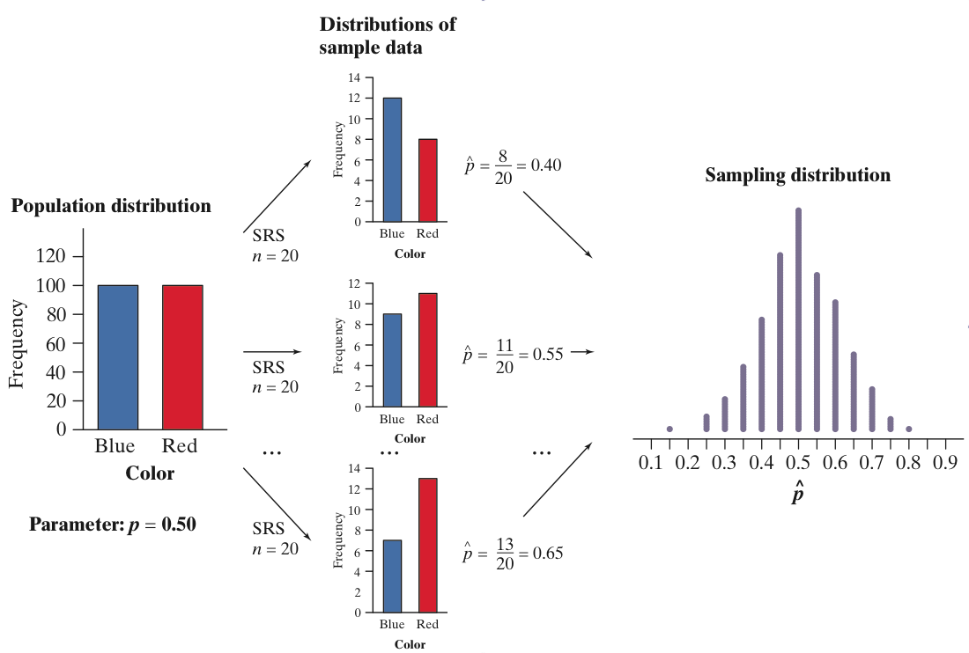
Population distributions versus sampling distributions
There are actually three distinct distributions involved when we sample repeatedly and measure a variable of interest.
The population distribution gives the values of the variable for all the individuals in the population.
The distribution of sample data shows the values of the variable for all the individuals in the sample.
The sampling distribution shows the statistic values from all the possible samples of the same size from the population.

Slide 8
The sampling distribution of $\overline{x}$
When we choose many SRSs from a population, the sampling distribution of the sample mean is centered at the population mean µ and is less spread out than the population distribution. Here are the facts.
MEAN AND STANDARD DEVIATION OF A SAMPLE MEAN
Suppose that $\overline{x}$ is the mean of an SRS of size $n$ drawn from a large population with mean $μ$ and standard deviation $σ$. Then the sampling distribution of $\overline{x}$ has mean $μ$ and standard deviation $σ/{\sqrt{n}}$.
We say the statistic $\overline{x}$ is an unbiased estimator of the parameter $μ$.
Because it’s standard deviation is $σ/{\sqrt{n}}$, the averages are less variable than individual observations, and the results of large samples are less variable than the results of small samples.
SAMPLING DISTRIBUTION OF A SAMPLE MEAN
If individual observations have the $N(μ,σ)$ distribution, then the sample mean $\overline{x}$ of an SRS of size $n$ has the $N(μ,σ/{\sqrt{n}})$ distribution.

Slide 9
The central limit theorem
Most population distributions are not Normal. What is the shape of the sampling distribution of sample means when the population distribution isn’t Normal?
It is a remarkable fact that as the sample size increases, the distribution of sample means changes its shape: it looks less like that of the population and more like a Normal distribution!
CENTRAL LIMIT THEOREM
Draw an SRS of size$n$ from any population with mean $μ$ and finite standard deviation $σ$. The central limit theorem says that when n is large, the sampling distribution of the sample mean $\overline{x}$ is approximately Normal:
$\overline{x}$ is approximately $N\left(μ,σ/{\sqrt{n}}\right)$
The central limit theorem allows us to use Normal probability calculations to answer questions about sample means from many observations even when the population distribution is not Normal.

Slide 10
The central limit theorem

Slide 11
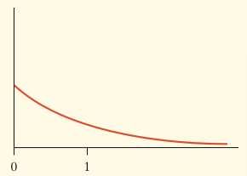
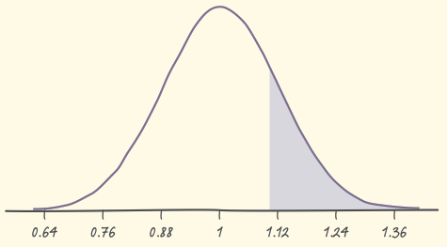
Central limit theorem: example
Based on service records from the past year, the time (in hours) that a technician requires to complete preventative maintenance on an air conditioner follows the distribution that is strongly right-skewed, and whose most likely outcomes are close to 0. The mean time is µ = 1 hour and the standard deviation is σ = 1.
Your company will service an SRS of 70 air conditioners. You have budgeted 1.1 hours per unit. Will this be enough?
The central limit theorem states that the sampling distribution of the mean time spent working on the 70 units has:
The sampling distribution of the mean time spent working is approximately N(1, 0.12) since n = 70 ≥ 30.
If you budget 1.1 hours per unit, there is a 20% chance the technicians will not complete the work within the budgeted time.

Slide 12
Sampling distributions and statistical significance
We have looked carefully at the sampling distribution of a sample mean.
However, any statistic we can calculate from a sample will have a sampling distribution.
The sampling distribution of a sample statistic is determined by the particular sample statistic we are interested in, the distribution of the population of individual values from which the sample statistic is computed, and the method by which samples are selected from the population.
The sampling distribution allows us to determine the probability of observing any particular value of the sample statistic in another such sample from the population.

