Slide 1
CHAPTER 16: Confidence Intervals: The Basics
Basic Practice of Statistics
7th Edition
Lecture PowerPoint Slides

Slide 2
In chapter 16, we cover …
The reasoning of statistical estimation
Margin of error and confidence level
Confidence intervals for a population mean
How confidence intervals behave

Slide 3
Statistical inference
After we have selected a sample, we know the responses of the individuals in the sample. However, the reason for taking the sample is to infer from that data some conclusion about the wider population represented by the sample.
Statistical Inference
Statistical inference provides methods for drawing conclusions about a population from sample data.
Population
Sample
Collect data from a representative Sample...
Make an Inference about the Population.

Slide 4
Simple conditions for inference about a mean
This chapter presents the basic reasoning of statistical inference. We start with a setting that is too simple to be realistic.
Simple Conditions for Inference About a Mean
We have an SRS from the population of interest. There is no nonresponse or other practical difficulty. The population is large compared to the size of the sample.
The variable we measure has an exactly Normal distribution $N(μ,σ)$ in the population.
We don’t know the population mean μ, but we do know the population standard deviation σ.
Note: The conditions that we have a perfect SRS, that the population is exactly Normal, and that we know the population standard deviation are all unrealistic.

Slide 5
The reasoning of statistical estimation
An NHANES report gives data for 654 women aged 20 to 29 years. The mean BMI of these 654 women was $\overline{x}=26.8$. On the basis of this sample, we want to estimate the mean BMI $μ$ in the population of all 20.6 million women in this age group. To match the “simple conditions,” we will treat the NHANES sample as an SRS from a Normal population with known standard deviation $σ=7.5$.
To estimate the unknown population mean BMI $μ$, use the mean $\overline{x}=26.8$ of the random sample. We don't expect $\overline{x}$ to be exactly equal to μ, so we want to say how accurate this estimate is.

Slide 6
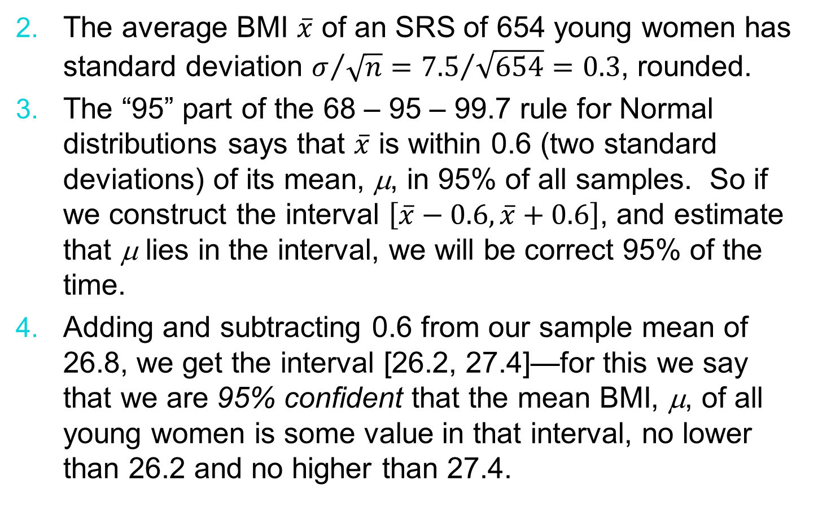
The reasoning of statistical estimation, cont’d
The average BMI $\overline{x}$ of an SRS of 654 young women has standard deviation $σ/{\sqrt{n}}={7.5}/{\sqrt{654}=0.3}$, rounded.
The “95” part of the 68 – 95 – 99.7 rule for Normal distributions says that $\overline{x}$ is within 0.6 (two standard deviations) of its mean, μ, in 95% of all samples. So if we construct the interval $\left[\overline{x}−0.6,\overline{x}+0.6\right]$, and estimate that μ lies in the interval, we will be correct 95% of the time.
Adding and subtracting 0.6 from our sample mean of 26.8, we get the interval [26.2, 27.4]—for this we say that we are 95% confident that the mean BMI, μ, of all young women is some value in that interval, no lower than 26.2 and no higher than 27.4.

Slide 7
Confidence interval
In our previous example, the 95% confidence interval was $\overline{x}±0.6$.
Most confidence intervals we construct will have a form similar to this:
$$\text{estimate}±\text{margin} \text{of} \text{error}$$
The margin of error $±0.6$ shows how accurate we believe our guess is, margin based on the variability of the estimate.
Confidence Interval
A level C confidence interval for a parameter has two parts:
An interval calculated from the data, which has the form:
$$\text{estimate}±\text{margin} \text{of} \text{error}$$
A confidence level C, which gives the probability that the interval will capture the true parameter value in repeated samples. That is, the confidence level is the success rate for the method.

Slide 8
Confidence level
The confidence level is the overall capture rate if the method is used many times. The sample mean will vary from sample to sample, but when we use the method $\text{estimate}±\text{margin} \text{of} \text{error}$ to get an interval based on each sample, C% of these intervals capture the unknown population mean µ.
INTERPRETING A CONFIDENCE LEVEL
The confidence level is the success rate of the method that produces the interval. We don't know whether the 95% confidence interval from a particular sample is one of the 95% that capture $μ$ or one of the unlucky 5% that miss.
To say that we are 95% confident that the unknown $μ$ lies between 26.2 and 27.4 is shorthand for “We got these numbers using a method that gives correct results 95% of the time.”

Slide 9
Confidence intervals for a population mean
In our NHANES example, wanting “95% confidence” dictated going out two standard deviations in both directions from the mean—if we change our confidence level C, we will change the number of standard deviations. The text includes a table with the most common multiples:
Once we have these, we may build any level C confidence interval we wish.
CONFIDENCE INTERVAL FOR THE MEAN OF A NORMAL POPULATION
Draw an SRS of size $n$ from a Normal population having unknown mean $μ$ and known standard deviation$σ$. A level C confidence interval for$μ$ is
$$\overline{x}±z^{∗}\frac{σ}{\sqrt{n}}$$
Some examples of critical values, $z^{∗}$, corresponding to the confidence level C are given above.
Confidence level C | 90% | 95% | 99%
Critical value z* | 1.645 | 1.960 | 2.576

Slide 10
Confidence intervals: the four-step process
The steps in finding a confidence interval mirror the overall four-step process for organizing statistical problems.
Confidence Intervals: The Four-Step Process
State: What is the practical question that requires estimating a parameter?
Plan: Identify the parameter, choose a level of confidence, and select the type of confidence interval that fits your situation.
Solve: Carry out the work in two phases:
1. Check the conditions for the interval that you plan to use.
2. Calculate the confidence interval.
Conclude: Return to the practical question to describe your results in this setting.

Slide 11
How confidence intervals behave
The 𝑧 confidence interval for the mean of a Normal population illustrates several important properties that are shared by all confidence intervals in common use: the user chooses the confidence level and the margin of error follows; we would like high confidence and a small margin of error; high confidence suggests our method almost always gives correct answers; and a small margin of error suggests we have pinned down the parameter precisely.
How do we get a small margin of error?
The margin of error for the z confidence interval is:
$$z^{∗}\frac{σ}{\sqrt{n}}$$
The margin of error gets smaller when:
$z^{∗}$ gets smaller (the same as a lower confidence level 𝐶)
𝜎 is smaller. It is easier to pin down µ when 𝜎 is smaller.
𝑛 gets larger. Since 𝑛 is under the square root sign, we must take four times as many observations to cut the margin of error in half.

