Slide 1
CHAPTER 20: Inference about a Population Mean
Basic Practice of Statistics
7th Edition
Lecture PowerPoint Slides

Slide 2
In Chapter 20, We Cover …
Conditions for inference about a mean
The t distributions
The one-sample t confidence interval
The one-sample t test
Matched pairs t procedures
Robustness of t procedures

Slide 3
Conditions for Inference About a Mean
• Random: our data as a simple random sample (SRS) from the population
• Normal: The population has a Normal distribution. In practice, it is enough that the distribution be symmetric and single-peaked unless the sample is very small.
When the conditions above are satisfied, the sampling distribution for has roughly a Normal distribution and Both μ and σ are unknown parameters.

Slide 4
Conditions for Inference About a Mean
First, a caution: A condition that applies to all the inference methods in this book: the population must be much larger than the sample, say at least 20 times as large.
Previously, we assumed that we knew the population standard deviation σ. In practice, we do not know σ, and we estimate it by the sample standard deviation s.
We then estimate the standard deviation of $\overline{x}$ by $s/{\sqrt{n}}$.
This quantity is called the standard error of the sample mean $\overline{x}$.
standard error
When the standard deviation of a statistic is estimated from data, the result is called the standard error of the statistic. The standard error of the sample mean $\overline{x}$ is$s/{\sqrt{n}}$.

Slide 5
One-Sample t Statistic
When σ is unknown we estimate σ with s, and the sample size is small, our statistic no longer follows a Normal distribution
The one–sample t statistic
has the t distribution with n − 1 degrees of
freedom

Slide 6
The t Distributions
When we perform inference about a population mean µ using a t distribution, the appropriate degrees of freedom are found by subtracting 1 from the sample size n, making df = n – 1.
The t Distributions; Degrees of Freedom
Draw an SRS of size n from a large population that has a Normal distribution with mean µ and standard deviation σ. The one-sample t statistic
has the t distribution with degrees of freedom df = n – 1.

Slide 7
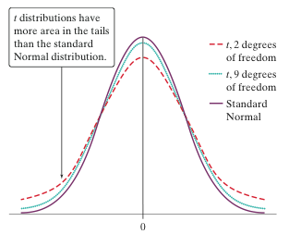
The t Distributions
When comparing the density curves of the standard Normal distribution and t distributions, several facts are apparent:
The density curves of the t distributions are similar in shape to the standard Normal curve. They are symmetric about 0, single-peaked, and bell-shaped.
The variability of the t distributions is a bit greater than that of the standard Normal distribution. The t distributions in Figure 20.1 have more probability in the tails and less in the center than does the standard Normal. This is true because substituting the estimate s for the fixed parameter $σ$ introduces more variation into the statistic.
As the degrees of freedom increase, the t density curve approaches the N(0; 1) curve ever more closely. This happens because s estimates $σ$ more accurately as the sample size increases. So using s in place of $σ$ causes little extra variation when the sample is large.
We can use Table C in the back of the book to determine critical values t* for t distributions with different degrees of freedom.

Slide 8
Using Table C
Suppose you want to construct a 95% confidence interval for the mean µ of a Normal population based on an SRS of size n = 12. What critical t* should you use?
Upper-tail probability p
df | .05 | .025 | .02 | .01
10 | 1.812 | 2.228 | 2.359 | 2.764
11 | 1.796 | 2.201 | 2.328 | 2.718
12 | 1.782 | 2.179 | 2.303 | 2.681
z* | 1.645 | 1.960 | 2.054 | 2.326
 | 90% | 95% | 96% | 98%
 | Confidence level C
In Table B, we consult the row corresponding to df = n – 1 = 11.
We move across that row to the entry that is directly above the 95% confidence level.
The desired critical value is t * = 2.201.

Slide 9
One-Sample t Confidence Interval
The one-sample t interval for a population mean is similar in both reasoning and computational detail to the one-sample z interval for a population proportion.
THE ONE-SAMPLE t CONFIDENCE INTERVAL
Draw an SRS of size n from a large population with unknown mean $μ$. A level C confidence interval for $μ$ is
$$\overline{x}±t^{∗}\frac{s}{\sqrt{n}}$$
where $t^{∗}$ is the critical value for the $t\left(n−1\right)$density curve with area C between ${−t}^{∗}$ and $t^{∗}$. This interval is exact when the population distribution is Normal and is approximately correct for large $n$ in other cases.

Slide 10
Example
STATE: Does the expectation of good weather lead to more generous behavior? Psychologists studied the size of the tip in a restaurant when a message indicating that the next day’s weather would be good was written on the bill. Here are tips from 20 patrons, measured in percent of the total bill:
20.8 18.7 19.9 20.6 21.9 23.4 22.8 24.9 22.2 20.3
24.9 22.3 27.0 20.4 22.2 24.0 21.1 22.1 22.0 22.7
We want to estimate the mean tip for comparison with tips under the other conditions.
PLAN: We will estimate the mean percentage tip $μ$ for all patrons of this restaurant when they receive a message on their bill indicating that the next day’s weather will be good by giving a 95% confidence interval.
SOLVE: Checking conditions:
SRS: This study was actually a randomized comparative experiment; as a consequence, we are willing to regard these patrons as an SRS from all patrons of this restaurant.

Slide 11
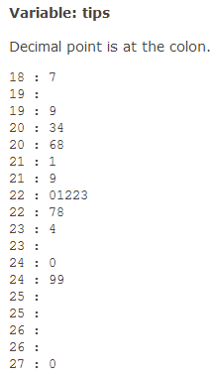
Example
Normal distribution: We can’t look at the population, but we can examine the sample. The stemplot does not suggest any strong departures from Normality. The sample size is at least 15, so we are comfortable using the t interval.
We can proceed to calculation. For these data,
$\overline{x}$ = 22.21 and s = 1.963
The degrees of freedom are $n−1$ = 19. From Table C we find that for 95% confidence $t^{∗}$ = 2.093. The confidence interval is
$$\begin{matrix}\overline{x}±t^{∗}\frac{s}{\sqrt{n}} & = & 22.21±2.093\frac{1.963}{\sqrt{20}} \\ & = & 22.21±0.92 \\ & = & 21.29 \text{to} 23.13 \text{percent}\end{matrix}$$
CONCLUDE: We are 95% confident that the mean percentage tip for all patrons of this restaurant when their bill contains a message that the next day's weather will be good is between 21.29 and 23.13.

Slide 12
The One-Sample t Test
Testing hypotheses about the mean $μ$ of a Normal population follows the same reasoning as for testing hypotheses about a population proportion that we met earlier.
THE ONE-SAMPLE t TEST
Draw an SRS of size $n$ from a large population having unknown mean $μ$. To test the hypothesis $H_{0}: μ=μ_{0}$, compute the one-sample t statistic
$$t =\frac{\overline{X}−μ_{0}}{S/{\sqrt{N}}}$$
In terms of a variable T having the $t(n−1)$ distribution, the P-value for a test of $H_{0}$ against
$H_{a}: μ>μ_{0}$ is$P(T> t)$
$H_{a}: μ<μ_{0}$ is $P(T< t)$
$H_{a}: μ≠μ_{0}$ is $2×P(T>\left|t\right| )$
These P-values are exact if the population distribution is Normal and are approximately correct for large n in other cases.

Slide 13
Example
We follow the four-step process for a significance test.
STATE: Ohio considers it unsafe if a 100-milliliter sample (about 3.3 ounces) of water contains more than 400 coliform bacteria. Here are the fecal coliform levels found by laboratories at 20 Ohio State Park swimming areas:
160 40 2800 80 2000 2000 1500 400 150 500
3000 2200 15 80 2000 2000 2600 600 1000 1500
Are these data good evidence that, on average, the fecal coliform levels in these swimming areas were unsafe?
PLAN: We ask the question in terms of the mean fecal coliform level $μ$ for all these swimming areas. The null hypothesis is “level is not unsafe," and the alternative hypothesis is “level is unsafe."
$$H_{0}: μ=400$$
$$H_{a}: μ>400$$

Slide 14
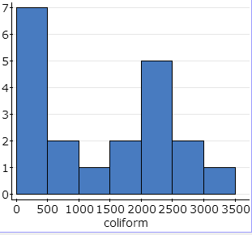
Example
SOLVE: We are willing to regard these particular 20 samples as an SRS from a large population of possible samples. The histogram (of 20 samples) doesn’t let us judge normality, but the data are somewhat skewed. The sample size is larger than 15, so it is safe to use the one-sample t test, but P-values may be off. Based on $\overline{x}=1231.3$ and s = 1037.5, the one-sample t statistic is
$$\begin{matrix}t= & \frac{\overline{x}−μ_{0}}{s/{\sqrt{n}}}= & \frac{1231.3−400}{{1037.5}/{\sqrt{20}}} \\ & = & 3.583\end{matrix}$$
The P-value for t = 3.583 is the area to the right of 3.583 under the t distribution curve with degrees of freedom $n − 1$ = 19.
Using Table C, P-value is between (0.001, 0.0005), 0.001< P-value< 0.0005

Slide 15
Matched Pairs t Procedures
Comparative studies are more convincing than single-sample investigations. For that reason, one-sample inference is less common than comparative inference. Study designs that involve making two observations on the same individual, or one observation on each of two similar individuals, result in paired data.
When paired data result from measuring the same quantitative variable twice, as in the job satisfaction study, we can make comparisons by analyzing the differences in each pair. If the conditions for inference are met, we can use one-sample t procedures to perform inference about the mean difference.
MATCHED PAIRS t PROCEDURES
To compare the responses to the two treatments in a matched pairs design, find the difference between the responses within each pair. Then apply the one-sample t procedures to these differences.

Slide 16
Robustness of t Procedures
A confidence interval or significance test is called robust if the confidence level or P-value does not change very much when the conditions for use of the procedure are violated.
USING THE t PROCEDURES
Except in the case of small samples, the condition that the data are an SRS from the population of interest is more important than the condition that the population distribution is Normal.
Sample size less than 15: Use t procedures if the data appear close to Normal (roughly symmetric, single peak, no outliers). If the data are clearly skewed or if outliers are present, do not use t.
Sample size at least 15: The t procedures can be used, except in the presence of outliers or strong skewness.
Large samples: The t procedures can be used, even for clearly skewed distributions when the sample is large, roughly$n ≥ 40$.

Slide 17
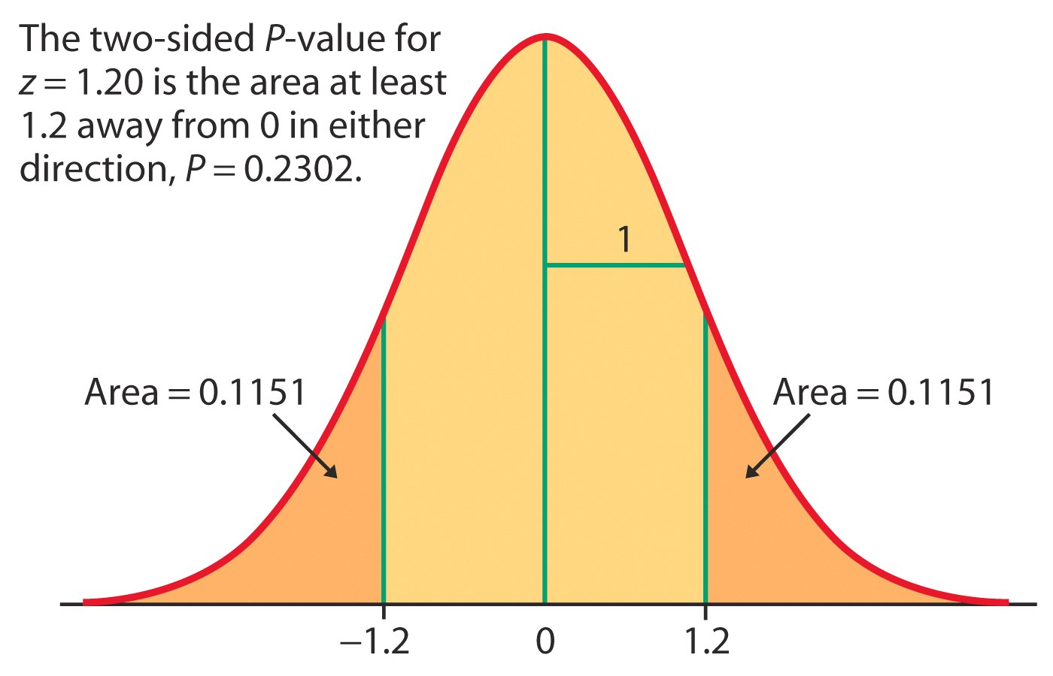
Example
For the test statistic z = 1.20 and alternative hypothesis H_{a}: μ ≠ 0, the P-value would be:
P-value = P(Z < –1.20 or Z > 1.20)
= 2 P(Z < –1.20) = 2 P(Z > 1.20) = (2)(0.1151) = 0.2302
If H₀ is true, there is a 0.2302 (23.02%) chance that we would see results at least as extreme as those in the sample; thus, because we saw results that are likely if H₀ is true, we therefore do not have good evidence against H₀ and in favor of H_{a}.

