Slide 1
CHAPTER 22: Inference about a Population Proportion
Basic Practice of Statistics
7th Edition
Lecture PowerPoint Slides

Slide 2
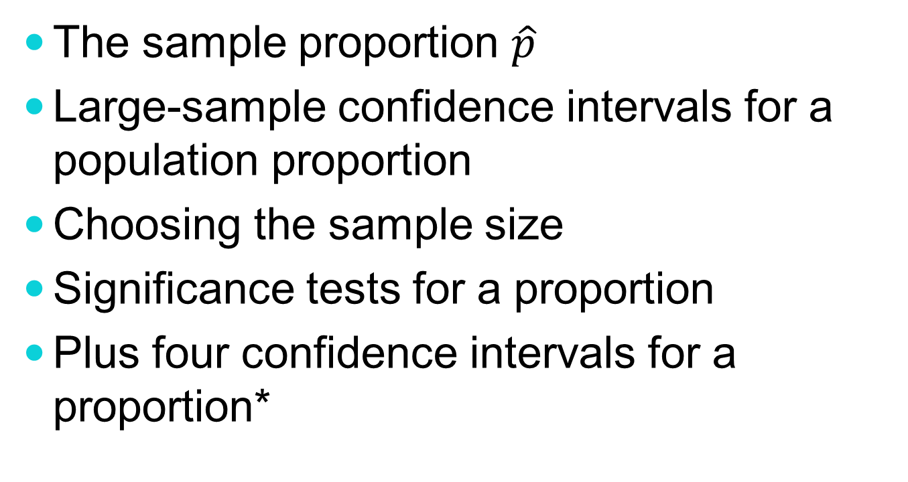
In Chapter 22, We Cover …
The sample proportion $\hat{p}$
Large-sample confidence intervals for a population proportion
Choosing the sample size
Significance tests for a proportion
Plus four confidence intervals for a proportion*

Slide 3
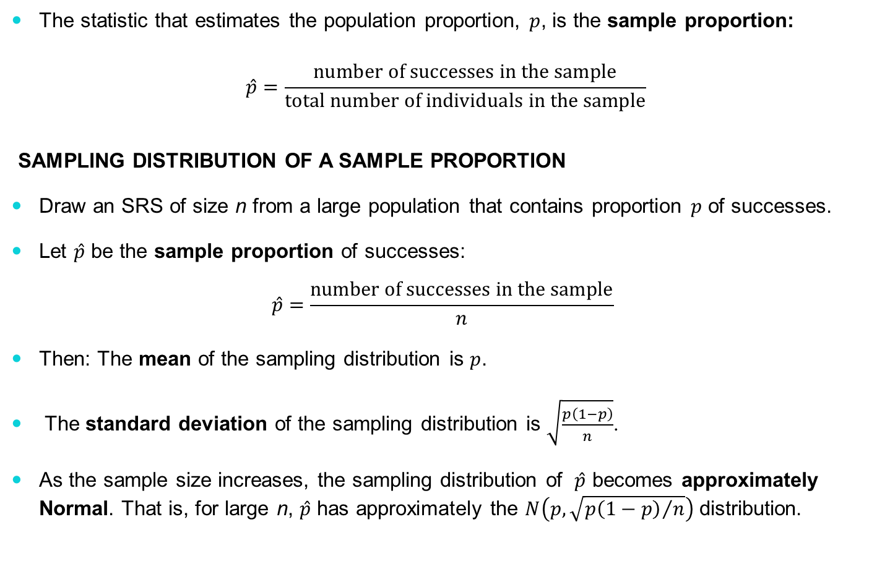
The Sampling Proportion, $\hat{p}$
The statistic that estimates the population proportion, $p$, is the sample proportion:
$$\hat{p}=\frac{\text{number} \text{of} \text{successes} \text{in} \text{the} \text{sample}}{\text{total} \text{number} \text{of} \text{individuals} \text{in} \text{the} \text{sample}}$$
SAMPLING DISTRIBUTION OF A SAMPLE PROPORTION
Draw an SRS of size n from a large population that contains proportion $p$ of successes.
Let $\hat{p}$ be the sample proportion of successes:
$$\hat{p}=\frac{\text{number} \text{of} \text{successes} \text{in} \text{the} \text{sample}}{n}$$
Then: The mean of the sampling distribution is $p$.
The standard deviation of the sampling distribution is $\sqrt{\frac{p\left(1−p\right)}{n}}$.
As the sample size increases, the sampling distribution of $\hat{p}$ becomes approximately Normal. That is, for large n, $\hat{p}$ has approximately the $N\left(p,\sqrt{{p\left(1−p\right)}/n}\right)$ distribution.

Slide 4
Confidence Intervals for a Population Proportion
We note the standard deviation of $\hat{p}$ depends on the parameter, $p$—a value we don’t know. We therefore estimate the standard deviation with the standard error of $\hat{p}$:
$${\text{SE}}_{\hat{p}}=\sqrt{\frac{\hat{p}\left(1−\hat{p}\right)}{n}}$$
LARGE-SAMPLE CONFIDENCE INTERVAL FOR A POPULATION PROPORTION
Draw an SRS of size n from a population having unknown proportion p with some characteristic. An approximate level C confidence interval for $p$ is
$$\hat{p}±z^{∗}\sqrt{{\hat{p}\left(1−\hat{p}\right)}/n}$$
where z* is the critical value for the standard Normal density curve with area C between –z* and z*.
Use this interval only when the numbers of successes and failures in the sample are both at least 15.

Slide 5
Choosing the Sample Size
The margin of error in the large-sample confidence interval for $p$ is
$$m=z^{∗}\sqrt{{\hat{p}\left(1−\hat{p}\right)}/n}$$
Here $z^{∗}$ is the standard Normal critical value for the level of confidence we want.
SAMPLE SIZE FOR DESIRED MARGIN OF ERROR
The level C confidence interval for a population proportion $p$ will have margin of error approximately equal to a specified value $m$ when the sample size is
$$n={\left(\frac{z^{∗}}{m}\right)}^{2}p^{∗}\left(1−p^{∗}\right)$$
where $p^{∗}$ is a guessed value for the sample proportion. The margin of error will always be less than or equal to m if you take the guess $p^{∗}$ to be 0.5.

Slide 6
Significance Tests for a Proportion
Draw an SRS of size n from a large population that contains an unknown proportion p of successes. To test the hypothesis H₀: p = p₀, compute the z statistic.
$$z=\frac{\hat{p}−p_{0}}{\sqrt{{p_{0}\left(1−p_{0}\right)}/n}}$$
In terms of a variable Z having the standard Normal distribution, the approximate P-value for a test of H₀ against
H_{a} : p > $p_{0}$ is $P\left(Z≥z\right)$
H_{a} : p < $p_{0}$ is $P\left(Z≤z\right)$
H_{a} : p ≠ $p_{0}$ is $2×P\left(Z≥\left|z\right|\right)$

Slide 7
Plus Four Confidence Interval for a Proportion*
The confidence interval $\hat{p}±z^{∗}\sqrt{{\hat{p}\left(1−\hat{p}\right)}/n}$ for a sample proportion p is easy to calculate and understand because it is based directly on the approximately Normal distribution of the sample proportion.
Unfortunately, confidence levels from this interval are often inaccurate, unless the sample is very large. The actual confidence level is usually less than the confidence level you asked for in choosing z*.
There is a simple modification that is almost magically effective in improving the accuracy of the confidence interval. We call it the “plus four” method because all you need to do is add four imaginary observations, two successes and two failures. The plus four estimate of p is

Slide 8
Plus Four Confidence Interval for a Proportion*
Using the plus four estimate of p:
$$\tilde{p}=\frac{\text{number} \text{of} \text{successes} \text{in} \text{the} \text{sample}+2}{n+4}$$
PLUS FOUR CONFIDENCE INTERVAL FOR A PROPORTION
Draw an SRS of size n from a large population that contains an unknown proportion p of successes. To get the plus four confidence interval for $p$, add four imaginary observations, two successes and two failures. Then use the large-sample confidence interval with the new sample size $(n + 4)$and number of successes$\left(\text{actual} \text{number} +2\right):$
$$\tilde{p}±z^{∗}\sqrt{{\tilde{p}\left(1−\tilde{p}\right)}/{\left(n+4\right)}}$$
Use this interval when the confidence level is at least 90% and the sample size n is at least 10, with any counts of successes and failures.

