Slide 1
CHAPTER 25: Two Categorical Variables: The Chi-Square Test
Basic Practice of Statistics
7th Edition
Lecture PowerPoint Slides

Slide 2
In Chapter 25, We Cover …
Two-way tables
Expected counts in two-way tables
The chi-square test statistic
Uses of the chi-square test: independence and homogeneity
The chi-square distributions

Slide 3
Relationships: Categorical Variables
“Is there a relationship between two categorical variables?”
“Are the two variables independent?”
What is Chi-square test?
How to locate the p-value?
How to check Table D?

Slide 4
Two-Way Table
A Two-way Table describes two categorical variables, organizing counts according to a row variable and a column variable.
Young adults by gender and chance of getting rich
 | Female | Male | Total
Almost no chance | 96 | 98 | 194
Some chance, but probably not | 426 | 286 | 712
A 50-50 chance | 696 | 720 | 1416
A good chance | 663 | 758 | 1421
Almost certain | 486 | 597 | 1083
Total | 2367 | 2459 | 4826

Slide 5
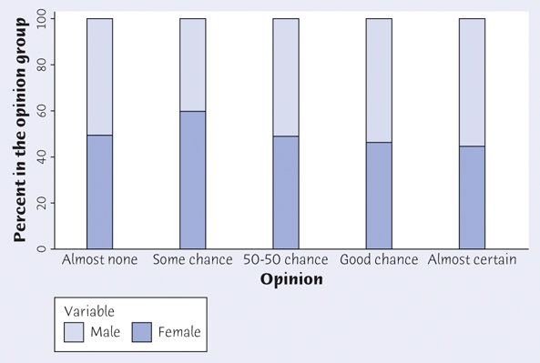
Conditional Distribution
Young adults by gender and chance of getting rich
 | Female | Male | Total
Almost no chance | 96 | 98 | 194
Some chance, but probably not | 426 | 286 | 712
A 50-50 chance | 696 | 720 | 1416
A good chance | 663 | 758 | 1421
Almost certain | 486 | 597 | 1083
Total | 2367 | 2459 | 4826
Calculate the conditional distribution of opinion among males.
Examine the relationship between gender and opinion.
Response | Male
Almost no chance | 98/2459 = 4.0%
Some chance | 286/2459 = 11.6%
A 50-50 chance | 720/2459 = 29.3%
A good chance | 758/2459 = 30.8%
Almost certain | 597/2459 = 24.3%
Female
96/2367 = 4.1%
426/2367 = 18.0%
696/2367 = 29.4%
663/2367 = 28.0%
486/2367 = 20.5%

Slide 6
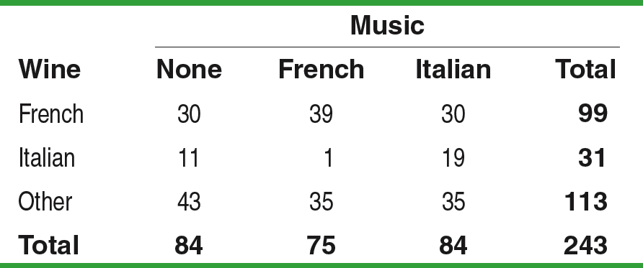
Two-Way Tables
Market researchers suspect that background music may affect the mood and buying behavior of customers. One study in a supermarket compared three randomly assigned treatments: no music, French accordion music, and Italian string music. Under each condition, the researchers recorded the numbers of bottles of French, Italian, and other wine purchased. Here is a table that summarizes the data:
PROBLEM:
Calculate the conditional distribution (in proportions) of the type of wine sold for each treatment.
Make an appropriate graph for comparing the conditional distributions in part a.
Are the distributions of wine purchases under the three music treatments similar or different?

Slide 7
Two-Way Tables
The two-sample t procedures of Chapter 21 allow us to compare the mean in two groups, either two populations or two treatment groups in an experiment.
When there are more than two outcomes, or when we want to compare more than two groups, we need a new statistical test.
The new test addresses a general question: Is there a relationship between two categorical variables?
Two-way tables of counts can be used to describe relationships between any two categorical variables.

Slide 8
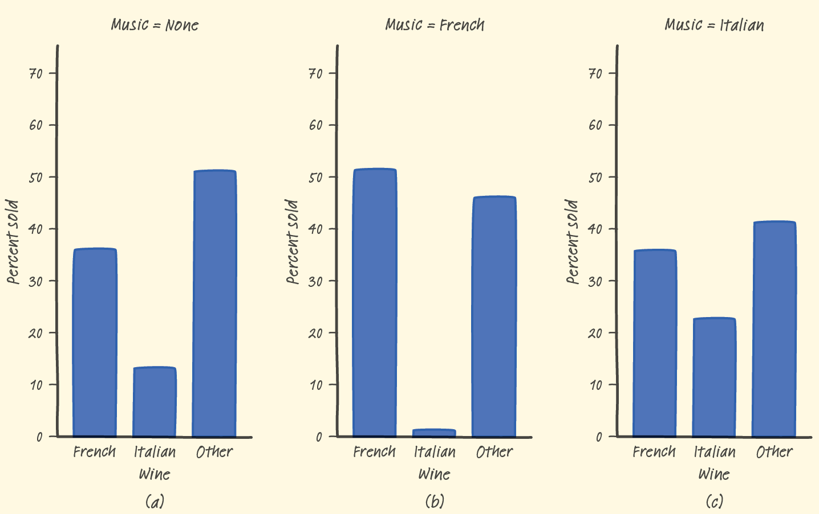
Two-Way Tables
The type of wine that customers buy seems to differ considerably across the three music treatments. Sales of Italian wine are very low (1.3%) when French music is playing but are higher when Italian music (22.6%) or no music (13.1%) is playing. French wine appears popular in this market, selling well under all music conditions but notably better when French music is playing. For all three music treatments, the percent of Other wine purchases was similar.

Slide 9
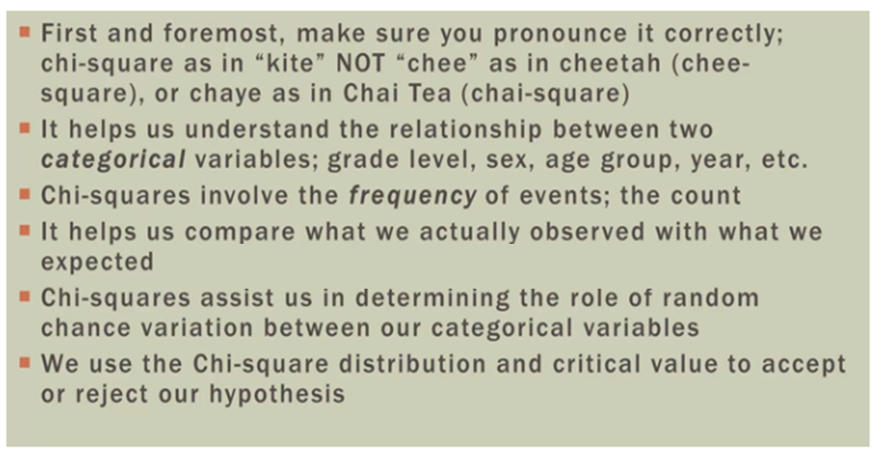
What Is Chi-Square Test?

Slide 10
Hypothesis Test
In tests for two categorical variables, we are interested in whether a relationship observed in a single sample reflects a real relationship in the population.
Hypotheses:
H₀: There is no difference in the distribution of a categorical variable for several populations or treatments.
H_{a}: There is a difference in the distribution of a categorical variable for several populations or treatments

Slide 11
Multiple Comparisons
How to do many comparisons at once with an overall measure. This is the problem of multiple comparisons. Statistical methods for dealing with multiple comparisons usually have two parts:
1. An overall test to see if there is good evidence of any differences among the parameters that we want to compare.
2. A detailed follow-up analysis to decide which of the parameters differ and to estimate how large the differences are.
The overall test uses the chi-square statistic and distributions.
Basic approach of chi-square test
we compare the observed counts in a two-way table with the counts we would expect if H₀ were true.

Slide 12
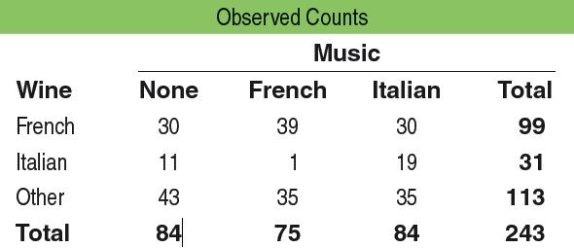
Expected Counts in Two-Way Tables
Finding the expected counts is not that difficult, as the following example illustrates.
The overall proportion of French wine bought during the study was 99/243 =
0.407. So the expected counts of French wine bought under each treatment are:
The null hypothesis in the wine and music experiment is that there’s no difference in the distribution of wine purchases in the store when no music, French accordion music, or Italian string music is played.
To find the expected counts, we start by assuming that H₀ is true. We can see from the two-way table that 99 of the 243 bottles of wine bought during the study were French wines.
The overall proportion of Italian wine bought during the study was 31/243 =
0.128. So the expected counts of Italian wine bought under each treatment are:
If the specific type of music that’s playing has no effect on wine purchases, the proportion of French wine sold under each music condition should be 99/243 = 0.407.
The overall proportion of Other wine bought during the study was 113/243 =
0.465. So the expected counts of Other wine bought under each treatment are:

Slide 13
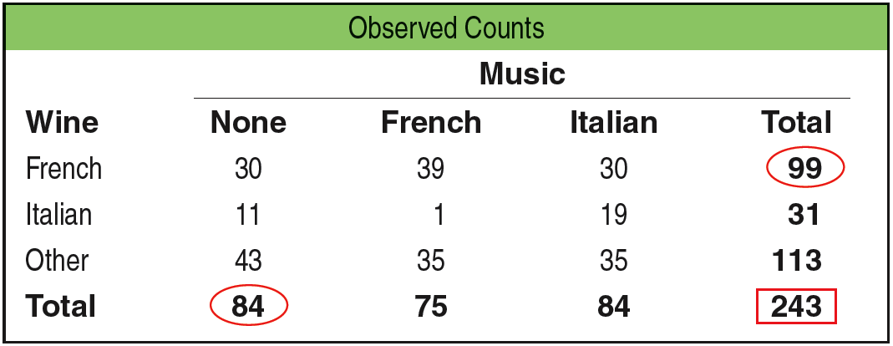
Expected Counts in Two-Way Tables
Consider the expected count of French wine bought when no music was playing:
99
99
84
243
84
243
The values in the calculation are the row total for French wine, the column total for no music, and the table total. We can rewrite the original calculation as:
•
= 34.22
Expected Counts
The expected count in any cell of a two-way table when H₀ is true is:

Slide 14
The Chi-Square Statistic
To see if the data give convincing evidence against the null hypothesis, we compare the observed counts from our sample with the expected counts assuming H₀ is true.
The test statistic that makes the comparison is the chi-square statistic.
The chi-square statistic is a measure of how far the observed counts are from the expected counts. The formula for the statistic is:

Slide 15
Chi-Square Calculation

Slide 16
Cell Counts Required for the Chi-Square Test
The chi-square test is an approximate method that becomes more accurate as the counts in the cells of the table get larger. We must therefore check that the counts are large enough to allow us to trust the P-value. Fortunately, the chi-square approximation is accurate for quite modest counts.
Cell Counts Required for the Chi-Square Test
You can safely use the chi-square test with critical values from the chi-square distribution when no more than 20% of the expected counts are less than 5 and all individual expected counts are 1 or greater. In particular, all four expected counts in a 2 × 2 table should be 5 or greater.

Slide 17
Data Analysis for Chi-Square
The chi-square test is an overall test for detecting relationships between two categorical variables. If the test is significant, it is important to look at the data to learn the nature of the relationship. We have three ways to look at the data:
Compare selected percents: which cells occur in quite different percents of all cells?
Compare observed and expected cell counts: which cells have more or less observations than we would expect if H₀ were true?
Look at the terms of the chi-square statistic: which cells contribute the most to the value of χ²?

Slide 18
Uses of the Chi-Square Test
One of the most useful properties of the chi-square test is that it tests the null hypothesis “the row and column variables are not related to each other” whenever this hypothesis makes sense for a two-way table.
Uses of the Chi-Square Test
Use the chi-square test to test the null hypothesis
H₀: there is no relationship between two categorical variables
when you have a two-way table from one of these situations:
Independent SRSs from two or more populations, with each individual classified according to one categorical variable.
A single SRS, with each individual classified according to both of two categorical variables.

Slide 19
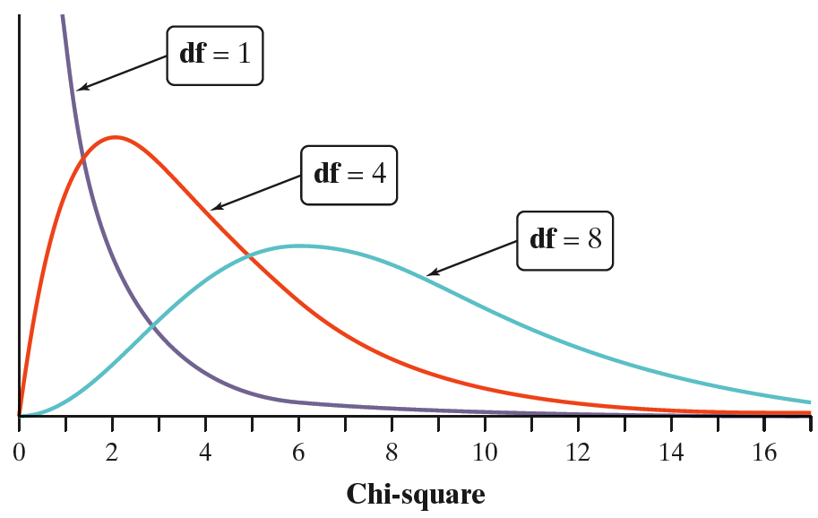
The Chi-Square Distributions*
Software usually finds P-values for us. The P-value for a chi-square test comes from comparing the value of the chi-square statistic with critical values for a chi-square distribution.
The chi-square distributions are a family of distributions that take only positive values and are skewed to the right. A particular chi-square distribution is specified by giving its degrees of freedom.
The chi-square test for a two-way table with r rows and c columns uses critical values from the chi-square distribution with (r – 1)(c – 1) degrees of freedom.
The P-value is the area under the density curve of this chi-square distribution to the right of the value of the test statistic.

Slide 20
Using the Chi-Square Table*
H₀: There is no difference in the distributions of wine purchases at this store when no music, French accordion music, or Italian string music is played.
H_{a}: There is a difference in the distributions of wine purchases at this store when no music, French accordion music, or Italian string music is played.
Our calculated test statistic is χ² = 18.28.
To find the P-value using a chi-square table
look in the
df = (3-1)(3-1) = 4.
P
df | .0025 | .001
4 | 16.42 | 18.47
The small P-value (between 0.001 and 0.0025) gives us convincing evidence to reject H₀ and conclude that there is a difference in the distributions of wine purchases at this store when no music, French accordion music, or Italian string music is played.

