Slide 1
CHAPTER 27: One-Way Analysis of Variance: Comparing Several Means
Basic Practice of Statistics
7th Edition
Lecture PowerPoint Slides

Slide 2
In Chapter 27, We Cover …
Comparing several means
The analysis of variance F test
The idea of analysis of variance
Conditions for ANOVA
F distributions and degrees of freedom
Using technology, conduct and interpret an ANOVA F test
Some details of ANOVA*

Slide 3
Introduction
The two-sample t procedures of Chapter 21 compared the means of two populations or the mean responses to two treatments in an experiment.
We need a method for comparing any number of means. We’ll use the analysis of variance, or ANOVA.
We are comparing means even though the procedure is Analysis of Variance.

Slide 4
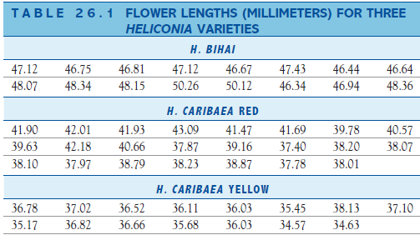
Comparing Several Means
EXAMPLE: Comparing tropical flowers
STATE: The relationship between varieties of the tropical flower Heliconia on the island of Dominica and the different species of hummingbirds that fertilize the flowers were examined. Researchers wondered if the lengths of the flowers and the forms of the hummingbirds' beaks have evolved to match each other. The table below gives length measurements (in millimeters) for samples of three varieties of Heliconia, each fertilized by a different species of hummingbird. Do the three varieties display distinct distributions of length? In particular, are the mean lengths of their flowers different?
PLAN: Use graphs and numerical descriptions to describe and compare the three distributions of flower length. Finally, ask whether the differences among the mean lengths of the three varieties are statistically significant.

Slide 5
Comparing Several Means
EXAMPLE: Comparing tropical flowers
SOLVE (first steps): Figure 26.1 displays side-by-side stemplots with the stems lined up for easy comparison. The lengths have been rounded to the nearest tenth of a millimeter. Here are the summary measures we will use in further analysis:
CONCLUDE (first steps): The three varieties differ so much in flower length that there is little overlap among them. In particular, the flowers of bihai are longer than either red or yellow. The mean lengths are 47.6 mm for H. bihai, 39.7 mm for H. caribaea red, and 36.2 mm for H. caribaea yellow. Are these observed differences in sample means statistically significant? We must develop a test for comparing more than two population means.
Sample | Variety | Sample size | Mean length | Standard deviation
1 | bihai | 16 | 47.60 | 1.213
2 | red | 23 | 39.71 | 1.799
3 | yellow | 15 | 36.18 | 0.975

Slide 6
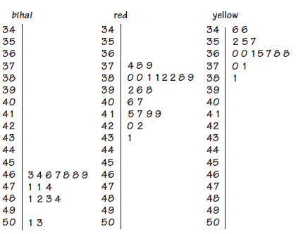
Comparing Several Means
Means:
bihai: 47.60
red: 39.71
yellow: 36.18
The flowers of bihai are longer than either red or yellow, and the spread for the lengths of the red flowers is somewhat larger than for the other two varieties.
Are these differences statistically significant?

Slide 7
Comparing Several Means
(Sample) Means:
bihai: 47.60
red: 39.71
yellow: 36.18
Null hypothesis: The true means (for length) are the same for all groups (the three flower types).
}
We could look at separate t tests to compare each pair of means to see if they are different:
47.60 vs. 39.71, 47.60 vs. 36.18, 39.71 vs. 36.18
H₀: μ₁ = μ₂ H₀: μ₁ = μ₃ H₀: μ₂ = μ₃
However, this gives rise to the problem of multiple comparisons.

Slide 8
Multiple Comparisons
Statistical methods for dealing with multiple comparisons usually have two steps:
An overall test to see if there is good evidence of any differences among the parameters that we want to compare.
A detailed follow-up analysis to decide which of the parameters differ and to estimate how large the differences are.
The overall test, though more complex than the tests we have met to this point, is reasonably straightforward. Formal follow-up analysis can be quite elaborate. We will concentrate on the overall test and use data analysis to describe in detail the nature of the differences.

Slide 9
The Analysis of Variance F test
We want to test the null hypothesis that there are no differences among the means of the populations.
$H_{0}: μ_{1}=μ_{2}=$ $μ_{3}$
The basic conditions for inference are that we have random samples from the three populations and that flower lengths (in our example) are Normally distributed in each population.
The alternative hypothesis is that there is some difference. That is, not all means are equal.
$H_{a}: {\text{not} \text{all} \text{of} μ}_{1}, μ_{2}, \text{and}$ $μ_{3} \text{are} \text{equal}$

Slide 10
The Analysis of Variance F test
This alternative hypothesis is not one-sided or two-sided. It is “many-sided.”
This test is called the analysis of variance F test (ANOVA).
EXAMPLE: Comparing tropical flowers: ANOVA
SOLVE (inference): Software tells us that, for the flower-length data in Table 26.1, the test statistic is F = 259.12 with P-value P < 0.0001. There is very strong evidence that the three varieties of flowers do not all have the same mean length. It appears from our preliminary data analysis that bihai flowers are distinctly longer than either red or yellow. Red and yellow are closer together, but the red flowers tend to be longer.
CONCLUDE: There is strong evidence (P < 0:0001) that the population means are not all equal. The most important difference among the means is that the bihai variety has longer flowers than the red and yellow varieties.

Slide 11
The Idea of Analysis of Variance
The details of ANOVA are a bit daunting; they appear in an optional section at the end of this presentation.
The main idea of ANOVA is more accessible and much more important: When we ask if a set of sample means gives evidence for differences among the population means, what matters is not how far apart the sample means are, but how far apart they are relative to the variability of individual observations.
The Analysis of Variance Idea
Analysis of variance compares the variation due to specific sources with the variation among individuals who should be similar. In particular, ANOVA tests whether several populations have the same mean by comparing how far apart the sample means are with how much variation there is within the sample.

Slide 12
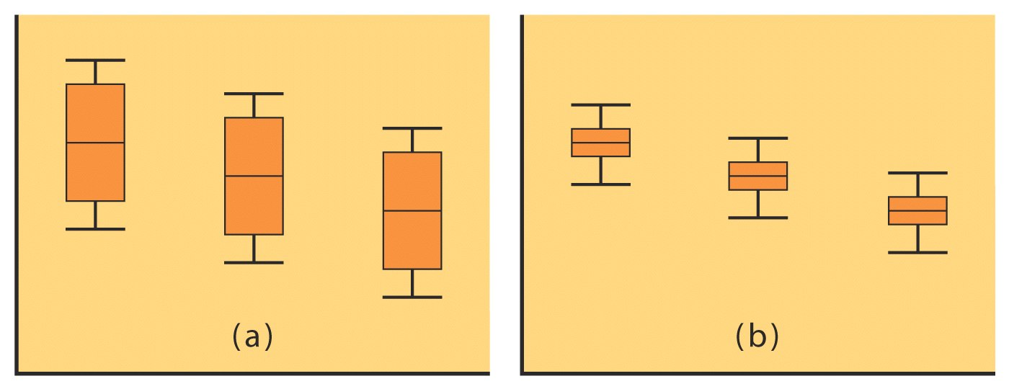
The Idea of Analysis of Variance
The sample means for the three samples are the same for each set (a) and (b) below:
The variation among sample means for (a) is identical to (b).
The variation among the individuals within the three samples is much less for (b).
CONCLUSION: The samples in (b) contain a larger amount of variation among the sample means relative to the amount of variation within the samples, so ANOVA will find more significant differences among the means in (b).
Assume equal sample sizes here for (a) and (b).
Note: Larger samples will find more significant differences.

Slide 13
The ANOVA F Statistic
To determine statistical significance, we need a test statistic that we can calculate:
The ANOVA F Statistic
The analysis of variance F statistic for testing the equality of several means has this form:
F must be zero or positive
F is zero only when all sample means are identical
F gets larger as means move further apart
Large values of F are evidence against H₀: equal means
while the alternative H_{a} is many-sided, the F test is upper one-sided.

Slide 14
Conditions for ANOVA
Like all inference procedures, ANOVA is valid only in some circumstances. The conditions under which we can use ANOVA are:
Conditions for ANOVA Inference
We have I independent SRSs, one from each population. We measure the same response variable for each sample.
The i^{th} population has a Normal distribution with unknown mean µ_{i}. One-way ANOVA tests the null hypothesis that all population means are the same.
All of the populations have the same standard deviation σ, whose value is unknown.
Checking Standard Deviations in ANOVA
The results of the ANOVA F test are approximately correct when the largest sample standard deviation is no more than twice as large as the smallest sample standard deviation.

Slide 15
F Distributions and Degrees of Freedom
The ANOVA F statistic has the form
$$F=\frac{\text{variation} \text{among} \text{the} \text{sample} \text{means}}{\text{variation} \text{among} \text{individuals} \text{in} \text{the} \text{same} \text{sample}}$$
To find the P-value for this statistic, we must know the sampling distribution of F when the null hypothesis (all population means equal) is true. This sampling distribution is an F distribution.
The degrees of freedom of the ANOVA F statistic depend on the number of means we are comparing and the number of observations in each sample. That is, the F test takes into account the number of observations.

Slide 16
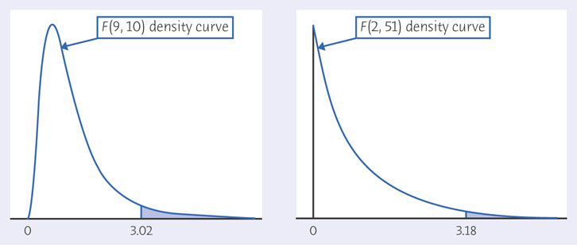
F Distributions and Degrees of Freedom*
The F distributions are a family of right-skewed distributions that take only values greater than 0. A specific F distribution is determined by the degrees of freedom of the numerator and denominator of the F statistic.
When describing an F distribution, always give the numerator degrees of freedom first. Our brief notation will be F(df1, df2) with df1 degrees of freedom in the numerator and df2 degrees of freedom in the denominator.

Slide 17
F Distributions and Degrees of Freedom
Degrees of Freedom for the F Test
We want to compare the means of I populations. We have an SRS of size n from the i^{th} population so that the total number of observations in all samples combined is
$$N=n_{1}+n_{2}+⋯+n_{i}$$
If the null hypothesis that all population means are equal is true, the ANOVA F statistic has the F distribution with I – 1 degrees of freedom in the numerator and N – I degrees of freedom in the denominator.

Slide 18
Some Details of ANOVA*
The ANOVA F statistic has the form
$$F=\frac{\text{variation} \text{among} \text{the} \text{sample} \text{means}}{\text{variation} \text{among} \text{individuals} \text{in} \text{the} \text{same} \text{sample}}$$
The measures in the numerator and denominator of F are called mean squares.
If we call the overall mean response $\overline{x}$, that is,
$$\overline{x}=\frac{\text{sum} \text{of} \text{all} \text{observations}}{N}=\frac{n_{1}{\overline{x}}_{1}+n_{2}{\overline{x}}_{2}+⋯+n_{I}{\overline{x}}_{I}}{N}$$
then we may measure the numerator by finding the I deviations of the sample means from the overall means:
${\overline{x}}_{1}−\overline{x}$, ${\overline{x}}_{2}−\overline{x}$, …, ${\overline{x}}_{I}−\overline{x}$

Slide 19
Some Details of ANOVA*
The mean square in the numerator of F is an average of the squares of these deviations.
We call it the mean square for groups, abbreviated as MSG:
$$MSG=\frac{n_{1}{\left({\overline{x}}_{1}−\overline{x}\right)}^{2}+n_{2}{\left({\overline{x}}_{2}−\overline{x}\right)}^{2}+⋯+n_{I}{\left({\overline{x}}_{I}−\overline{x}\right)}^{2}}{I−1}$$
The mean square in the denominator of F measures variation among individual observations in the same sample.
For all I samples together, we use an average of the individual sample variances:
$$MSE=\frac{{\left(n_{1}−1\right)s}_{1}^{2}+{\left(n_{2}−1\right)s}_{2}^{2}+⋯+{\left(n_{I}−1\right)s}_{I}^{2}}{N−I}$$
We call this the mean square for error, MSE.

Slide 20

Some Details of ANOVA*
THE ANOVA F TEST
Draw an independent SRS from each of I Normal populations that have a common standard deviation but may have different means. The sample from the i^{th} population has size n_{i}, sample mean ${\overline{x}}_{i}$, and sample standard deviation s_{i}.
To test the null hypothesis that all I populations have the same mean against the alternative hypothesis that not all the means are equal, calculate the ANOVA F statistic:
$$F=\frac{MSG}{MSE}$$
The numerator of F is the mean square for groups:
$$MSG=\frac{n_{1}{\left({\overline{x}}_{1}−\overline{x}\right)}^{2}+n_{2}{\left({\overline{x}}_{2}−\overline{x}\right)}^{2}+⋯+n_{I}{\left({\overline{x}}_{I}−\overline{x}\right)}^{2}}{I−1}$$
The denominator of F is the mean square for error:
$$MSE=\frac{{\left(n_{1}−1\right)s}_{1}^{2}+{\left(n_{2}−1\right)s}_{2}^{2}+⋯+{\left(n_{I}−1\right)s}_{I}^{2}}{N−I}$$
When H₀ is true, F has the F distribution with I – 1 and N – I degrees of freedom.

Slide 21
One-way ANOVA in Excel
Make sure that the “Analysis ToolPak” is installed.
Under “Tools” select “Data Analysis”
In the window that appears select “ANOVA: One factor” and click “OK.”
Using your mouse highlight the cells containing the data. Be sure to include the labels (row 1)
And click on “Labels in First Row”.
Select “Columns” if each group is its own column or “Row” if each group is its own row.
Set your level of significance. (The default is 5% or 0.05.)
Click “OK” and the ANOVA output will appear on a new worksheet.

Slide 22
ANOVA Output in Excel: Tropical Flowers
Anova: Single Factor
SUMMARY
Groups | Count | Sum | Average | Variance
bihai | 16 | 761.56 | 47.5975 | 1.471073
Red | 23 | 913.36 | 39.7113 | 3.235548
Yellow | 15 | 542.7 | 36.18 | 0.951257
ANOVA
Source of Variation | SS | df | MS | F | P-value | F crit
Between Groups | 1082.872 | 2 | 541.4362 | 259.1193 | 1.92E-27 | 3.178799
Within Groups | 106.5658 | 51 | 2.089525
Total | 1189.438 | 53

Slide 23
ANOVA Confidence Interval
We can get a confidence interval for any one of the means µ from the usual form
estimate ± t*Se_{estimate}
using s_{p} to estimate σ. The confidence interval for µ_{i} is
Use the critical value t* from the t distribution with N − I degrees of freedom.

Slide 24
Example of ANOVA Confidence Interval
Formula
S_{p} : Pooled standard deviation, n: observations in each group
Example: Tropical Flowers
Note: The confidence interval calculation will use some numbers from ANOVA output results.
Pooled standard deviation: S_{p} = √MSE = √(2.0895) = 1.446
t* degree of freedom is 51 (within groups).
In Table C use df = 50, and confidence level 95%
t* = 2.009

Slide 25
`95% confidence intervals:
Bihai
margin of error m = (2.009 *1.446)/√16 = 0.7263
Confidence interval : 47.5975 ± 0.7263
(46.871, 48.324)
Red
margin of error m = (2.009 *1.446)/√23 = 0.6057
Confidence interval : 39.7113 ± 0.6057
(39.106, 40.3167)
Yellow
margin of error m = (2.009 *1.446)/√15 = 0.750
Confidence interval : 36.18 ± 0.750
(35.43, 36.93)

Slide 26
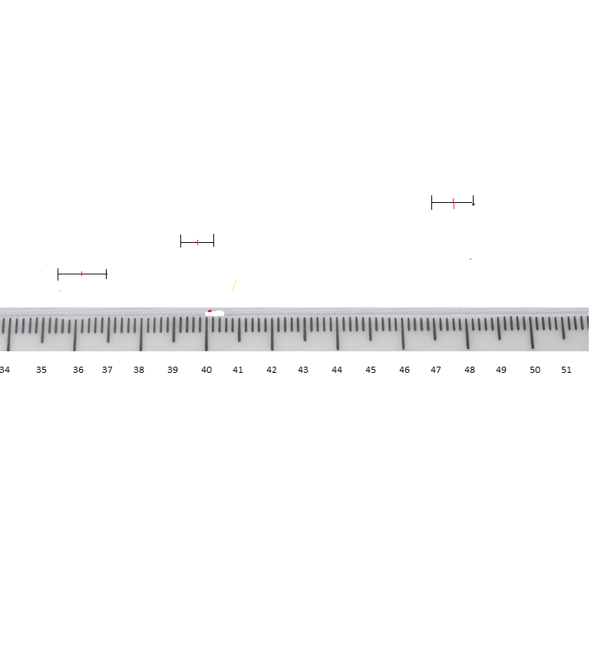
Tropical Flowers
- Confidence Intervals -
Bihai
Red
Yellow

