Slide 1
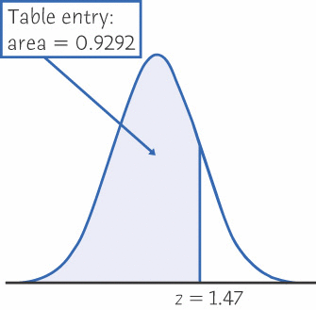
Table A & Its Applications - The entry in Table A -
Table A is based on standard Normal distribution N(0, 1)
An area underneath the curve, less than z is given in your Table A
Table A’s entry is a probability, corresponding to the z-score value
Math formula: P(z ≤ z₀ ) = 0.XXXX
P(z ≤ 1.47 ) = 0.9292

Slide 2
Problem Type I
If asking the probability (area) when z ≤ z₀
in math language that is: p(z ≤ z₀) =?,
checking Table A, based on z₀ to locate the Table A’s entry p₀
For type I problem, using table A to get the answer directly
Example:
z ≤ -0.71 table entry p₀ = 0.2389
p(z ≤ -0.71) = 0.2389

Slide 3
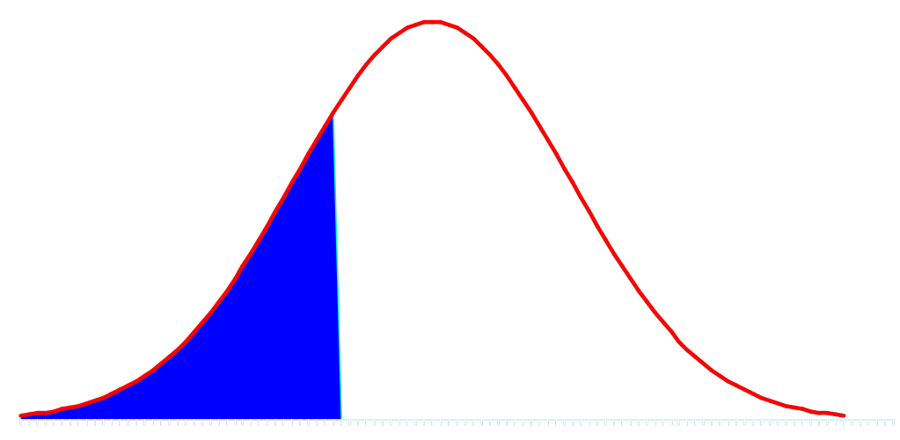
Problem Type II
If asking the probability (area) when z ≥ z₀
in math language that is: P(z ≥ z₀ ) = ?
The type II’s problem, use the following operation:
P(z ≥ z₀ ) = 1 - P(z ≤ z₀ ) = 1 - P₀
Example: P(z ≥ -0.71) = ?
P(z ≥ -0.71) = 1 - P₀ = 1- 0.2389 = 0.7611
0.7611
0.2389
68 70 (height values)
-0.71 0 (z-score)

Slide 4
Problem Type III
If asking the probability (area) when z₂ ≤ z ≤ z₁
in math language that is: P (z₂ ≤ z ≤ z₁ ) = ?
In Table A, Look up z₁ → P₁
In Table A, Look up z₂ → P₂
Then we have: P (z₂ ≤ z ≤ z₁ ) = P₁ - P₂
For example, P (-1.4 ≤ z ≤ 1.3 ) = ?
Look up z₁ = 1.3, P₁ = 0.9032
Look up z₂ = -1.4, P₂ = 0.0808
P (-1.4 ≤ z ≤ 1.3 ) = 0.9032 – 0.0808 = 0.8224

Slide 5
Steps Summary
Write down the Normal distribution N(µ, σ) for observation data set
Locate the specific observation value X₀ or X₁ & X₂
Transfer x₀ to z₀ by z-score formula
Check Table A using z₀ to locate the table entry P₀
If is type I problem, the result is P(z ≤ z₀) = P₀
If is type II problem, the result is:
P(z ≥ z₀) = 1- P(z ≤ z₀) = 1 - P₀
If is type III problem, the result is:
P (z₂ ≤ z ≤ z₁ ) = P₁ - P₂
P₁ = P(z ≤ z₁), P₂ = P(z ≤ z₂)

