Slide 1
Montmorillonite
Nicholas Chan

Slide 2
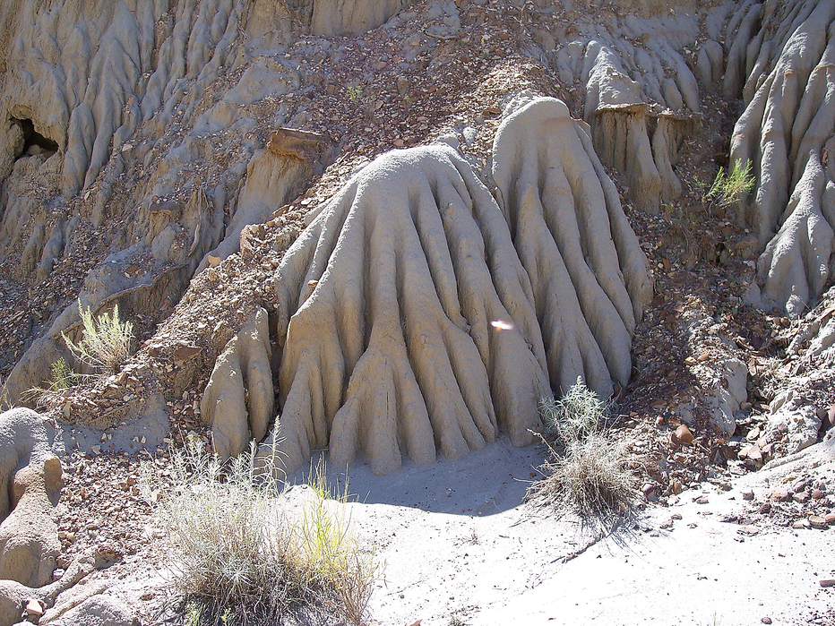
Formation
Aqueous weathering of volcanic ash and tuff
Poor drainage areas and saline environments
Ash that falls into bodies of water
Converts from glass to a crystalline material
Chemical alteration to a soft plastic rock = bentonite
Bentonite mainly consists of montmorillonite

Slide 3
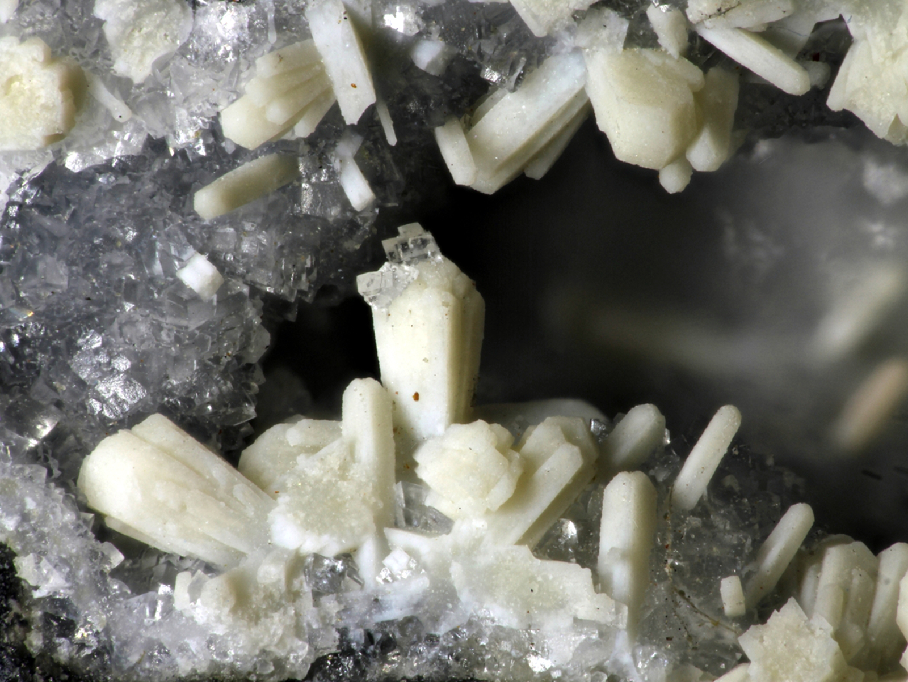
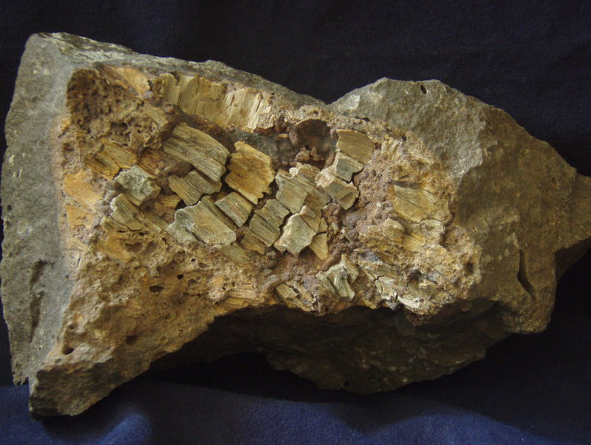
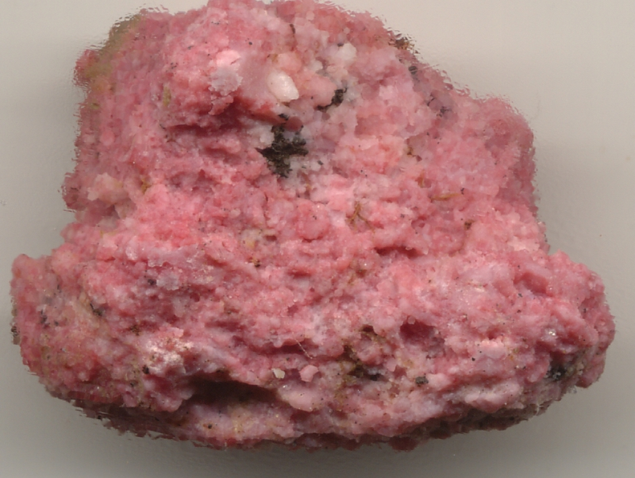
Appearance
White, yellow, green, and sometimes pink/red due to Mn substitution
Dull/earthy luster
Discovered in Montmorillon of Vienne, Frnace
Notes:
“The variable colors are the result of substitution of interlayer-cations by iron, titanium, and manganese within the lattice structure and depend upon the level of substitution and valence state of cations” (https://www.intechopen.com/books/current-topics-in-the-utilization-of-clay-in-industrial-and-medical-applications/montmorillonite-an-introduction-to-properties-and-utilization)

Slide 4
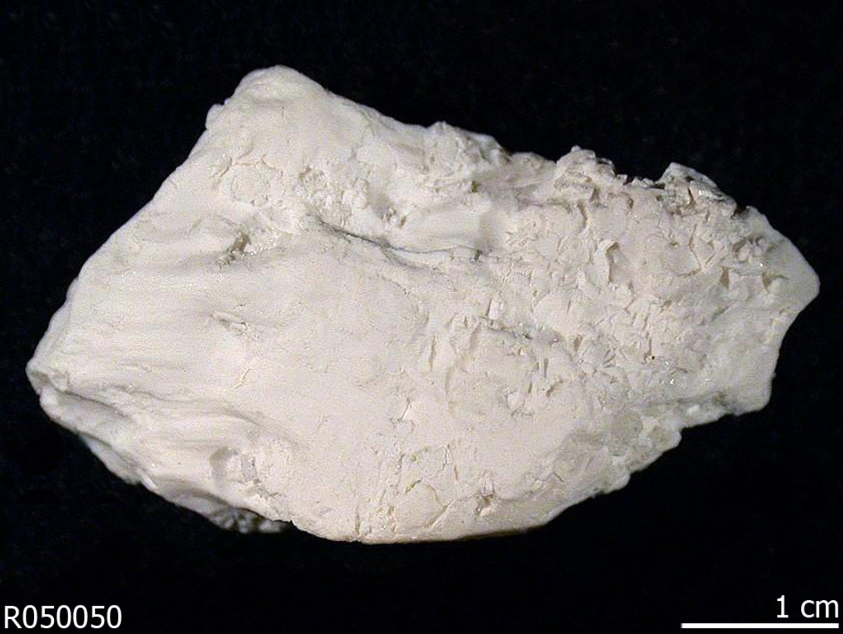
Physical Properties
White streak
1-2 on Mohs’ Scale of Hardness
Density = 2-3 g/cm³
Uneven/irregular fracture

Slide 5
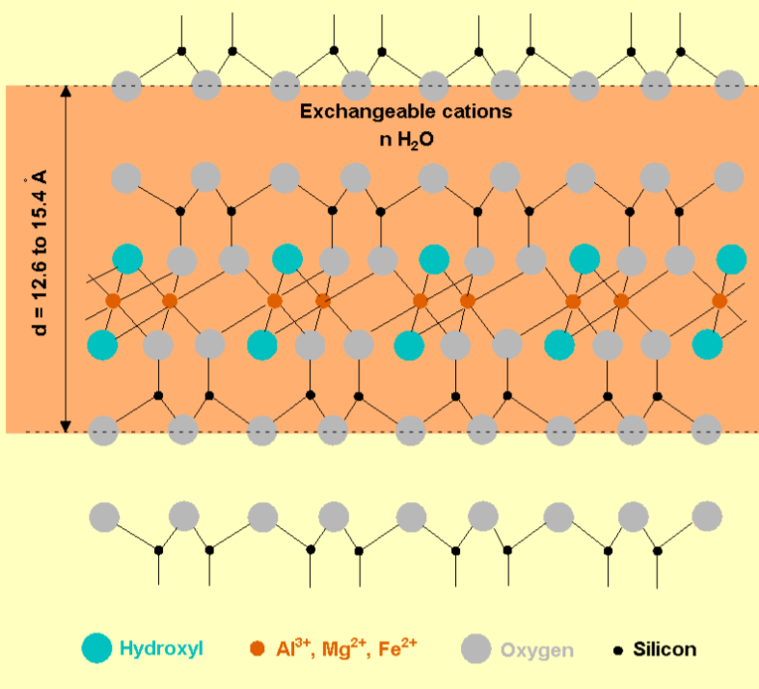
Structure/Formula
(Na,Ca)_{0.33}(Al,Mg)₂(Si₄O₁₀)(OH)₂ · nH₂O
Crystal System: monoclinic
2:1 layer clay part of smectite group (phyllosilicate)
2 tetrahedral sheets of silica with an octahedral sheet of aluminum in between
Allows the clay to swell/absorb water
High cation exchange capacity

Slide 6
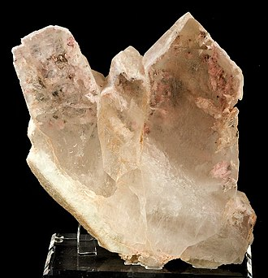
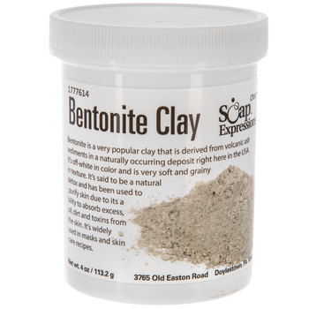
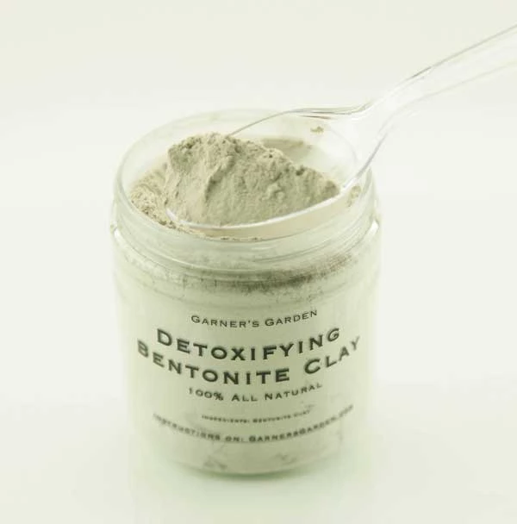
Medical Uses
Can help treat certain skin conditions (Ex. contact dermatitis)
Absorbs heavy metals
Bentonite clay used for infections and indigestion

Slide 7
Uses
Component of drilling mud used in oil industry
Sodium montmorillonite for nonexplosive agents
Bentonite used for seals in wells and liners in landfills
Anticaking agent in pet food
Cosmetics
Sodium montmorillonite for cat litter
Ceramics
Dessicant
Flocculant in ponds
Notes:
-keeps drill bit cool and removes drilled solids
-when sodium is the predominant exchangeable cation it can let the clay swell much more

Slide 8
Works Cited
https://www.mindat.org/min-2821.html#autoanchor1
Klein, C., & Philpotts, A. R. (2017). Earth materials: introduction to mineralogy and petrology. Cambridge: Cambridge University Press.
Uddin, F. (2018). Montmorillonite: An Introduction to Properties and Utilization. Current Topics in the Utilization of Clay in Industrial and Medical Applications. doi: 10.5772/intechopen.77987

