Slide 1
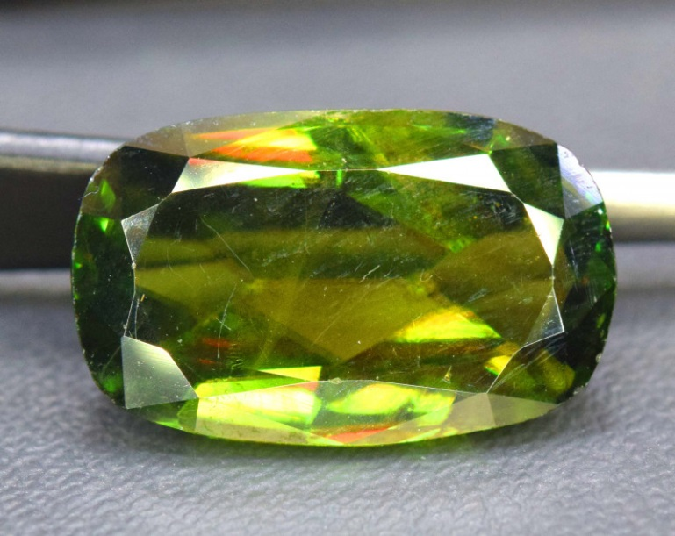
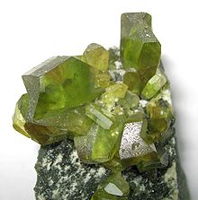
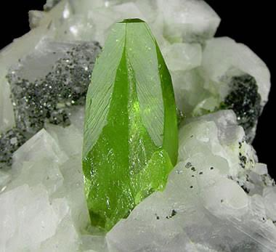
Titanite
Joseph Chomthakham

Slide 2
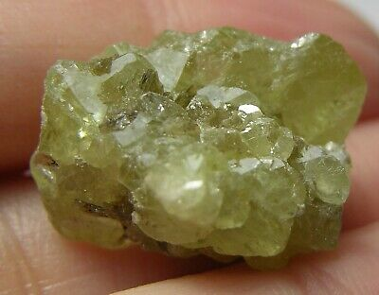
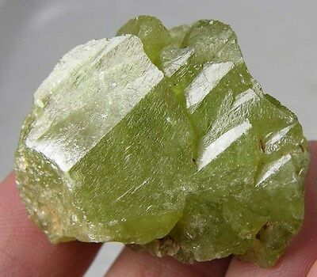
Characteristics
Chemical Formula: CaTi(SiO4)O
Lustre: Resinous, Adamantine (high RI like diamond)
Hardness: 5 – 5.5 (apatite)
Tenacity: Brittle
Crystal system: Monoclinic
Nesosilicate
Streak: White
Refractive index: 1.843 – 2.110 (higher than diamond)
Optical type: Biaxial
Specific gravity: 3.48 – 3.60
Pleochroic

Slide 3
Geological Occurrences
Rare titanium mineral found in granitic(igneous) and calcium-rich metamorphic rocks
Minor ore to titanium
Accessory mineral to granite, granodiorite, diorite, syenite, nepheline syenite
Can be found in marble, calcium rich Gneiss, and schist.

Slide 4
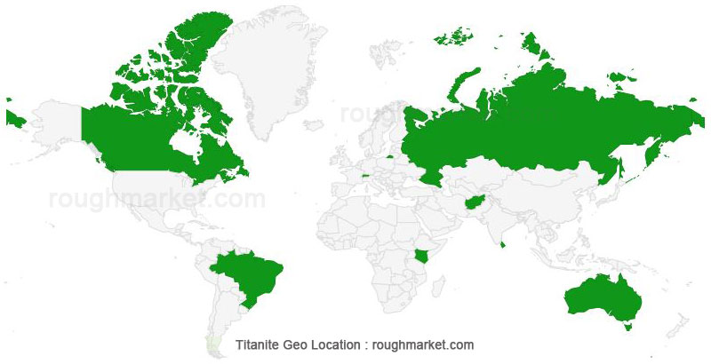
Locations:
Can be mostly found in:
Afghanistan, Australia, Brazil, Burma, Canada, Kenya, Russia, Sri Lanka, Switzerland.

Slide 5
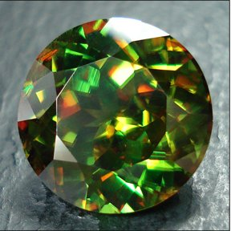
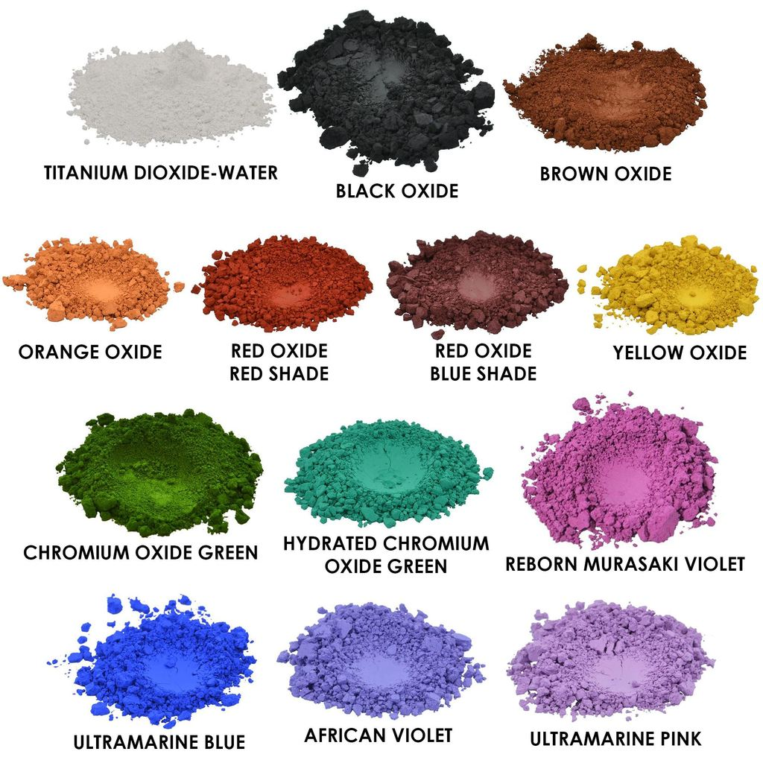
Uses in Real life
Gemstone (Also known as Sphene), but limited use in jewelry
Due to rarity of gem quality, and lack of hardness
Used in pigments
Due to being a source of titanium dioxide

Slide 6
References
Barthelmy, D. (1998, August 3). General Titanite Information. Retrieved December 5, 2019, from http://www.webmineral.com/data/Titanite.shtml#.XemB4uhKiUk.
King, H. M. (2005). Titanite - Also Known as Sphene. Retrieved December 5, 2019, from https://geology.com/minerals/titanite.shtml.

