Slide 1
Pyrope
By: Evelynn Cousey

Slide 2
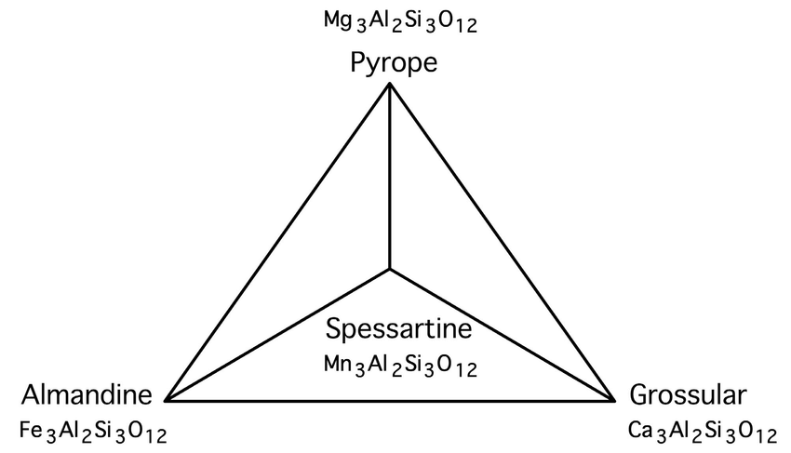
What Is It?
Chemical Formula: Mg₃Al₂(SiO₄)₃
Crystal System: Isometric
Mineral Group: Garnet group
Other common minerals:
Almandine Fe²⁺₃Al₂(SiO₄)₃
Spessartine Mn²⁺₃Al₂(SiO₄)₃
Andradite Ca₃Fe³⁺₂(SiO₄)₃
Grossular Ca₃Al₂(SiO₄)₃
Solid Solution: Pyralspite X₃Z₂(SiO₄)₃
_{X= Mg, Ca, Fe(II), Mn (II)}
Z= Al, Fe(III), Cr(III), V(III)
Trace amounts of Sn may replace Fe(III)

Slide 3
What is it?
Class:
Nesosilicate
Specific Gravity:
3.58, sinks in all common heavy liquids
Inclusions:
rounded crystals, rutile needles
Cleavage:
None
Fracture:
Conchoidal
Streak:
White
Luster:
Vitreous
Hardness:
7.5

Slide 4
What is It?
Refractive Index:
1.714, distinguishes itself from Almandine and Spessartine
Pleochroism:
None
Birefringence:
0.000 isotropic

Slide 5
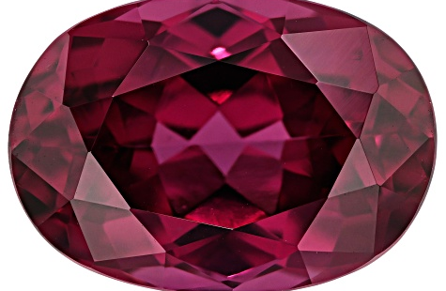
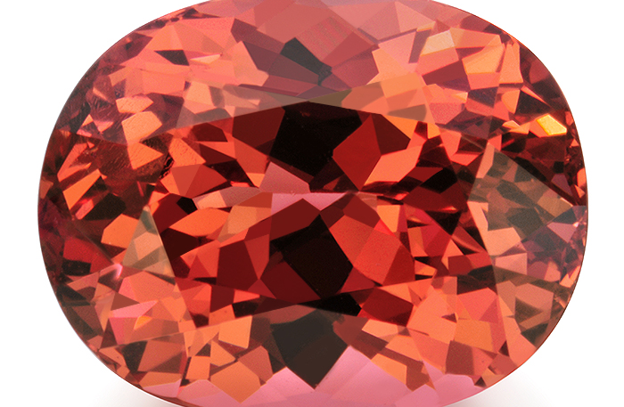
Varieties
Malaia:
Red-orange variety of pyrope spessartine
By-product of rhodolite
Rhodolite:
Purple variety of pyrope-almandine

Slide 6
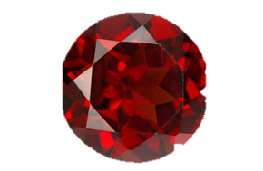
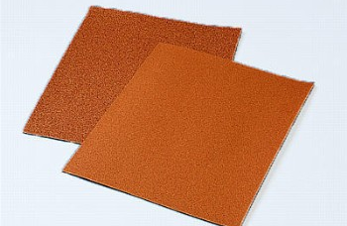
What are its uses?
Garnet paper
Gemstone
This Photo by Unknown Author is licensed under CC BY-NC-ND
Notes:
The gemstone can be crushed into pieces and used in sandpaper as an abrasive tool
The gemstone is a dark red, transparent and usually flawless mineral (meaning no cracks or inclusions) making it perfect for jewelry, pyrope is much rarer than almandine and is more transparent

Slide 7
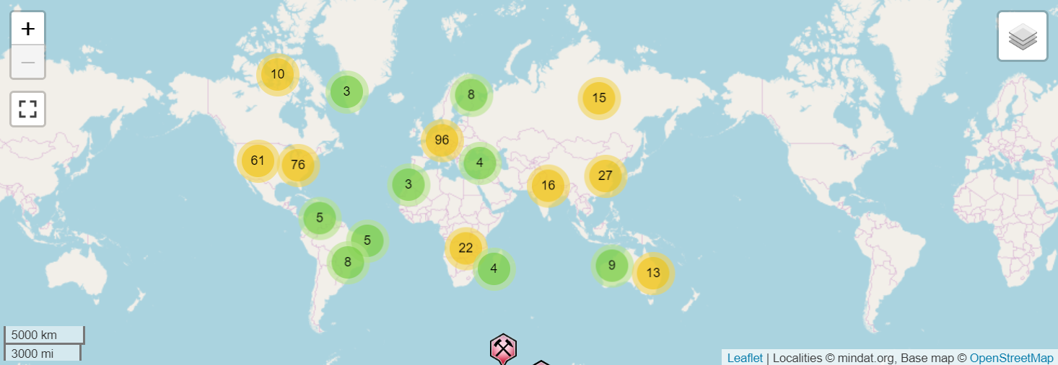
Where can you find it?
Environment:
Ultramafic rock (peridotite)
Ultra High Pressure metamorphic rocks in the Dora-Maira massif in the western Alps
Kimberlite pipe
Pyrope xenoliths
Czech Republic, Bohemia, South Africa, USA
Notes:
Kimberlite pipes are often mined for diamonds since kimberlite is a diamond bearing mineral, the pyrope xenoliths near the pipes are often a violet to deep purple color with a hint of green tinge, this can be used as signifying mineral for the hard to locate kimberlite pipes

Slide 8
Fun facts
Healing power
16th century, Industrial Revolution

Slide 9
Works cited
Mindat.org and the Hudson Institute of Mineralogy, mindat.org, 1993-2019, https://www.mindat.org/min-3321.html
Minerals.net and Hershel Friedman, minerals.net, 1997-2019, https://www.minerals.net/gemstone/pyrope_gemstone.aspx
Wiener Edelstein Zentrum, edelsteine.at, https://www.edelsteine.at/en/glossaries/lexicon/pyrope-garnet/
Crystal Vaults, crystalvaults.com, 2009-2019, https://www.crystalvaults.com/crystal-encyclopedia/pyrope
Wikipedia, Wikipedia.org, August 27th 2018, https://en.wikipedia.org/wiki/Pyrope

