Slide 1
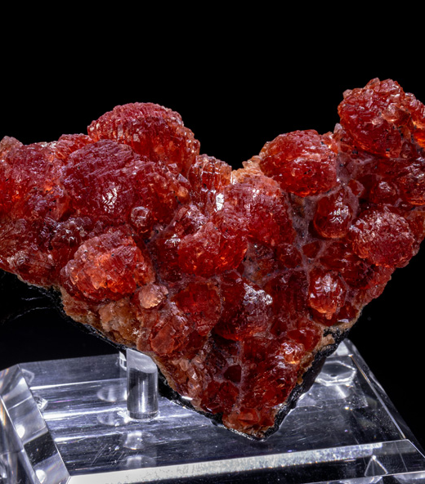
Rhodochrosite
By Isabella Giesing

Slide 2
Rhodochrosite Properties
Color: Pink, yellow, gray, brown
Streak: White
Luster: Vitreous to pearly
Diaphaneity: Transparent to translucent

Slide 3
Rhodochrosite Properties
Cleavage: Perfect, rhombohedral, in three directions
Mohs Hardness: 3.5 to 4
Specific Gravity: 3.5 to 3.7
Crystal System: Hexagonal
Fracture: Irregular/Uneven, Conchoidal

Slide 4
X-Ray Powder Diffraction Information
d-spacing Intensity
3.66 Å (35)
2.84 Å (100)
2.39 Å (20)
2.172 Å (25)
2.000 Å (25)
1.770 Å (30)
1.763 Å (35)

Slide 5
Optical Data of Rhodochrosite
Uniaxial
RI Values: n_{ω} = 1.814 - 1.816 n_{ε} = 1.596 - 1.598
Max Birefringence: δ = 0.218
Surface relief: High
Pleochroism: Weak

Slide 6
Rhodochrosite Chemical Composition
(Mn, Fe, Mg, Ca)CO3
Impurities in mineral specimen can cause discoloration of mineral
Part of the carbonate mineral family

Slide 7
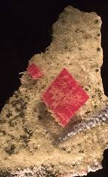
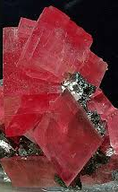
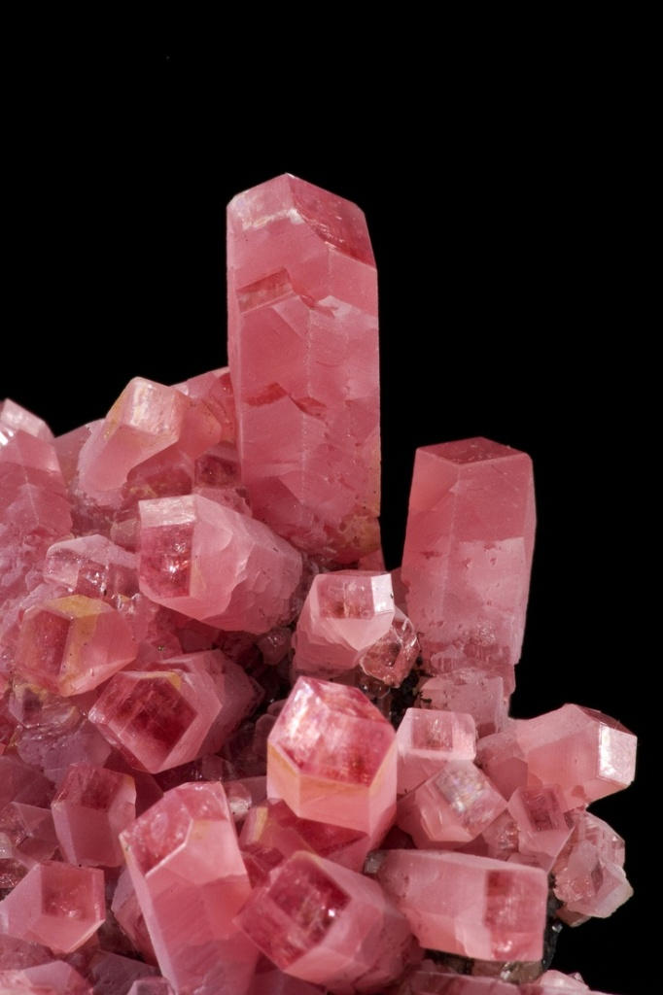

Slide 8
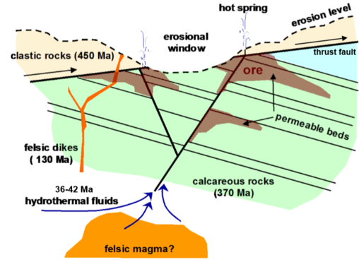
Vein Formation Hydrothermal Filling Deposits

Slide 9
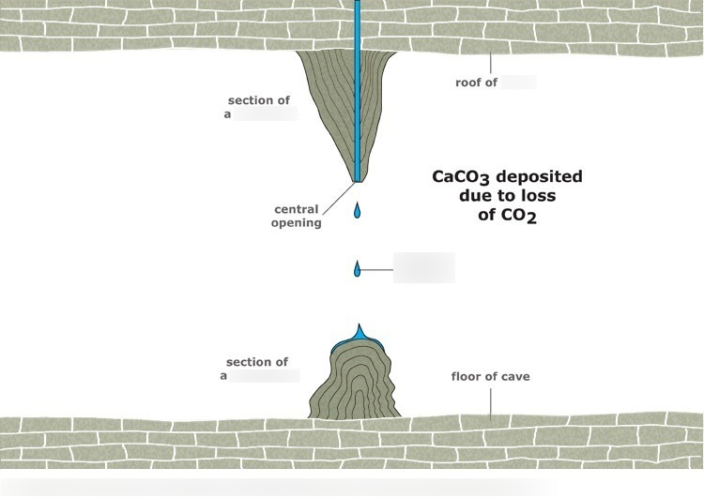
Stalactites Formation

Slide 10
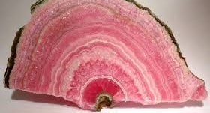
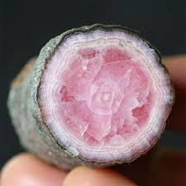
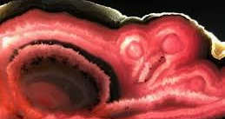

Slide 11
Rhodochrosite Locations
Argentina Japan
Africa Peru
Montana Colorado
Russia Romania
Gabon Mexico

Slide 12
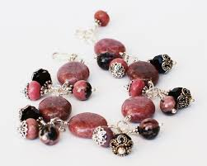
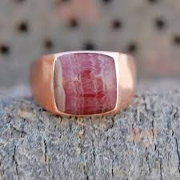
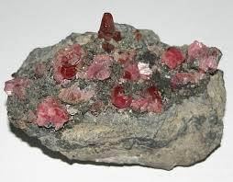
Rhodochrosite Uses
Ore of manganese
Gemstone
Ornamental stone

Slide 13
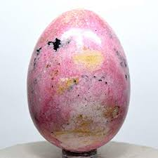
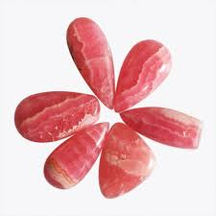

Slide 14
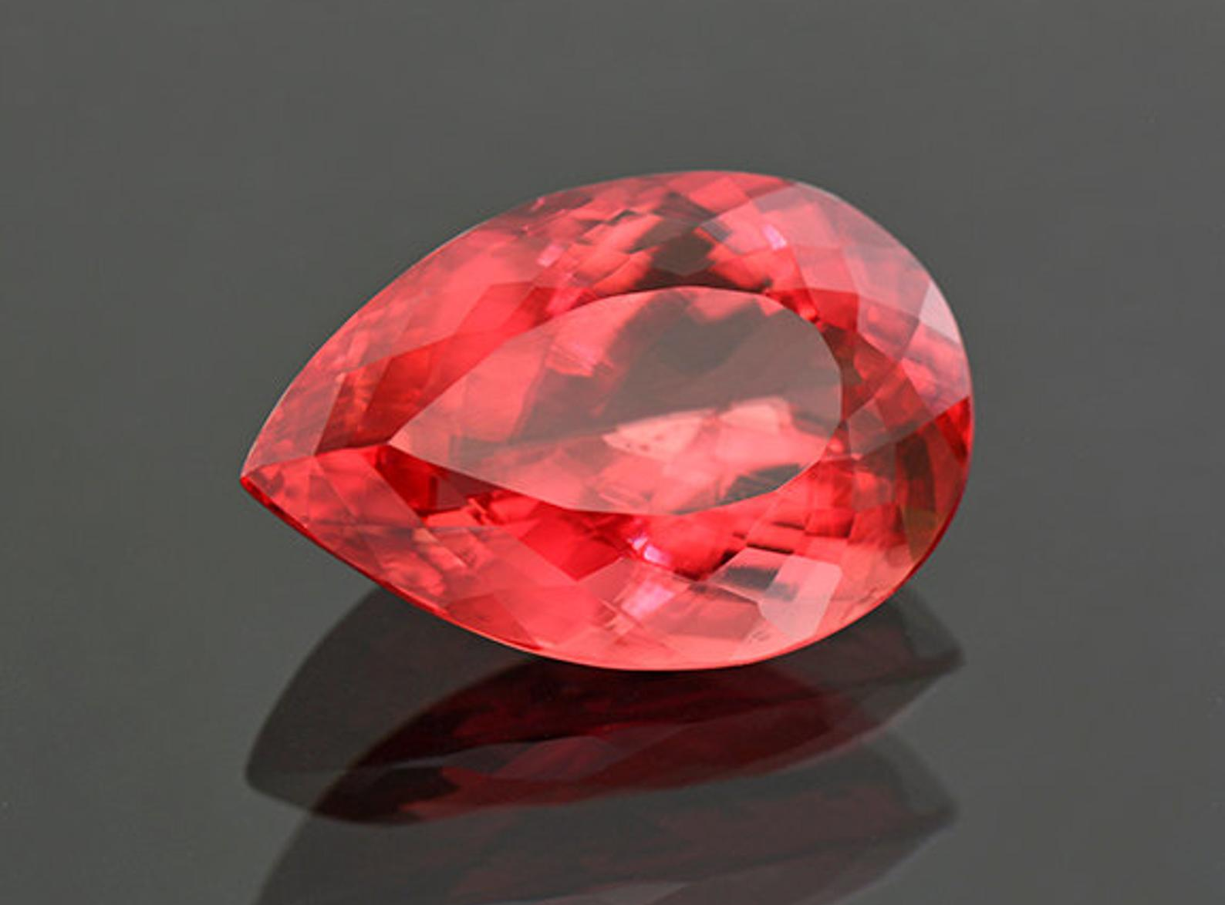
How much do you think this costs?

Slide 15
Rhodochrosite Price
Ranges vary on the compositional color of the mineral
Medium dark red: $204 per carat.
Light pink: $241 per carat
Medium pink: $344 per carat
Medium red: $365 per carat
Medium orangey red: $436 per carat

Slide 16
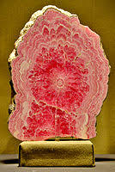
Fun Facts
Rhodochrosite is the mineral of Colorado
Argentina's national's gemstone
Rhodochrosite supposedly has healing powers
Very soft mineral with perfect cleavage makes the mineral very hard to cut

Slide 17
Works Cited
https://www.jewelsforme.com/gem_and_jewelry_library/rhodochrosite
https://geology.com/minerals/rhodochrosite.shtml
https://www.mindat.org/min-3406.html http://www.bernardine.com/gemstones/rhodochrosite.htm https://www.minerals.net/mineral/rhodochrosite.aspx
https://geology.com/minerals/rhodochrosite.shtml
https://en.wikipedia.org/wiki/Rhodochrosite#Use
https://www.gemsociety.org/article/rhodochrosite-jewelry-and-gemstone-information/ http://www.chem.ucla.edu/~harding/IGOC/C/crystal.html

