Slide 1

Gypsum
By: Kayla Gusikoff

Slide 2

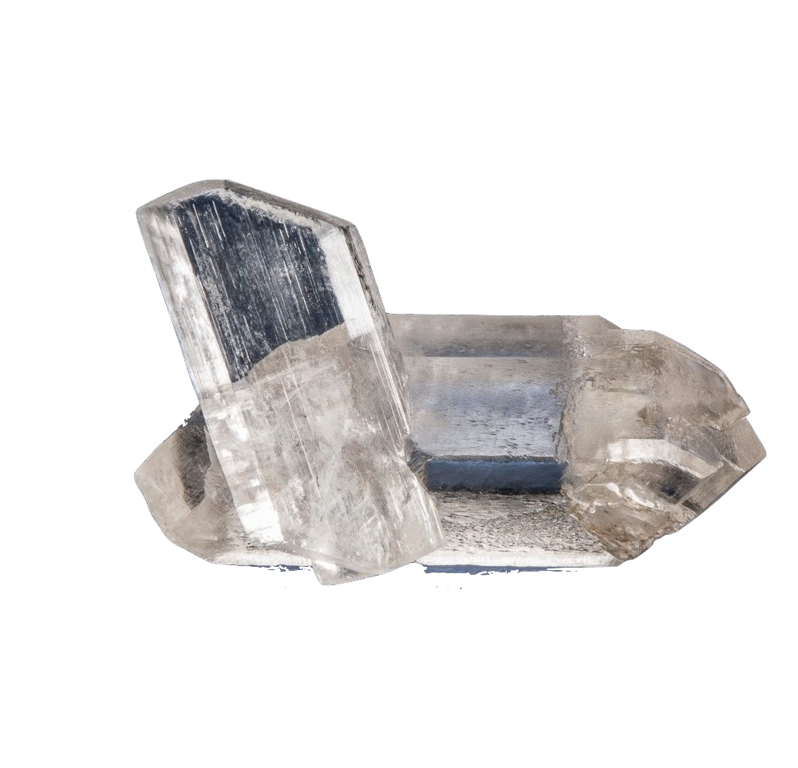
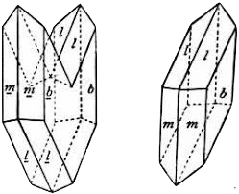
Physical Properties
Chemical Formula
CaSO₄·2H₂O
Chemical Classiﬁcation
Sulfate
Color
Translucent, white, grey, yellow, brown
Streak
White
Luster
Vitreous, pearly
Cleavage
Perfect
Fracture
Conchoidal
Hardness
Two
Crystal System
Monoclinic

Slide 3


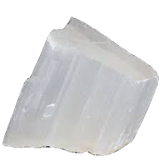
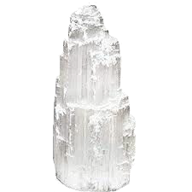
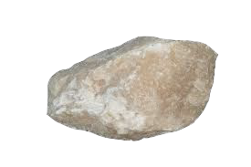
Properties & Varieties
Type: Biaxial (+)
RI values:n_{α} = 1.519 - 1.521 n_{β} = 1.522 - 1.523 n_{γ} = 1.529 - 1.530
Birefringence: interference colour range (at 30µm thickness)
Varieties:
Satin spar- Pearly, ﬁbrous masses Selenite- Transparent and bladed crystals Alabaster- Fine-grained, slightly colored

Slide 4


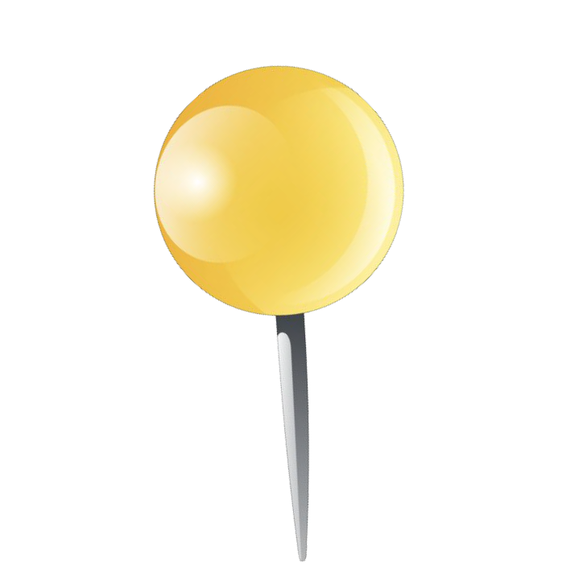

Countries Where Gypsum are Found

Slide 5

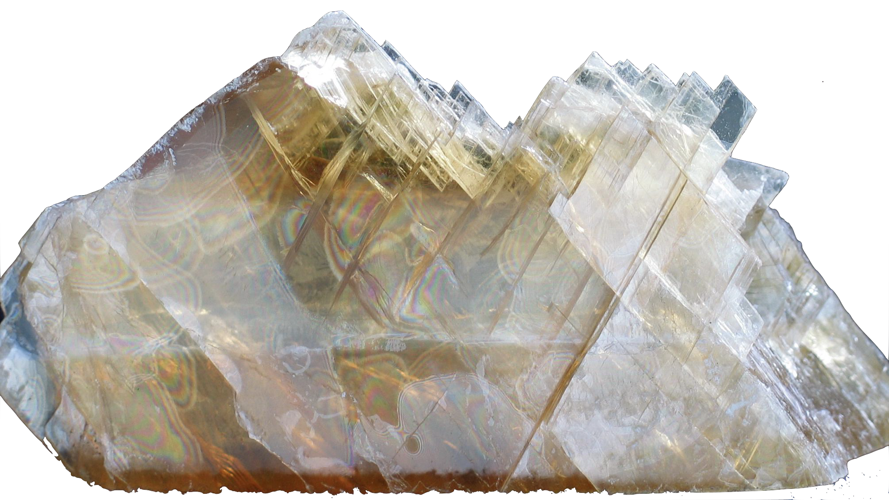
Uses
Gypsum can be milled into a ﬁne powder, then boiled until its moisture is removed— a process known as calcination. As water is added back to the powder, it makes a pliable material that can be molded. It will then harden and keep the shape that it was shaped into. Because of its binding abilities, the uses of gypsum include:
⬡ Toothpaste
⬡ Plaster to crate surgical casts
⬡ Additive in foods like canned vegetables, ice cream, and tofu.
⬡ For brewing beer and making mead
⬡ For creating drywall, wallboard or plasterboard
⬡ For binding tennis court clay
⬡ As a hardening element in Portland cement
⬡ In roads and highways
⬡ As sidewalk or classroom chalk
⬡ In hair products, like shampoo, and creams
⬡ As molds for dinnerware, car windows and dental impression plasters

Slide 6

History
Large beds of gypsum were discovered in New York.
3700
B.C.
Incorporation in the building of palace, King Minos of Crete
Crete
1760’s
Over the next 100 years, gypsum mines opened up in several locations
Coming to America
1880
Egypt
Egyptians used gypsum blocks and plaster in the building of the pyramid of Cheops
Paris
As gypsum was being mined in reservoirs in Paris, the new building material “Plaster of Paris” was popular
America
Augustine Sackett and Fred Kane conceived the idea of producing wallboard comprised of gypsum plaster pressed between four layers of wood felt paper
1200
B.C.
1792

Slide 7

Important Facts
Name Origin
The name “gypsum” is derived from the ancient Greek word “gypsos,” meaning plaster.
First Use In America
Benjamin Franklin was one of the ﬁrst people in America to use this mineral. He used it on his farm to condition the soil. A process that is still used in agricultural applications today to provide a source of plant nutrition.
Movies
Early Hollywood ﬁlmmakers used shaved gypsum on set to mimic the look of real snow.
Fire Protection
Gypsum contains water, and the gypsum in the plaster blocks it from heating past 100℃. Should a ﬁre occur in the home, the water in the gypsum will be released as steam. Although not ﬁreproof, it would protect the structure of the house from damage.

Slide 8

References
5 Things You Didn't Know About Gypsum. (2019, November 19). Retrieved from https://www.mclanahan.com/blog/ﬁve-things-you-didnt-know-about-gypsum.
Gypsum, var. Selenite. (n.d.). Retrieved from http://www.mcdougallminerals.com/Gypsum-var-Selenite-15.html.
Gypsum. (n.d.). Retrieved from https://www.mindat.org/min-1784.html.

