Slide 1
Apatite
Christian Hoffmann

Slide 2
Properties of Apatite
Chemical Formula: Ca₅(PO₄)₃(Cl, F, OH)
Fluorapatite is most common, while Chlorapatite and Hydroxylapatite are rare
Crystal System: Hexagonal
5 on the Mohs Hardness Scale
Specific Gravity of roughly 3.2 g/cm³
https://www.crystalvaults.com/crystal-encyclopedia/apatite-blue

Slide 3
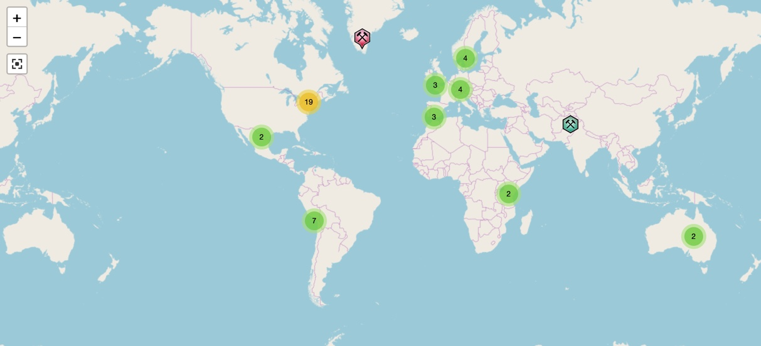
Where is Apatite found?
In the U.S., Maine is a great source for Apatite, coming from the Mount Apatite area and the Noyes Mountain Quarry
Massachusetts is also home to the Acushnet Quarry, which is another great source of Apatite
Internationally, Apatite can be found in Germany, Australia, and some spots in Africa
https://www.mindat.org/min-29229.html

Slide 4
Facts about Apatite
Can have multiple different colors, such as red, blue, yellow, and pink
Main source of phosphorous
Popular mineral in collections, therefore, commands high prices for the mineral
14 different varieties
5th mineral on the Mohs Hardness Scale
https://www.crystal-life.com/product/apatite-blue-free-form-c-4-tall/

Slide 5
Uses of Apatite
Primary use is in phosphate fertilizers
Apatite can also be used in the making of gemstones
Used in the chemical and pharmaceutical industries
Can be used in phosphoric acid and hydrofluoric acid
https://en.gkd.de/news/vacuum-belt-filters-high-performance-in-fertilizer-production-operations/

Slide 6
Citations
Apatite: The mineral apatite information and pictures. (n.d.). Retrieved
from https://www.minerals.net/mineral/apatite.aspx
Apatite, Phosphorite and Phosphate Rock. (n.d.). Retrieved from
https://geology.com/minerals/apatite.shtml.
Blue Apatite Free Form: Crystal Life Technology, Inc. (n.d.). Retrieved from
https://www.crystal-life.com/product/apatite-blue-free-form-c-4-tall/.
Blue Apatite Meanings and Uses. (n.d.). Retrieved from
https://www.crystalvaults.com/crystal-encyclopedia/apatite-blue.
Gebr, & Kufferath AG. (n.d.). Vacuum belt filters: High performance in fertilizer
production operations. Retrieved from https://en.gkd.de/news/vacuum-belt
-filters-high-performance-in-fertilizer-production-operations/.
Moonrise Crystals. (n.d.). Retrieved from https://moonrisecrystals.com/tumbled
-stones/apatite/.

