Slide 1
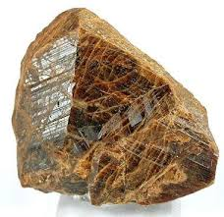
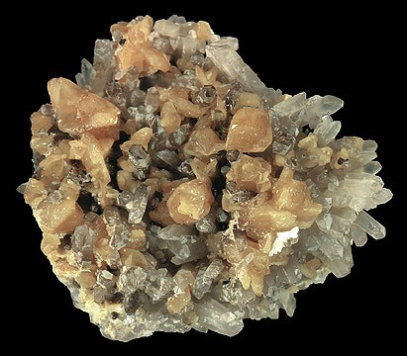
Monazite
Earth Materials
Alex Kimball

Slide 2
Monazite Background
Phosphate mineral – very rare
Found in Igneous and Metamorphic rocks such as Schist, Gneiss, Granite, Pegmatite
Sedimentary rocks
Chemical formula: (Ce, La, Nd, Th)(PO₄, SiO₄).
Brown-Red in color, white streak
Mohs Hardness scale: 5 to 5.5
Small size (sand grains) - resistant to weathering
Isolated crystals

Slide 3
Monazite Facts
Crystal system: Monoclinic
Optical axis: Biaxial
Vitreous luster
Melting Point: 1900 to 2100 Celsius
Specific gravity: 4.6 - 5.4
High density

Slide 4
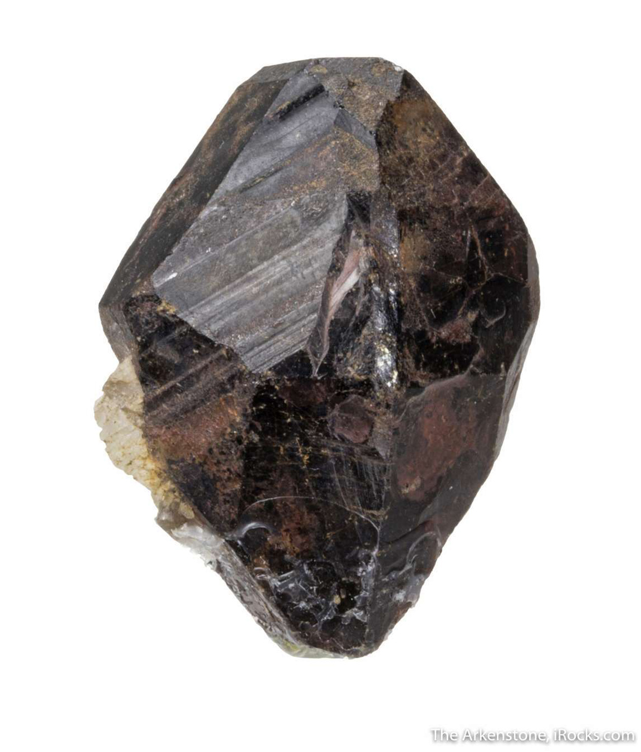
Monazite Facts Continued
Pleochroism is weak
Crystal habit: prismatic
Cleavage: conchoidal fracture
Contact twins
Mined for Thorium, Cerium, other Rare Earth material

Slide 5
Monazite Facts Continued
Discovered by Carl Auer von Welsbach in 1880s in Brazil
India, Australia, South Africa, USA
Radioactive due to Thorium. Used for geochronology
Monazite group – monoclinic phosphate (PO₄) and arsenate (AsO₄³⁻) minerals
At least 8 variations in Monazite group
Slightly varying formulas

Slide 6
Works Cited
https://geology.com/minerals/monazite.shtml
http://www.galleries.com/monazite
https://en.wikipedia.org/wiki/Monazite
http://www.science.smith.edu/geosciences/petrology/petrography/monazite/monazite.html
https://en.wikipedia.org/wiki/Monazite_geochronology

