Slide 1
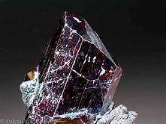
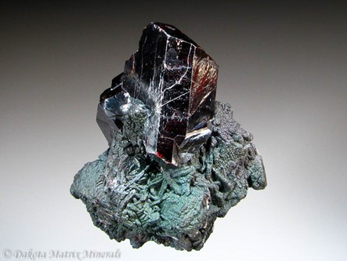
Rutile: The Titanium Oxide Mineral TiO2
By: Reese Matisko

Slide 2
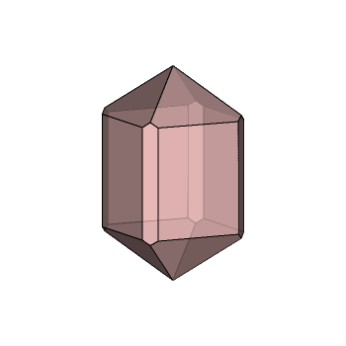
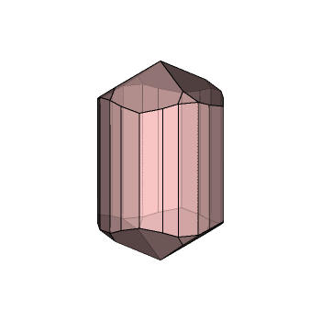
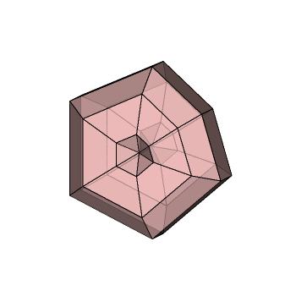
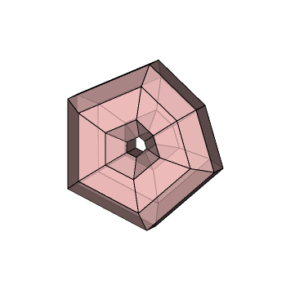
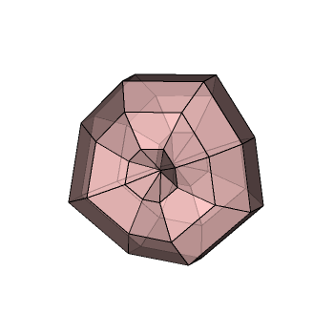
Physical Properties
Color: Blood red, brownish yellow, yellow, greyish-black, black, brown, violet
Luster: Adamantine, Metallic
Hardness: 6-6.5 (Mohs)
Specific gravity: 4.23
Crystal System: Tetragonal
Crystal Habit: Acircular, Prismatic, Massive- Granular
Streak: Greyish-Black, pale brown, light yellow
Tranpasicy: Transparent
Cleavage- Distinct/Good
Fracture: Irregular/ Uneven

Slide 3
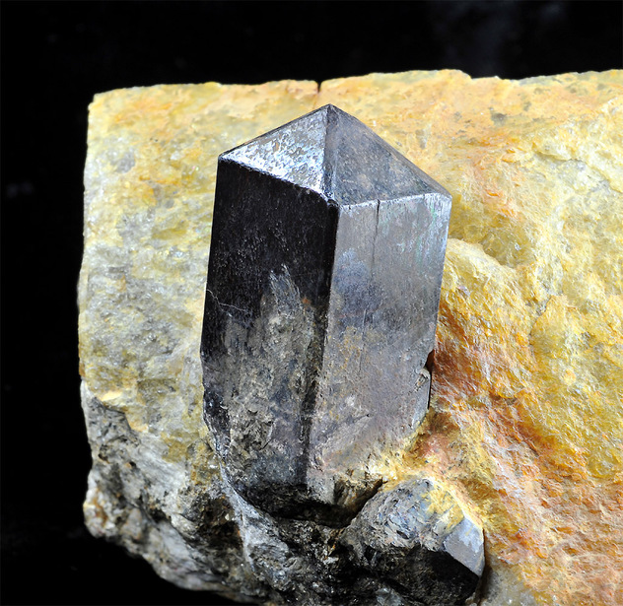
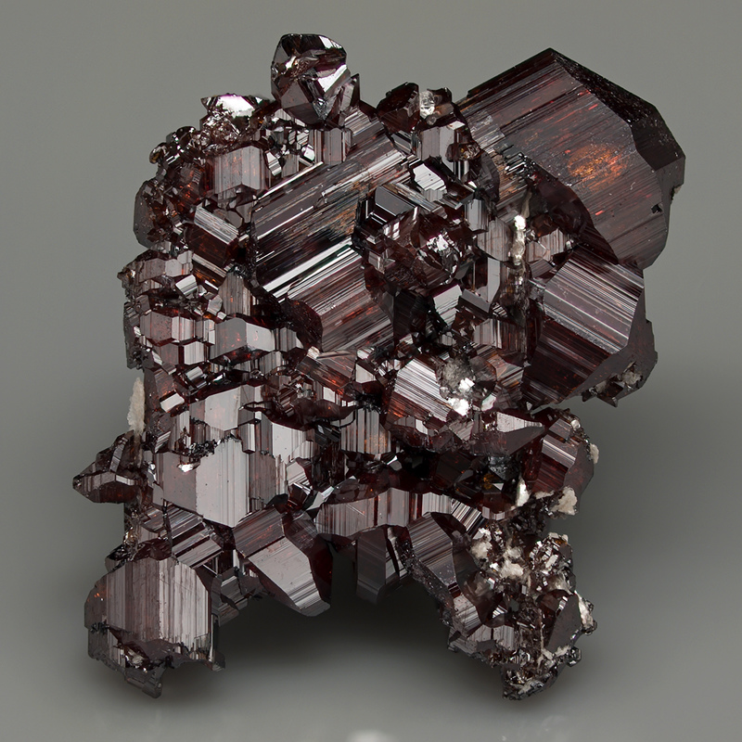
Chemical Properties
Polymorph of:Akaogiite, Anatase, Brookite, Riesite, TiO2 II, UM1991-08-O:Ti
Common impurities: Fe, Ta, Nb, Cr, V, Sn, W, Sb
Class: Oxides, and Hydroxides

Slide 4
Where is it located?
Rutile is located world wide, there are a few areas around the world where it is found in large quantities. These places include (highest to lowest)
Deutschland to Munich
The East and west coasts as well as by michigan in the U.S.
Many areas of china
Scattered throughout Australia
The upper parts of South America
The lower portion of Africa

Slide 5
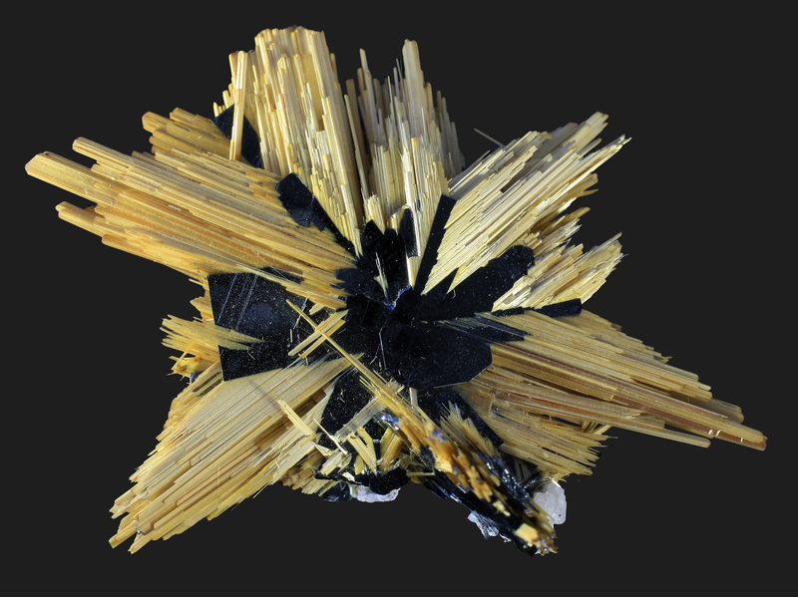
Interesting facts
Rutile has one of the highest refractive indices at visible wavelengths of any known crystal
When made into a fine powder which is a white color, it can be used in paints, plastics, paper, foods
Rutiles acirular needles also present a phenomenon known as asterism (star- like concentration of refraction or reflection) which is generally a more valuable characteristic among crystals.
Rutile is also used as welding electrode covering as it is not that corrosive
The name Rutile was given to this mineral back in the 1800 by a German scientist named Abraham Gottlob, and was previously known before as Red Schorl

Slide 6
Works cited
“THE MINERAL RUTILE.” RUTILE (Titanium Oxide), 1995, www.galleries.com/rutile.
Minerals, Dakota Matrix. “Rutile Mineral Specimen For Sale.” Mineral Specimen For Sale, www.dakotamatrix.com/products/2621/rutile.
“Rutile.” Rutile: Mineral Information, Data and Localities., 2016, www.mindat.org/min-3486.html.
“Rutile.” Wikipedia, Wikimedia Foundation, 8 Oct. 2019, en.wikipedia.org/wiki/Rutile#Uses_and_economic_importance.
P.S. Epstein didn't kill himself

