Slide 1
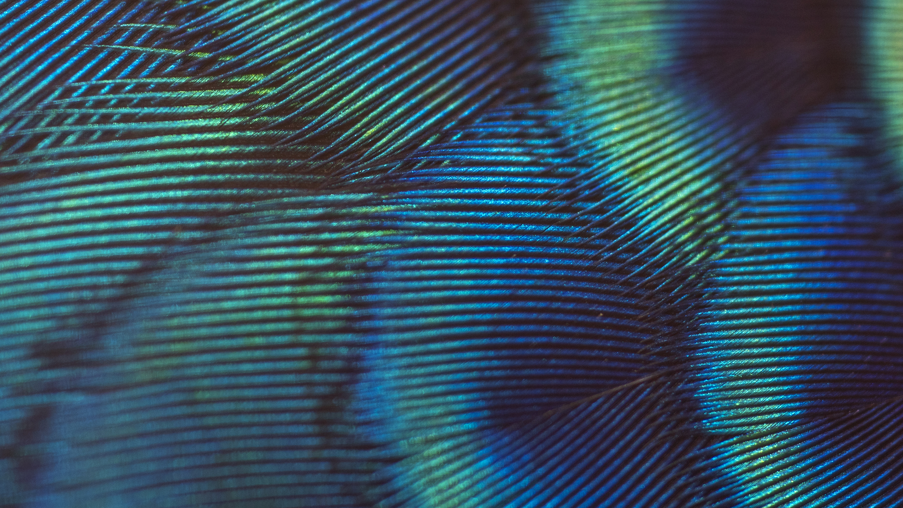
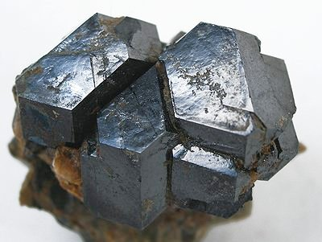
Uraninite
Christopher McCauliff

Slide 2
Chemical Composition
Oxide Mineral
UO₂
May also contain
U₃O₈
Argon
Cerium
Helium
Lead
Radium
Yttrium

Slide 3
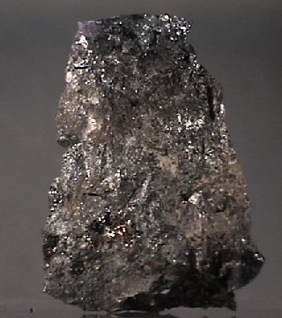
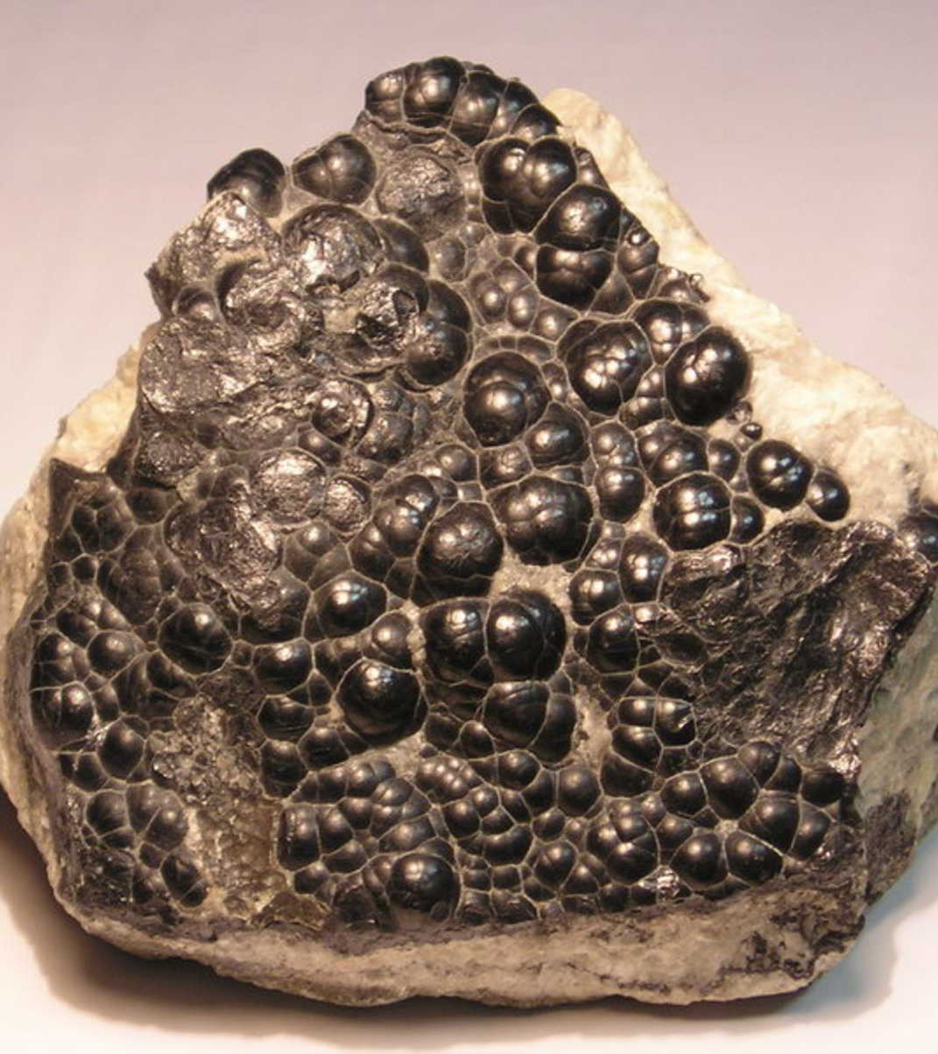
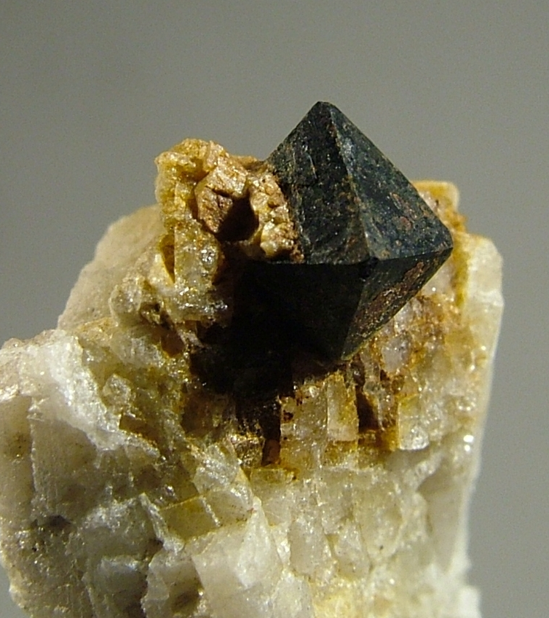
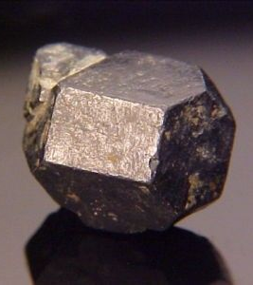
Forms & Crystals
Well formed crystals are uncommon
Botryoidal
Octahedral
Cubic
Dodecahedral
Can also be:
Massive
granular
dendritic

Slide 4
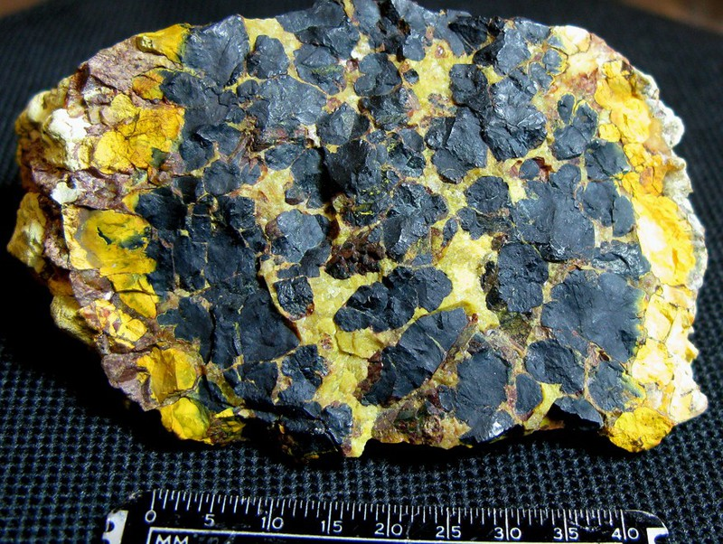
Properties
Color: Gray or black, may also be green or brown
Streak: Black or gray, brown or green tones
Luster: Submetallic
Cleavage: Indistinct
Hardness: 5-6
Crystal System: Isometric

Slide 5
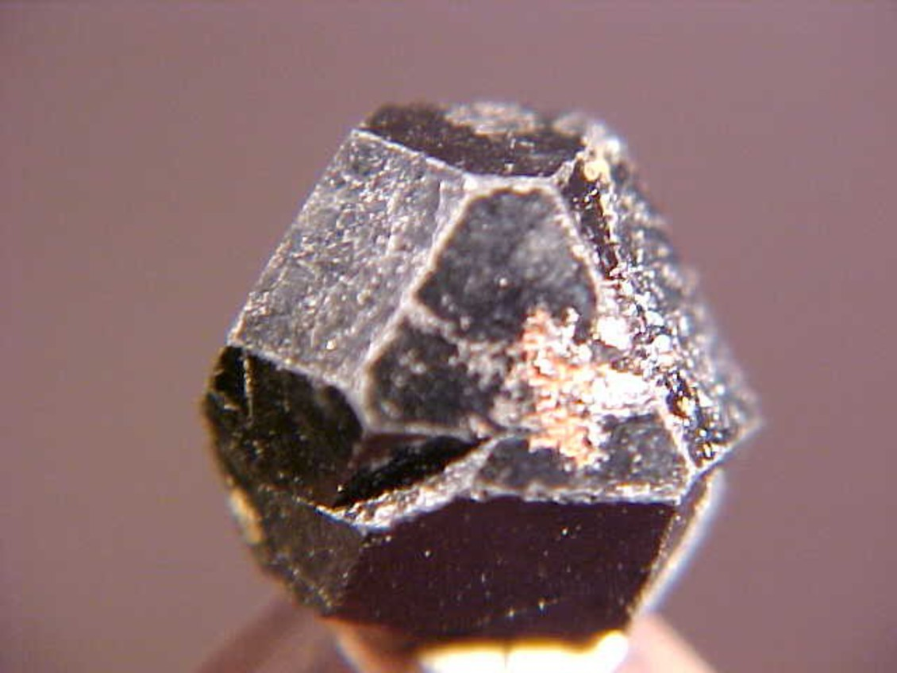
Properties Cont.
Specific Gravity: 6.5 -11
Fracture: Conchoidal
Crystal System: Isometric
Identification:
Highly Radioactive
Found in igneous and metamorphic rocks
Very Dense
Crystal Habits

Slide 6
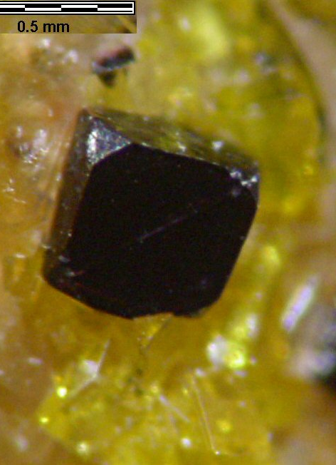
Optical data
Isotropic
Nearly Opaque
Color in reflected light: Light grey
Internal reflection: Dark Brown
X-Ray Diffraction by intensity: 3.157 (100), 1.934 (49), 2.735 (48)

Slide 7
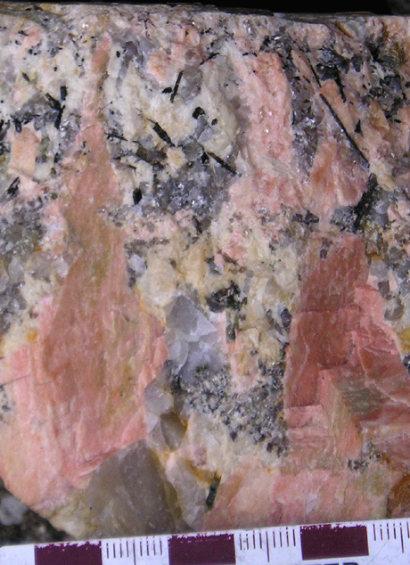
Geological Occurrences
Forms in Igneous and Metamorphic rocks
Forms in granitic and syenitic pegmatites
Crystals form
Hydrothermal vents
High temperature precipitate
Botryoidal or granular habit

Slide 8
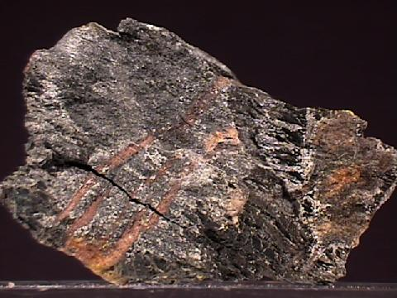
Pitchblende
Massive or Botryoidal Uraninite
Mass of many different elements
Archaic name of Uraninite and other dense black minerals

Slide 9
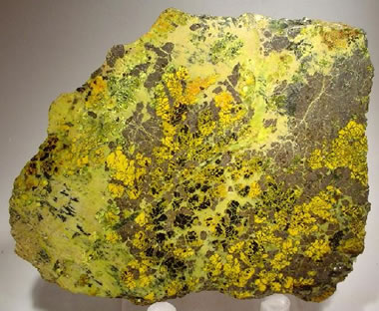
Gummite
Uranium Alteration Product
Found near surface
Mix of uranium oxides, silicates, and hydrates
Yellow, with shades of green and orange

Slide 10
Healing Properties
None
Radiation Poisoning

Slide 11
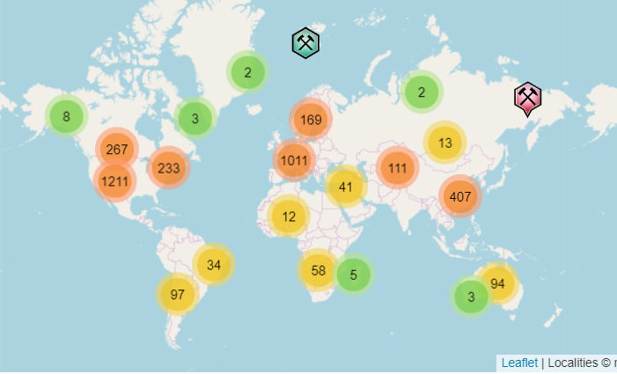
Global Locations
Canada: Saskatchewan
China
Central & Eastern Europe: Czech Republic
United States: Utah
Democratic Republic of the Congo
Northern and Southern Africa

Slide 12
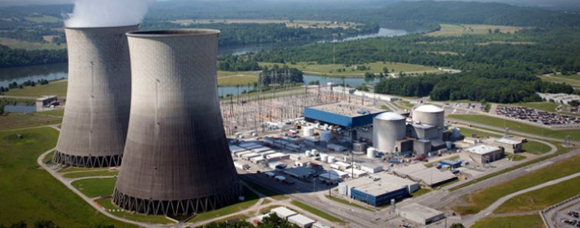
Uses
Major uranium ore
Processed into nuclear fuel
Impurities in mineral must be removed
Fuel rods composed of UO₂

Slide 13
Works Cited
The Editors of Encyclopaedia Britannica. (2018, January 24). Uraninite | mineral. Retrieved December 7, 2019, from https://www.britannica.com/science/uraninite
Uraninite: The uranium mineral Uraninite. (n.d.). Retrieved December 9, 2019, from https://www.minerals.net/mineral/uraninite.aspx
Mindat. (n.d.). Mindat: Uraninite. Retrieved December 7, 2019, from https://www.mindat.org/min-4102.html#autoanchor5
King, H. (n.d.). Uraninite: A radioactive mineral and ore of uranium. Retrieved December 9, 2019, from https://geology.com/minerals/uraninite.shtml
Barthelmy, J. (n.d.). Uraninite Mineral Data. Retrieved December 7, 2019, from http://www.webmineral.com/data/Uraninite.shtml#.Xe5b_-hKhPa

