Slide 1
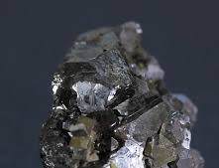
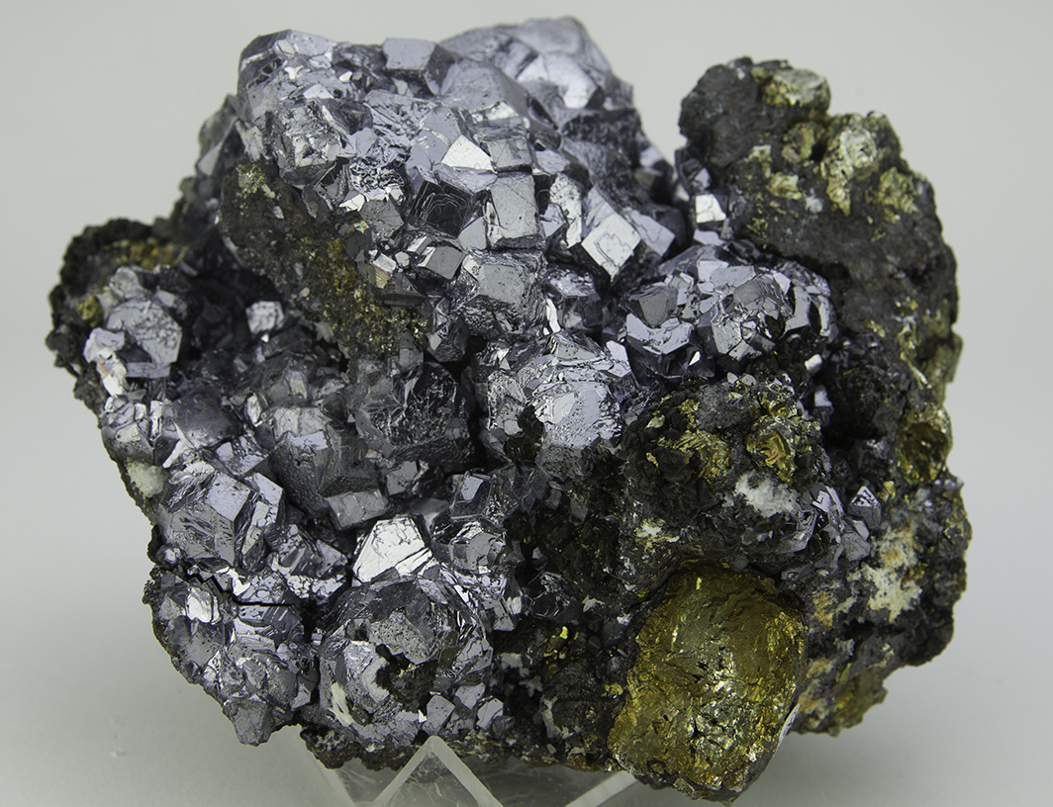
Galena
Paige Mead

Slide 2
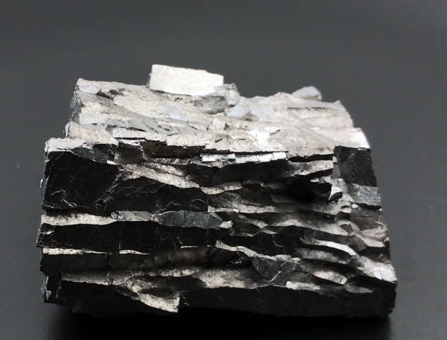
Classification
Galena is identified by its metallic (and sometimes dull) luster and lead-gray color and streak
it has a hardness of 2.5 on the Mohs hardness scale
Elemental formula: PbS
It is isometric
Cleavage: perfect
Fracture: Brittle
Habit: Well formed euhedral crystals, massive – granular, massive - indistinguishable uniform crystals

Slide 3
Some more!
Found in lead sulfide ore veins as well as disseminated in igneous and sedimentary rocks
IN the U.S., it is mined in Missouri, Kansas, and Okalahoma
It’s also called Blue Lead, ICSD 38293, Lead Glance, and PDF 5-592

Slide 4
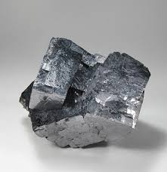
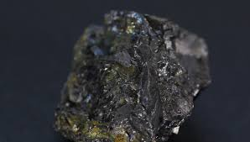
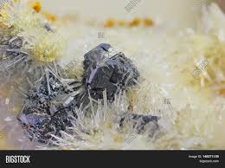
What is it even good for?
Galena has been mined and refined for centuries for lead and silver
Uses for Lead
Uses for Silver
Pigments
Car batteries
Storing corrosive liquids
Shielding from radiation
Ammunition
Solder
Weights for lifting
Jewelry
Tableware
Mirrors
Dental alloys
Solder
Electrical contacts
Batteries

Slide 5
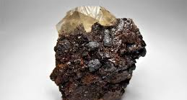
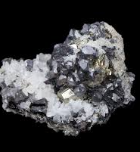
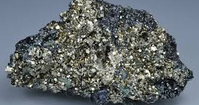
With sphalerite and calcite
Galena with pyrite, and sphalerite
Galena with quartz

Slide 6
Fun Fact! It snows Galena on venus
Volcanoes on Venus’s surface vent superheated gases into the atmosphere, including lead and sulfur

Slide 7
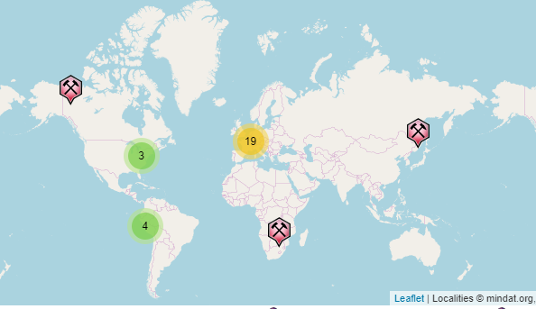
Global Locations
South Africa, South America, Russia, Canada, North America, and many more

Slide 8
References
Info
https://www.rsc.org/periodic-table/element/82/lead
http://webmineral.com/data/Galena.shtml#.Xe2R5-hKiUk
https://geology.com/minerals/galena.shtml
https://www.mindat.org/min-1641.html#autoanchor2
https://www.rsc.org/periodic-table/element/47/silver
Images
https://www.planetary.org/multimedia/space-images/venus/global-view-of-venus-from-akatsuki.html
https://www.crystalspringsmining.com/Galena-136-cm-x-134-_p_249.html

