Slide 1
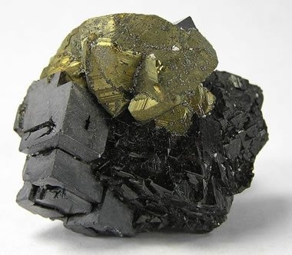
Sphalerite
Damani Mitchell

Slide 2
Name Origin
Sphalerite was named in 1847 by Ernest Glocker after the Greek word Sphaleros, meaning Treacherous. It got this name due to its dark colored variety that people thought was galena

Slide 3
Chemical Composition
The chemical formula of Sphalerite is ZnS
Sometimes written as (Zn,Fe)S because it can have a wide variety of iron content depending on the temperature. Higher temperature favors higher iron content. The iron content is usually less than 25%
There can also be small traces of cadmium, indium, germanium, or gallium.
Sphalerite is a Sulfide mineral

Slide 4
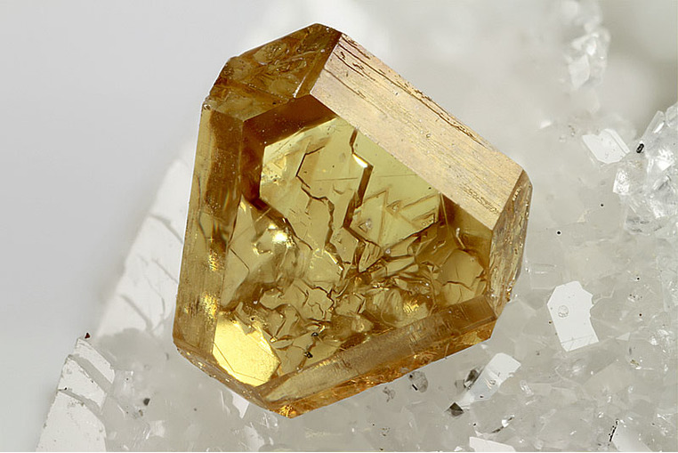
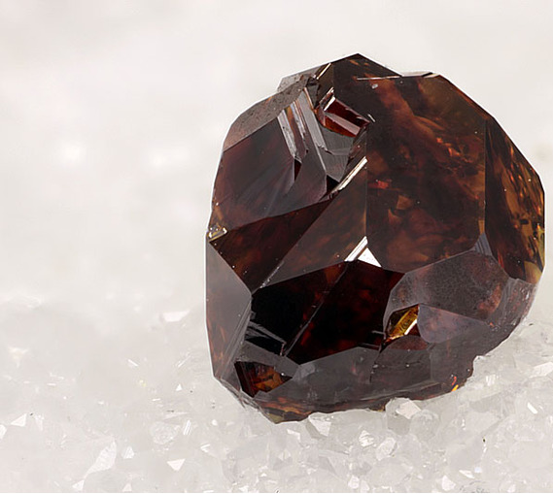
Color
The color of Sphalerite varies. It can be green, light brown, dark brown, red-brown, yellow, light blue, black, or colorless.
Below are a few different colored examples of sphalerite.

Slide 5
Physical Properties
Streak: White, Yellow, or Pale brown
Hardness: 3.5 – 4
Specific Gravity: 3.9 – 4.1
Luster: Ranges from nonmetallic – resinous
Perfect dodecahedral {011} cleavage
Ranges from Transparent to Translucent
Can smell like sulfur

Slide 6
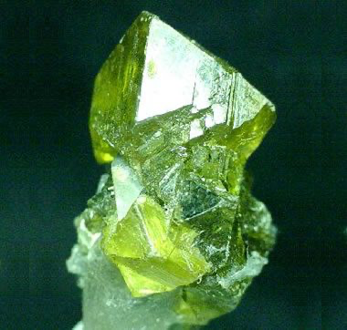
Crystal Forms
The crystal form of Sphalerite is described as Isometric; 43m. Common forms of sphalerite include Tetrahedrons, dodecahedrons, and cubes
—

Slide 7
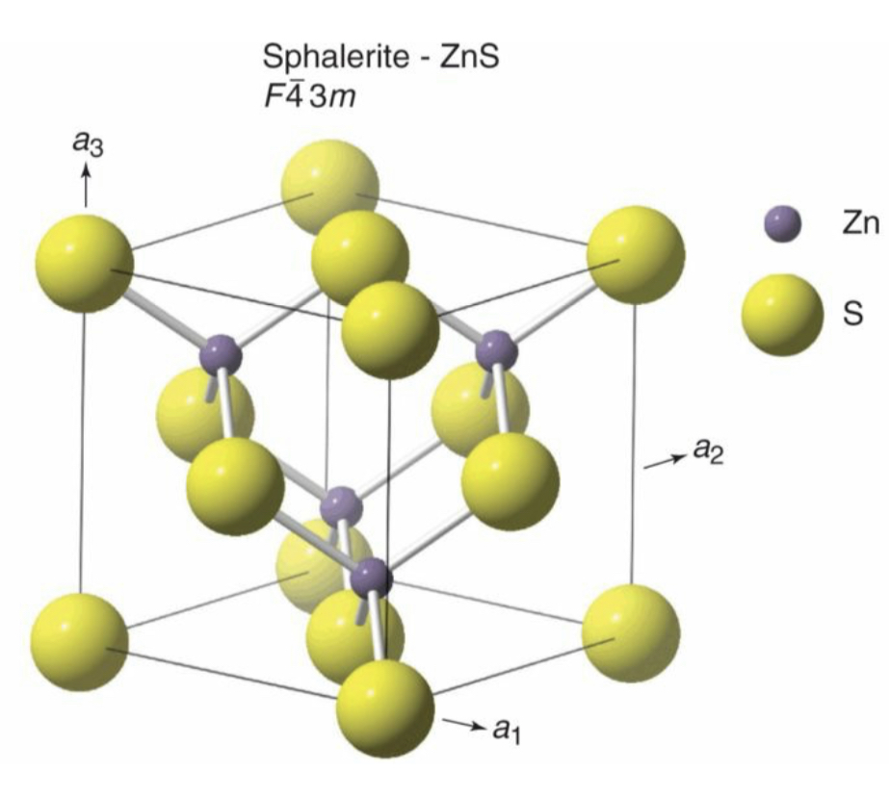
Crystal Structure
- The Crystal system of sphalerite is Isometric.
The crystal structure of carbon is very similar to that of diamond. In diamond, each carbon atoms in regular tetrahedrons. In sphalerite, half of those carbon atoms is replaced by Zinc and the other half is replaced by Sulfur. This means that the Zinc is in tetrahedral coordination with Sulfur.

Slide 8
Location
Sphalerite is mined in many different places including Australia, Mexico, Germany, Italy, Spain, and various places in the United States. There are sphalerite mines in Tennessee, Missouri, Illinois, Kansas, Oklahoma, and even in New Jersey.

Slide 9
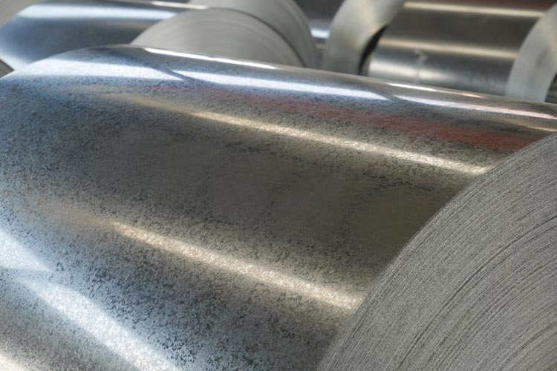
Uses
Sphalerite is mainly used for its Zinc contents
Approximately 50% of all Zinc is used as a coating on galvanized steel which is widely used in the production of automobiles.
Pharmaceutical products
Cosmetic products
Medical purposes (Zinc deficiency)

Slide 10
Other facts
Sphalerite is found in all three types of rocks (metamorphic, igneous, sedimentary).
Although sphalerite would look nice as jewelry, it’s low hardness makes it very fragile and unsuitable.
Sphalerite has a very high dispersion (3x that of diamond), making it very popular among some collectors

Slide 11
Sources
Klein, Cornelis. Earth Materials. Cambridge Univ Press, 2016.
https://geology.com/minerals/sphalerite.shtml
https://www.mindat.org/min-3727.html
https://geology.com/minerals/sphalerite.shtml
https://careertrend.com/how-does-5212481-sphalerite-mined-.html
https://www.thoughtco.com/chemistry-of-diamond-602110

