Slide 1
Franklinite
Sarah Perkins

Slide 3
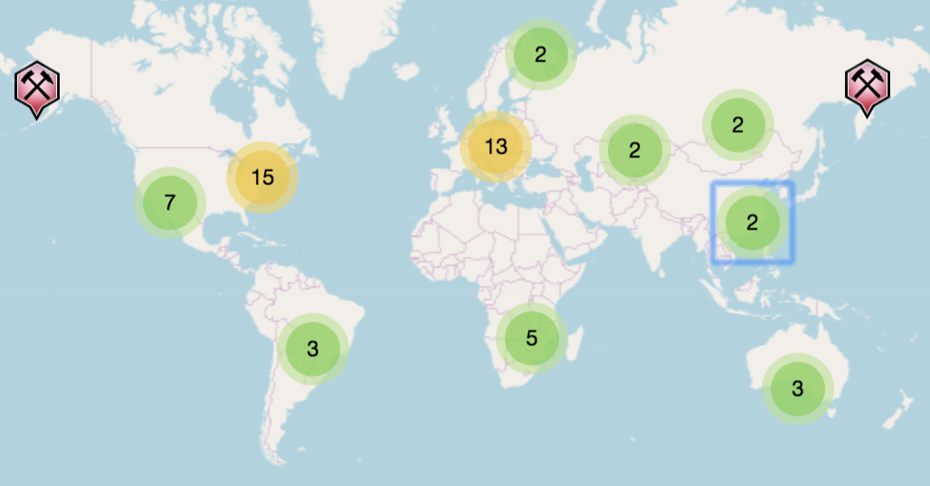
History
Named in 1819 for the type locality of Franklin Furnace, NJ
Found in the zinc ore zone of the metamorphic marble deposit of Franklin and Ogdensburg, NJ

Slide 4
About
Formula: Zn²⁺Fe³⁺₂O₄
Common Impurities: Mn, Ti, Al, M, Ca
Crystal System: Isometric
Octahedral
Dodecahedral less common
Cubic rare
Common Associates:
Calcite
Willemite
Zincite

Slide 5
Physical Characteristics
Color: Black
Lustre: Metallic, Sub-Metallic
Transparency: Opaque
Streak: Reddish brown to black
Hardness: 5.5-6
Tenacity: Very brittle
Cleavage: None
Fracture: Irregular/Uneven, Conchoidal
Specific Gravity: 5.07-5.22
Magnetism: Paramagnetic

Slide 6
Optical Data
Type: Isotropic
RI Values: n=2.36(2)
Birefringence: None because its isotropic
Surface Relief: Very high
Color in reflected light: White to gray
Internal Reflections: Red
Pleochroism: Non-pleochroic

Slide 7
References
“Franklinite.” Franklinite: Mineral Information, Data and Localities., www.mindat.org/min-1598.html.
“Franklinite: The Mineral Franklinite Information and Pictures.” Franklinite: The Mineral Franklinite Information and Pictures, www.minerals.net/mineral/franklinite.aspx.
“Using Characteristics of Minerals to Identify Them.” Illinois State Geological Survey, isgs.illinois.edu/outreach/geology-resources/using-characteristics-minerals-identify-them.

