Slide 1
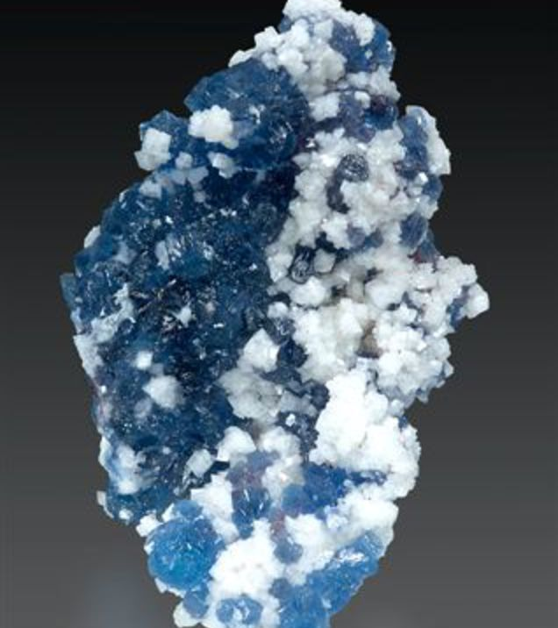
Willemite
Zn₂SiO₄

Slide 2
Name origins
Named in 1830 by Serve-Dieu Abailard
"Armand" Lévy in honor of
William I King of the Netherlands,
This species was previously discovered in 1825 and was identified as "siliceous oxide of zinc"

Slide 3
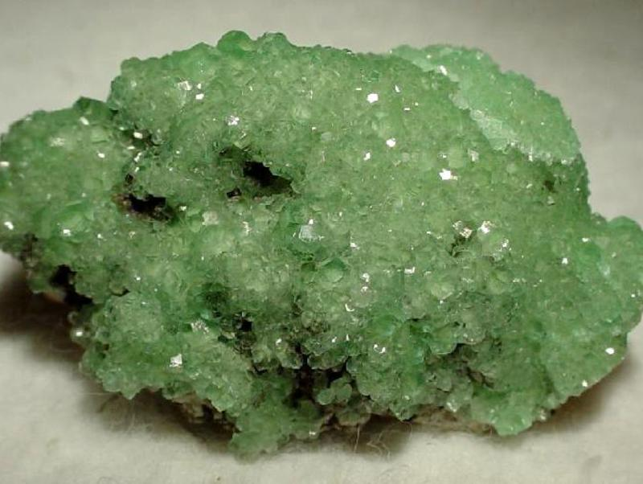
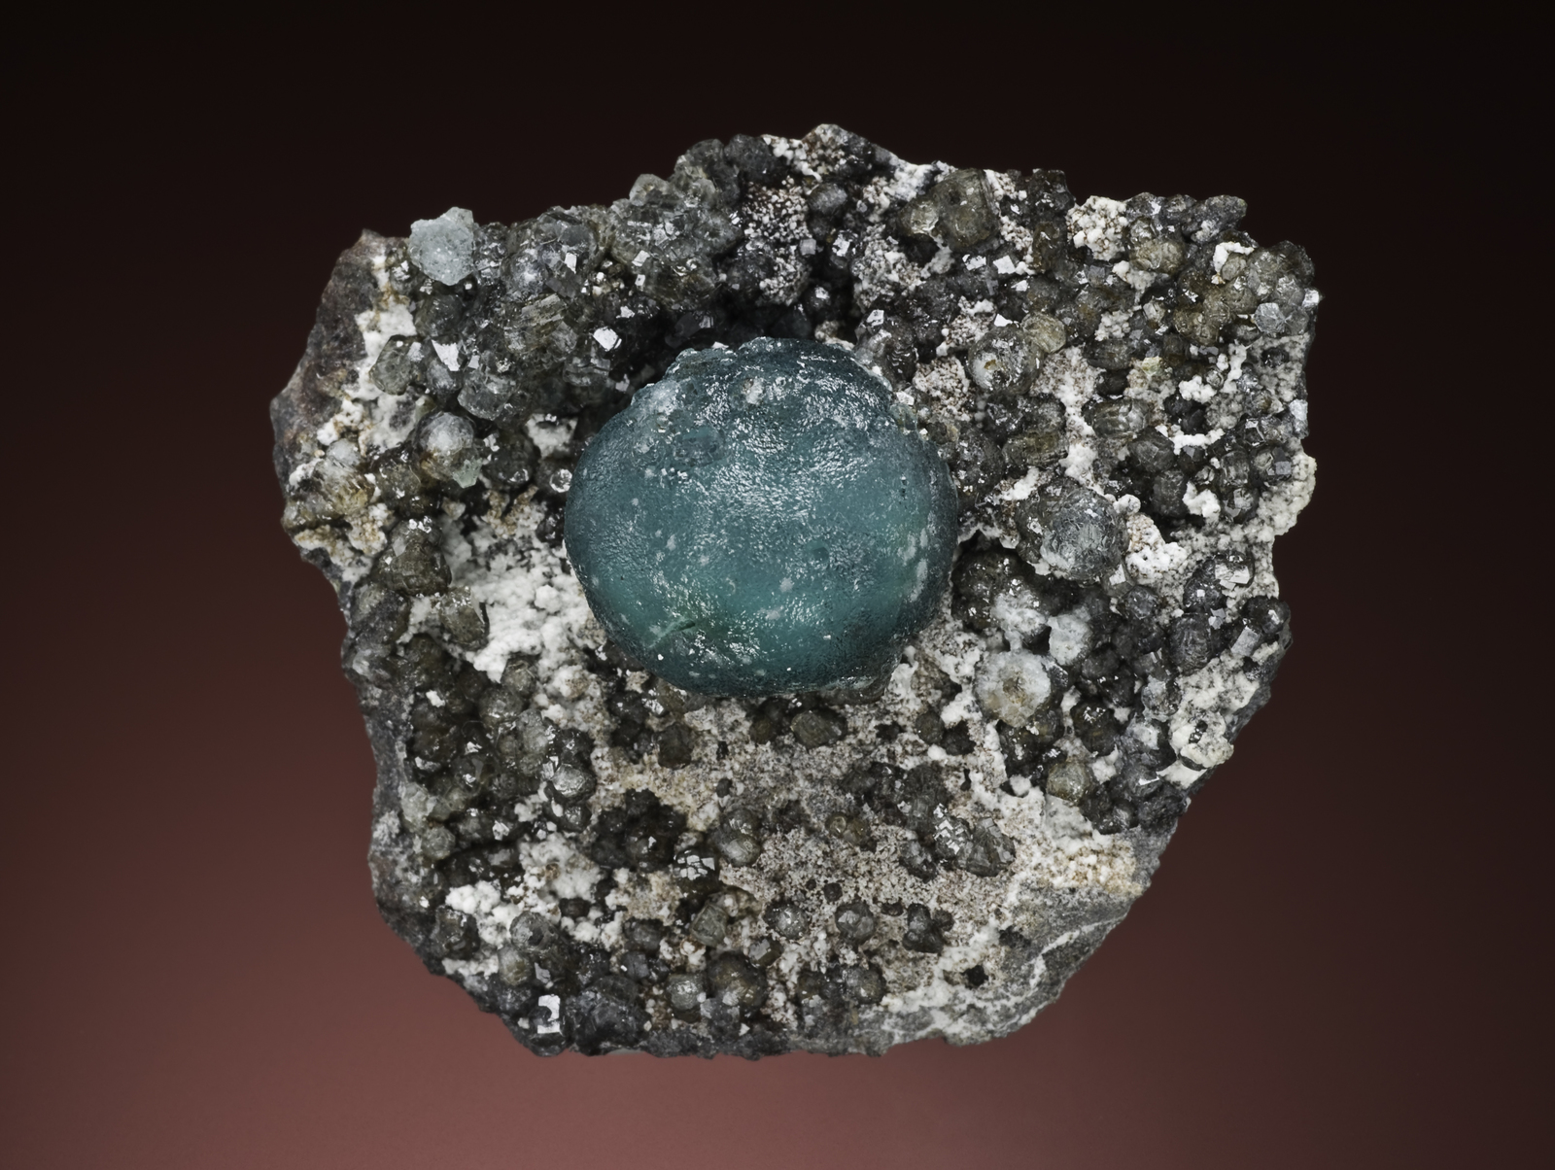
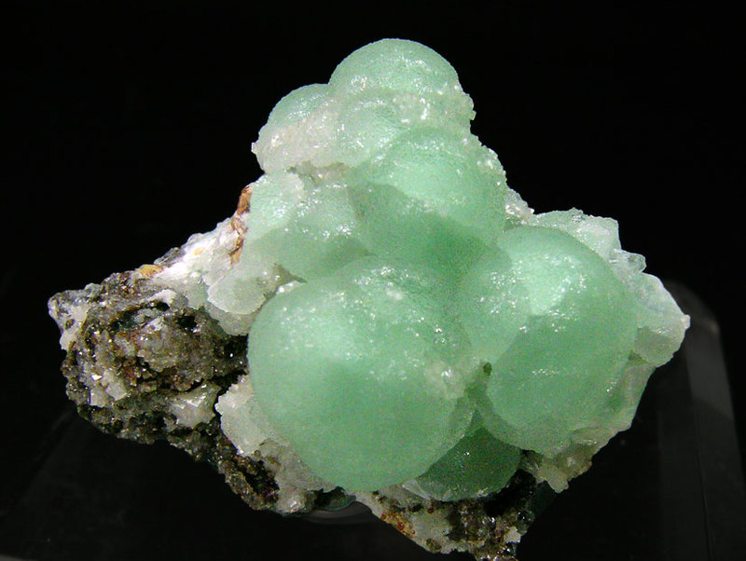
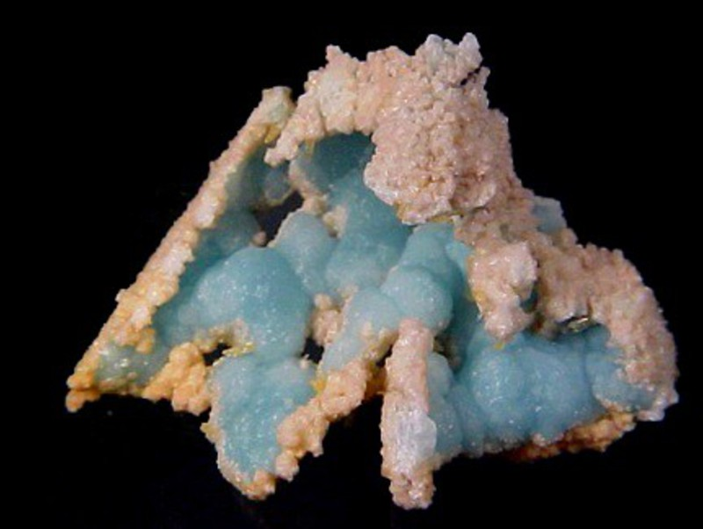
Color:
Colorless
White
Pastel Green
Apple Green
Light Blue
Azure-Blue
Yellow
Bourgendy-Red
Brown
Gray
Black
Pink

Slide 4
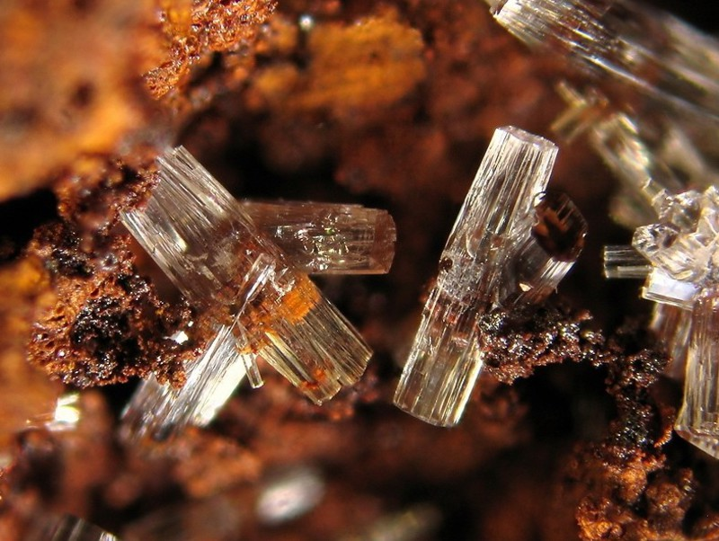
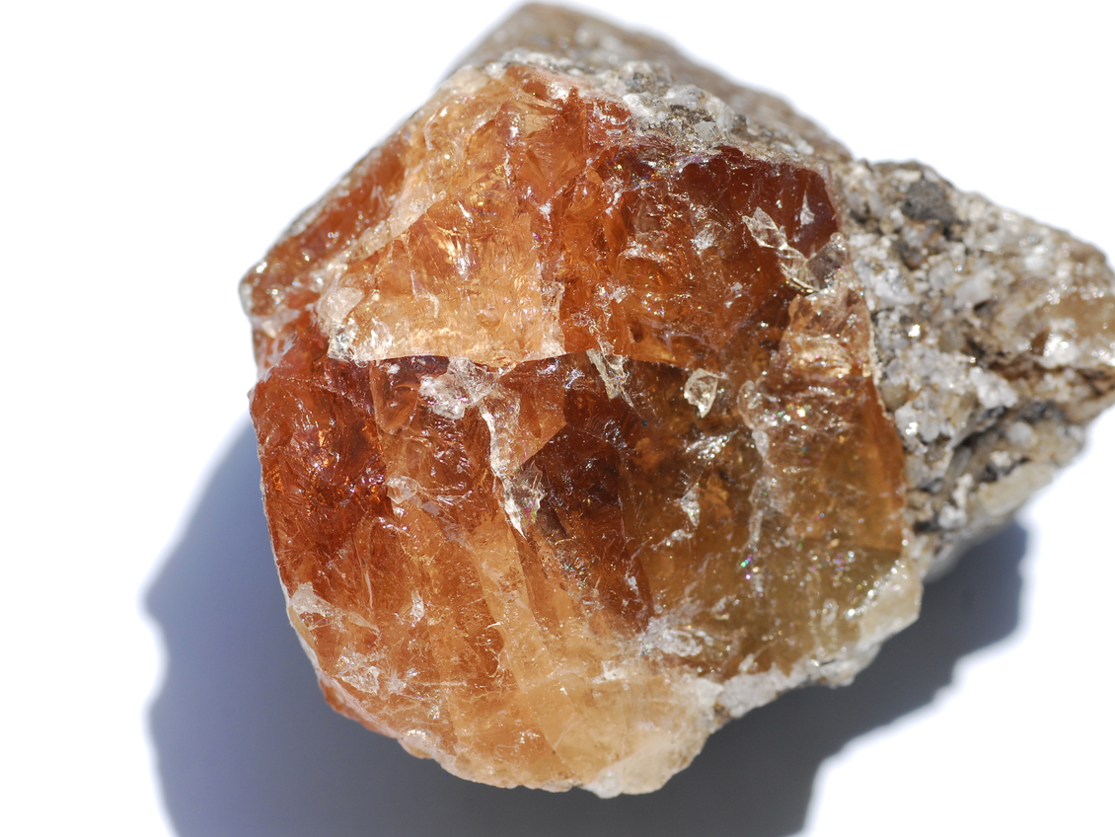
Luster:
Vitreous
Resinous

Slide 5
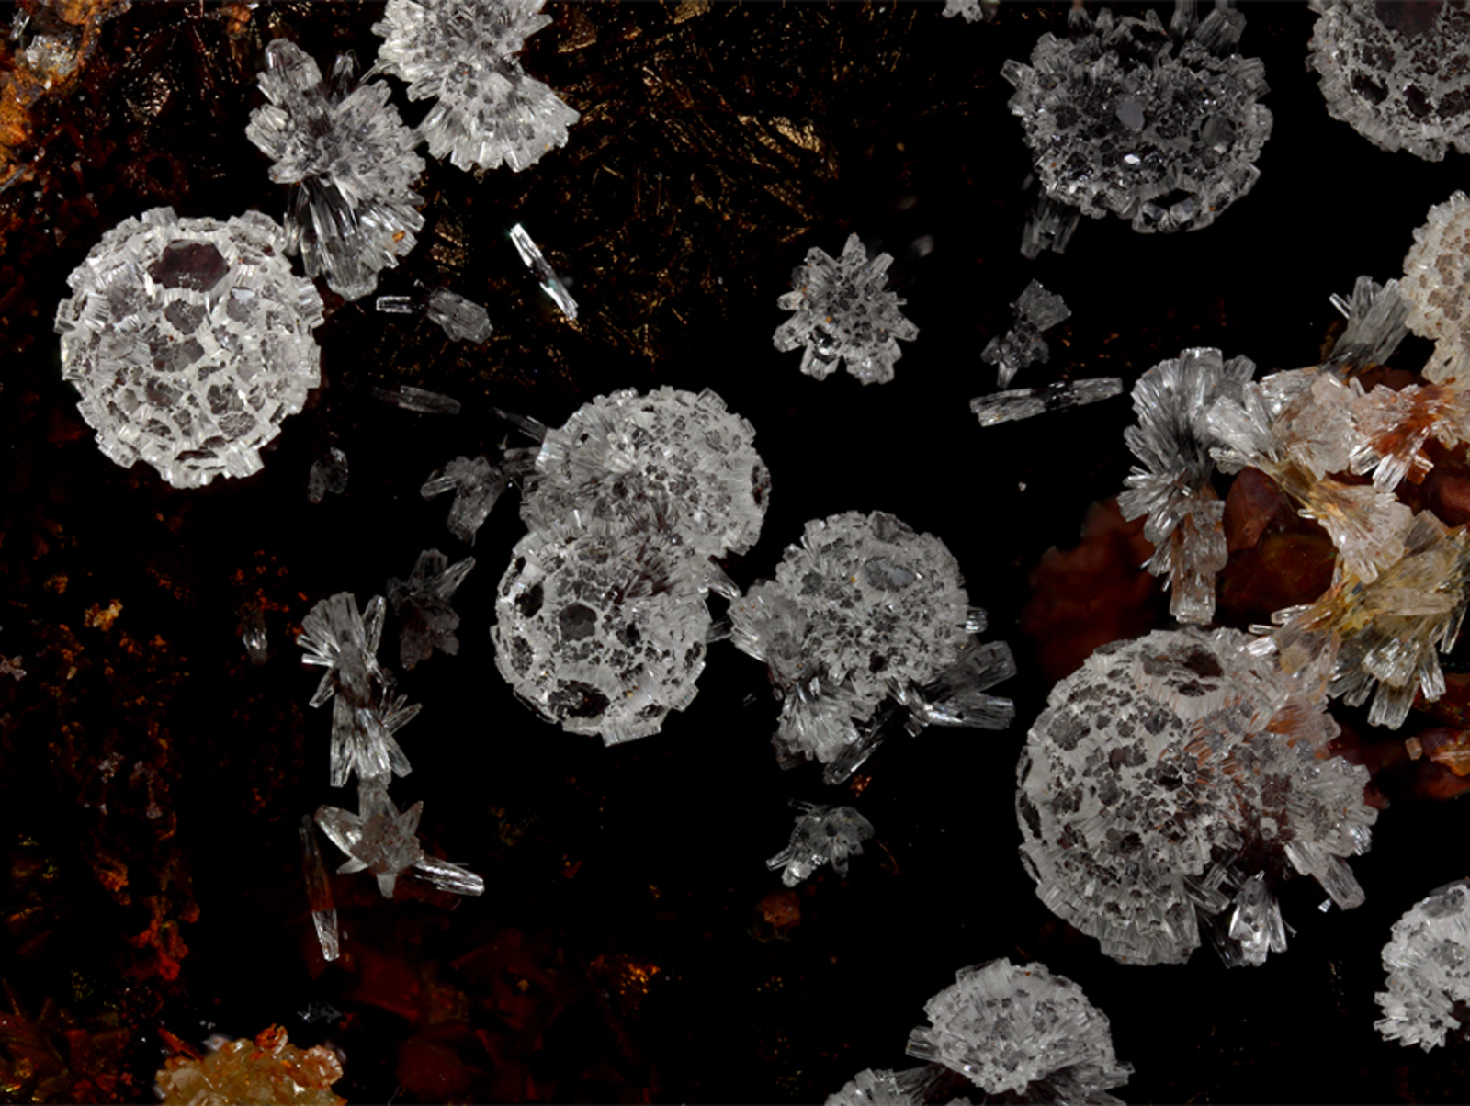
Transparency:
Transparent
Translucent

Slide 6
Important information:
White Streak
5 ½ on the Mohs hardness scale
Brittle tendency
Cleavage is considered good to poor {1120} and poor {0001}
Irregular/uneven, sub-conchoidal fracture
Main use as zinc ore

Slide 7
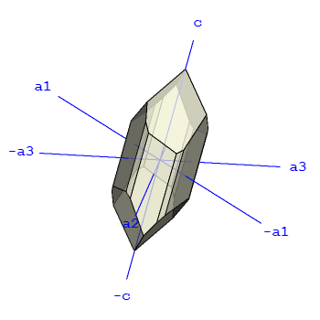
Chemical Properties:
Common Impurities include:
Al, Fe, Mn, Pb, Mg, Ca
Crystallography:
Trigonal
Rhombohedral

Slide 8
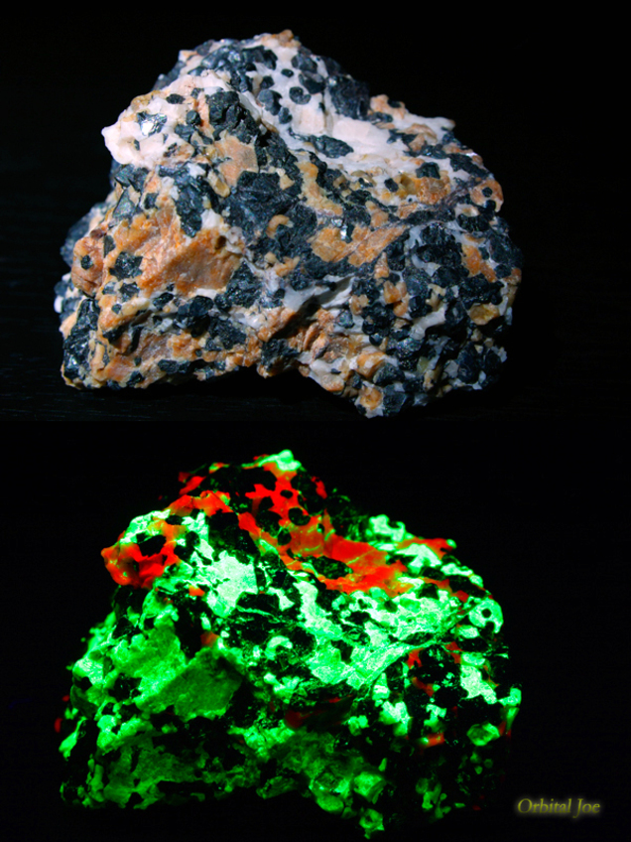
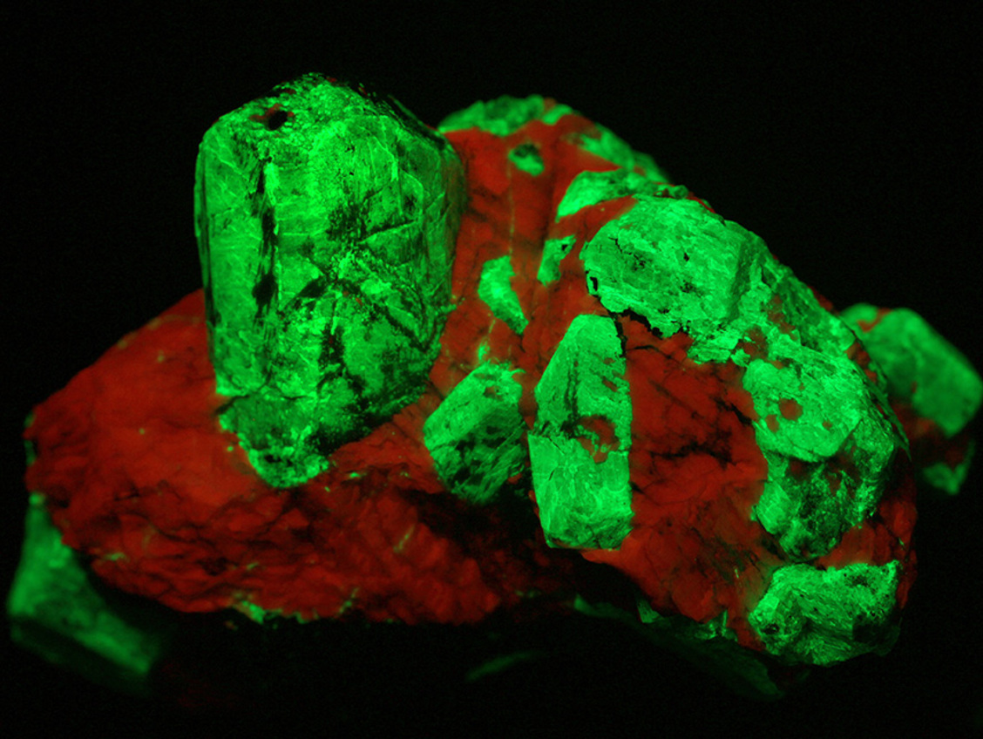
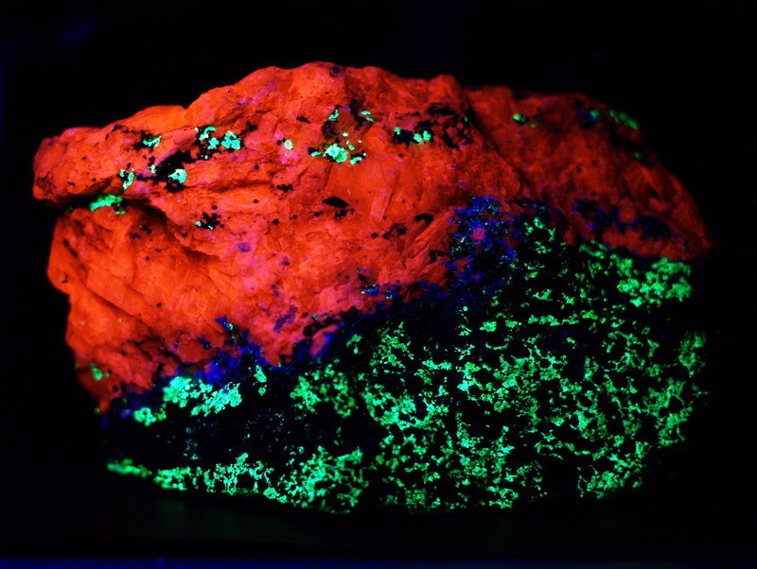
Florescence:
.

Slide 9
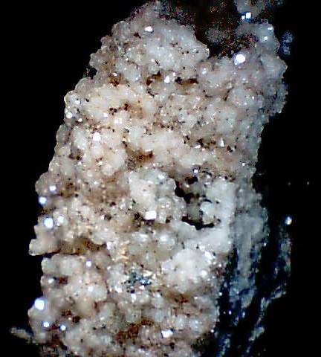
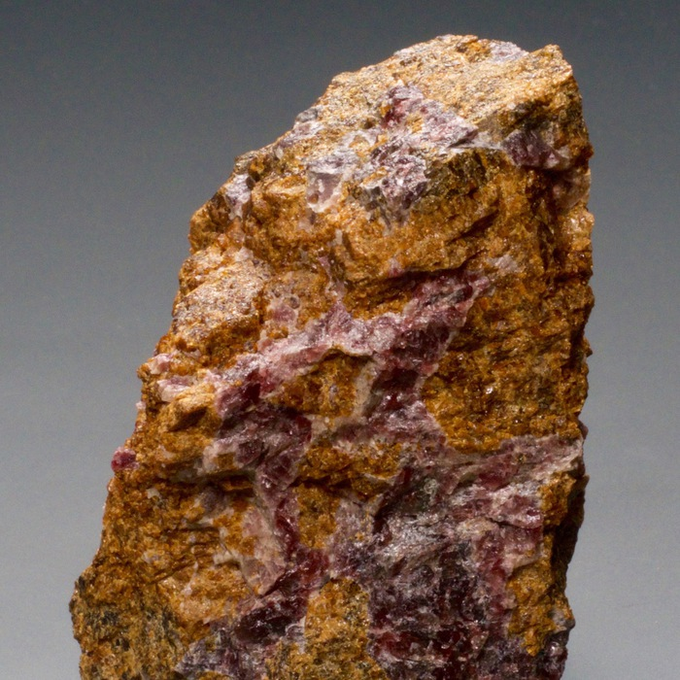
Variations:
Beta-Willemite
Grape Willemite
Radial Willemite

Slide 10
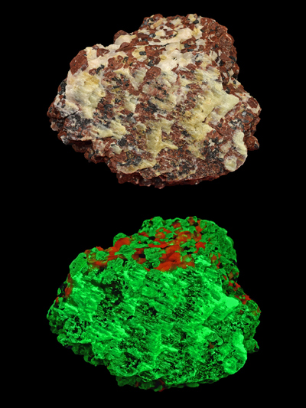
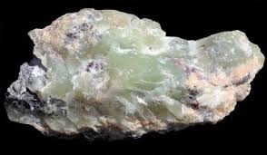
Xingshaoite
Sea-foam willemite
Troostite
Zn₂SiO₄
(Zn,Co)₂SiO₄
(Zn,Mn)₂SiO₄

Slide 11
Where does Willemite come from?!?!?

Slide 13
References:
https://www.mindat.org/
http://webmineral.com/crystall.shtml#.XfElfOhKhPZ
https://en.wikipedia.org/wiki/Willemite

