Slide 1
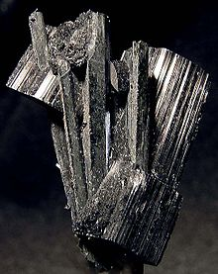
Arfvedsonite
Stefanie Sganga
Earth Materials I

Slide 2
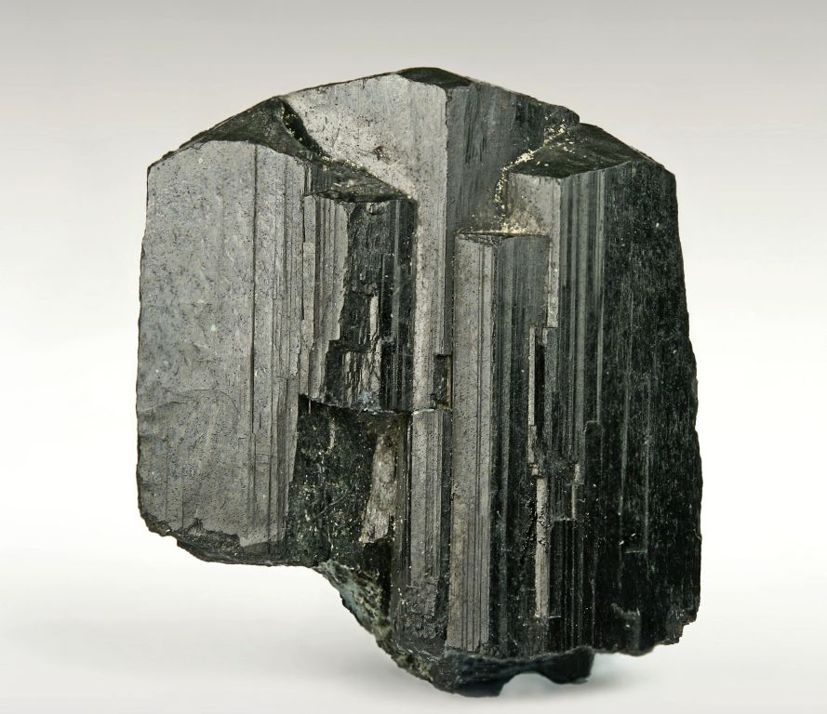
General Information
Rare mineral
Only formed in iron-rich igneous intrusions associated with nepheline syenites and pegmatites
Igneous intrusions – magma cools and solidifies before reaching the surface
Limited in areas globally
Discovered in 1823
Named after Swedish chemist Johan Arfwedson
Discovered Lithium

Slide 3
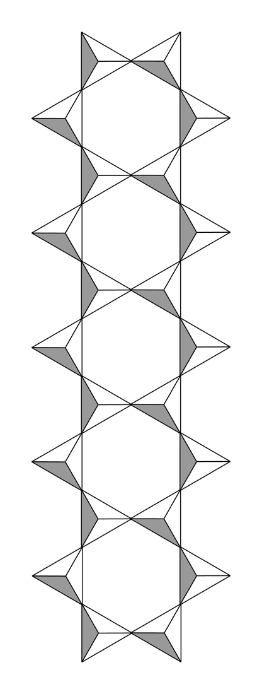
Chemical Formula and Structure
[Na][Na₂][Fe²⁺₄Fe³⁺]Si₈O₂₂(OH)₂
Amphibole mineral (double chain structure)
Iron – rich sodium silicate
Part of solid solution series
Other end member is magnesio-arfvedsonite
Magnesium rich

Slide 4
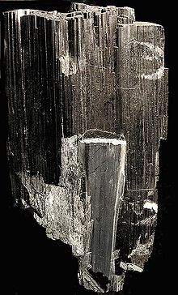
Physical Properties
Color can be bluish black, black, or greenish black
Luster tends to be vitreous
Nonmetallic
Streak is dark bluish gray or gray-green

Slide 5
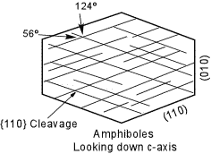
Physical Properties
Hardness between 5 and 6 on Mohs Scale
Crystal habit varies
Fibrous, prismatic, or tabular
Perfect prismatic cleavage {110}
56° and 124° angles

Slide 6
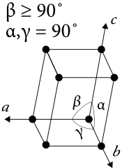
Crystallography
Monoclinic
All axes unequal lengths
2 axes are perpendicular to each other (90°)
1 axis at angle larger than 90°

Slide 7
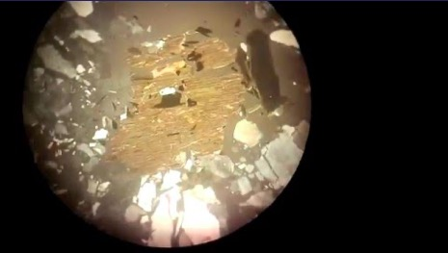
Optics
Biaxial
2 optic axes
Strong pleochroism
Changes to yellow-browns, blue-greens, or gray-violets
Birefringence
Low color order

Slide 8
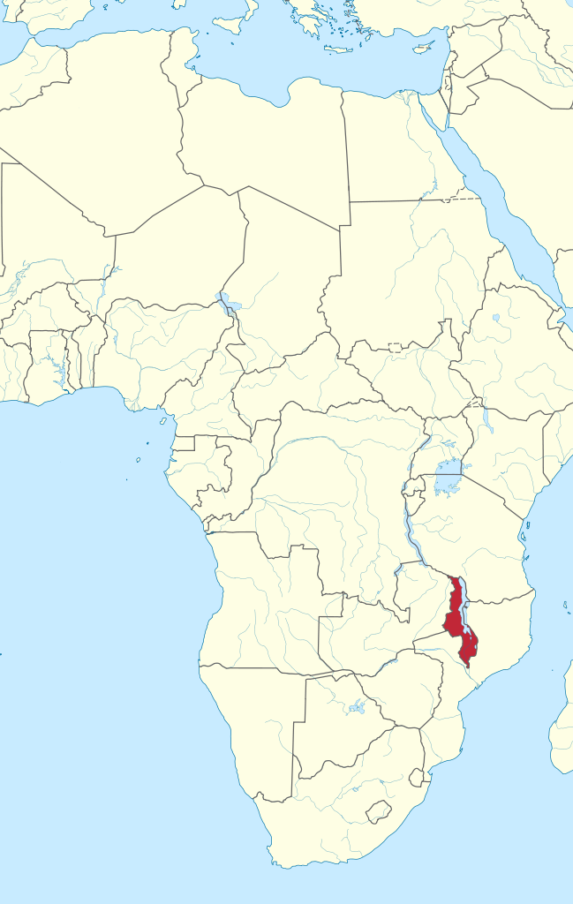
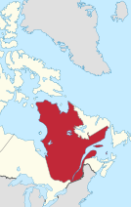
Locations
Found in Southern Africa
Zomba, Malawi
Found in Quebec, Canada
Iron-rich igneous intrusions

Slide 9
Works Cited
https://www.britannica.com/science/arfvedsonite
https://www.mindat.org/min-325.html
http://webmineral.com/data/Arfvedsonite.shtml#.Xc7cfjJKh-U
https://www.minerals.net/mineral/arfvedsonite.aspx
https://www.youtube.com/watch?v=ZDqecHKhhFA

