Slide 1
Malachite
MEGHA SUDHEENDRA
EARTH MATERIALS I

Slide 2
What is malachite?
Copper ore
Very important in history
Frequently found as a pseudomorph of after azurite
Light to dark green swirls, due to water content being highly concentrated (stalactites in caves)

Slide 3
Physical properties
Formula: Cu₂(CO₃)(OH)₂
Luster: Vitreous, Silky, Earthy
Hardness: 3½ - 4
Specific Gravity: 3.6 - 4.05
Crystal System: Monoclinic
Cleavage: Perfect
Fracture: Uneven/poor
Morphology: Crystals uncommon, usually short or long prismatic or acicular. Can be fibrous. Almost always twinned structure

Slide 4
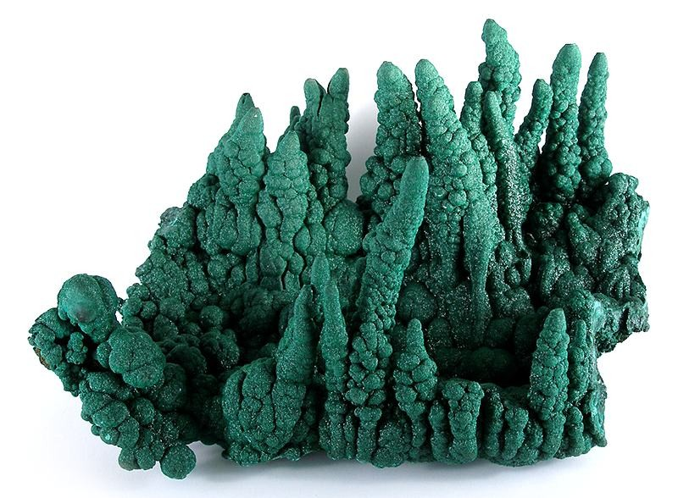
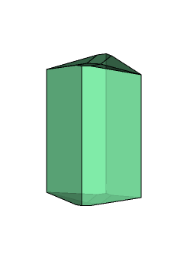
crystallography
MONOCLINIC crystal structure
- Class (H-M): 2/m - Prismatic
Can be found as banded and crusted over/in close proximity to Azurite or Cuprite
can be found as botryoidal (literally meaning bunch of grapes) pictured to the right
Can crystalize as acicular/prismatic

Slide 5
Optical data
Type: Biaxial (-)
RI Values: n_{α} = 1.655 n_{β} = 1.875 n_{γ} = 1.909
2V: Measured: 43° , Calculated: 38°
Surface Relief: Very High
Dispersion: relatively weak
Pictured: birefringence interference color range (30µm) (does not take into account mineral coloration)

Slide 6
Found in multiple locations
Chile
Germany
Egypt
Israel
Russia
Democratic Republic of Congo
Australia
France
Arizona
Mexico

Slide 7
History and cultural significance
Ancient mineral – Ancient Egyptians used this has jewelry/makeup to line their eyes/eye shadows as it is an anti-inflammatory mineral
Used for healing purposes and protecting from evil spirits in some cultures
Constantly mined – goes very very far back in human history as one of the first carbonate copper ores mined (as early as 4000 B.C.)
Unfortunately, a lot of the world is being depleted of its’ malachite resources ☹

Slide 8
REFERENCES
“Malachite.” Malachite: Mineral Information, Data and Localities., www.mindat.org/min-2550.html.
“Malachite.” CrystalAge.com, www.crystalage.com/online_store/stone_type/malachite.cfm.
F. Girgsdies, Behrens, M. (2012) On the structural relations of malachite. II. The brochantite MDO polytypes. Acta Crystallographica B68: 571-577
Lang (1864) Philosophical Magazine and Journal of Science: 28: 502.
Anthony, J.W., Bideaux, R.A., Bladh, K.W. and Nichols, M.C., Eds. Handbook of Mineralogy, Mineralogical Society of America, Chantilly, VA 20151-1110, USA. http://www.handbookofmineralogy.org/ (2016)

