Slide 1
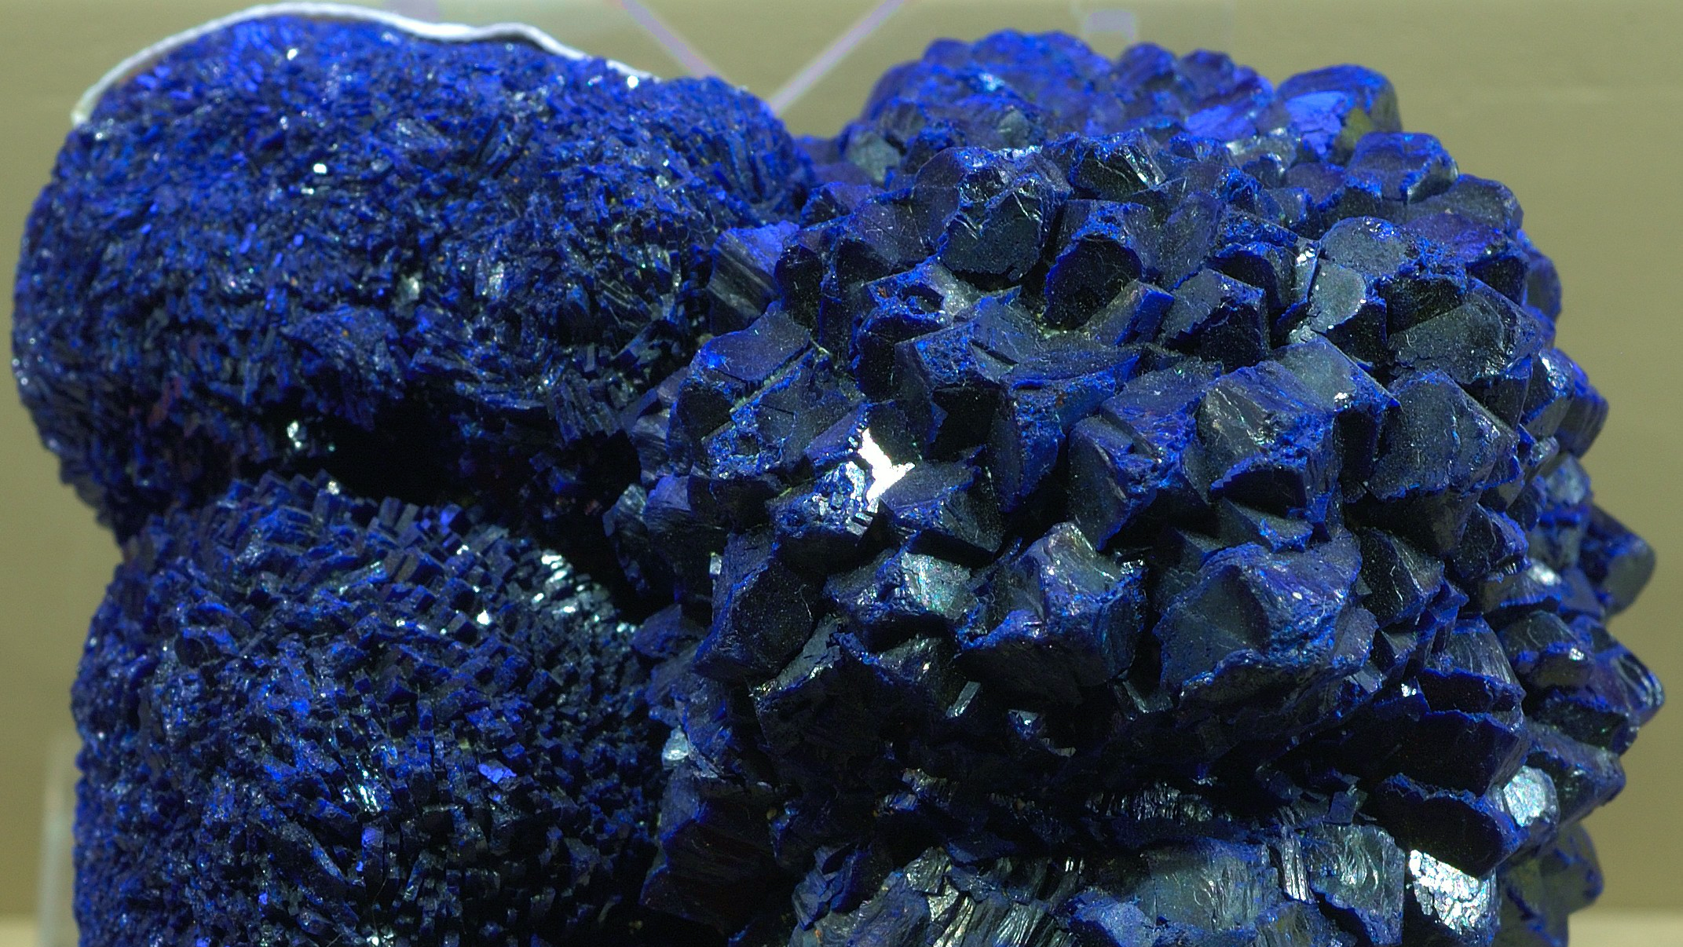
Azurite Cu₃(CO₃)₂(OH)₂
By: Marileidy Tejeda

Slide 2
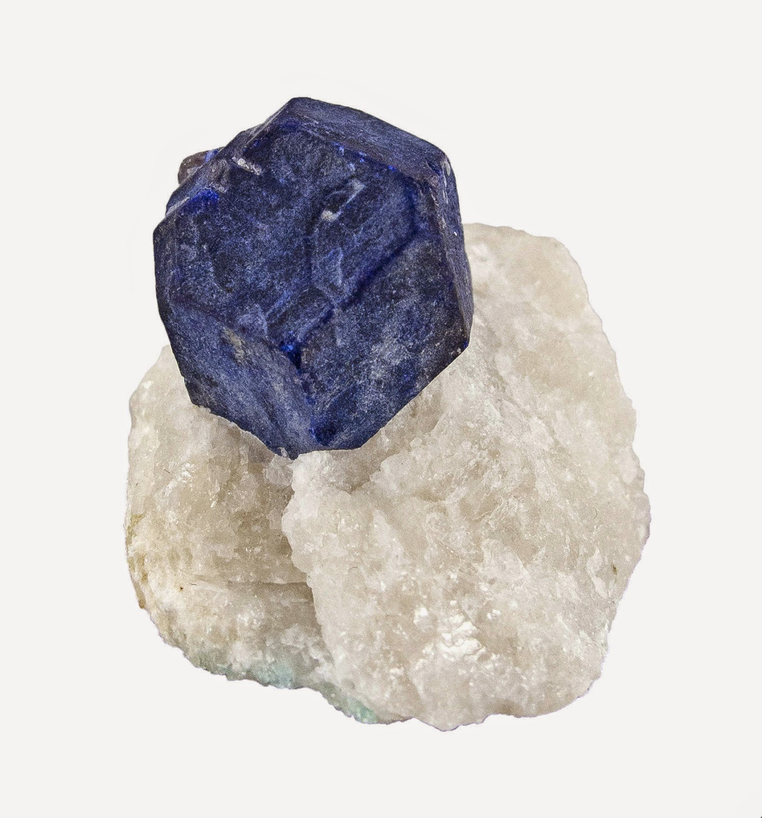
Background
Names: Chessylite, Azurite
Named by Chessy-les-Mines in France.
&
Lazhward, an area in Persia known for deposits of a blue mineral and stone.
Approved ‘Grandfathered”, named in 1824
Lazurite on marble

Slide 3
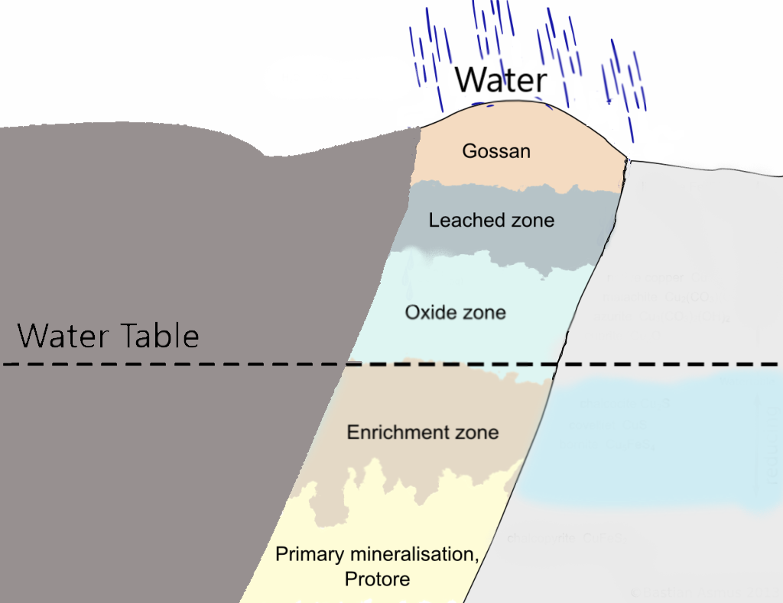
Formation
Super-gene enrichment- base of oxidation
Chalcopyrite weathering
https://geologyuniverse.com/gossan/

Slide 4
Azurite sites

Slide 5
Mineral Properties
Azurite on calcite from Hungary
Light or dark blue color
Light blue streak
H= 3.5-4
SG= 3.77
Vitreous luster

Slide 6
Mineral Properties
Transparent/Translucent
Brittle
Perfect cleavage
Conchoidal fracture
None fluorescent
Prismatic, tabular, stalactitic & massive habit

Slide 7
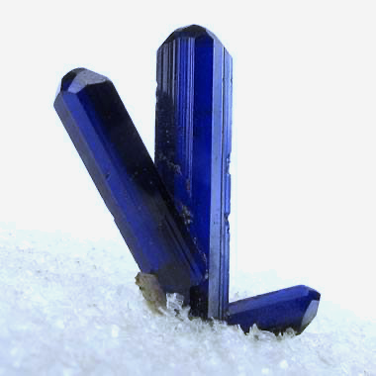
Crystallography & optics
Monoclinic crystal system
Biaxial (+)
Rare twinning
Pleochroic pale to deep blue
Highly refracting
Specimen from Namibia

Slide 8
Uses
Pigments (eyeshadow & paint)
Collection
Jewelry
Minor ore of copper

Slide 9
Other Facts
Slight effervescence with dilute hydrochloric acid
Unstable with-
Heat
Bright light,
Open air

Slide 10
References
https://www.mindat.org/min-447.html
https://www.mindat.org/min-955.html
https://geology.com/minerals/azurite.shtml
https://www.minerals.net/mineral/azurite.aspx
http://geologyscience.com/minerals/azurite/
http://www.handbookofmineralogy.com/pdfs/azurite.pdf
https://geology.com/minerals/chalcopyrite.shtml
http://en.archaeometallurgie.de/gossan-iron-cap/#more-1943
http://www.minsocam.org/ammin/AM49/AM49_1111.pdf
https://www.nationalgallery.org.uk/paintings/hans-holbein-the-younger-a-lady-with-a-squirrel-and-a-starling-anne-lovell
https://www.mindat.org/photo-58046.html

