Slide 1
Tourmaline
by Erica Tran

Slide 2
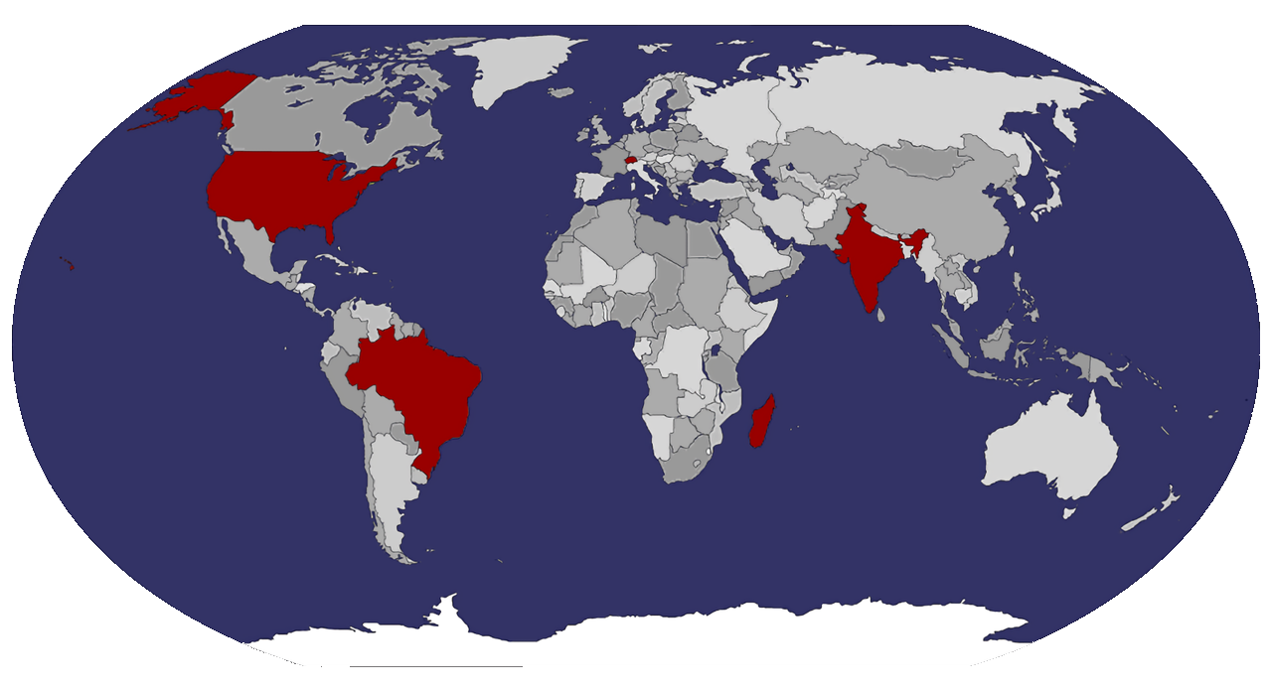
Origins
It is believed that the first tourmalines were discovered by conquistadors in Brazil in the 1500s.
It was in the 1800s when scientists realized these stones were their own species of mineral.
Mined chiefly in:
Brazil
Myanmar
Tanzania
Pakistan
India

Slide 3
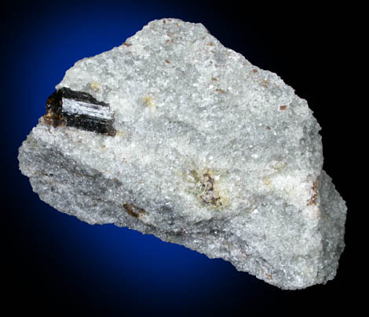
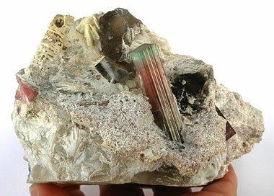
Formation
Tourmaline is formed most often in granite pegmatites
Coarse-grained and containing large crystals
Occurs when magma undergoes a cooling process, but develops from aqueous solutions within the magma.
The host rock around pegmatites that form tourmaline are generally granite, though some species will grow in metamorphic rocks such as marble as well.

Slide 4
Etymology
The name tourmaline comes from the Singhalese word touramalli, meaning “stone with mixed colours”.
Tourmaline has a large variety of hues, and is a highly diverse mineral group composed of 32 currently known species.

Slide 5
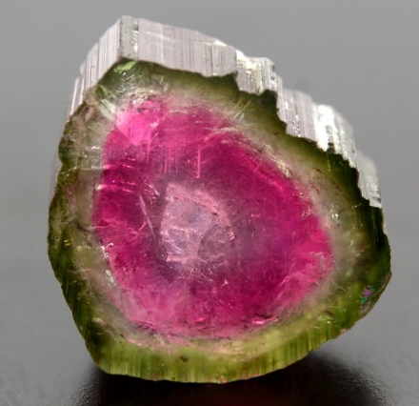
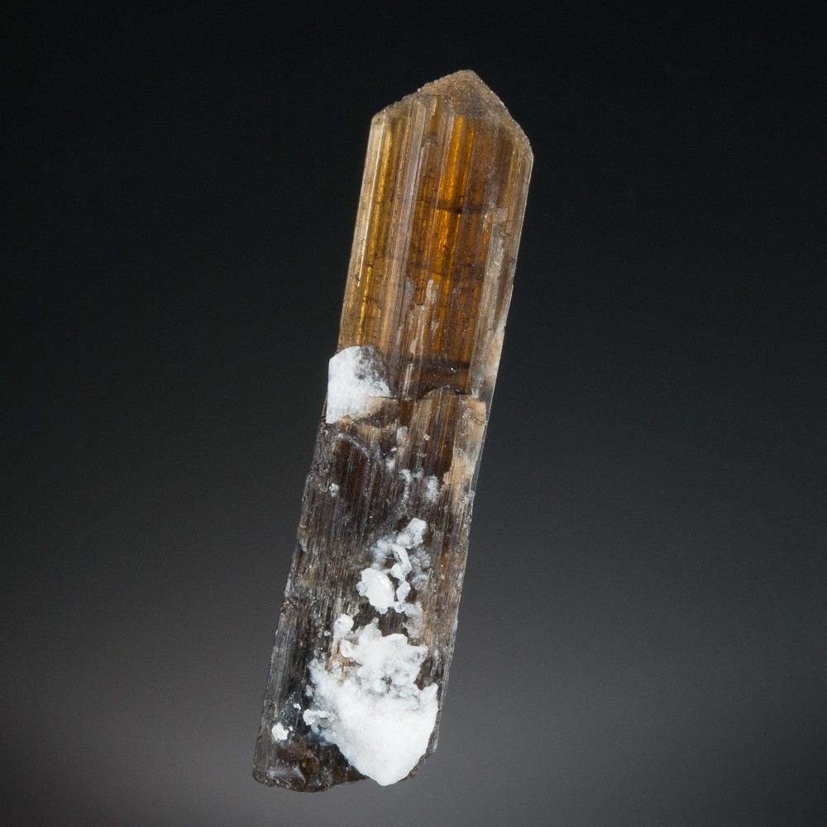
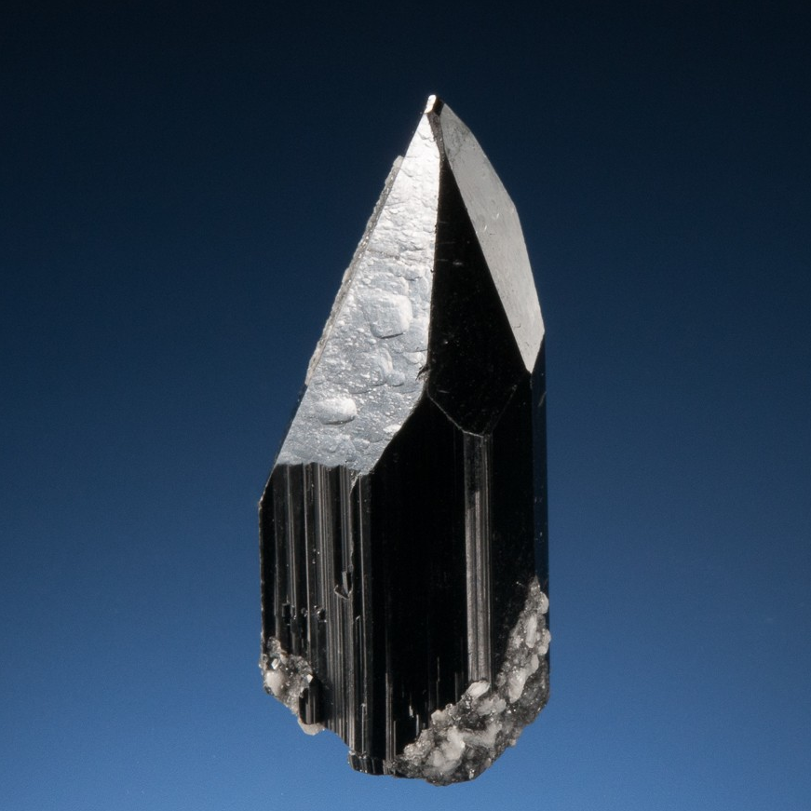
Main Species of Tourmaline
Elbaite
Dravite
Schorl
A sodium lithium aluminium tourmaline species.
A sodium magnesium aluminum tourmaline species
A sodium iron aluminum tourmaline species
Most common variety. of gem-quality tourmalines. Allochromatic, and occur in granite-containing pegmatites.
Varies from brown to yellow. Not often used in jewelry, as many varieties of it are dull in appearance.
Typically black and rich in iron. Rarely used as a gem, though popular in mourning jewelry. idiochromatic.

Slide 6
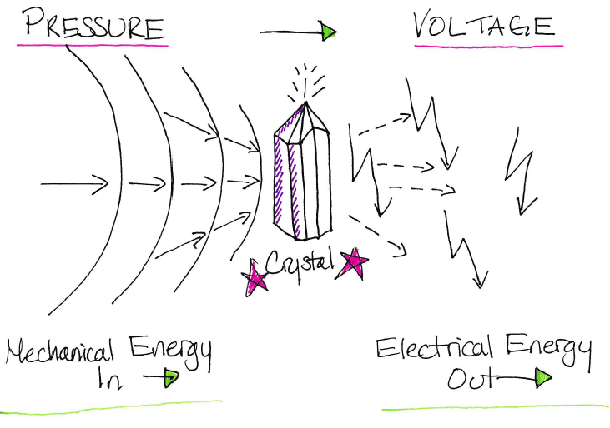
Physical Properties of Tourmaline
Hardness
Crystal System
Optic Axis
Streak
Luster
Electricity
7-7.5
Trigonal, often linked by rings
Uniaxial
White
Vitreous, pleochromatic and also chatoyancy
Piezoelectric and pyroelectric

Slide 7
Chemical Composition
X
Y
Z
Ca, Na, K
Li, Mg, Fe, Mn, Zn, Al, Cr, V, Fe, Ti
Mg, Al, Fe, Cr, V
XY₃Z₆(T₆O₁₈)(BO₃)₃V₃W
T
B
Si, Al, B
B, vacancy
Elbaite: Na(Li_{1.5},Al_{1.5})Al₆Si₆O₁₈(BO₃)₃(OH)₃OH
Dravite: NaMg₃Al₆Si₆O₁₈(BO₃)₃(OH)₃OH
Schorl: NaFe²⁺₃Al₆Si₆O₁₈(BO₃)₃(OH)₃OH
V
W
OH, O
OH, F, O

Slide 8
Sources
https://www.gemstonemagnetism.com/how_to_page_7.htm
http://www.gemsbrokers.org/gemstone/gems_and_gemology/tourmaline_myths.htm
https://www.gemdat.org/gem-4003.htmll
https://www.gia.edu/tourmaline-description
https://www.minerals.net/mineral/tourmaline.aspx
https://www.mindat.org/min-4003.html
http://www.stonefinder.com/gemstone/brown_gems/tourmaline.html
https://www.sandatlas.org/pegmatite/
http://www.geologyin.com/2018/04/tourmaline-species-and-color-varieties.html
http://www.mcdougallminerals.com/Elbaite-Tourmaline-3.html
http://www.mcdougallminerals.com/Dravite-Tourmaline-3.html
http://www.mcdougallminerals.com/Schorl-Tourmaline-3.html
https://www.gemselect.com/gem-info/cats-eye-tourmaline/cats-eye-tourmaline-info.php

