Slide 1
Underground Geological Storage of CO2
By Lisa Luchford and Rick Butts

Slide 2
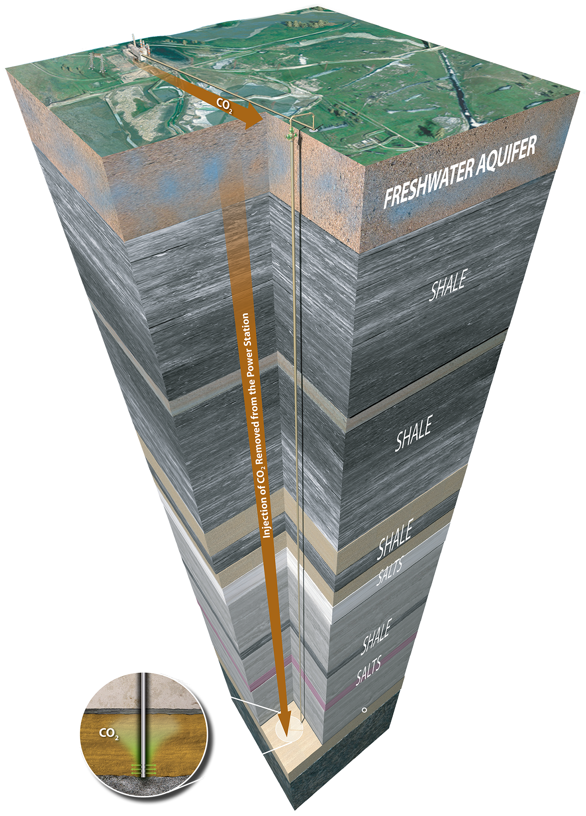
Overview and History
What is geological storage?
  capturing CO2 from major stationary sources, transporting it (often via pipelines) and injecting it into suitable deep rock formations
Vast majority of the world’s carbon is held in coals, oil, gas organic-rich shales and carbonate rocks

Slide 3
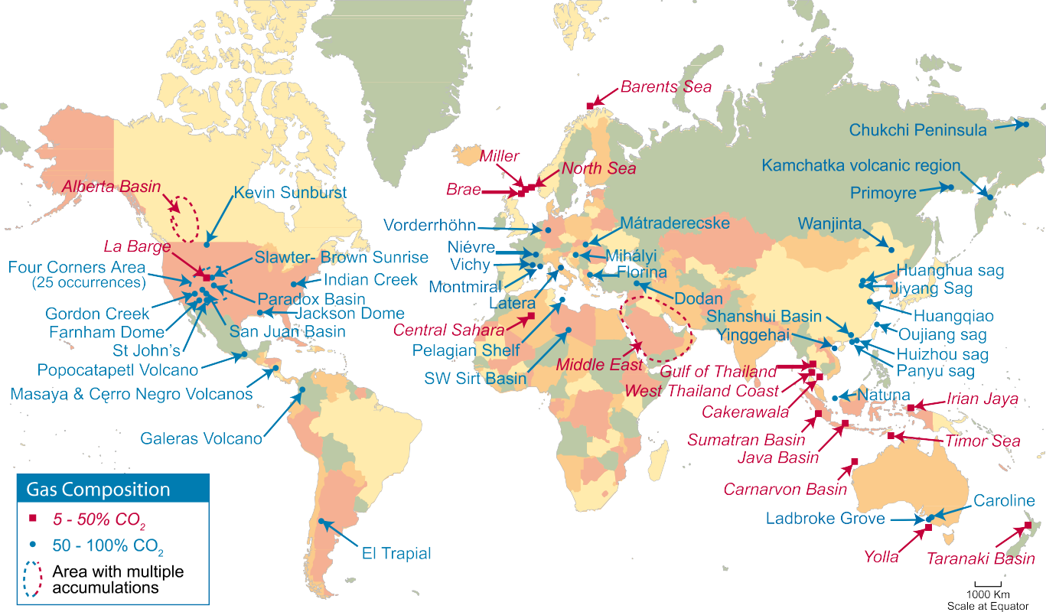
Natural Geological Accumulations of CO2
Figure 5.11 Examples of natural accumulations of CO2 around the world. Regions containing many occurrences are enclosed by a dashed line. Natural accumulations can be useful as analogues for certain aspects of storage and for assessing the environmental impacts of leakage. Data quality is variable and the apparent absence of accumulations in South America, southern Africa and central and northern Asia is probably more a reflection of lack of data than a lack of CO2 accumulations.

Slide 4
Site Selection Criteria
Geological storage sites should have:
adequate capacity and injectivity
a satisfactory sealing caprock or confining unit
a sufficiently stable geological environment to avoid compromising the integrity of the storage site
Criteria for assessing basin suitability:
Basin characteristics → tectonic activity, sediment type, geothermal and hydrodynamic regimes
Basin resources → hydrocarbons, coal, salt
Industry maturity and infrastructure
Societal issues → level of development, economy, environmental concerns, public education and attitudes

Slide 5
Table 5.3 Types of data that are used to characterize and select geological CO2 storage sites.
  Seismic profiles across the area of interest, preferably three-dimensional or closely spaced two-dimensional surveys;
  Structure contour maps of reservoirs, seals and aquifers;
  Detailed maps of the structural boundaries of the trap where the CO2 will accumulate, especially highlighting potential spill points;
  Maps of the predicted pathway along which the CO2 will migrate from the point of injection;
  Documentation and maps of faults and fault;
  Facies maps showing any lateral facies changes in the reservoirs or seals;
  Core and drill cuttings samples from the reservoir and seal intervals;
  Well logs, preferably a consistent suite, including geological, geophysical and engineering logs;
  Fluid analyses and tests from downhole sampling and production testing;
  Oil and gas production data (if a hydrocarbon field);
  Pressure transient tests for measuring reservoir and seal permeability;
  Petrophysical measurements, including porosity, permeability, mineralogy (petrography), seal capacity, pressure, temperature, salinity
  and laboratory rock strength testing;
  Pressure, temperature, water salinity;
  In situ stress analysis to determine potential for fault reactivation and fault slip tendency and thus identify the maximum sustainable pore
  fluid pressure during injection in regard to the reservoir, seal and faults;
  Hydrodynamic analysis to identify the magnitude and direction of water flow, hydraulic interconnectivity of formations and pressure
  decrease associated with hydrocarbon production;
  Seismological data, geomorphological data and tectonic investigations to indicate neotectonic activity.

Slide 6
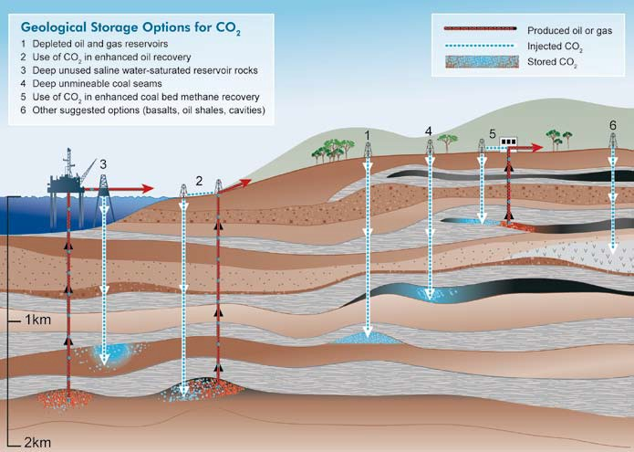
Where do you geologically store CO2?
Can be stored in formations in sedimentary basins:
  Oil fields
  Depleted gas fields
  Deep coal seams
  Saline formations: deep sedimentary rocks saturated with formation waters or brines containing high concentrations of dissolved salts
Can be stored in offshore sites:
  Continental shelf
  Adjacent deep-marine sedimentary basins
  The majority of abyssal deep ocean floor sediments are too thin and impermeable

Slide 7
Where do you geologically store CO2?
Other storage options:
  Salt Caverns
  Basalt
  Organic-rich shales
  Abandoned mines
So far CO2 injections are small-scale
  To significantly decrease emissions from stationary sources, injections need to be done at a much larger scale

Slide 8
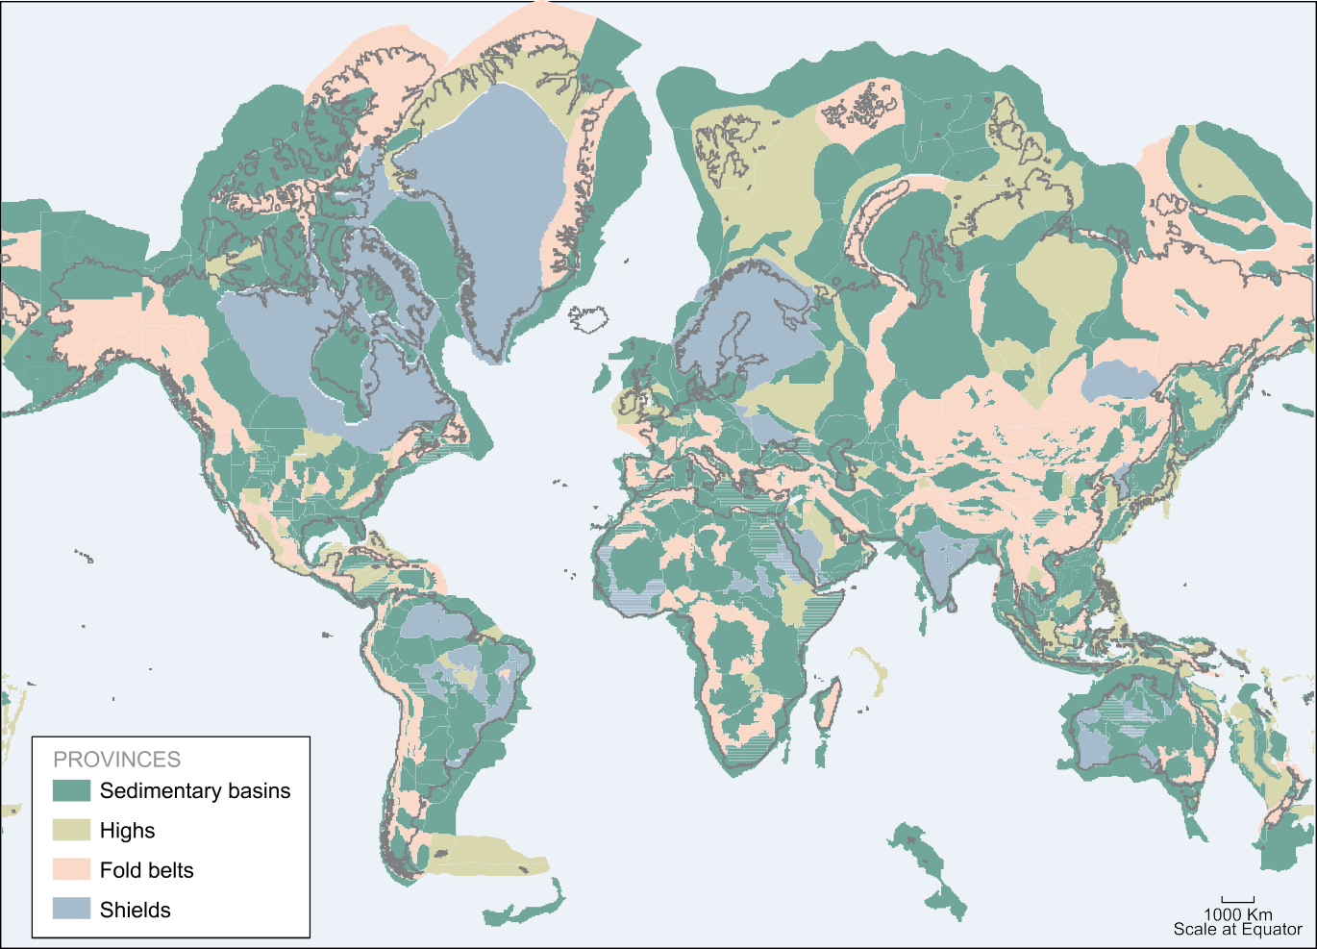
Distribution of Sedimentary Basins Around the World
Figure 5.14 Distribution of sedimentary basins around the world (after Bradshaw and Dance, 2005; and USGS, 2001a). In general, sedimentary basins are likely to be the most prospective areas for storage sites. However, storage sites may also be found in some areas of fold belts and in some of the highs. Shield areas constitute regions with low prospectivity for storage. The Mercator projection used here is to provide comparison with Figures 5.1, 5.11 and 5.27. The apparent dimensions of the sedimentary basins, particularly in the northern hemisphere, should not be taken as an indication of their likely storage capacity.

Slide 9
Primary Flow and Transport Controlling the Spread of CO2
Fluid flow (migration) in response to pressure gradients created by the injection process
Fluid flow in response to natural hydraulic gradients
Buoyancy caused by the density differences between CO and the formation fluids
Diffusion
Dispersion and fingering caused by formation heterogeneities and mobility contrast between CO2 and formation fluid
Dissolution into the formation fluid
Mineralization
Pore space (relative permeability) trapping
Adsorption of CO onto organic material

Slide 10





CO2 Storage Mechanisms in Geological Formations
Physical trapping: structural and stratigraphic
Physical trapping: hydrologic
Geochemical trapping
Caprock (impermeable, confining layer)
Immobile phase in pore spaces
Dissolution in the in-situ formation fluids
Adsorption onto organic matter (i.e. coal and shale)
Reacts with minerals to produce carbonate minerals
CO2 becomes less mobile over time
Figure 5.9 Storage security depends on a combination of physical and geochemical trapping. Over time, the physical process of residual CO2 trapping and geochemical processes of solubility trapping and mineral trapping increase.

Slide 11
Industrial Analogs for CO2 Storage
Natural gas storage
Acid gas injection
Liquid waste injection

Slide 12
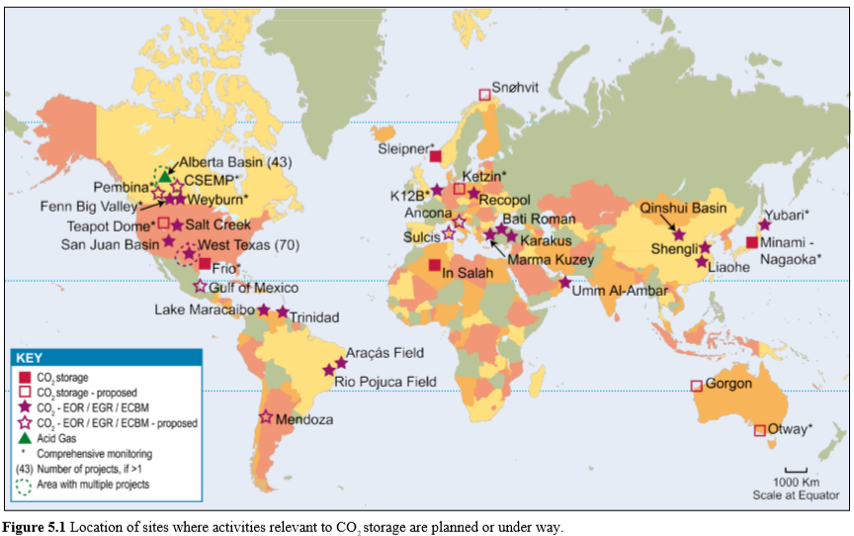

Slide 13
Table 5.2 Storage capacity for several geological storage options. The storage capacity includes storage options that are not economical.
a These numbers would increase by 25% if “undiscovered” oil and gas fields were included in this assessment.

Slide 14
Security and Duration of CO2 Storage in Geological Formations
CO2 can remain trapped for millions of years (as indicated by evidence from oil and gas fields)
World-class petroleum provinces have storage times for oil and gas of 5–100 million years, others for 350 million years
Some minor petroleum accumulations have been stored for up to 1400 million years

Slide 15
CO2 Injection Wells
Important well design considerations:
  Pressure
  corrosion-resistant materials
  production and injection rates
Design very similar to that of a gas injection well in an oil field or natural gas storage project
# of wells depends on:
  total injection rate
  permeability and thickness of the formation
  maximum injection pressures
  availability of land-surface area for the injection wells
Abandonment of wells: brines, hydrocarbons or CO2 could migrate up the well and into shallow drinking water aquifers ( if wells remain open when no longer in use)
Well abandonment/closure prosedures:
  place cement or mechanical plugs in all or part of the well
  Extra care is usually taken to seal wells adjacent to drinking water aquifers

Slide 16
Reasoning
*Ensure that the injection well is working correctly
*Make sure that the CO2 was successfully transferred
*Efficiently store CO2
*Detect any leaks
NIOSH, OSHA, and the EPA use gas chromatography to validate real time measurements of CO2
5.6 Monitoring and verification technology

Slide 17
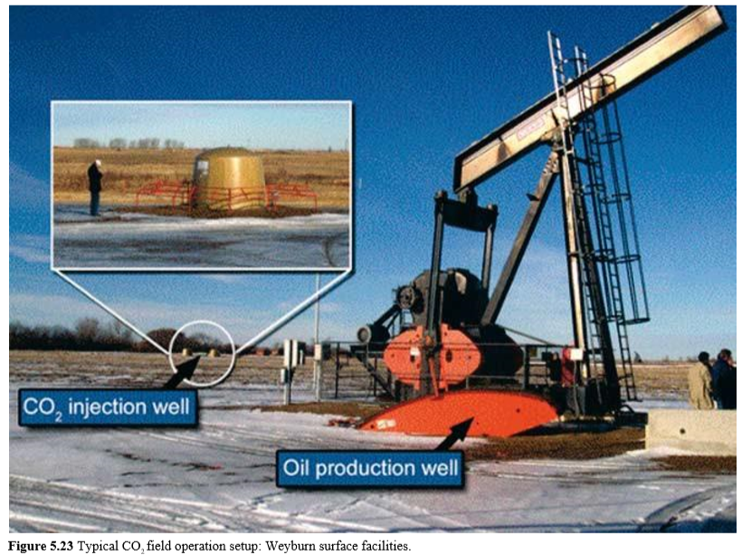
CO2 Storage Project in Weyburn, Canada

Slide 18
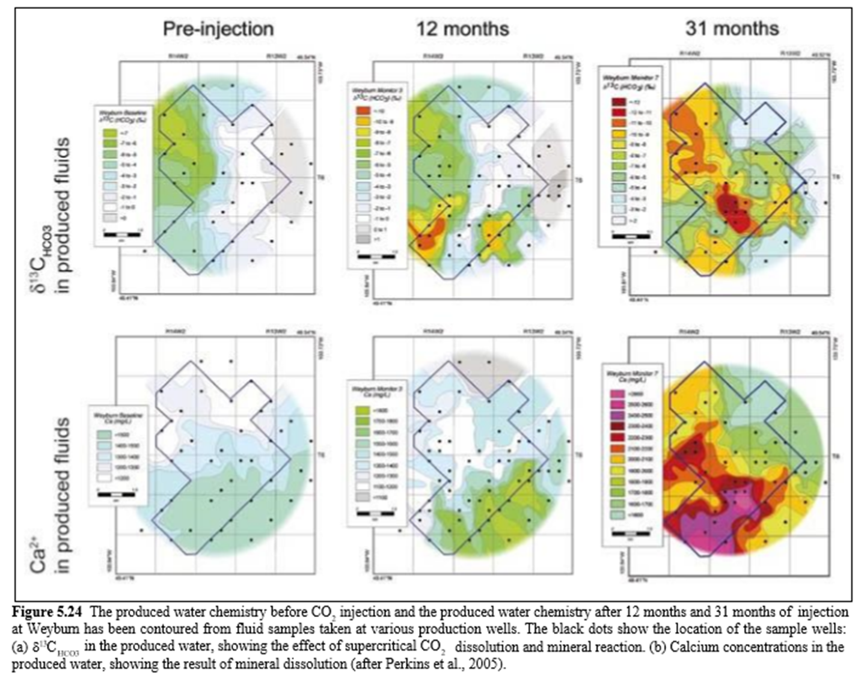

Slide 19
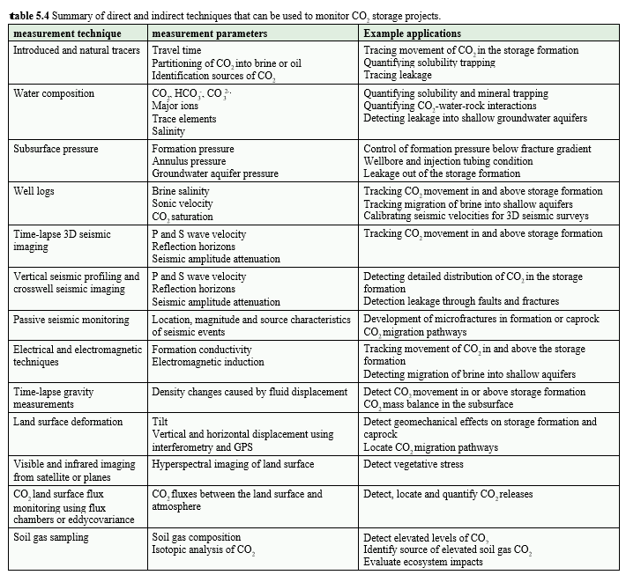

Slide 20
Risk to the environment
Air and groundwater could become contaminated with CO2
CO2 could escape through the pore space and faults in a shale caprock
Probability of CO2 leakage can be assessed
Coal, oil, and natural gas fields have been able to store CO2 over geologic time
I would strongly recommend placing a geological storage site miles away from any buildings, farms, or currently used groundwater and surface water resources.
5.7 Risk management, risk assessment and remediation

Slide 21
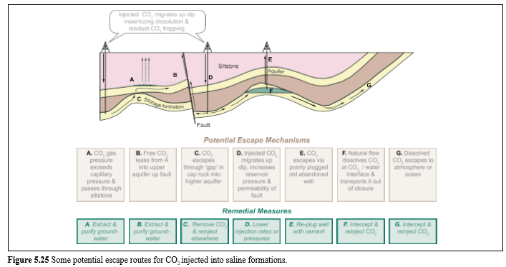

Slide 22
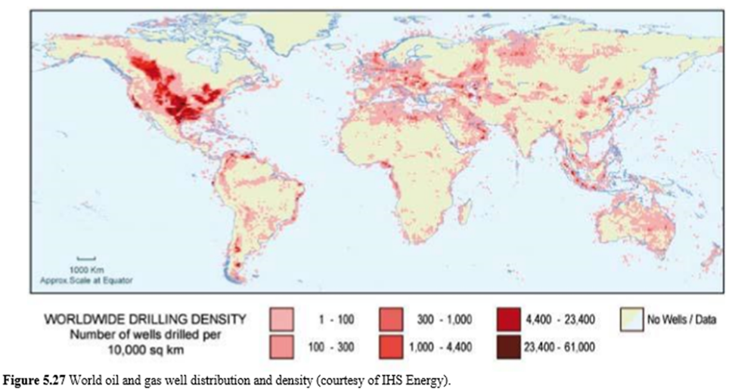

Slide 23
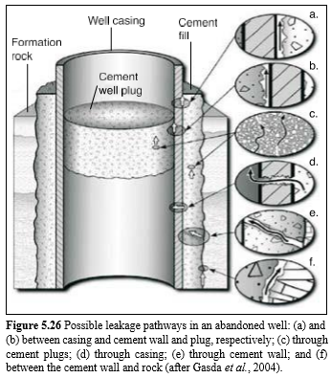

Slide 24
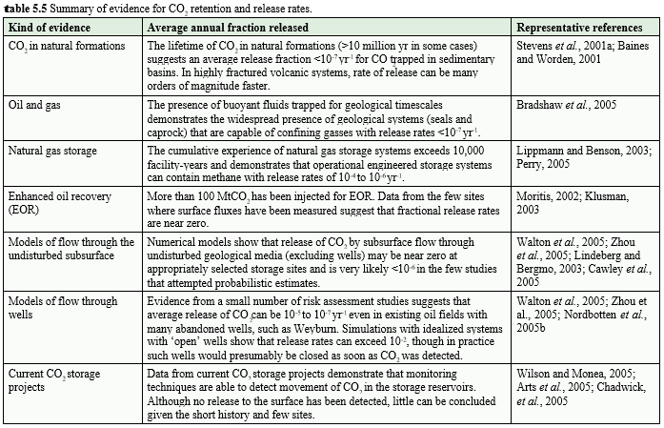

Slide 25
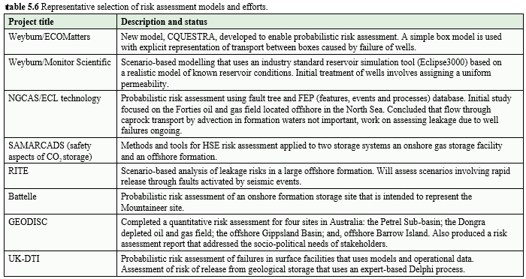

Slide 26
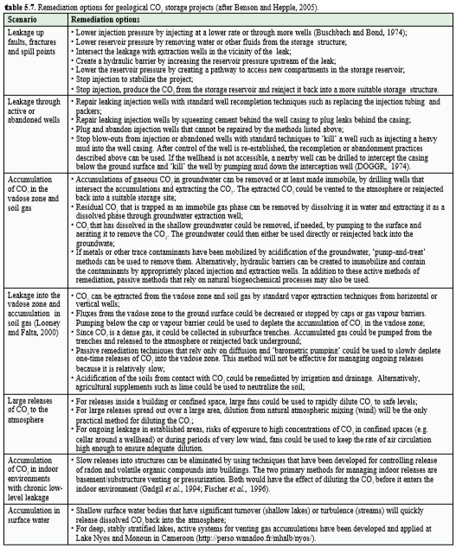
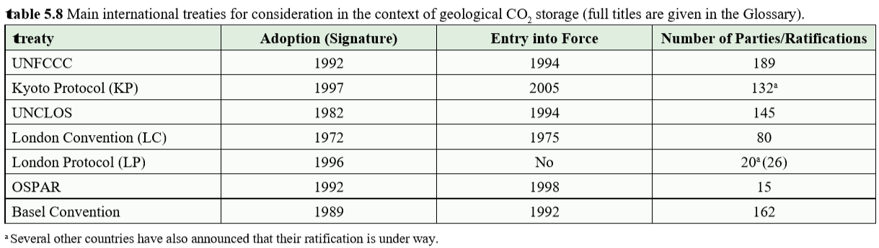
5.8 Legal issues and public acceptance
CO2 geologic storage would have to meet federal regulations. For geologic storage of CO2 to happen, people must consider climate change to be serious and accept the risks and cost of geologic CO2 storage.

Slide 27
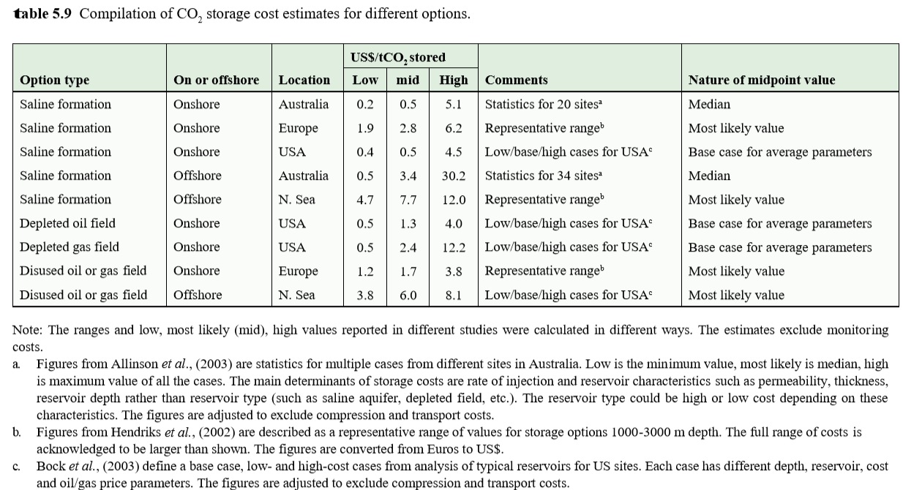
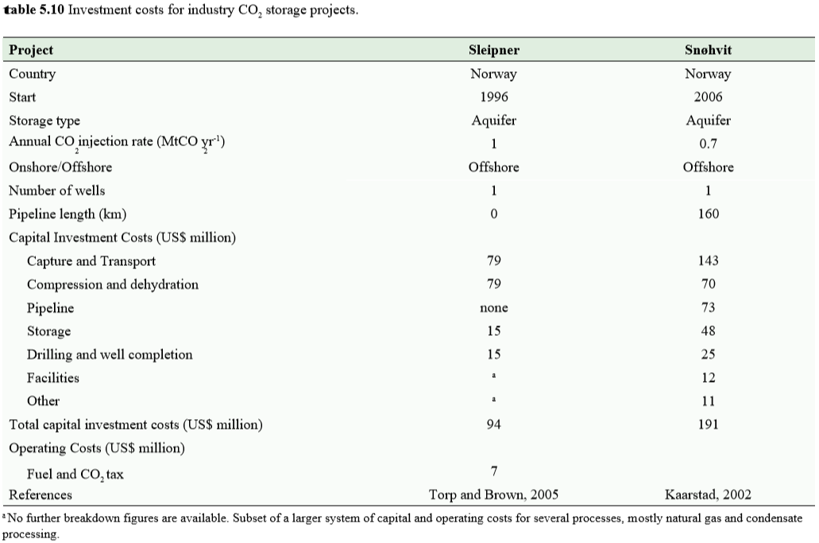
5.9 Costs of geological storage
*Wells can cost between $200,000 onshore and $25 million
*Cost depends on location, technology, and the size of the project
*Cost of CO2 compression increases with depth

Slide 28
“Current storage capacity estimates are imperfect.”
A better understanding is required of kinetics and adsorption of CO2, desorption of CH4 in coal beds
More knowledge about cement degradation CO2 leaks, the amount and area distribution of leaks, effects of bacteria below ground, effects of CO2 in continental shelf storage processes, primary and secondary air-quality long term data
Will the storage be long term?
Availability of monitoring technology
Mitigation and remediation has not yet been done for CO2 geological storage projects
Cost variations and future regulations of liability are unknown
5.10 Knowledge gaps

Slide 29
Literature Cited
Gale,, S. & Thomson,, G. & Zarlenga, Francesco. (2005). Chapter 5 - Underground geological storage.. IPCC Special Report on Carbon Dioxide Capture and Sequestration, Cambridge University Press, 195-265
file:///C:/Users/Richard%20W.%20Butts/Documents/Energy%20and%20Environment/srccs_chapter5.pdf
file:///C:/Users/Richard%20W.%20Butts/Downloads/srccs_chapter5-1.pdf
http://faculty.uml.edu/nelson_eby/ENVI.5720/Material.htm
https://www.researchgate.net/publication/329707783_Capter_5_-_Underground_geological_storage
https://www.researchgate.net/publication/329707783_Capter_5_-_Underground_geological_storage/citation/download

