Slide 1
By Lea Richter, Tyler Lagasse, and Marquise Meda

Slide 2
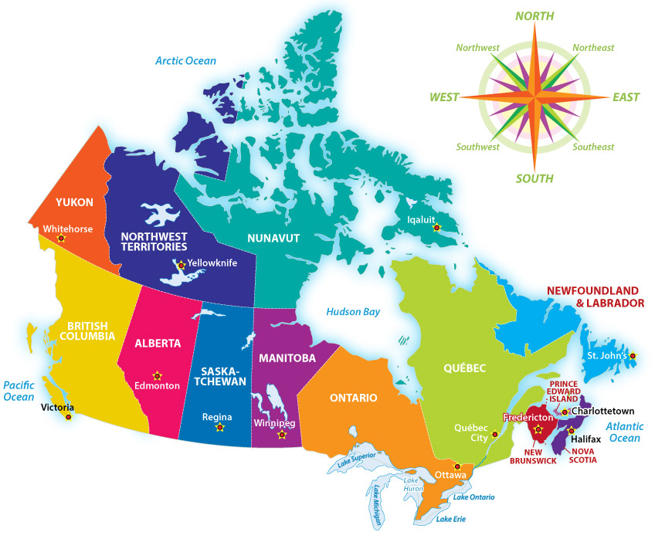
CANADA
36 million people increasing at 0.9% annually
2nd largest country by area in the world
4th in the world for natural resources
8th largest emitter in the world (2016)
https://www.statcan.gc.ca/eng/start

Slide 3
Outline
Production
Electricity Production
Fossil fuels – petroleum, oil, natural gas
Renewables and Nuclear
Consumption
Sectors
Renewable vs. Non-Renewables
Paris Agreement and the Future of Canadian Energy

Slide 4
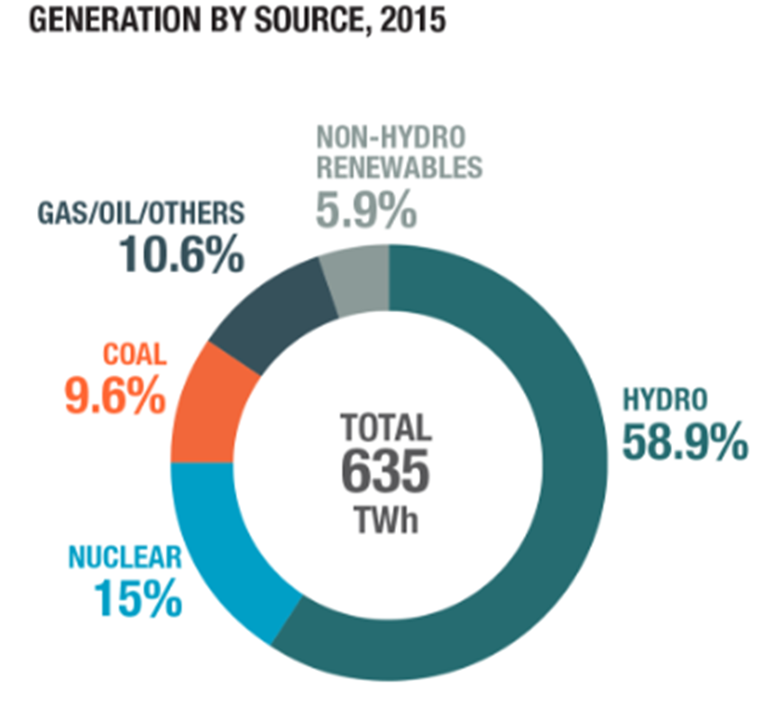
Electricity Production
Total: 625 TWh
Hydroelectricity – 374TWh (2nd largest producer in the world; 3% of world generation)
Nuclear – 95.25 TWh
Coal – 60.96 TWh
Gas – 67.31 TWh
65% comes from Renewables
www.iedm.org/sites/default/files/web/page_files/booklet-energy0314.pdf.

Slide 5
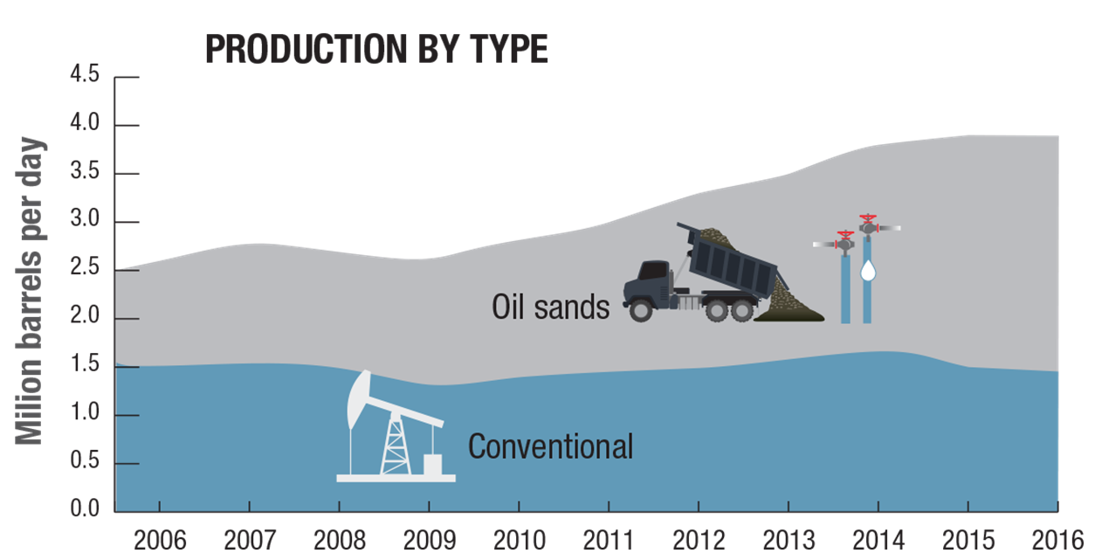
Crude Oil Resources
5th largest producer
4th largest exporter
97% to United States
Oil sands
Increasing since 2006
Peaked at 2.42 million barrels/day
Conventional Oil:
Decrease since 2014
1.5 million barrels/day
5 Main oil companies: Suncor, Canadian Natural Resources Limited, Imperial Oil, Husky, Cenovus
www.nrcan.gc.ca/energy/facts/electricity/20068.

Slide 6
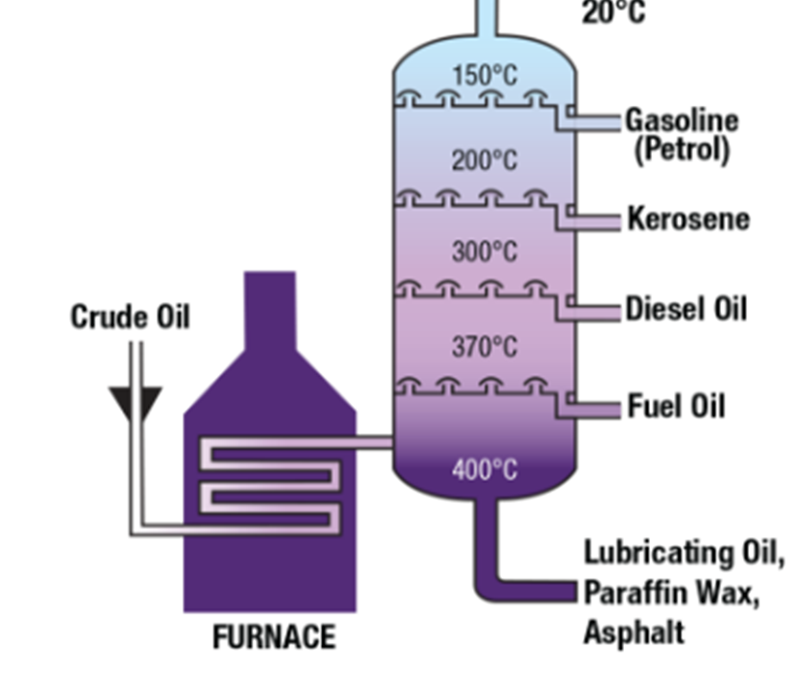
Petroleum Reserves
Canadian Refineries process 1.9 million barrels/day
Leads to fueling of transport
Gas, Diesel, Aviation
13% petroleum is imported
Transportation Fuels (gasoline, diesel, heavy fuel oil, aviation, fuelage)
Liquid Petroleum Gases (propane, butane)
Petrochemical feedstocks (synthetic rubber)
www.nrcan.gc.ca/energy/facts/electricity/20068.

Slide 7
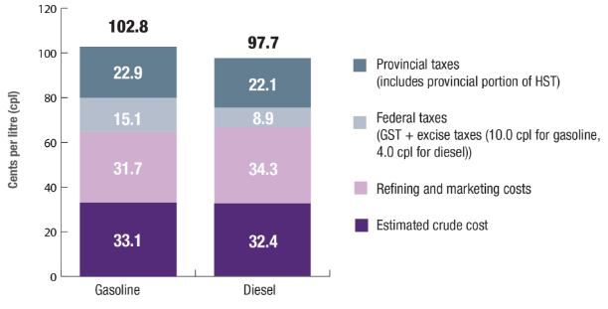
Petroleum Reserves (cntd.)
Petroleum Reserves

Slide 8
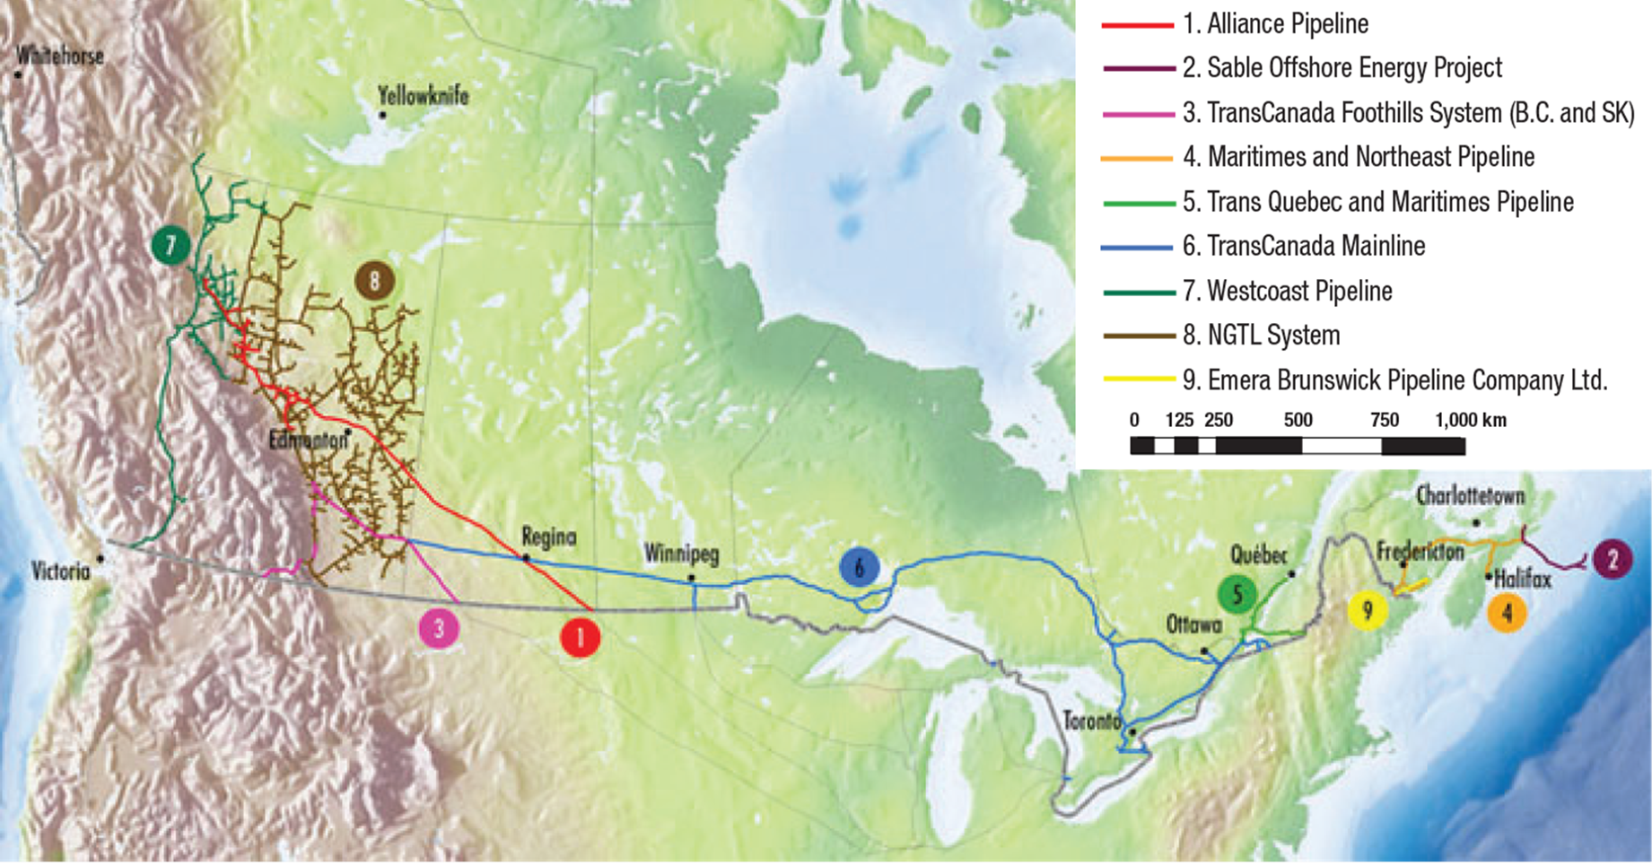
Natural Gas and TransCanada Pipelines
Natural Gas Composition: methane, propane, butane, pentane
Fourth Largest Producer:
15.4billion ft³/day (5% of world total)
Several hundred companies engage in exploration drilling and and production of raw natural gas
Pipeline distribution companies that receive natural gas and distribute it (Keystone Pipeline)

Slide 9
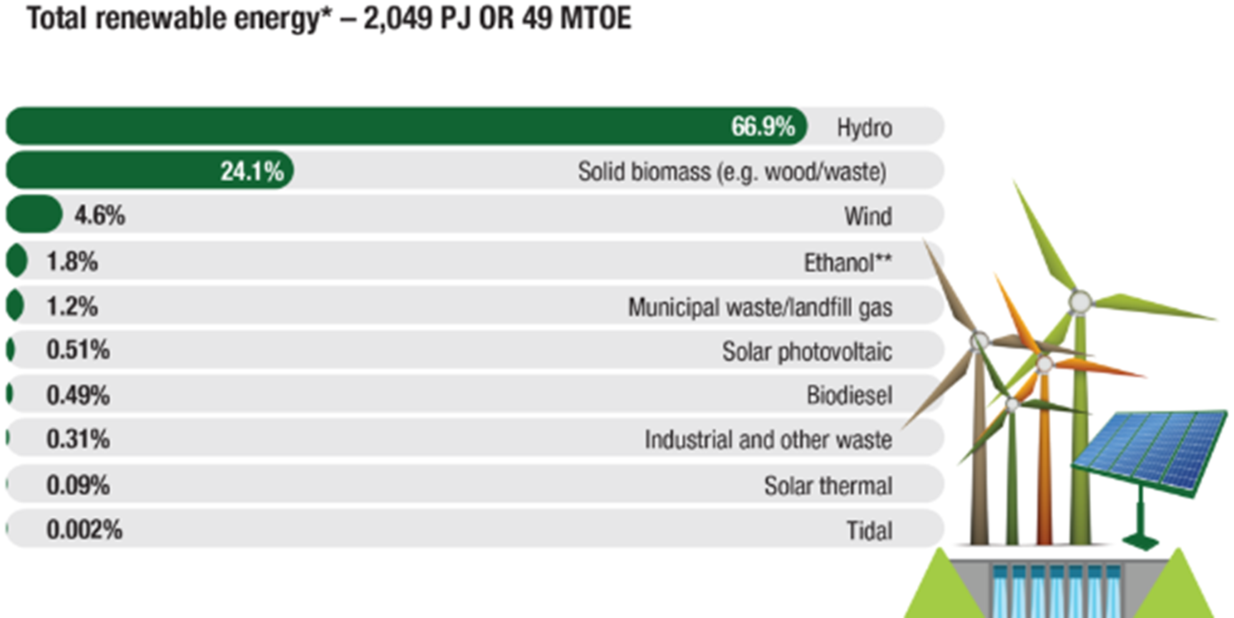
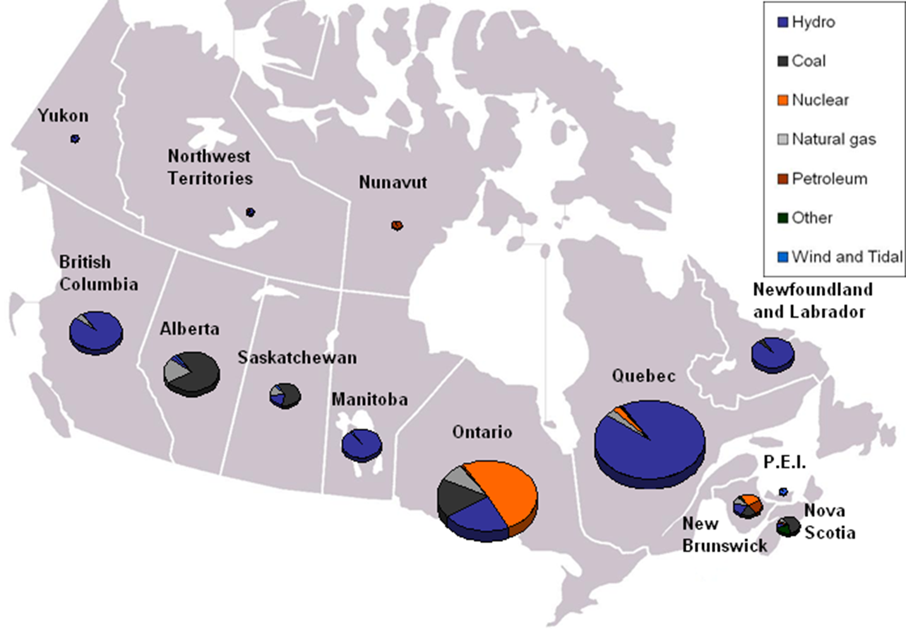
Renewable Energy - Hydroelectricity
Total renewable electricity: 18%
66% of Renewable Energy Available = Hydro
www.iedm.org/sites/default/files/web/page_files/booklet-energy0314.pdf.

Slide 10
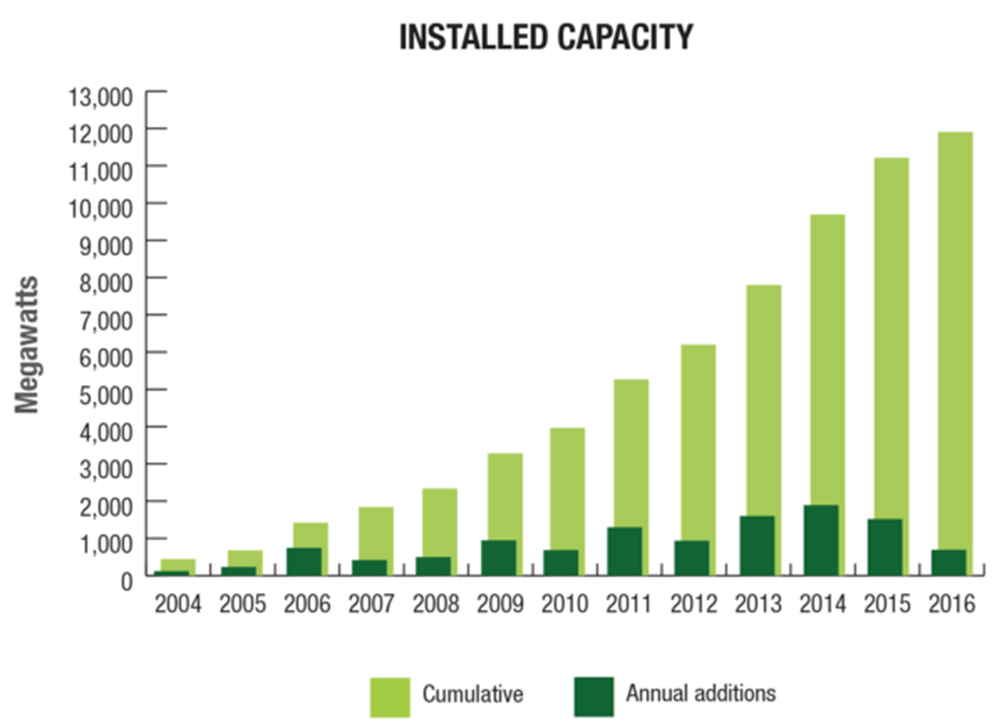
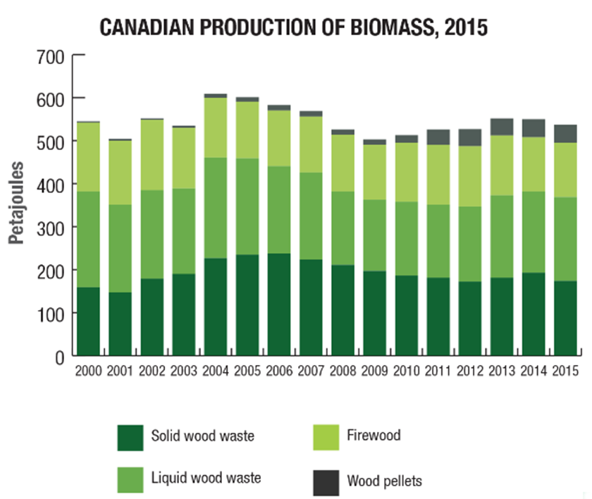
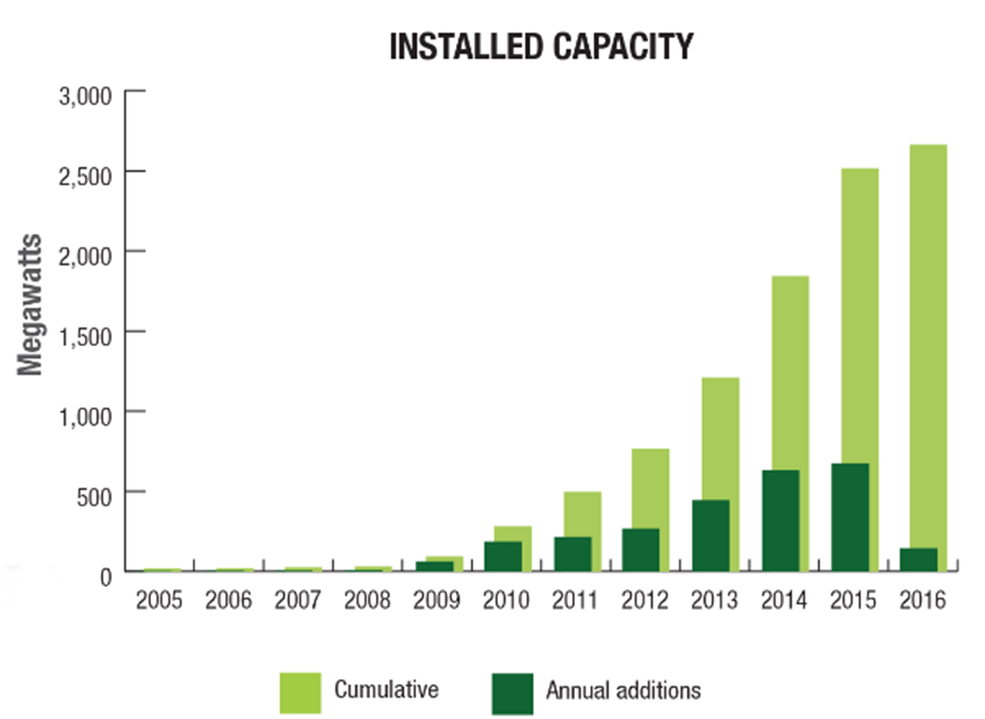
Renewable Energy – Biomass, Solar and Wind
24% Total energy = Biomass
4.6% Energy = Wind, and 0.09% = Solar
Solar (Right top) and wind (Bottom Right) resources rising exponentially

Slide 11
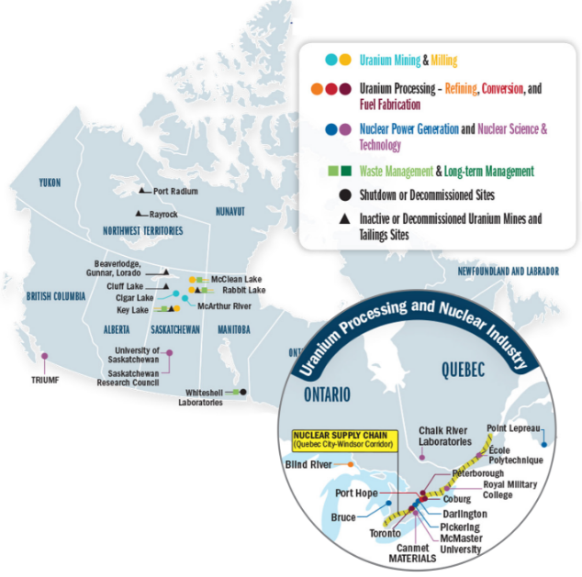
Nuclear Energy
2nd Largest Producer of uranium in the world (23%)
14.23 kilotonnes
40% of exports go to Kazahstan
88% of uranium exported
In 2015, nuclear made up 15% of Canadian electricity
4% World generation (7th overall)
99.04TWh
www.statcan.gc.ca/pub/11-402-x/2012000/chap/ener/ener-eng.htm.

Slide 12
Consumption
Primary vs. Secondary Energy Use
Energy Use Sectors:
Industrial
Transportation
Residential
Commercial/Institutional
Energy Consumption:
Non-renewable
Renewable
Consumption of Imported Energy

Slide 13
Primary vs. Secondary Energy
Definition Primary: measure of total energy requirements of all users of energy (includes energy lost in inefficiencies and non-renewables used in final products)
Definition Secondary: energy used by final consumers (ex. Fuel for vehicles, heating/cooling, etc.)
Energy Use Sectors
Energy Fact Book 2016-17

Slide 14
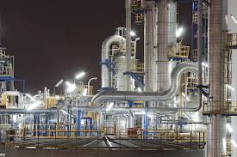
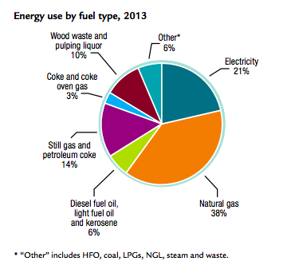
Industrial Energy Use
Industrial sector spends $47.6 billion annually on energy
Includes manufacturing, mining, forestry, and construction
1990-2013 saw 8.1% energy efficiency improvement ($3billion savings)
Energy Fact Book 2016-17

Slide 15
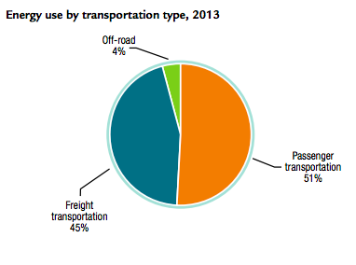
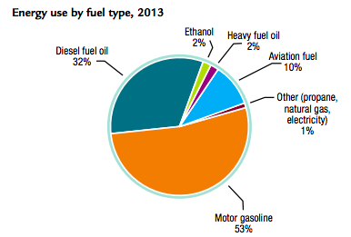
Transportation Energy Use
Three major types of transportation:
Passenger
Freight
Offroad
1990-2013: increase total energy use by 43%
29% efficiency improvement and savings of $17.1 billion
Energy Fact Book 2016-17

Slide 16
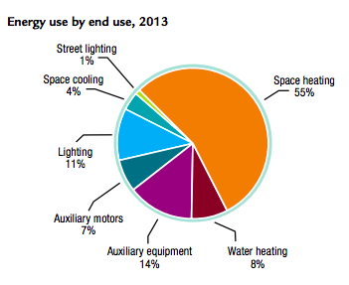
Commercial/Institutional Energy Use
Commercial: Businesses and Retail
Institutional: offices, schools, public service property
Overall energy increase by 23% (55% with no efficiency improvement)
Efficiency improvement of 33%, saving $5.4 billion in 2013
Energy Fact Book 2016-17

Slide 17
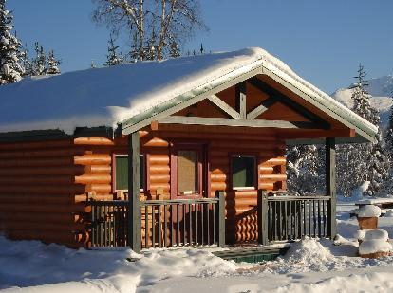
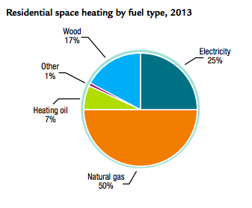
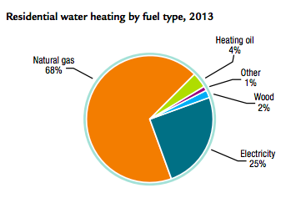
Residential Energy Use
Residential Use increased 6.5% (51% with no efficiency improvements)
Energy efficiency improved 45% saving $12 billion dollars
Energy intensity decreased 24% per household
Energy Fact Book 2016-17

Slide 18
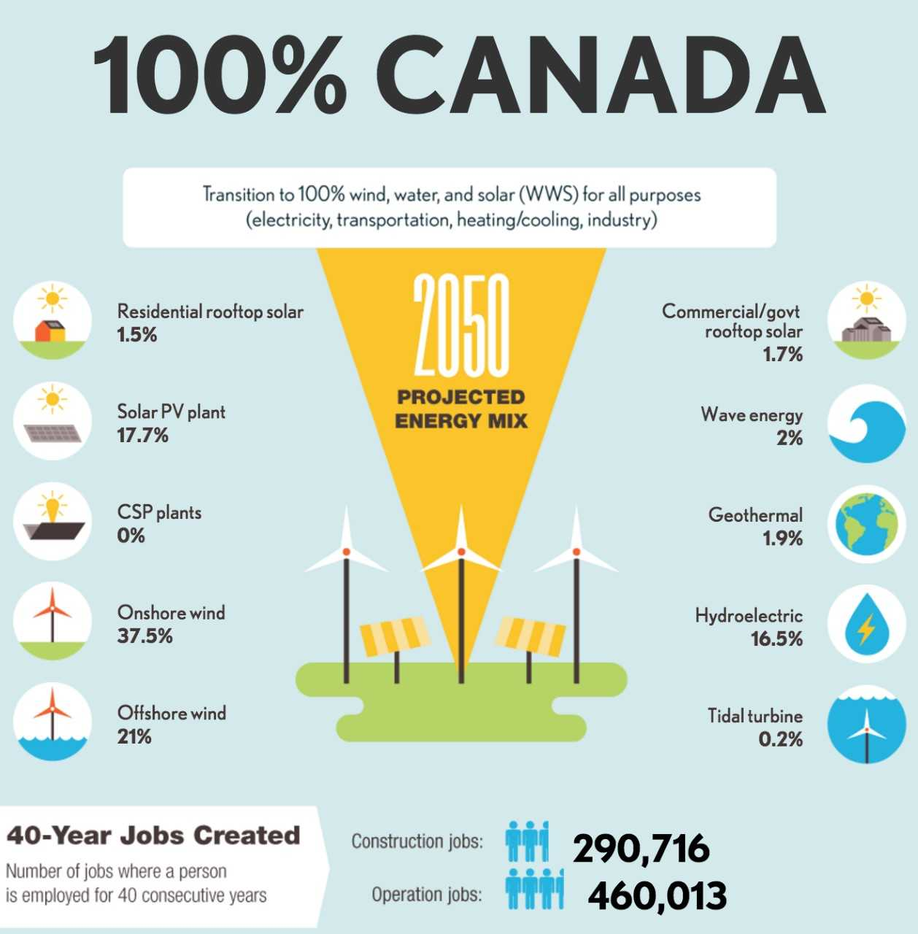
Energy Consumption: Renewables vs. Non-Renewables
Creating ~750,000 jobs soon
7th in the world producing renewables
National Inventory Report, 1990-2013

Slide 19
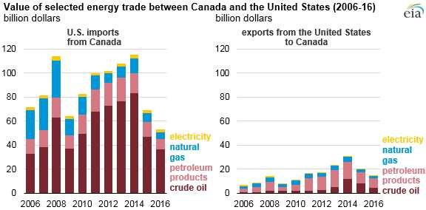
Imported Energy
National Energy Board

Slide 20
Future of Canadian Energy
Production Potential
Estimated Future Consumption
Paris Accord → Pan-Canadian Framework on Clean Growth and Climate Change
Carbon Pricing
Expansion Low-Carbon Energy
Increase Energy Efficiency
Enhancing Carbon Sinks
Environmental Justice

Slide 21
Production Potential
Renewables
Hydropower increase from 77GW to 87GW 2014-2040
Non-hydro renewables set to grow and taper out as renewable energy targets are met
Non-renewables
Crude Oil remaining (330B barrels as of Dec 2014) (90% in oil sands)
Marketable natural gas remaining (15.0 x 10¹² m³)
6.6 B tonnes recoverable coal reserves (declining demand)

Slide 22
Future Consumption
https://www.neb-one.gc.ca/nrg/ntgrtd/ftr/2016/2016nrgftr-eng.pdf

Slide 23
Paris Accord
Goals: limit warming to well below 2°C and if possible 1.5°C
Canada 2006-2015: growth of emissions
Conference of the Parties (COP21)
Pan-Canadian Framework on Clean Growth and Climate Change

Slide 24
Pan-Canadian Framework on Clean Growth and Climate Change
Commitment to reduce GHG emissions 30% below 2005 levels by 2030
“reduce emissions across all sectors of the economy, accelerate clean economic growth, build resilience to the impacts of climate change”
“The Road from Paris: Canada's Progress Toward Its Climate Pledge.”

Slide 25
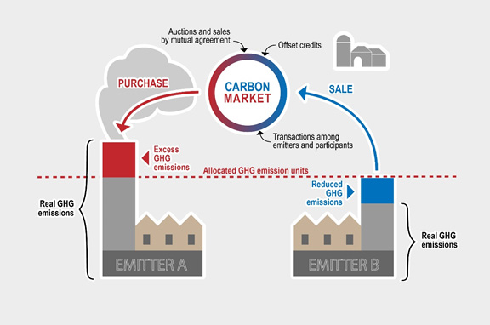
Carbon Pricing
Benchmark carbon pollution price of $10 per tonne by 2018, rising to $50 per tonne by 2022 (may due so through carbon tax or cap-and-trade system)
“The Road from Paris: Canada's Progress Toward Its Climate Pledge.”

Slide 26
Expansion of Low-Carbon Energy
Develop clean fuel standard (30 megatonnes reduction/yr by 2030) in transportation, buildings and industry
Published Dec 2017
Phase-out traditional coal units by 2030
Performance standards for natural-gas electricity
Intent to implement published Mar. 2017

Slide 27
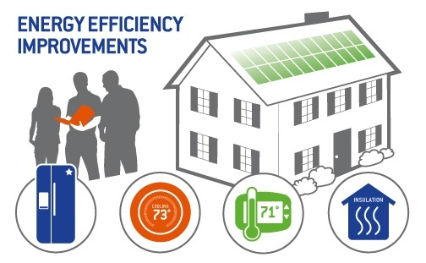
Increase Energy Efficiency
Fuel-switching
“Net-zero energy ready” building codes
Building retrofitting
North American Leaders’ Summit:
Generate 50% clean energy by 2025
Invest in and deploy clean energy technology
Advance collaborative research
Align environmental standards
taf.ca/projects/

Slide 28
Enhancing Carbon Sinks and Disadvantaged Populations
Land use protection
Forests, wetlands, agricultural lands
Protect Indigenous People and coastal and northern regions disproportionately

Slide 29
Is it enough?
Projections achieve 10% reduction of 1990 levels 2020 and 75-85% below 2001 levels by 2050
In order to achieve Paris Accord goals:
Implement national regulations to eliminate methane releases in oil and gas sector by 2030
Implement accelerated phase-out of coal-fired power
Work with provinces and territories to design an ambitious clean fuel standard, and achieve 30MT emissions reductions by 2030
Incentivize low- or zero-emissions vehicles, facilitate investment in corresponding road infrastructure
Work with progressive country leaders to meet Paris Agreement rulebook
“Canada's 2017 Nationally Determined Contribution Submission to the United Nations Framework Convention on Climate Change.”

Slide 30
Thank you!
Questions?

Slide 31
References
CANSIM Canada. “Energy.” Statcan.gc.ca, 7 Oct. 2016, www.statcan.gc.ca/pub/11-402-x/2012000/chap/ener/ener-eng.htm.
Government of Canada. “Electricity Facts.” Natural Resources Canada, Natural Resources Canada, 17 Apr. 2018, www.nrcan.gc.ca/energy/facts/electricity/20068.
Montreal Economic Institute. “Canada's Energy Profile in 40 Questions.” 2014, pp. 1–47., www.iedm.org/sites/default/files/web/page_files/booklet-energy0314.pdf.
Natural Resources Canada (Energy Fact Book 2016-17: Natural Resources Canada)
National Energy Board (Canada's Energy Future 2016: Energy Supply and Demand Projections to 2040)
British Petroleum (BP: Statistical Review of World Energy 2015)
Environmental and Climate Change Canada (National Inventory Report, 1990-2013)
Alberta Energy Regulator (ST98 - Alberta's Energy Reserve & Supply/Demand Outlook)
Canadian Solar Industries Association (National Survey Report of PV Power Applications in Canada 2013)
Ontario Ministry of Energy (Ontario Energy Report, Electricity, 1st Quarter, 2015)
(Canada - Climate Action Tracker)
Anthony, Craig. “Here Are the Countries With the Most Natural Resources.” Investopedia, Investopedia, 12 Sept. 2016, www.investopedia.com/articles/markets-economy/090516/10-countries-most-natural-resources.asp.
“Canada Population 2018.” Canada Population 2018 (Demographics, Maps, Graphs), World Population Review,
“Projects.” The Atmospheric Fund, Toronto, taf.ca/projects/.
“Top 100 Largest Countries by Area.” The Largest Countries in the World by Area, Countries-of-the-World, 2018, www.countries-ofthe-world.com/largest-countries.html.https://www.statista.com/statistics/271748/the-largest-emitters-of-co2-in-the-world/
“CO2 Emissions by Country 2016.” Statista, Statista, 2016, www.statista.com/statistics/271748/the-largest-emitters-of-co2-in-the-world/.
Chen, Han. “The Road from Paris: Canada's Progress Toward Its Climate Pledge.” Pembina Institute, NRDC, Nov. 2017, www.bing.com/cr?IG=3D517536C5364EB2B42B2712E13C76A9&CID=116A00032C106C4430EA0BE02DBF6DEE&rd=1&h=6W6jo_JMg_sDpYYE_CA6-5kXBXWOqiICYJBfx7X4jjM&v=1&r=https%3a%2f%2fwww.nrdc.org%2fsites%2fdefault%2ffiles%2fparis-climate-agreement-progress-2017-canada-ib.pdf&p=DevEx.LB.1,5520.1.
“Canada's 2017 Nationally Determined Contribution Submission to the United Nations Framework Convention on Climate Change.” UNFCCC, 11 May 2017, www4.unfccc.int/ndcregistry/PublishedDocuments/Canada%20First/Canada%20First%20NDC-Revised%20submission%202017-05-11.pdf.

