Slide 1
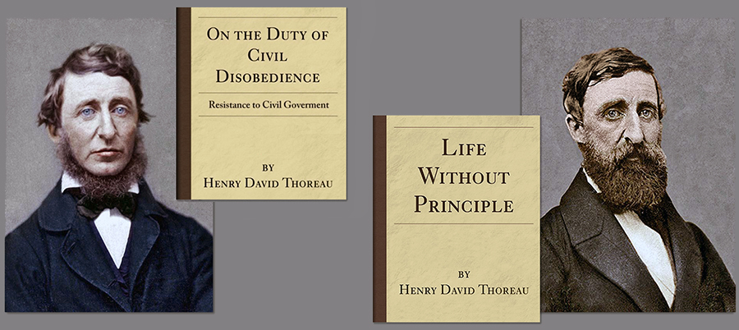
Resistance & Freedom: The Political Legacy of Henry David Thoreau
Susan E. Gallagher

Slide 2


Slide 3
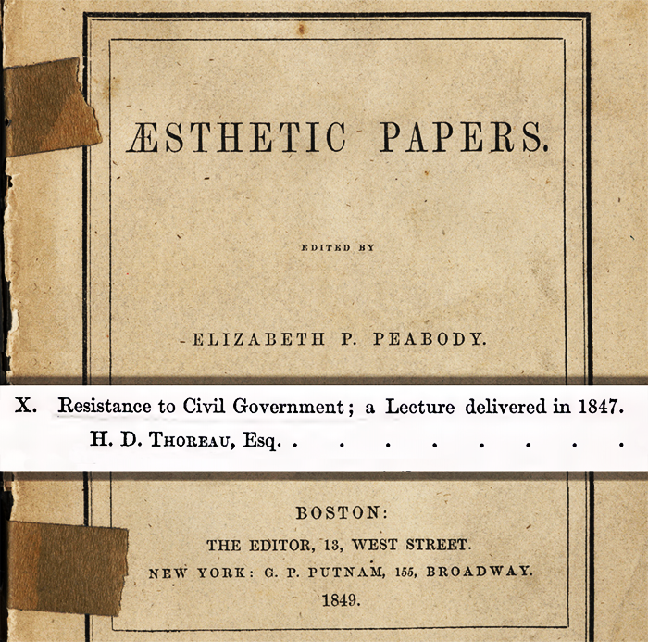
“If the injustice is part of the necessary friction of the machine of government, let it go, let it go... but if it... requires you to be the agent of injustice to another, then, I say, break the law. Let your life be a counter-friction to stop the machine. What I have to do is to see, at any rate, that I do not lend myself to the wrong which I condemn,” c.1847-1848.

Slide 4


"While the law holds fast the thief and murderer," it lets itself go loose. When I have not paid the tax which the State demanded for that protection which I did not want, itself has robbed me; when I have asserted the liberty it presumed to declare, itself has imprisoned me,” 1847-1849.
“I was seized and put into jail, because... I did not pay a tax to, or recognize the authority of, the State which buys and sells men, women, and children, like cattle at the door of its senate-house... I might have resisted forcibly with more or less effect, might have run "amok" against society; but I preferred that society should run “amok" against me, it being the desperate party,” 1847-1854.

Slide 5
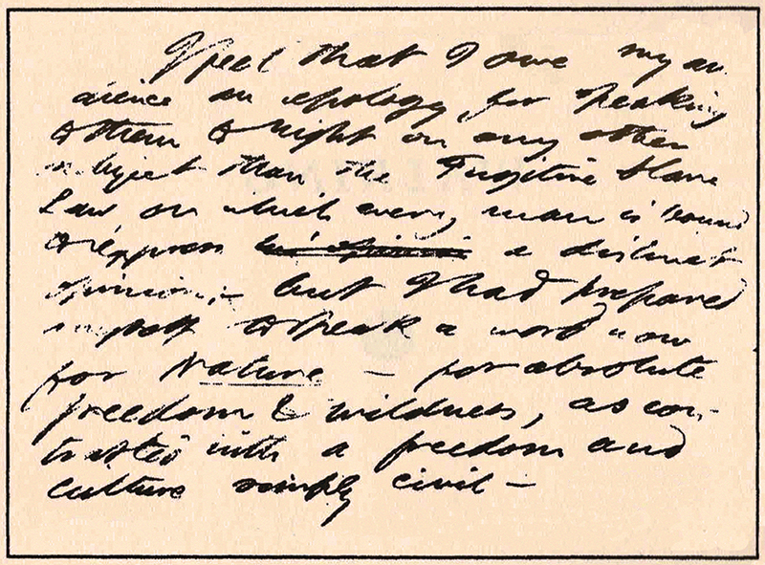
“Walking,” 1851
Houghton Library, Harvard University (MS M271.5 folder 21B).
"I feel that I owe my audience an apology for speaking to them tonight on any other subject than the Fugitive Slave Law, on which every man is bound to express a distinct opinion, but I had prepared myself to speak a word now for Nature — for absolute freedom & wildness, as contrasted with a freedom and culture simply civil...

Slide 6
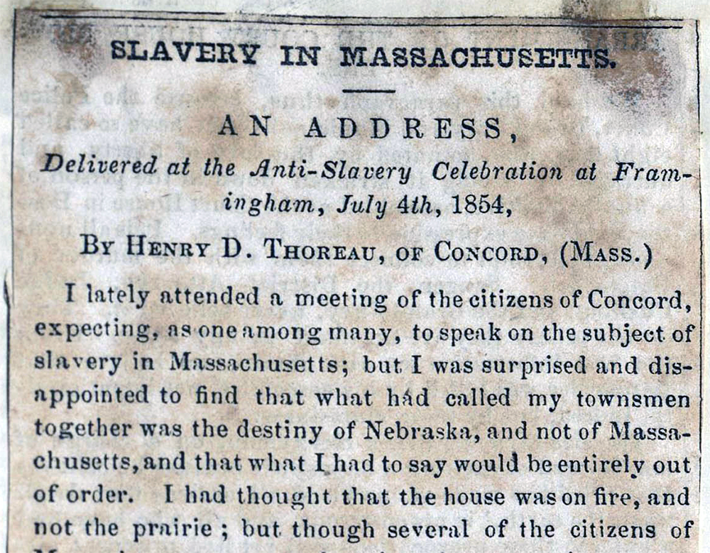
“I walk toward one of our ponds; but what signifies the beauty of nature when men are base? We walk to lakes to see our serenity reflected in them; when we are not serene, we go not to them. Who can be serene in a country where both the rulers and the ruled are without principle? The remembrance of my country spoils my walk. My thoughts are murder to the State, and involuntarily go plotting against her.”
⎯“Slavery in Massachusetts”
“I had never respected the Government near to which I lived, but I had foolishly thought that I might manage to live here, minding my private affairs, and forget it.”

Slide 7
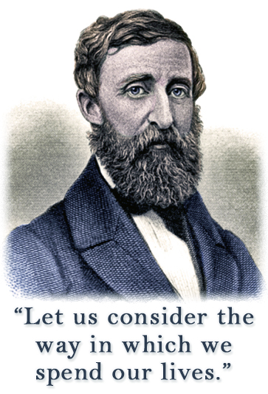
“Do we call this the land of the free? What is it to be free from King George and continue the slaves of King Prejudice? What is it to be born free and not to live free? What is the value of any political freedom, but as a means to moral freedom? Is it a freedom to be slaves, or a freedom to be free, of which we boast? ... We tax ourselves unjustly. There is a part of us which is not represented. It is taxation without representation. We quarter troops, we quarter fools and cattle of all sorts upon ourselves. We quarter our gross bodies on our poor souls, till the former eat up all the latter's substance.”
⎯ H.D. Thoreau, “Life Without Principle,” 1854.

Slide 8
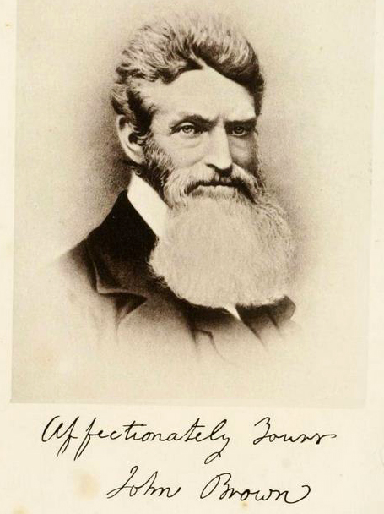
“These men, in teaching us how to die, have at the same time taught us how to live... It is the best news that America has ever heard. It has already quickened the feeble pulse of the North, and infused more and more generous blood into her veins and heart than any number of years of what is called commercial and political prosperity could. How many a man who was lately contemplating suicide has now something to live for!”
H.D. Thoreau, “A Plea for Captain John Brown,” 1859.

Slide 9
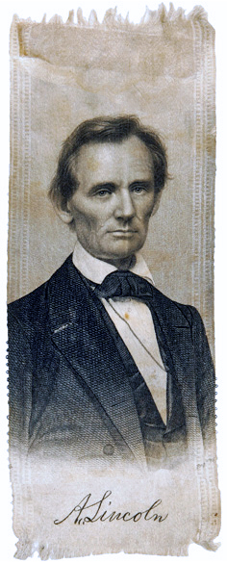
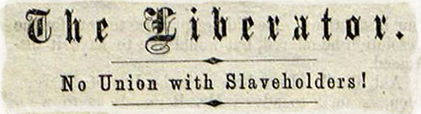
  Resolutions passed at a meeting of the Middlesex Anti-Slavery Society
Concord Townhouse, July 15, 1860
Resolved, That the absurdity of professing to hold to an anti-slavery interpretation of the Constitution, while supporting by vote and every way the election of Abraham Lincoln, is beyond the power of words to describe, and shows the masses of the party to be as unfortunate in their mental perceptions, as their leaders are in moral integrity and honesty.

Slide 10
Allegory of Freedom, (detail) 1863 or after, recorded as from Piscataquis County, Maine,
National Gallery of Art.
“Resolved, That although we are seeking, by moral means alone, the immediate and unconditional emancipation of the slaves, yet we would not, in view of the terrible wrong done four million people, do less than thank God if some black John Brown should arise among his fellows, and imitating the examples of the fathers of ‘76, terminate at once this unrighteous infringement of personal liberty, though every slaveholder in the South should be made to pay the penalty with his life,” H. Ford Douglas, September 1, 1860.

Slide 11
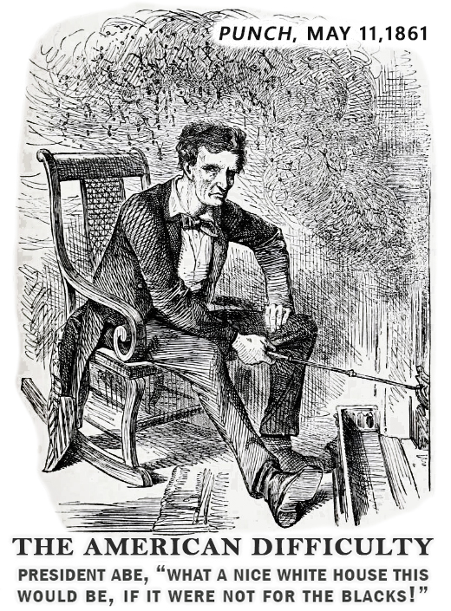
“I have no purpose, directly or indirectly, to interfere with the institution of slavery in the States where it exists. I believe I have no lawful right to do so, and I have no inclination to do so,”
Abraham Lincoln, Inaugural Address, March 4, 1861.

Slide 12
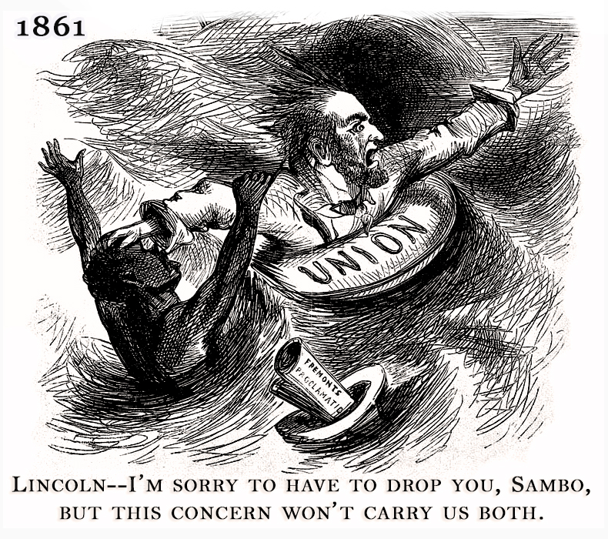

Slide 13
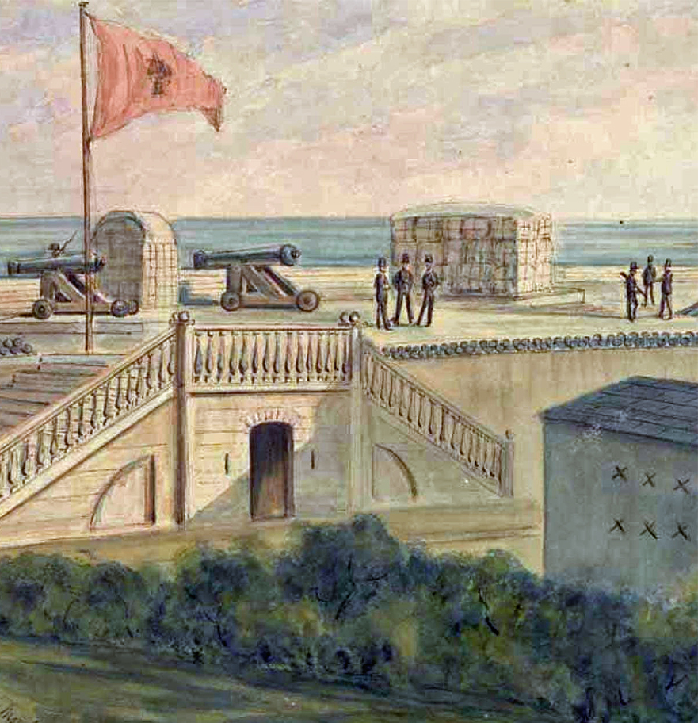
As for your friend, my prospective reader, I hope he ignores Fort Sumter, and “Old Abe,” and all that ; for that is just the most fatal, and, indeed, the only fatal weapon you can direct against evil, ever ; for, as long as you know of it, you are particeps criminis.
Letter to Parker Pillsbury, April 10, 1861
REBEL TROOPS OCCUPYING FORT MOULTRIE
(Library of Congress)

Slide 14
Blessed were the days before you read a President's Message. Blessed are the young for they do not read the President's Message. Blessed are they who never read a newspaper for they shall see Nature and through her God. But, alas! I have heard of Sumter and Pickens and even of Buchanan (though I did not read his Message).
Letter to Parker Pillsbury, April 10, 1861
“[Thoreau’s] petulant words... concerning national affairs would hardly have been said a few days later, when, at the call of Abraham Lincoln, the people rose to protect their government, and every President's Message became of thrilling interest, even to Thoreau.”
Franklin Sanborn, Familiar Letters of Henry David Thoreau (1894)

Slide 15
“The plan of colonization may involve the acquiring of territory... [Such acquisition] was questioned at first by Mr. Jefferson, who, however, in the purchase of Louisiana, yielded his scruples on the plea of great expediency. If it be said that the only legitimate object of acquiring territory is to furnish homes for white men, this measure effects that object, for the emigration of colored men leaves additional room for white men remaining or coming here... On this whole proposition... does not the expediency amount to absolute necessity--that without which the Government itself can not be perpetuated?”
Abraham Lincoln, First Annual Message, December 3, 1861

Slide 16
“But Paley appears never to have contemplated those cases to which the rule of expediency does not apply, in which a people, as well as an individual, must do justice, cost what it may. If I have unjustly wrested a plank from a drowning man, I must restore it to him though I drown myself. This, according to Paley, would be inconvenient. But he that would save his life, in such a case, shall lose it. This people must cease to hold slaves, and to make war on Mexico, though it cost them their existence as a people,”
“Resistance to Civil Government,” 1847-1848.

