Slide 1

Introduction To 2010 Excel
Super-size Tool Bar: Ribbon
Basic Tasks on Home Tab
Math and Formula
Statistical Functions (examples)
Create A Chart
Play with Insert & Layout
Create A Histogram
Curve Fitting & Regression Line
Tips for Excel Applications

Slide 2

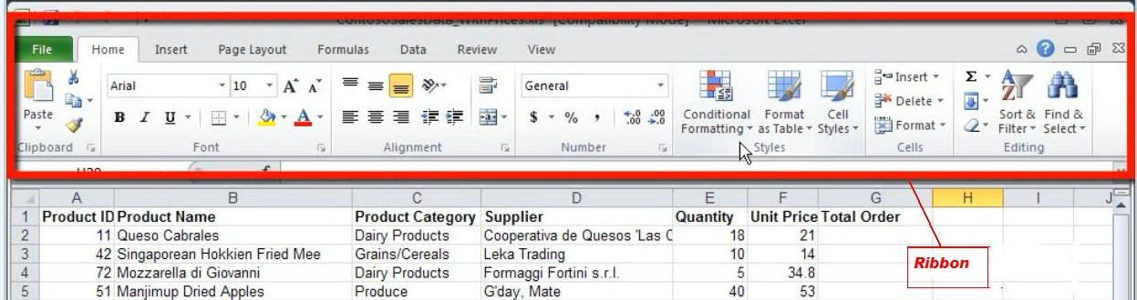
Supersize Toolbar: Ribbon
The Ribbon is designed to help you quickly find the commands to complete a task
Commands are organized in logical groups under tabs. Each tab relates to a type of activity
For example: the principle tabs are:
◙ File ◙ Home ◙ Insert ◙ Page layout ◙ Formula
◙ Data

Slide 3
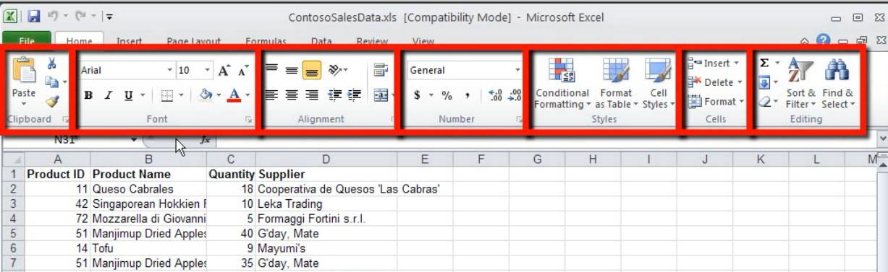
Basic Tasks Under Home Tab
◙ Copy & Paste ◙ Style
◙ Font ◙ Insert (cell, row), cell format
◙ Alignment ◙ Editing
◙ Number

Slide 4
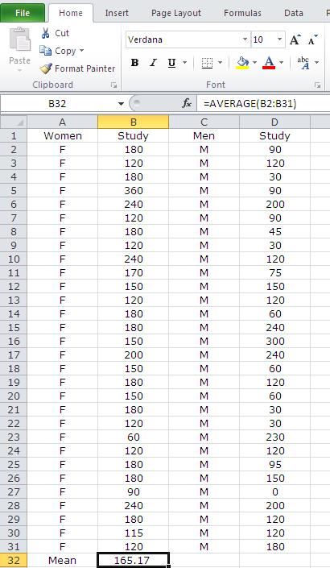

Math & Formula
♫ Do math under any tab
♫ Click the cell (B32) where put the result
mean, and next to fx type: average(B2:B31)
♫ (B2:B31) is define the data range
♫ Equal sign “=“ always before a formula
♫ You can define a formula yourself
♫ Find a function under Formula tab
♫ Find functions library:
Formula 
▬▬▬ more functions
▬▬▬ Statistical
▬▬▬ function list

Slide 5
Statistical Functions (Exampes)
MEDIAN median(a2:a55)
MEAN average(a2:a55)
FIRST QUARTILE quartile(a2:a55, 1)
THIRD QUARTILE quartile(a2:A55, 3)
STANDARD DEVIATION stdev(b2:b43)
MINIMUM min(a2:a67)
MAXIMUM max(a2:a67)
SUM sum(b2:b43)
CORRELATION COEFFICIENT correl(b2:b105,c2:c105)

Slide 6
Create A Chart/Plot
♫ Highlight the data for plotting
♫ Click Insert tab, showing different plots available:
◙ column ◙ bar ◙ line ◙ scatter ◙ pie
♫ Select bar plot for example
♫ After chart is inserted, more commands show up under Chart Tool
♫ Click inside chart – chart tool appear
click outside chart – chart tool gone
♫ Chart tool - Layout tab – sub commands
◙ chart title ◙ axis title ◙ axes ◙ plot area ◙ gridlines
♫ Using above sub-commends to complete a plot

Slide 7
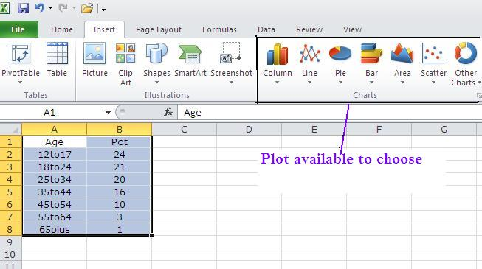
Play With Insert Tab
Highlight data
Click “Insert”
Select a chart to present data

Slide 8

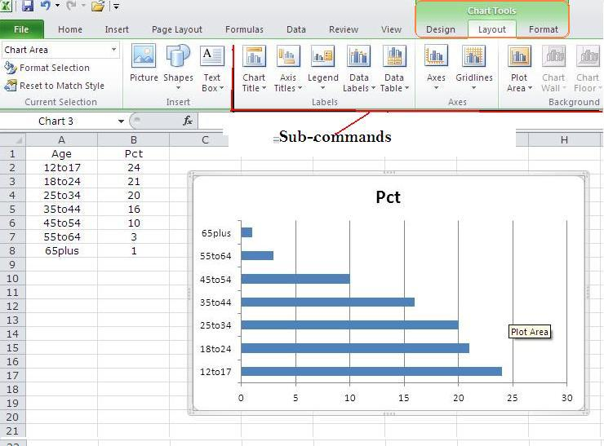
Play With Chart Tool - Layout
♫ Make Chart tool available (keep cursor inside chart)
♫ Select layout under Chart tool
♫ Sub-commands show up to fill detail of the chart

Slide 9
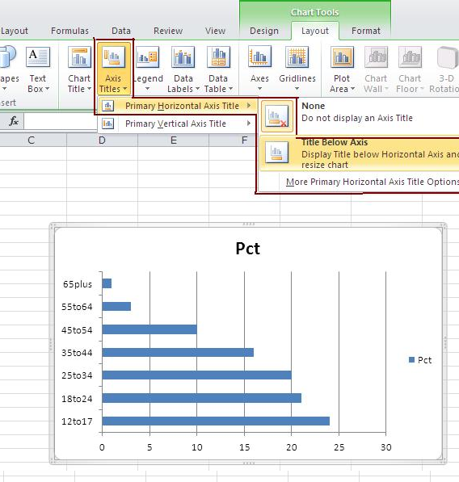
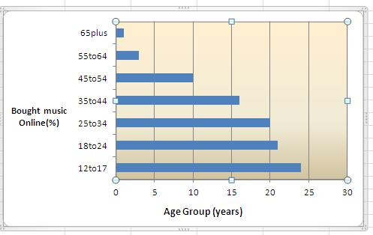
Play With Sub-command
Sub-command example:
◘ Axis Title ◘ Plot Area
To add a axis title
◙ Insert ▬ Chart Tools ▬
Layout ▬ Axis Titles ▬
Horizontal Axis Title ▬
Title Below Axis
To manage plot area
◙ Insert ▬ Chart Tools ▬
Layout ▬ Plot Area ▬
Plot Area Options :
Fill: No fill
Solid fill
Gradient

Slide 10
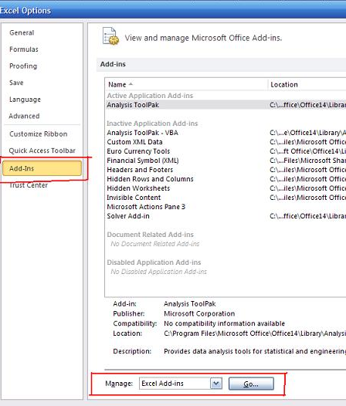
Create A Histogram: Install Analysis Toolpak
◙ In Excel 2010, click File tab then Options
◙ In Options sub-window, locate and click “Add-Ins”
◙ In the Manage list (bottom), select
“Excel Add-ins, and then click Go
◙ In the Add-Ins dialog box, select the Analysis Toolpak check box, then click OK
◙ Under Data tab, click Data Analysis and highlight the Histogram tool, click OK

Slide 11
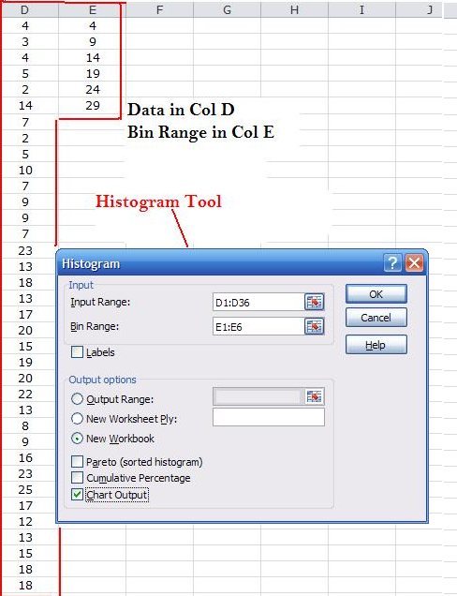
Create A Histogram: Using Histogram Tool
♫ We have data shown right:
◙ 1th col: data
◙ 2th col: bin range
♫ In the Histogram window
◙ Input Range box: type D1:D36
◙ Bin Range box: type E1:E6
◙ Under Output Options, click
New Worksheet Ply:
◙ Select Chart Output check box
Click OK
♫ A new Histogram table and a
histogram chart are created

Slide 12
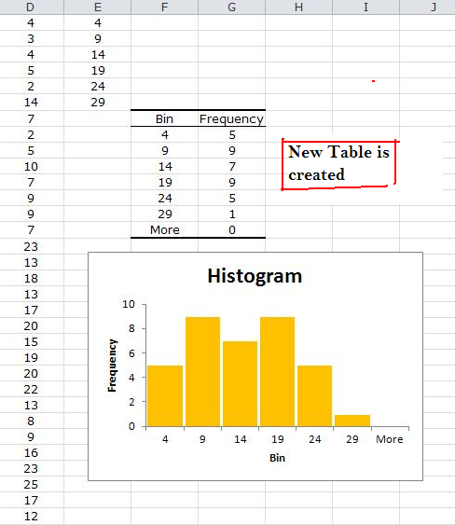
Create A Histogram Chart
A Histogram table (a new workbook) is generated
A histogram chart is created
To adjust the gap between columns
Click any column, right click and select “format data series” , change the gap between 0-100%
You can adjust the gap 0-10%, or as you like.

Slide 13
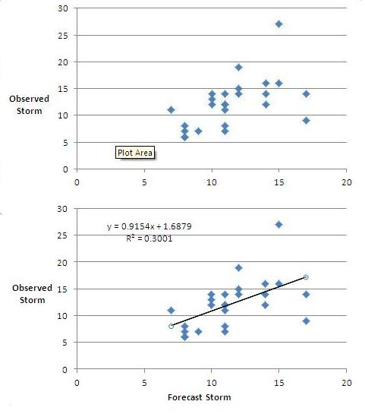

Curve Fitting & Regression Line
Draw a scatter plot without line
Do regression line
Insert ▬ Chart Tools ▬
Layout ▬ Trendline ▬ Trendline options & select:
◙ Linear
◙ Display Equation on chart
◙ display R-squared value on chart

Slide 14
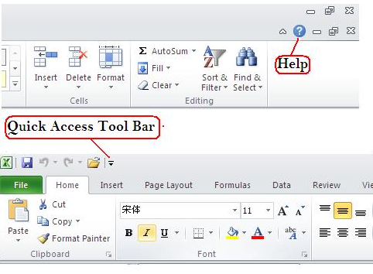
Tips For Excel Applications
Get help from Excel
click the question mark located the most left corner
Quick access tool bar:
located the most right corner (open, save, undo, …)
Printing
♫ if highlight the plot, only print the plot
♫ without highlight, print data & plots

