Slide 1
Chapter Two The Nature and Extent of Crime

Slide 2
Primary Sources of Crime Data
Official Records: The Uniform Crime Report (UCR)
Part I Crimes
Part II Crimes
Compiling the UCR
Validity of the UCR
Notes:
LO 1: Discuss the various forms of crime data.

Slide 3
Primary Sources of Crime Data
National Incident-Based Reporting System (NIBRS): The Future of the Uniform Crime Report
Improvement over UCR
46 specific offenses
11 lesser offenses
22 crime patterns
Incident, victim, and offender information
33 states certified to participate
Other state programs in various testing stages
Notes:
LO 1: Discuss the various forms of crime data.

Slide 4
Class Discussion/Activity
Read the section of your text on UCR and NIBRS
What are the shortcomings of the UCR?
What advantages does NIBRS have compared to the UCR?

Slide 5
Primary Sources of Crime Data
Survey Research
People asked about attitudes, beliefs, values, characteristics, and experiences with crime and victimization
Sampling
Population
Notes:
LO 1: Discuss the various forms of crime data.

Slide 6
Primary Sources of Crime Data
The National Crime Victimization Survey (NCVS)
An annual survey of victims
Addresses the nonreporting issue
Surveyed twice a month for three years
Contains information regarding victims, offenders, and crimes
What is the validity of the NCVS?
Notes:
LO 1: Discuss the various forms of crime data.

Slide 7
Primary Sources of Crime Data
Self-Report Surveys
Given in groups
Anonymous
Asks people to describe recent and lifetime participation in criminal activity
Validity of Self-Reports
Honesty of self-reporting participants
Monitoring the Future
Consistency
Longitudinal
Notes:
LO 1: Discuss the various forms of crime data.

Slide 8
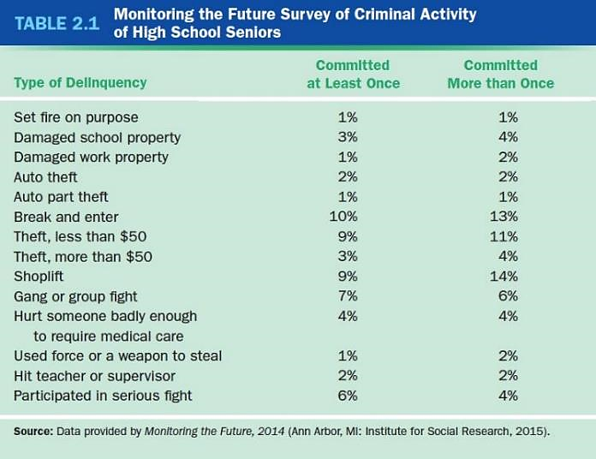
Primary Sources of Crime Data
Notes:
LO 1: Discuss the various forms of crime data.

Slide 9
Primary Sources of Crime Data
Evaluating Crime Data
Strengths
UCR
Offender data
Particular crimes that surveys cannot measure
NCVS
Unreported crime
Information on personal characteristics of victims
Self-report surveys
Personal characteristics of offenders
Notes:
LO 1: Discuss the various forms of crime data.

Slide 10
Primary Sources of Crime Data
Evaluating Crime Data
Weaknesses
UCR
Does not include unreported crimes
Subject to reporting caprices of police departments
NCVS
Estimates from limited samples of population
Personal recollections
Does not include homicide, drug abuse crimes
Self-report surveys
Rely on honesty of offenders
Notes:
LO 1: Discuss the various forms of crime data.

Slide 11
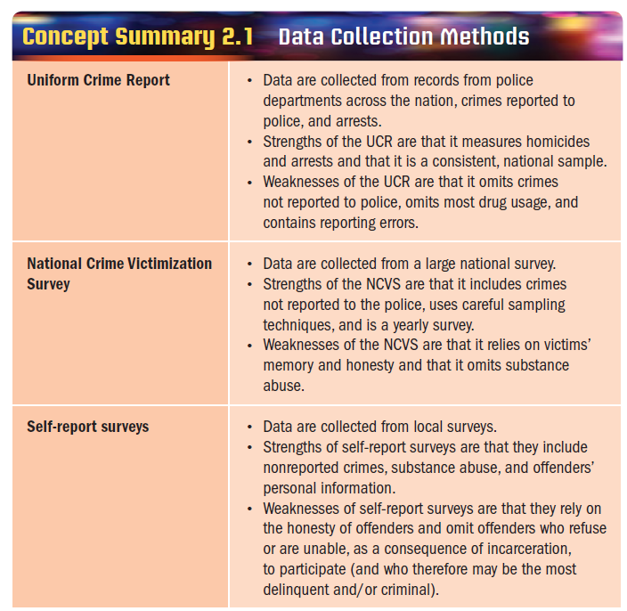
Primary Sources of Crime Data
Notes:
NEEDS NEW PICTURE – IMAGE HAS “NOT FOR SALE” OVER IT
LO 1: Discuss the various forms of crime data.

Slide 12
Class Discussion/Activity
Look at Table 2.1 in your text and analyze the information in the table
Which types of delinquency are committed the most often?
Which type of delinquency has the highest probability of having been committed more than once?
Which type of delinquency is committed the least often?
Why do you think some types of delinquency are more likely to be committed repeatedly?

Slide 13
Crime Trends
Contemporary Trends
Crime rates are declining from the peak in 1991
Violent crimes and thefts have declined
Trends in Victimization
Decrease in victimization across all age groups
Significant decrease in serious violent crime against youth ages 12 to 17
Notes:
LO 2: Analyze recent trends in the crime rate.
LO 3: List the factors that influence crime rates.

Slide 14
Crime Trends
Predicting Future Crime Trends
Increase in numbers of elementary school-aged children may lead to future increase in crime as children reach teenage and young adult age
Rising number of senior citizens could lead to lower crime rate
Notes:
LO 2: Analyze recent trends in the crime rate.
LO 3: List the factors that influence crime rates.

Slide 15
Explaining Trends in Crime Rates
Age structure
Immigration
Economy/Jobs
Abortion
Gun availability
Gang membership
Drug use
Media
Medical technology
Aggressive law enforcement
Incarceration
Cultural change
Internet
Notes:
LO3: List the factors that influence crime rates.

Slide 16
Crime Patterns
Co-Offending and Crime
Tends to be a group activity
More prevalent in neighborhoods that are less disadvantaged, more stable, and contain more people who can be trusted
Notes:
LO 4: Identify the gender and racial patterns in crime.

Slide 17
Crime Patterns
Gender and Crime
Trait differences
Masculinity hypothesis
Socialization differences
Cognitive differences
Social/political differences
Liberal feminist theory
Notes:
LO 4: Identify the gender and racial patterns in crime.

Slide 18
Crime Patterns
Race and Crime
Institutional bias
Racial profiling
Racial threat hypothesis
Structural racism
Notes:
LO 4: Identify the gender and racial patterns in crime.

Slide 19
Crime Patterns
Ecology of Crime
Day, season, and climate
Most reported crimes occur during summer months
Temperature
Weather effects may have an impact on violent crime rates
Regional differences
Large urban areas have higher rates of violence
Notes:
LO 3: List the factors that influence crime rates.

Slide 20
Crime Patterns
Use of Firearms
According to the NCVS, firearms are typically involved in:
20 percent of robberies
10 percent of assaults
More than 5 percent of rapes
About 70% of murders
On-going debate about gun control
Notes:
LO 2: Analyze recent trends in the crime rate.
LO 3: List the factors that influence crime rates.

Slide 21
Crime Patterns
Social Class and Crime
Instrumental crimes
Expressive crimes
Unemployment and Crime
Weak association
Young people earning money are more likely to engage in antisocial behavior such as drinking and drugs
Notes:
LO 3: List the factors that influence crime rates.

Slide 22
Crime Patterns
Age and Crime
Age is inversely related to crime
Aging out of crime
Age and biology
Neurotransmitters
Gap between adult and teen official crime rates is starting to even out
Notes:
LO 5: Clarify what is meant by the term aging-out process.

Slide 23
Class Discussion/Activity
From your perspective as a student, why are teenagers more likely to commit crimes?
What is the aging-out effect?

Slide 24
Chronic Offenders/Criminal Careers
Persistent offenders are called chronic offenders or career criminals
Delinquency in a Birth Cohort
Wolfgang, Figlio, and Sellin
Classic longitudinal study that tracked a cohort of boys over an 18 year period
Notes:
LO 6: Define the concept of chronic offending and know its causes.

Slide 25
Chronic Offenders/Criminal Careers
What Causes Chronicity?
Early onset
Implications of the Chronic Offender Concept
Mandatory sentences
Three-strikes policies
Truth-in-sentencing policies
Notes:
LO 6: Define the concept of chronic offending and know its causes.

