Slide 1
U.S. Department of Justice
Office of Justice Programs
Presented by
James P. Lynch, Ph.D.
Director
Bureau of Justice Statistics
May 4, 2012
CORRECTIONS IN THE UNITED STATES
BJS
Trends in correctional populations,
common perceptions of incarceration,
and the role of corrections in society
www. .gov

Slide 2
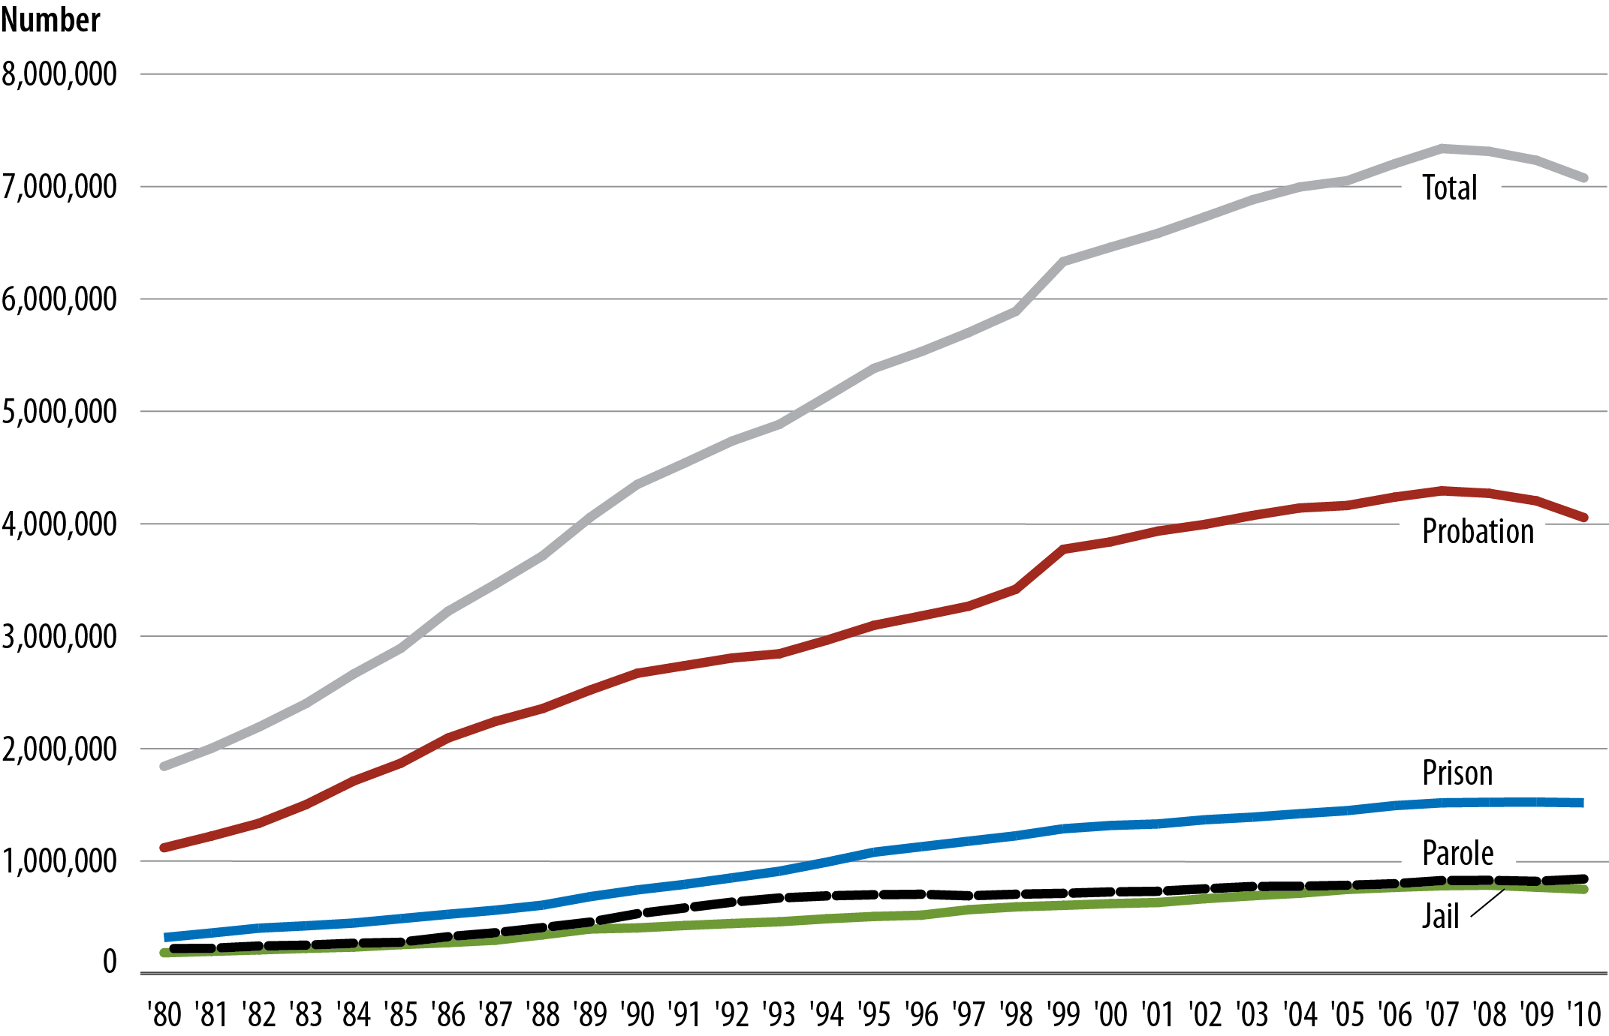
Figure 1. Adult correctional population on probation, in jail or prison, or on parole, 1980–2010
Note: Prison data based on custody counts. Includes inmates held in privately operated facilities.
Source: Bureau of Justice Statistics, Annual Parole Survey, Annual Probation Survey, Annual Survey of Jails, Census of Jails, and National Prisoner Statistics Program.

Slide 3
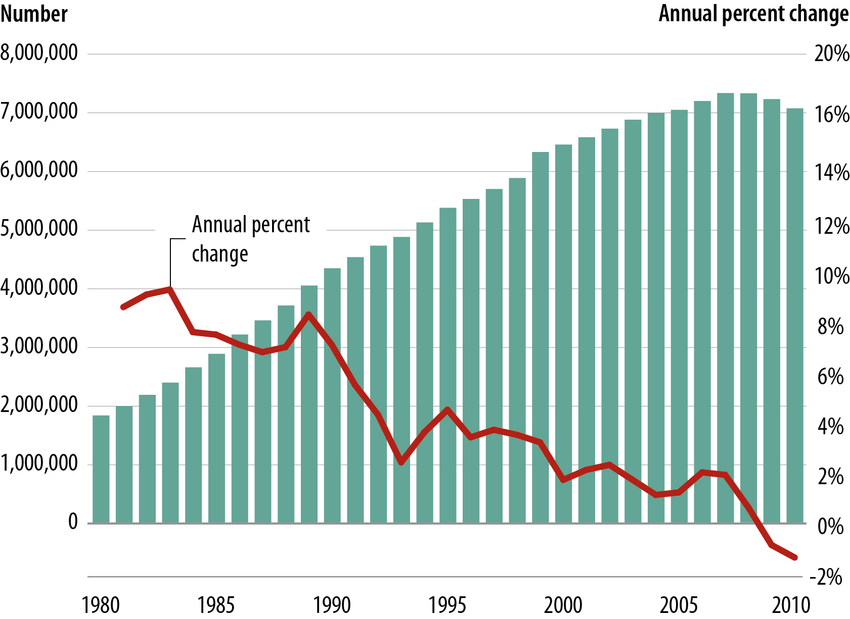
Figure 2. Adult correctional population and annual percent change, 1980–2010
Source: Bureau of Justice Statistics, Annual Parole Survey, Annual Probation Survey,
Annual Survey of Jails, Census of Jails, and National Prisoner Statistics Program.

Slide 4
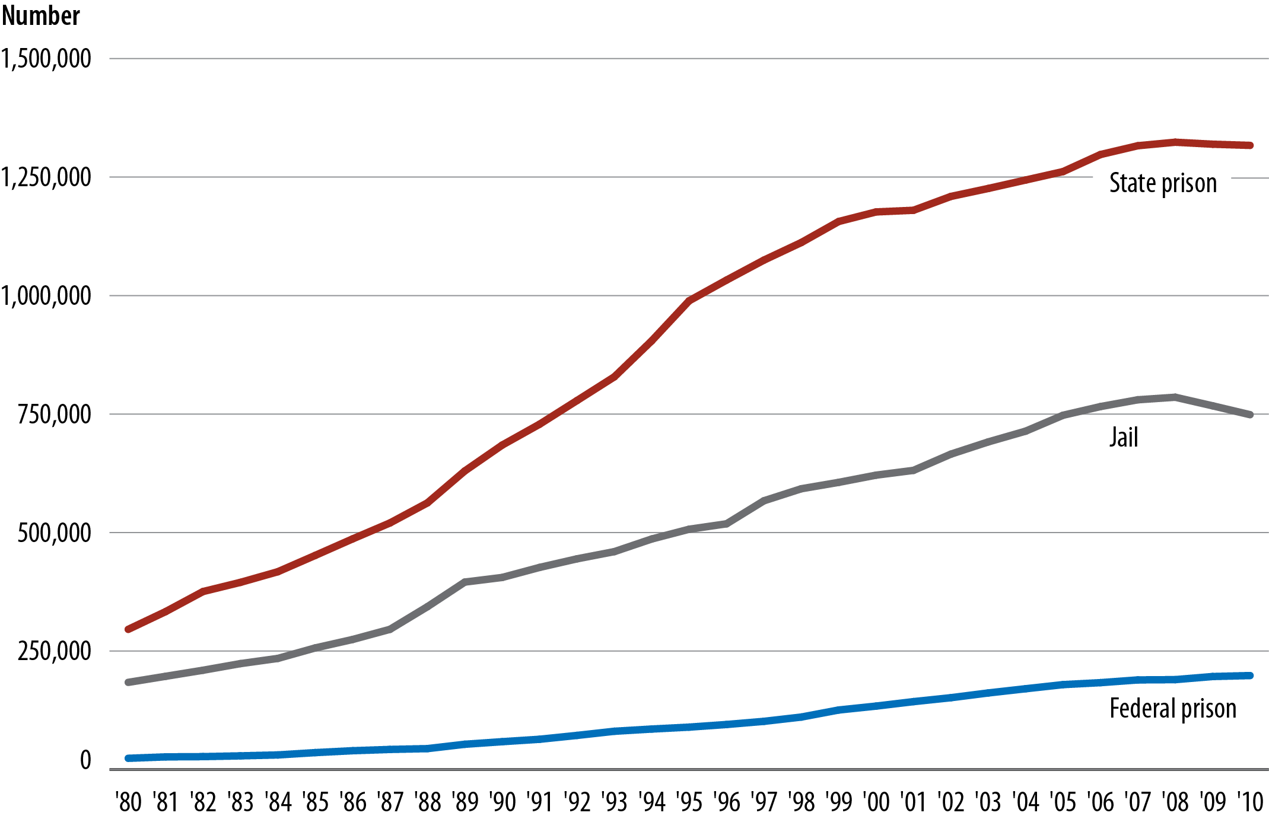
Figure 3. Incarcerated adult correctional population in state or federal prison or local jail,1980–2010
Note: Prison custody counts are for December 31 within the reporting year; jail population counts are for June 30.
Source: Bureau of Justice Statistics, Annual Survey of Jails, Census of Jails, and National Prisoner Statistics Program.

Slide 5
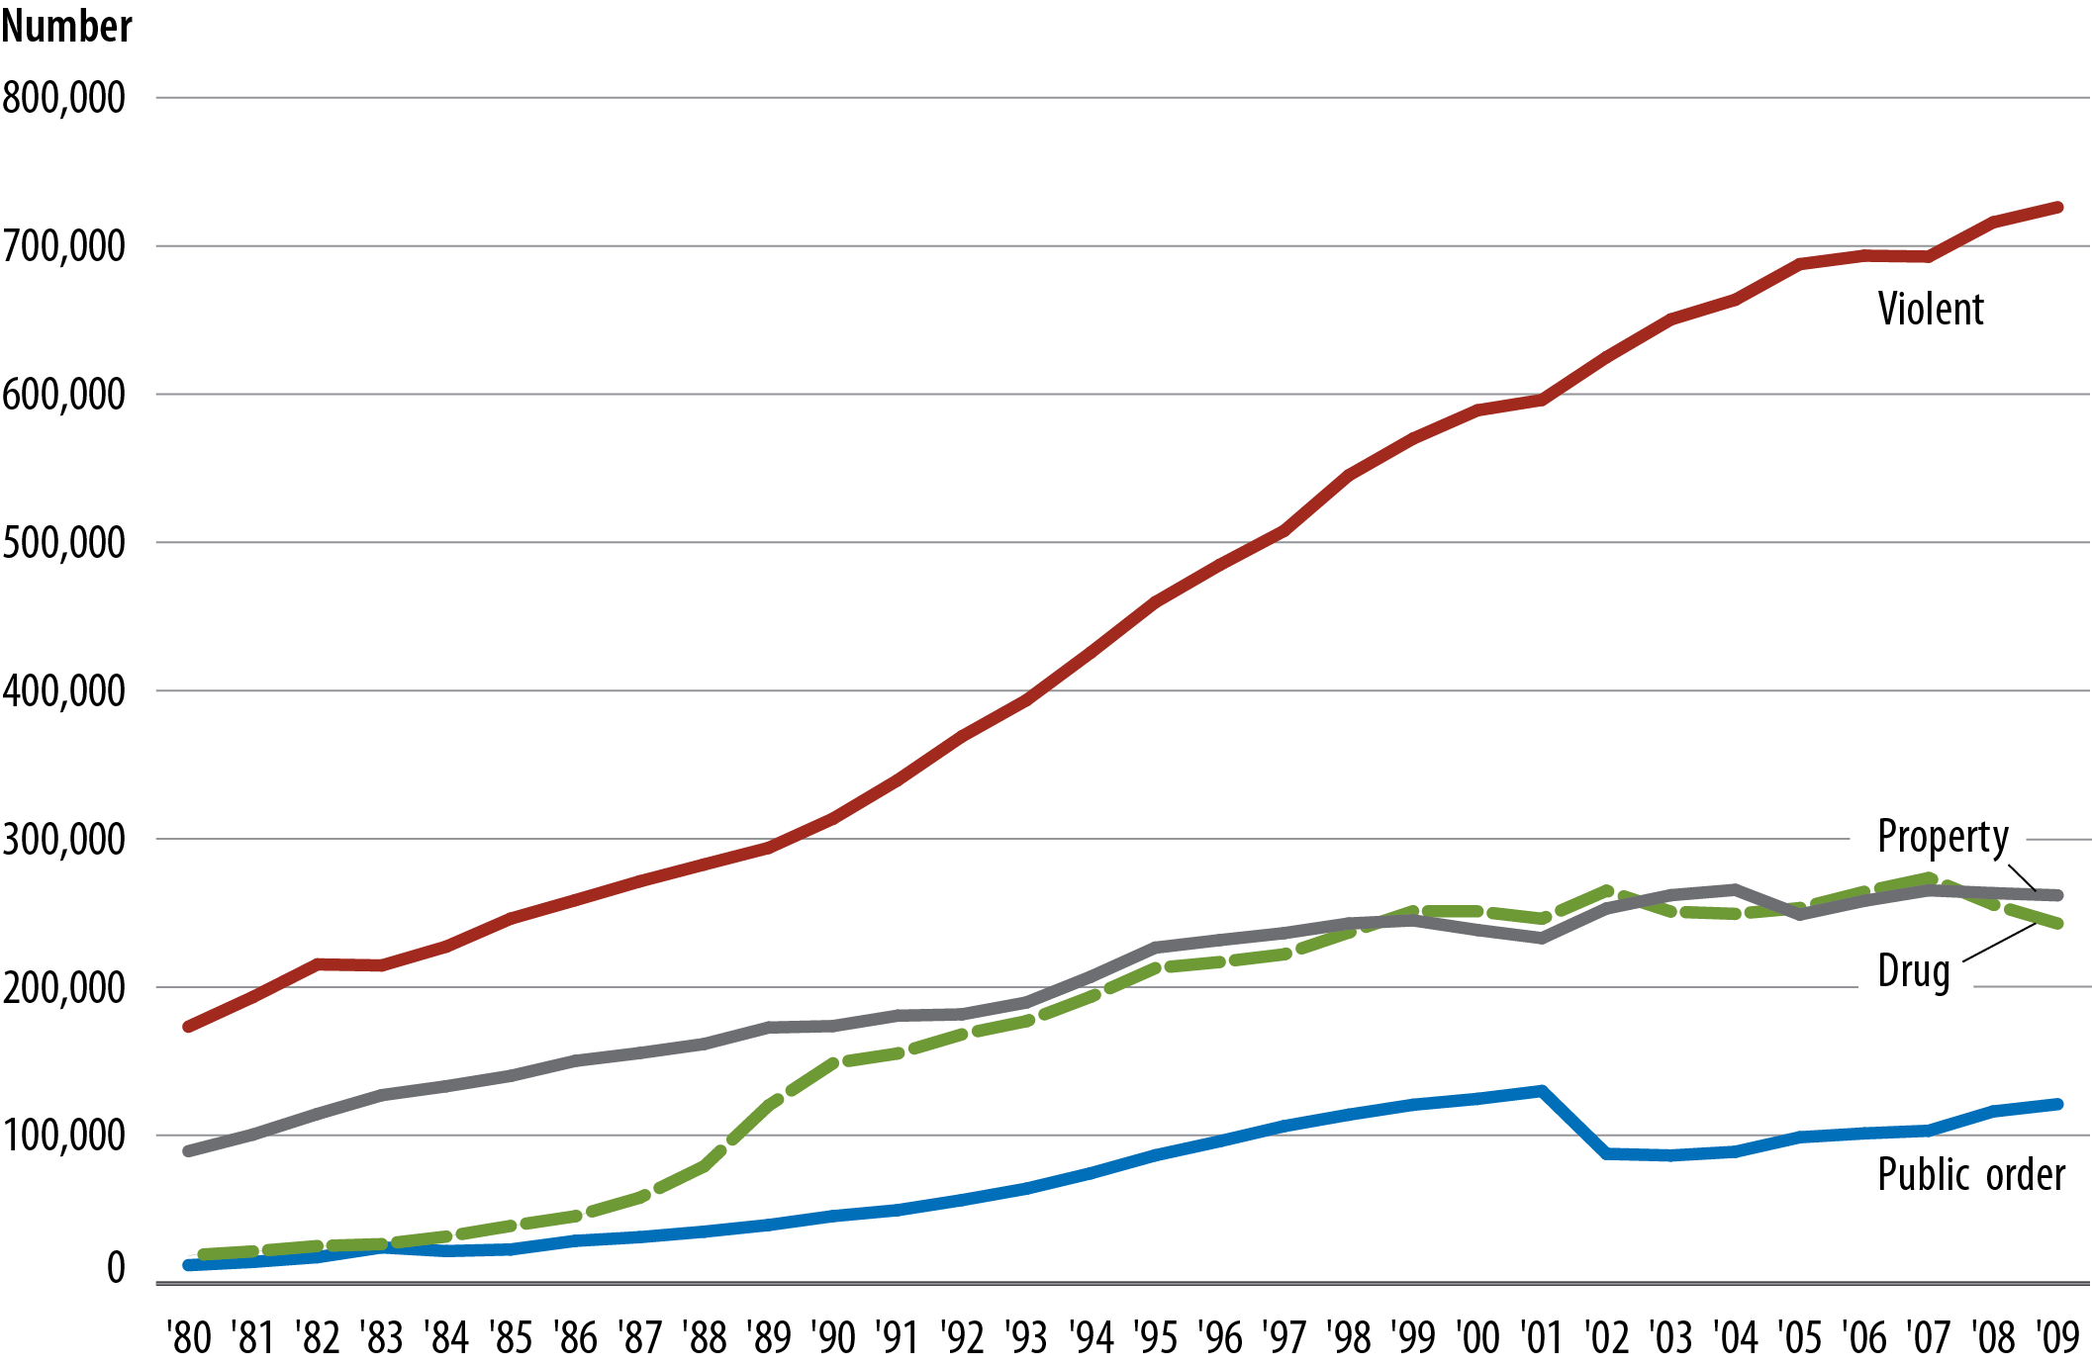
Figure 4. Number of state prisoners, by offense, 1980–2009
Source: Bureau of Justice Statistics, National Prisoner Statistics Program, National Corrections Reporting Program, and Survey of Inmates in State Correctional Facilities, 2004.

Slide 6
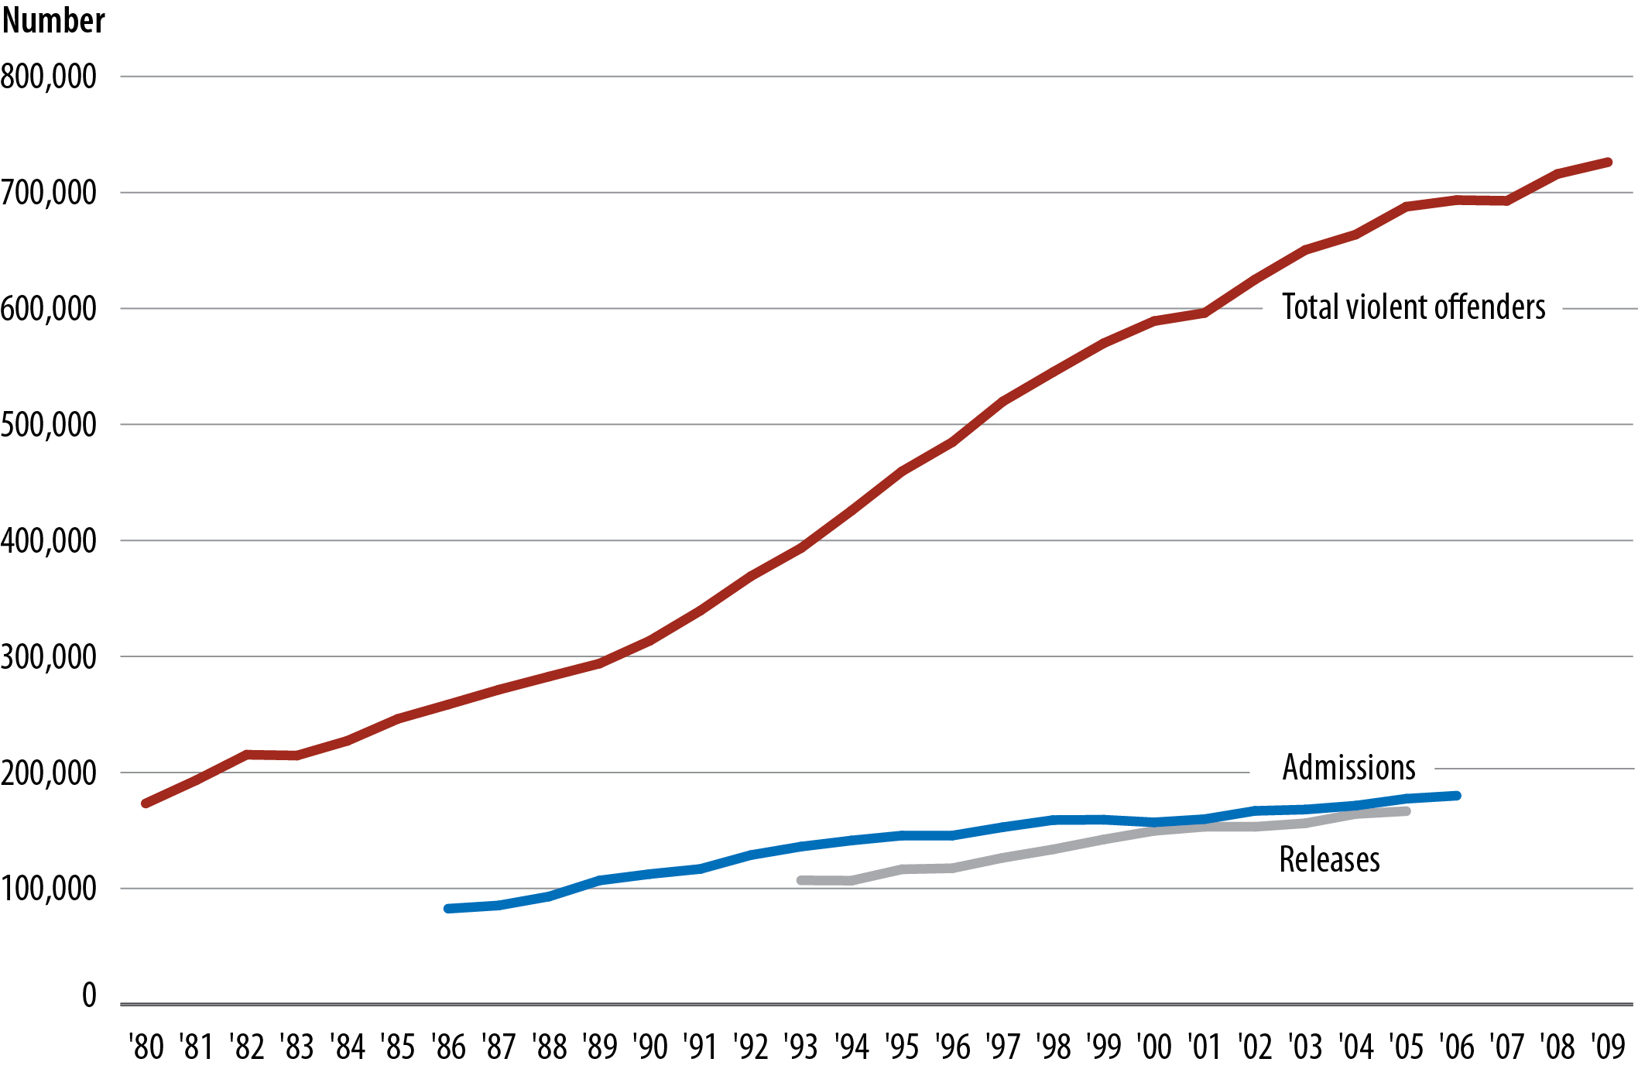
Figure 5. Violent offenders in state prison, by admissions and releases, 1980–2009
Source: Bureau of Justice Statistics, National Corrections Reporting Program and National Prisoner Statistics Program.

Slide 7
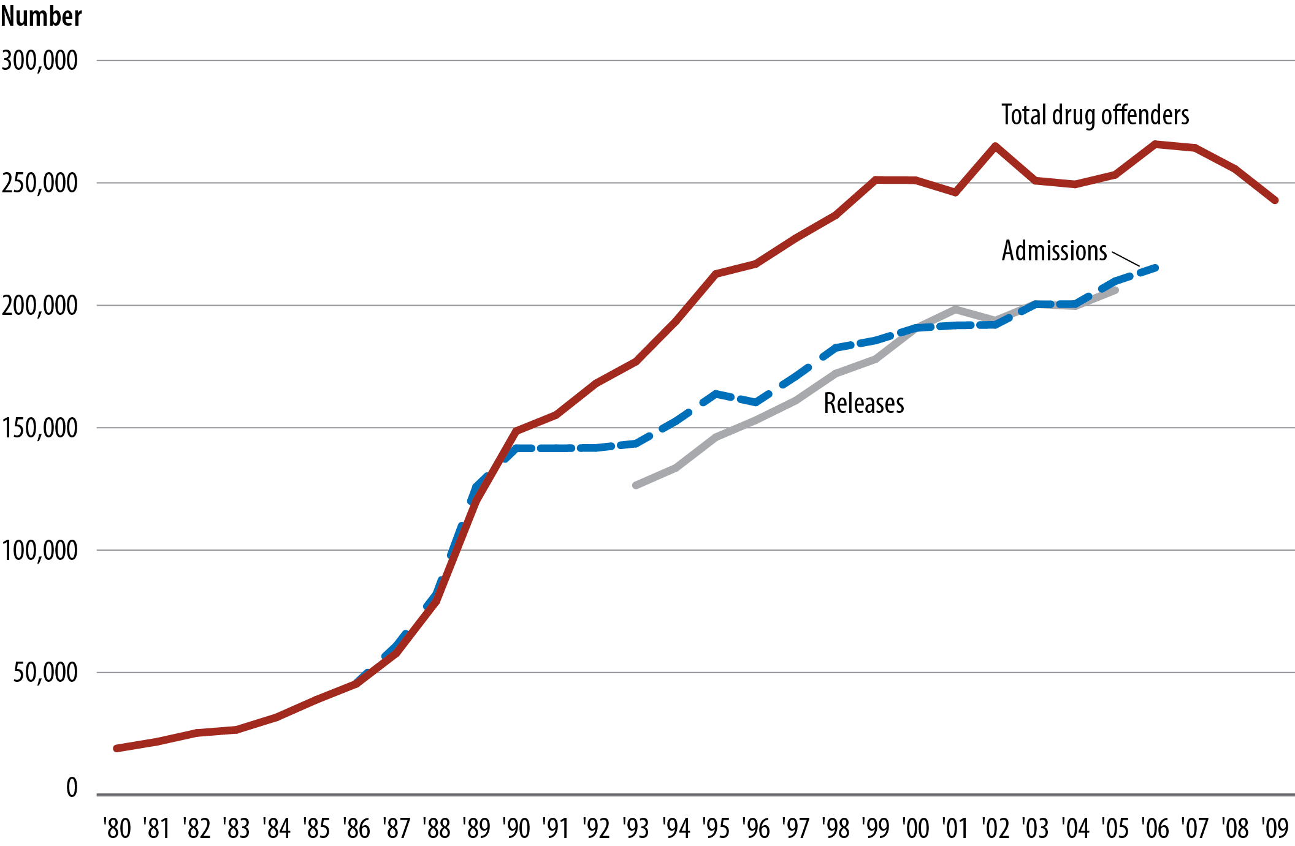
Figure 6. Drug offenders in state prison, by admissions and releases, 1980–2009
Source: Bureau of Justice Statistics, National Corrections Reporting Program and National Prisoner Statistics Program.

Slide 8
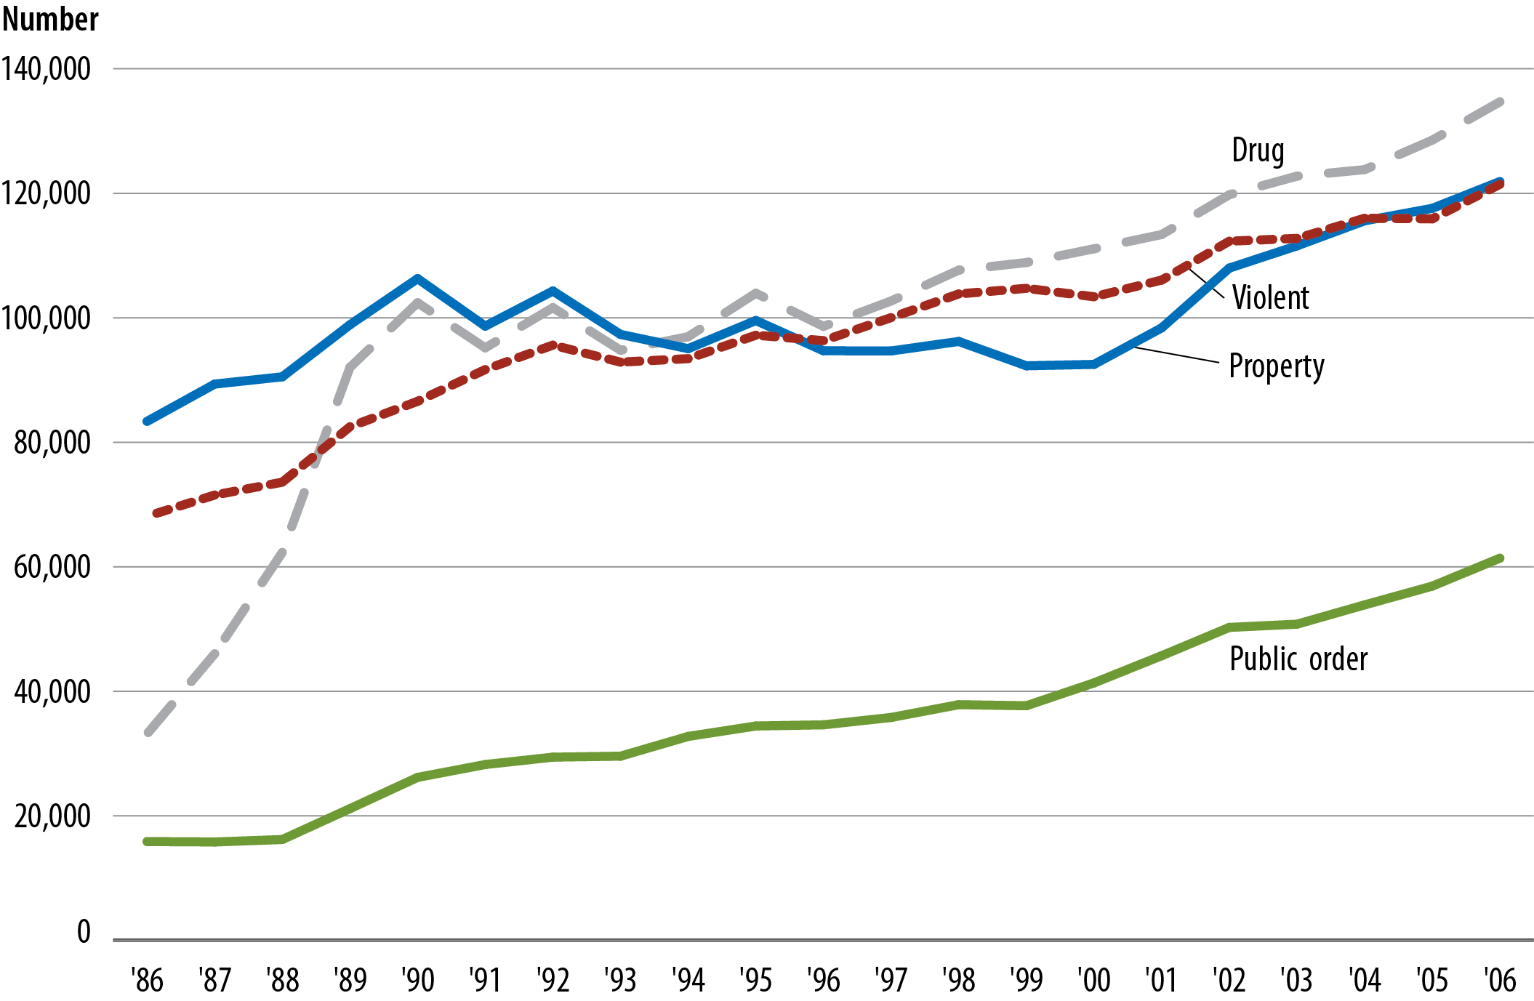
Figure 7. New court commitments to state prison, by offense, 1986–2006
Source: Bureau of Justice Statistics, National Prisoner Statistics Program and National Corrections Reporting Program.

Slide 9
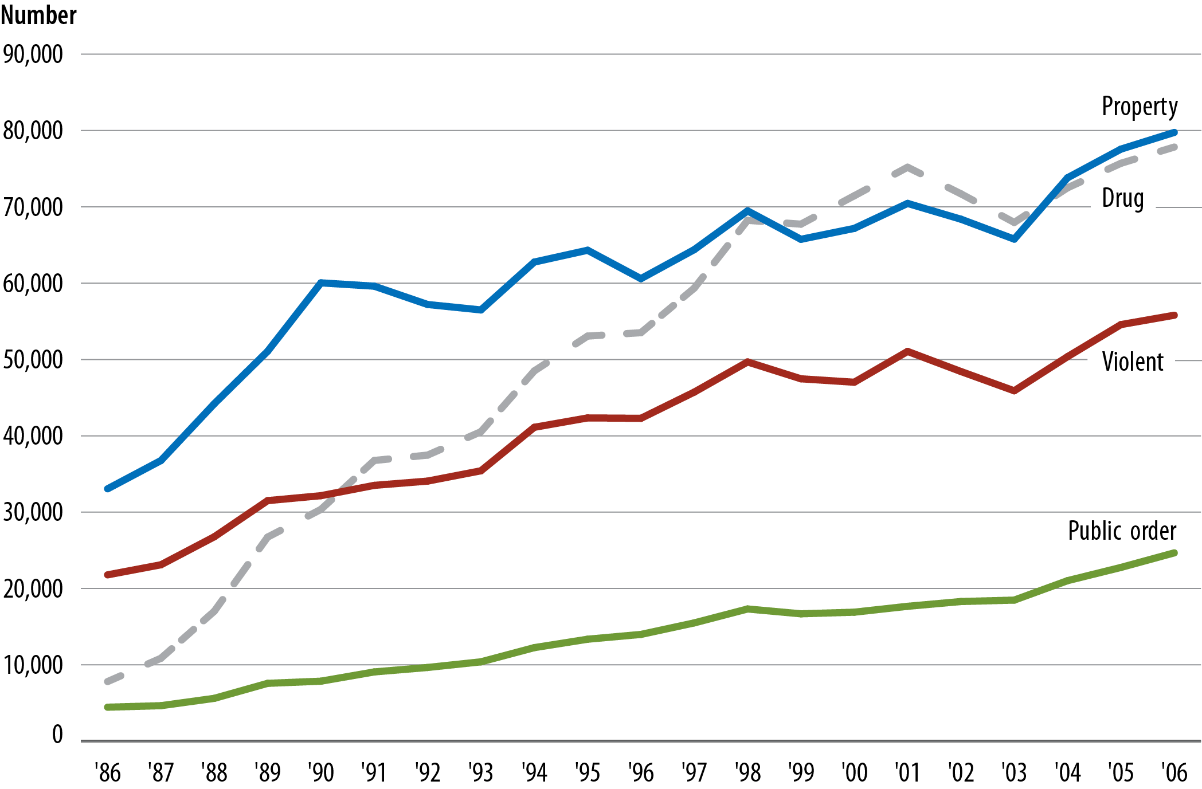
Figure 8. Parole violators admitted to state prison, by offense, 1986–2006
Source: Bureau of Justice Statistics, National Prisoner Statistics Program and National Corrections Reporting Program.

Slide 10
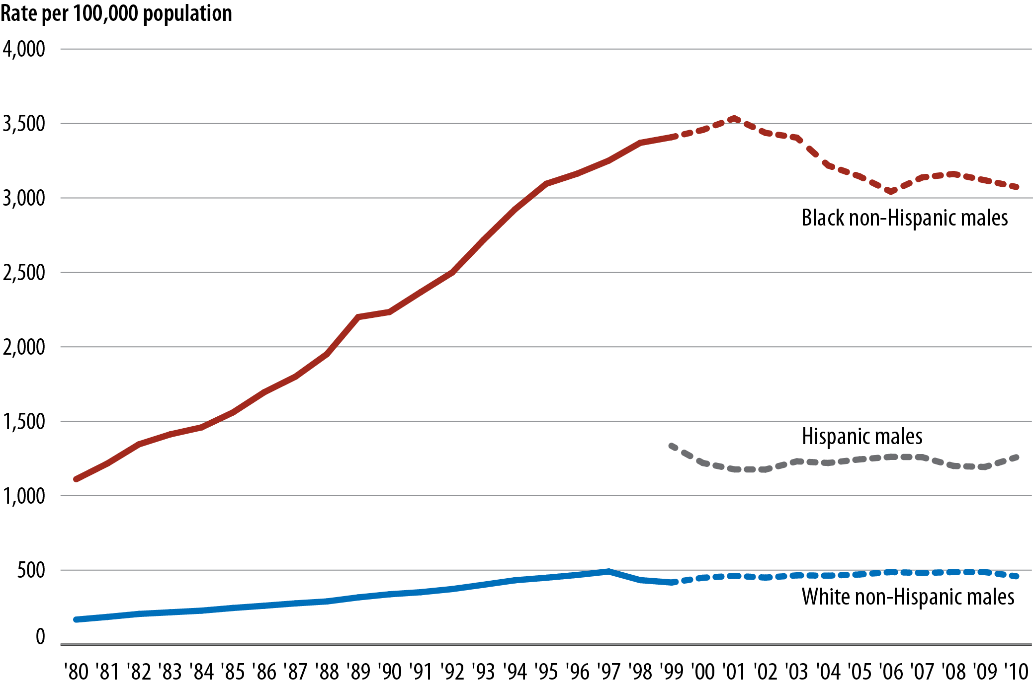
Figure 9. Sentenced male prisoners under state or federal jurisdiction per 100,000 residents, by race and Hispanic origin, 1980–2010
Note: Data for whites and blacks from 1980 through 1999 include persons of Hispanic origin.
Source: Bureau of Justice Statistics, National Prisoner Statistics Program and Survey of Inmates in State Correctional Facilities, 2004.

Slide 11
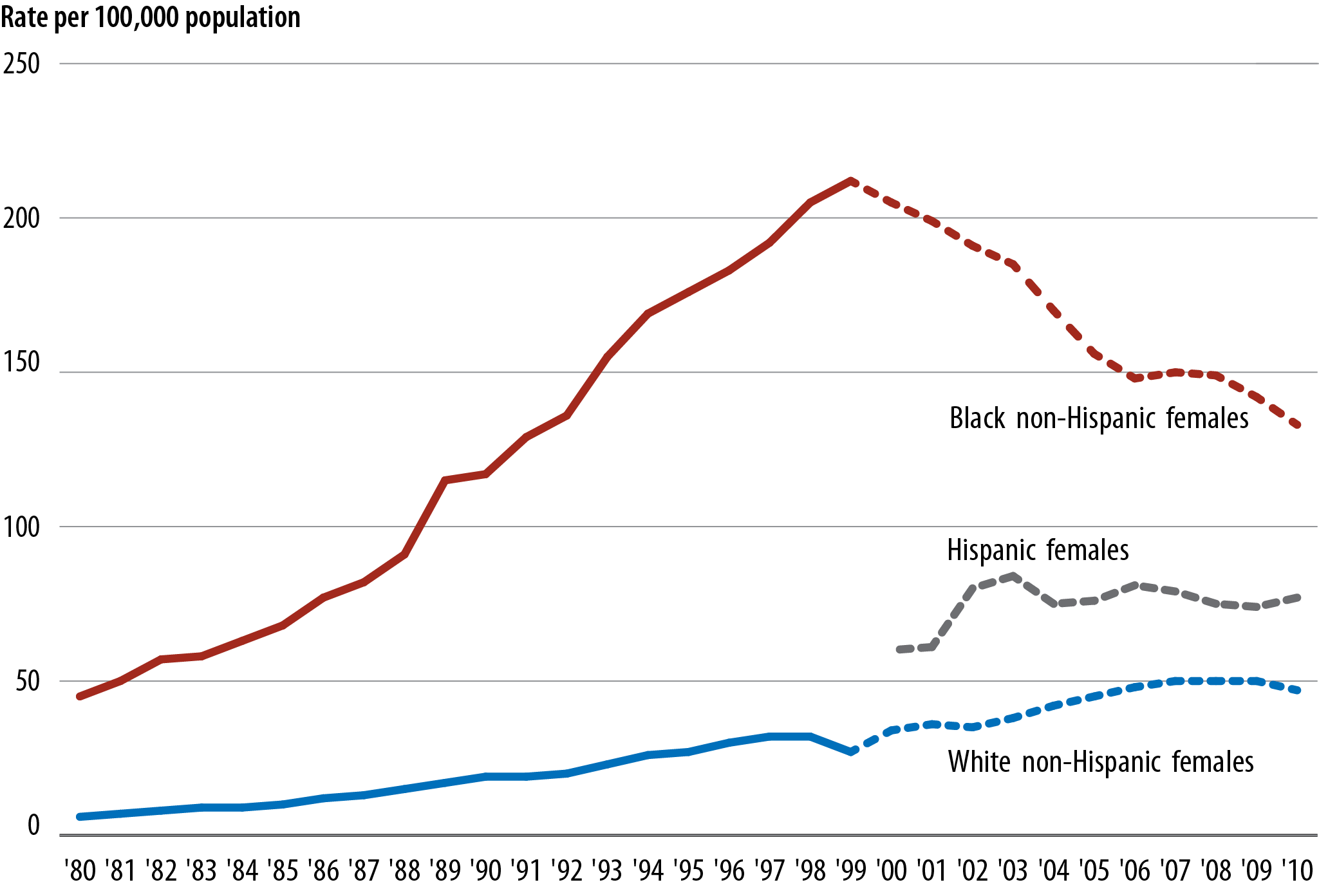
Figure 10. Sentenced female prisoners under state or federal jurisdiction per 100,000 residents, by race and Hispanic origin, 1980–2010
Note: Data for whites and blacks from 1980 through 1999 include persons of Hispanic origin.
Source: Bureau of Justice Statistics, National Prisoner Statistics Program
and Survey of Inmates in State Correctional Facilities, 2004.

Slide 12
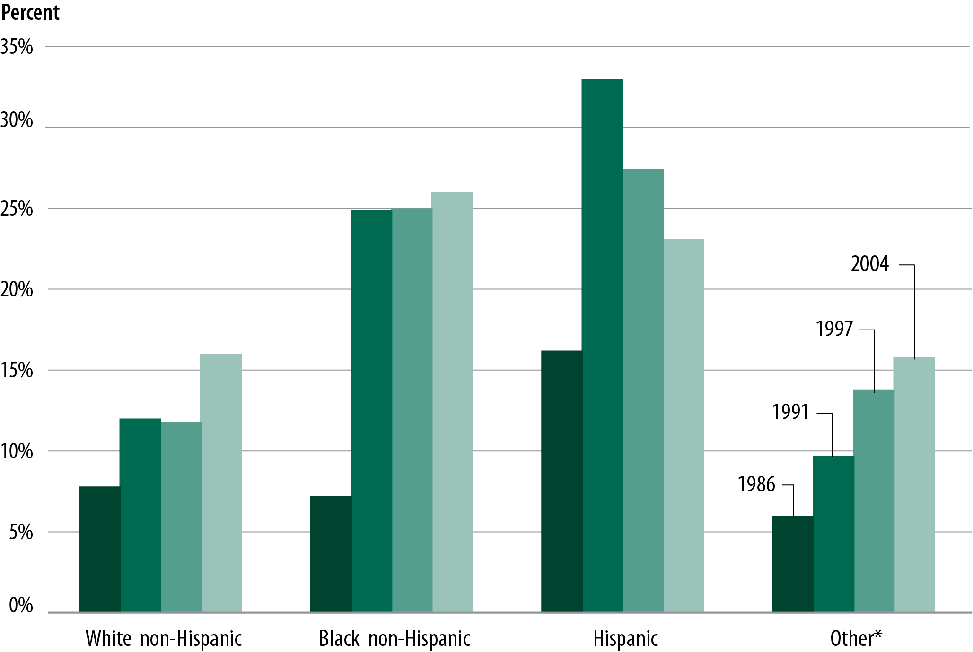
Figure 11. Drug offenders in state prison, by race and Hispanic origin
Note: Other race includes American Indian or Alaska Native, Asian, Native Hawaiian or other Pacific Islander.
Source: Bureau of Justice Statistics, Survey of Inmates in State Correctional Facilities.

Slide 13
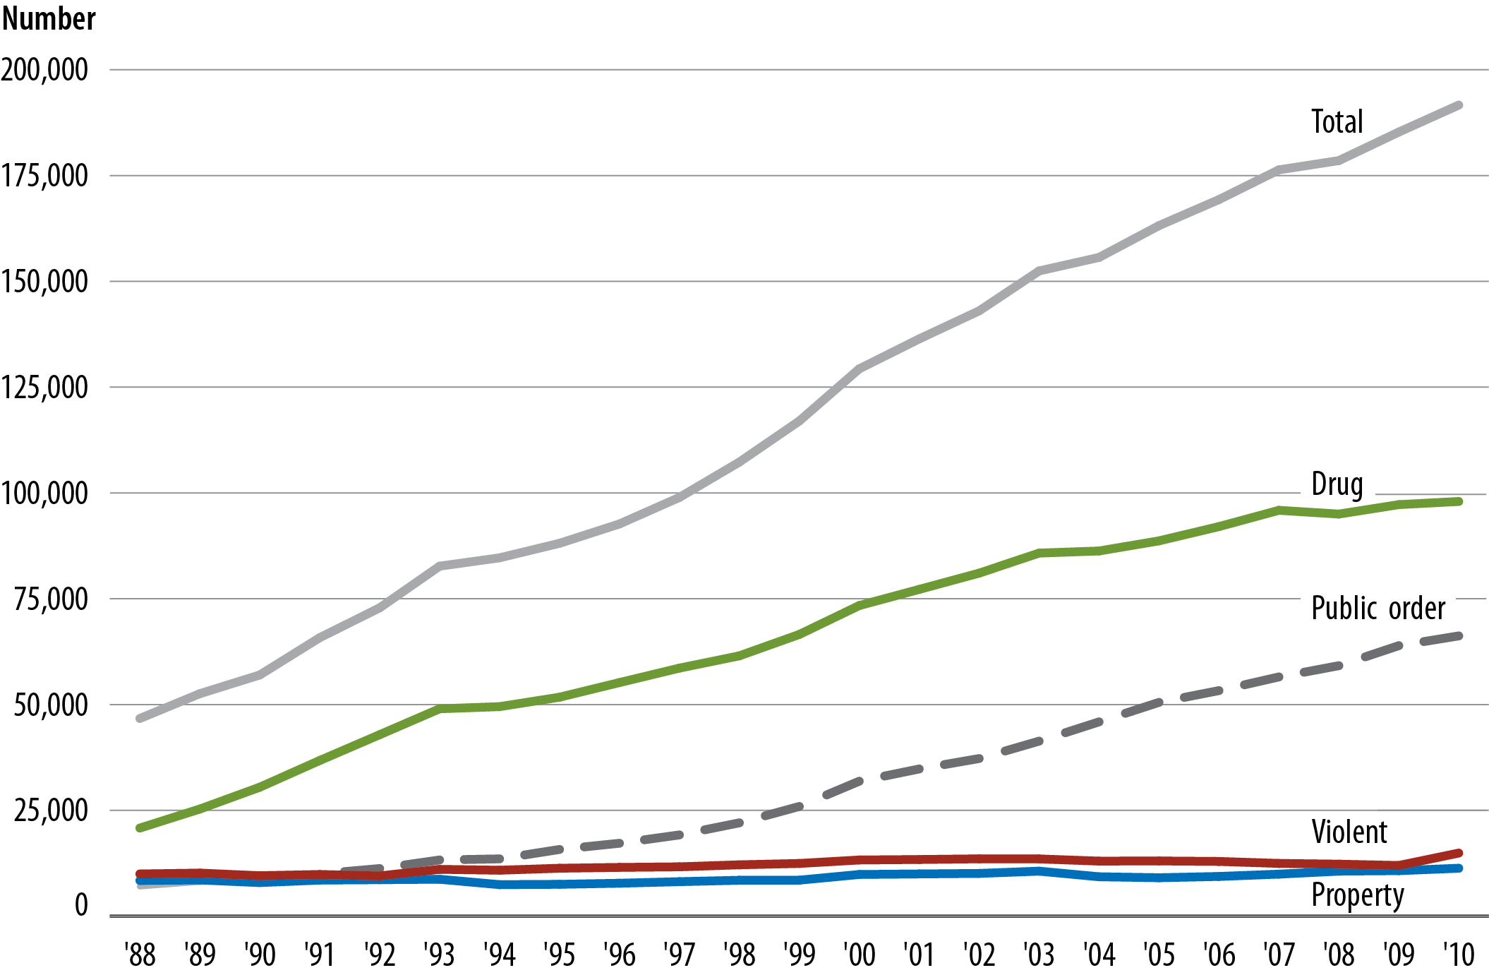
Figure 12. Number of federal prisoners, by offense, 1988–2010
Source: Bureau of Justice Statistics, Federal Justice Statistics Program.

Slide 14
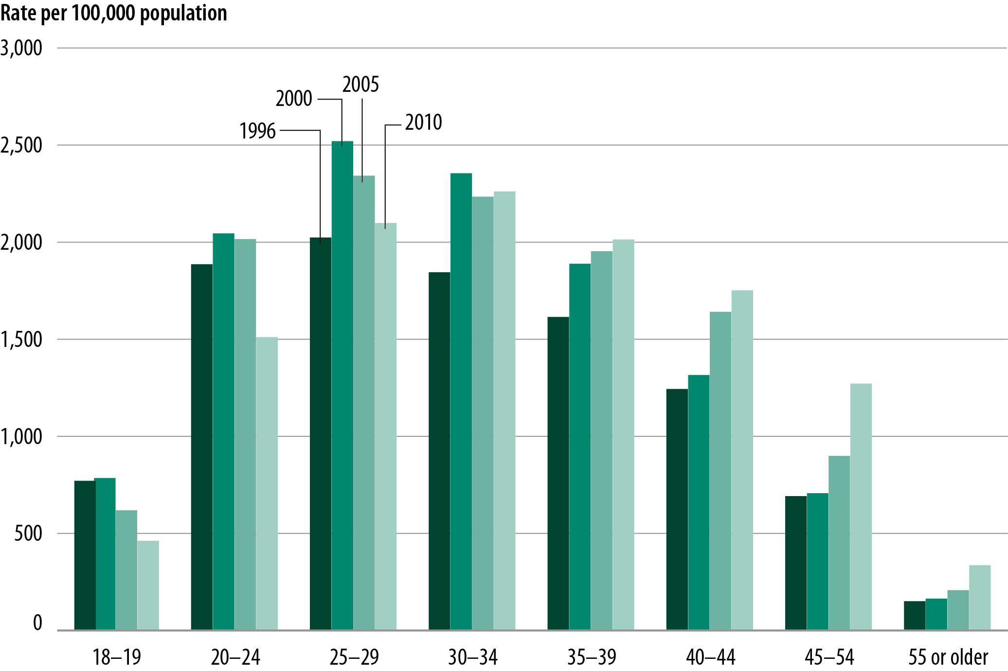
Figure 13. Sentenced male prisoners, by age
Source: Bureau of Justice Statistics, National Prisoner Statistics Program, Survey of Inmates in State and Federal Correctional Facilities,
National Inmate Survey, and Federal Justice Statistics Program.

Slide 15
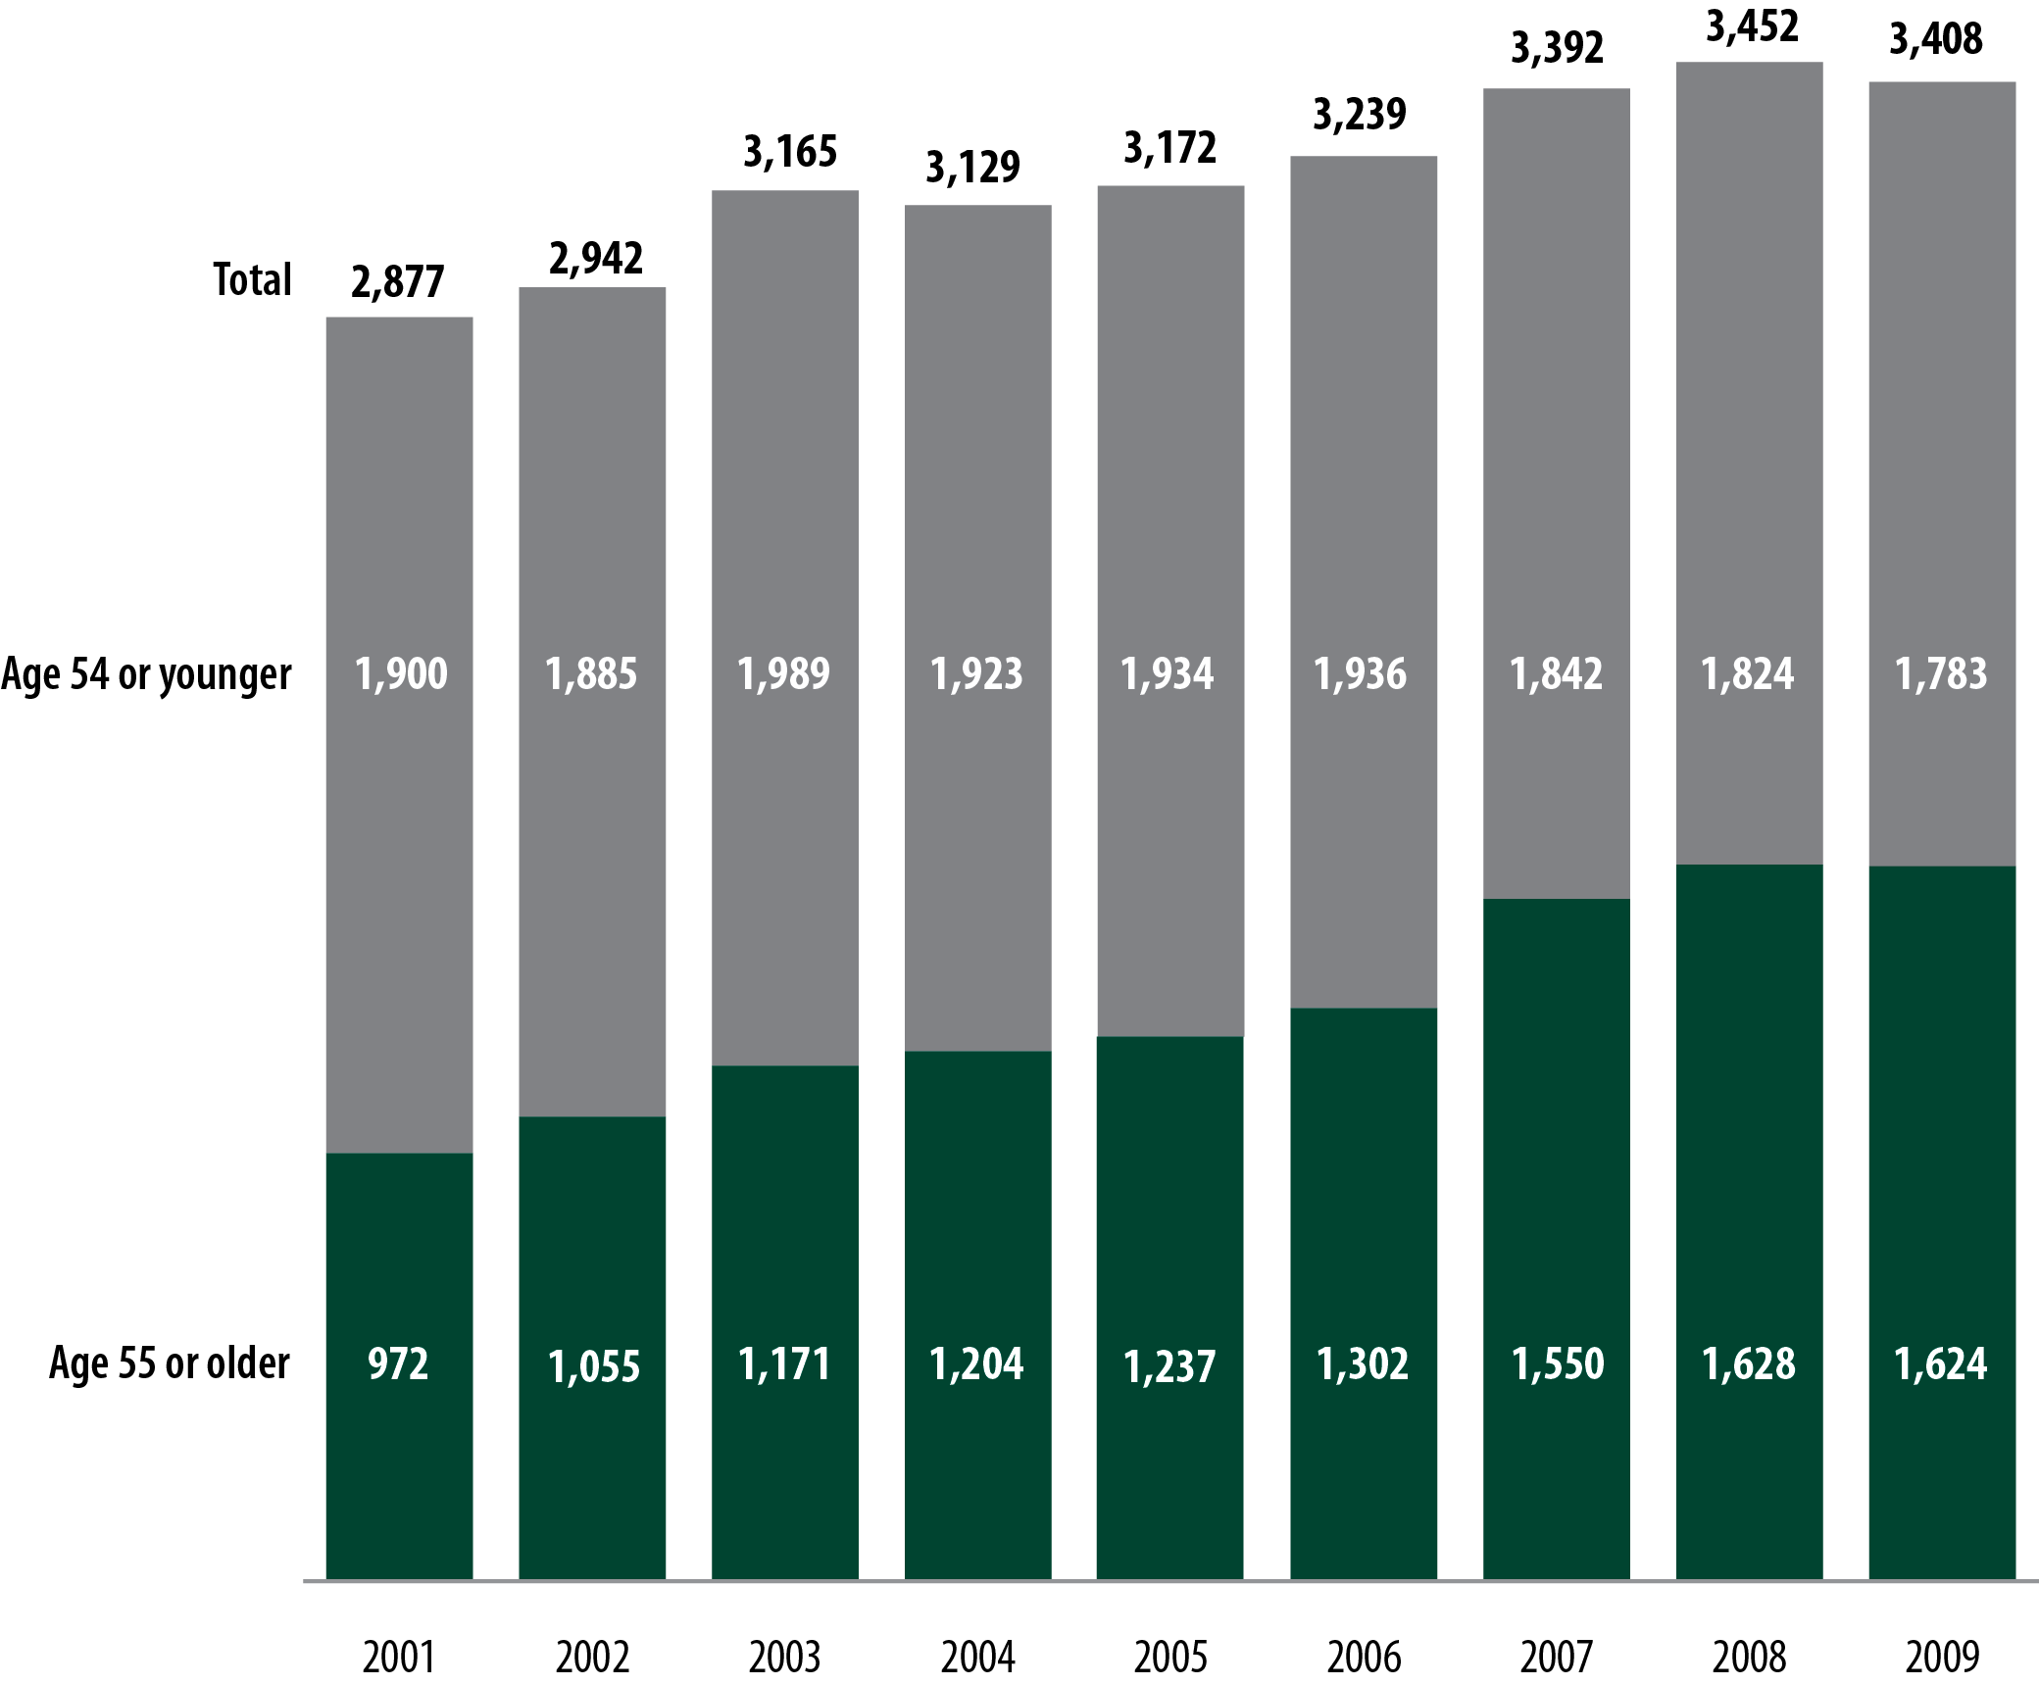
Figure 14. State prison inmate deaths in custody, by age, 2001–2009
Note: Detail may not sum to total due to missing data.
Source: Bureau of Justice Statistics, Deaths in Custody Reporting Program, 2001–2009.

Slide 16
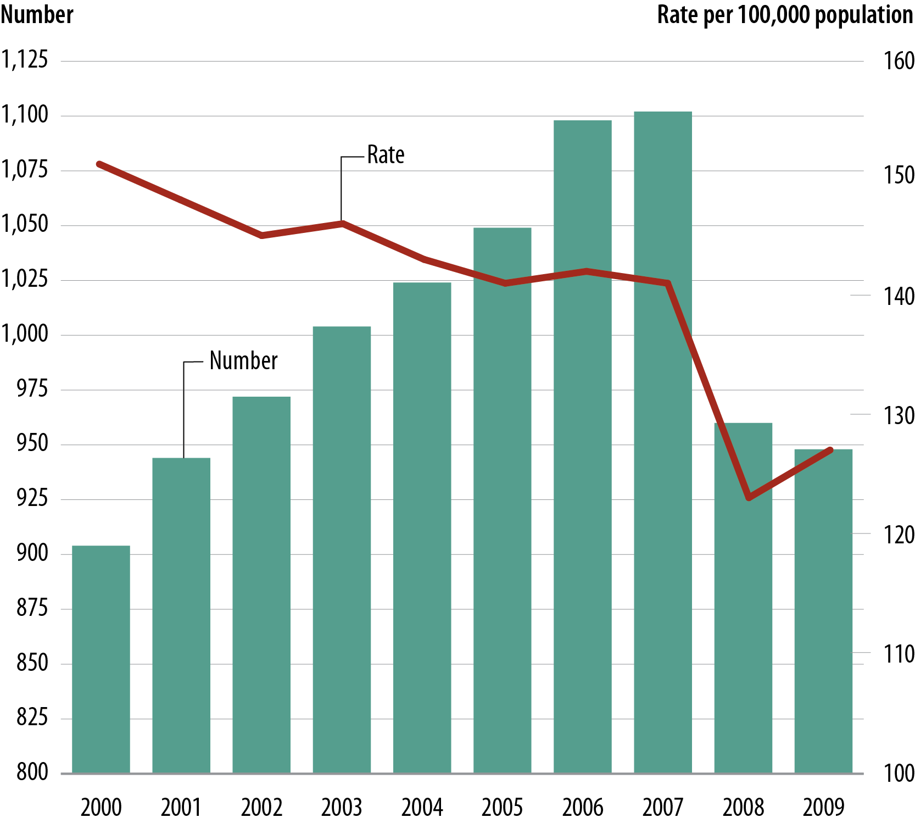
Figure 15. Jail inmate deaths in custody, 2000–2009
Source: Bureau of Justice Statistics, Deaths in Custody Reporting Program, 2000–2009.

Slide 17
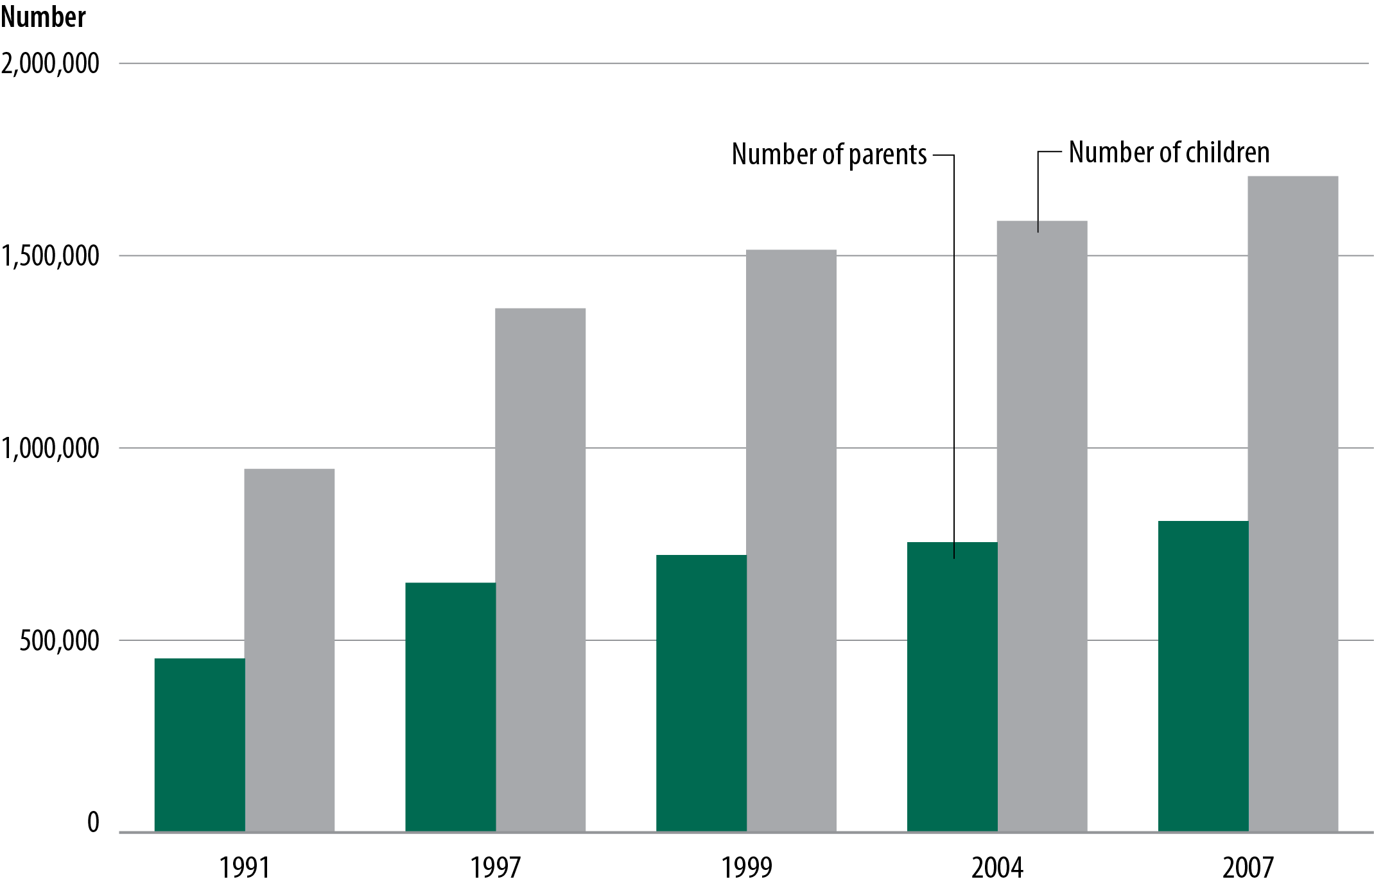
Figure 16. Parents in state prison and their children under age 18
Source: Bureau of Justice Statistics, Survey of Inmates in State Correctional Facilities, 2004.

Slide 18
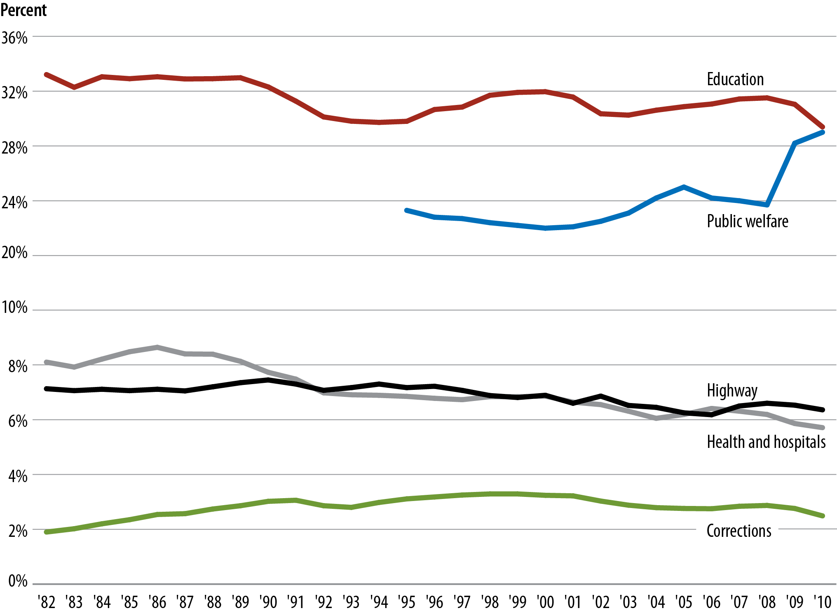
Figure 17. State expenditures, by function, 1982–2010
Note: Interpret with caution. Scale has been adjusted to show subtle changes in data.
Source: Bureau of Justice Statistics, Justice Expenditures and Employment Extract Tables.

