Slide 1
New Technology in Prisons and Jails: Impact on Safety, Cost, and Offender Rehabilitation
Professor James Byrne

Slide 2
Hard And Soft Prison Technology
Hard Technology
Contraband detection devices used in prison/jail
Duress alarm systems for corrections officers in indoor and outdoor settings
Language translation devices for use within prisons
Remote monitoring of inmate movements in cells and throughout prison
Perimeter security technology; new cell extraction technology
Less than lethal force in prison
Othe r(e.g. the Supermax prison)
Soft Technology
inmate classifications systems
New monitoring technology for inmate phone calls and financial transactions
Within-prison crime analysis and response capabilities (examination of incident/sanctioning patterns, including transfer, segregation, loss of privileges, etc. identification of high rate offenders and/or prison hot-spot locations)
Information sharing with community corrections, police, treatment providers (continuity/seamless system), and public health system
Monitoring of inmate health problems (e.g. mental and physical)
Other (e.g. testing new technologies in a simulated “mock” riot; using software to model death row outcomes

Slide 3
What is the Link between New Technology and Safety?
Staff Safety: Public vs. private; security level variations
Inmate Safety: Variations by type of injury( self-injury, assaults by inmates, assaults by staff)
Community Safety: Escapes

Slide 4
Is New Technology Cost Effective?
Cost of Corrections: 60 Billion and climbing
Cost of New Technology: People vs. thing Technology; short-term control vs. long term change

Slide 5
New Technology and Justice Reinvestment
What is Justice Reinvestment? Reallocation of prison funds to community corrections initiatives
How can Simulation Modeling be applied to impact assessment? BJA study

Slide 6
Can We Use Technology Change Prisoners: What Works?
Technology of Control: we can reduce inmate-on inmate violence using control strategies, but it will increase the level of self-injury and assaults on staff
Technology of Offender Change: Prison programming matters

Slide 7
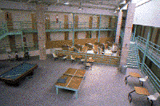
Prison Violence
A review of the official data on the extent of the prison violence problem (murder, rape, and assault) suggests that the most serious forms of violence are rare in federal and state prisons
The rate of violence in federal and state prisons is actually slightly on the decline, despite the doubling of our prison population in the last decade (Useem & Piehl, 2006).

Slide 8
Numbers Vs. Rates
Examination of data from the 2000 Census of State and Federal Correctional Facilities revealed that “the number of assaults, including both physical and sexual assaults, was 32% higher [in 2000] than in a similar period preceding the 1995 census” (Stephan & Karberg, 2003, p. vi).
In 2000,there were 34,000 inmate-on-inmate assaults reported.

Slide 9
Do We have a Prison Violence Problem?
The Debate: Official vs Unofficial Estimates of the Level and Rate of Violence in Prison vary significantly for both violence and disorder.
Prison vs. Community Safety: A Recent BJS Report found that the Likelihood of homicide victimization among prisoners was 9 times greater in the community than in prison.

Slide 10
Mapping Offender Reentry: Why Do It?
High Risk Offenders vs. High Stakes Offenders: Who should we Target?
High Risk Locations: Can we change community risk level?
High Risk Times: When are returning offenders most likely to fail?

Slide 12
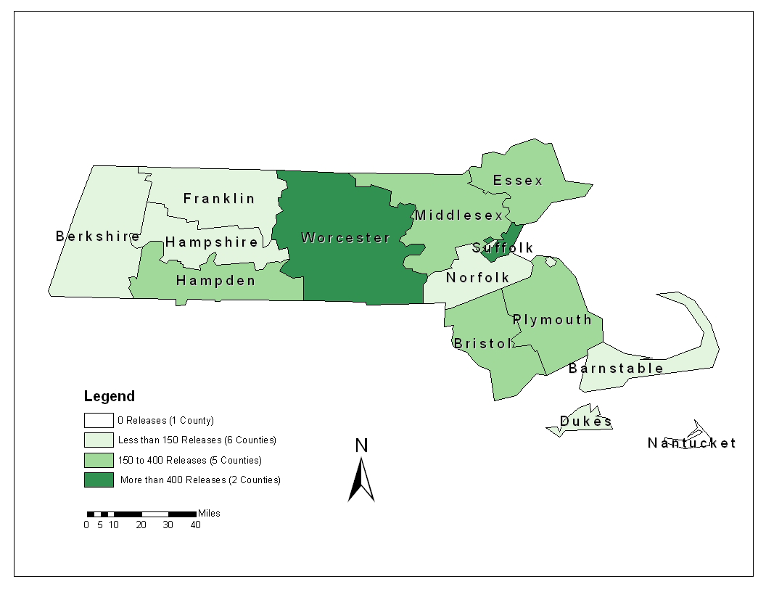

Slide 13
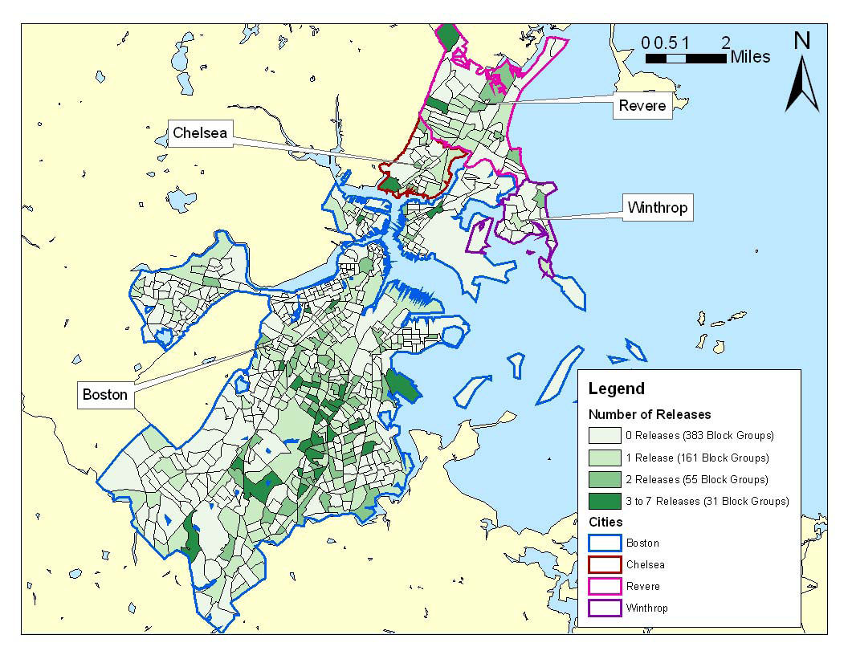

Slide 14
