Slide 1
The Implementation and Impact of Drug Courts
Drug Courts and the New Technology of Offender Change
James M. Byrne, Professor
March 26,2015

Slide 2
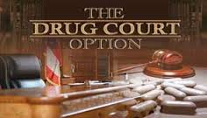

Slide 3
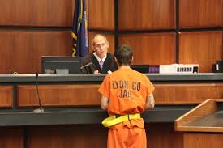

Slide 4
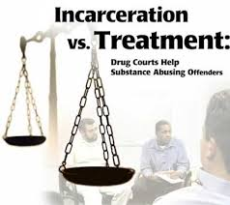

Slide 5
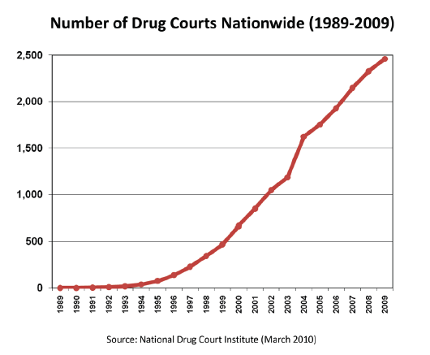

Slide 6
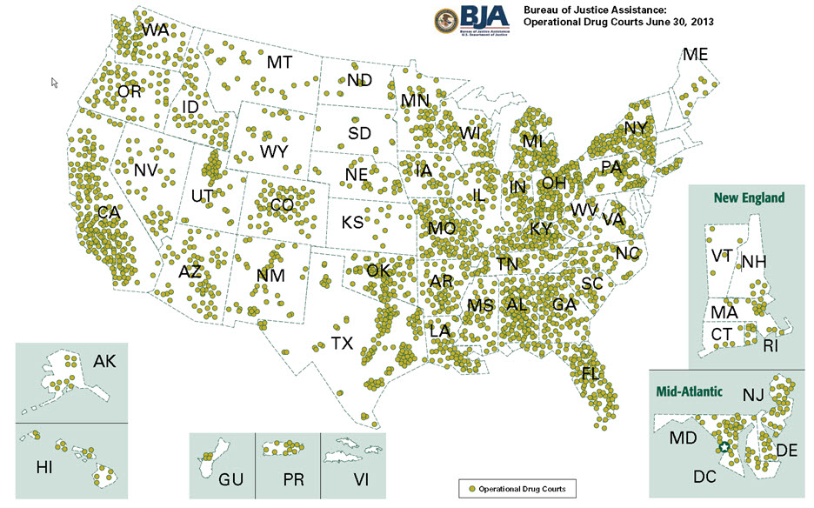

Slide 7
The Drug Court Movement
Number of Drug Courts :As of June 2014, the estimated number of drug courts operating in the U.S. is over 3400. By comparison, in December 31, 2007, there were 2,147drug courts in operation.
Capacity of Drug Courts: over 120,000 drug court clients are currently being served at any given time throughout the United States and its territories.
President Obama’s FY 2012 Budget request included $101 million for drug, mental health,and other problem‐solving courts, including Veterans Treatment, Tribal Healing to Wellness, and Family Dependency Treatment Courts.

Slide 8
Drug Courts: Pre-Conviction vs Post-Conviction Strategies
Old Strategies: the first generation of adult drug court programs, which tended to be diversionary or pre-plea models,
New Strategies: Today only 7% of adult drug courts are diversionary programs compared to 59% which are strictly post conviction.

Slide 9
Separating Alcohol-Related Offenses From Other Drugs
DWI Offenders: Recognizing that repeat DWI offenders pose a threat to society in a way very different from other offenders, many jurisdictions are establishing a distinct DWI court or a Hybrid DWI/drug court.
DWI Courts: Unlike drug courts, however, DWI Courts operate only at the post-conviction stage.

Slide 10
Drug Court Purpose: Why Do we Need A Specialized Court?
Drug Offenders pose a unique challenge to our court system; they are different than offenders who break other criminal laws.
Traditional Court Systems focus on determination of guilt and sanctions, not the addiction problem.
Judges need specialized training and courts need specialized services and supervision for drug offenders.

Slide 11
How Do Drug Courts Operate?
Drug courts represent the coordinated efforts of justice and treatment professionals to actively intervene and break the cycle of substance abuse, addiction, and crime.
Drug Courts are an alternative to less effective interventions,
Drug courts quickly identify substance abusing offenders and place them under ongoing judicial monitoring and community supervision, coupled with effective, long-term treatment services.

Slide 12
What Happens in a Drug Court?
A drug court participant undergoes an intensive regimen of substance abuse treatment, case management, drug testing, and probation supervision while reporting to regularly scheduled status hearings before a judge with specialized expertise in the drug court model.
Drug courts also provide a wide array of ancillary services such as mental health treatment, trauma and family therapy, job skills training, and many other life-skill enhancement services.

Slide 13
What is the Drug of Choice for Drug Court Participants?

Slide 14
Drug Types Vary by Location
Urban Drug Courts: cocaine/crack is the primary drug of choice for urban drug court clients,
Suburban Drug Courts: marijuana is the primary drug of choice for suburban drug court clients,
Rural Drug Courts: methamphetamine is the primary drug of choice for rural drug court clients.

Slide 15
Impact of Drug Courts: Do They Work?
OVERALL Impact: According to over a decade of research, drug courts significantly improve substance abuse treatment outcomes, substantially reduce crime ,and produce greater cost benefits than any other justice strategy

Slide 16
Research Findings: Drug Use, And
Other Criminal Behavior:
Drug Use: This is a difficult question to answer definitively.
Criminal Behavior: Four independent meta-analyses have now concluded that drug courts significantly reduce crime rates an average of approximately 7 to 14 percentage points

Slide 17
What is the Cost Effectiveness of Drug Courts?
California Researchers concluded that drug courts cost an average of about $3,000 per client, but save an average of $11,000 per client over the long term
The Multnomah County Oregon Drug Court was found to cost less than business as usual for drug offenders, because probationers typically have multiple failed treatment experiences that are very expensive but elicit few gains.

Slide 18
Variations on a Theme: Emerging Models
DWI Court
Family Dependency Treatment Court
Gambling Court
Reentry Court
Federal District Drug Court
Juvenile Drug Court
Mental Health Court

Slide 19
Drug Court Technology and Individual Offender Change
Hard Technology Innovations: New Drug testing Devices, New Drug Treatment Strategies involving drug replacement.
Soft Technology: New Classification Systems designed to target offenders amenable to treatment in a drug court setting, new information sharing protocols, and case management systems

Slide 20
Tipping Point: What is the Link Between formal and informal social controls?
Why Do we use and abuse drugs and alcohol?
Why are some drugs legal and others illegal?
Can drug users be forced to change using the threat of sanctions and mandatory treatment?

Slide 21
