Slide 1
Using Hard Technology to Make Prisons and Jails Safer : Does It Really Work?
Professor James Byrne

Slide 2
Examples of Hard Technology Innovations in Prison and Jail Settings
Contraband detection devices used in prison/jail
Duress alarm systems for corrections officers in indoor and outdoor settings
Language translation devices for use within prisons
Remote monitoring of inmate movements in cells and throughout prison
Perimeter security technology
New cell extraction technology
Less than lethal force in prison
Other hard technology applications in prisons and jails (e.g. the Supermax prison)

Slide 3
1.Contraband detection devices used in prison/jail

Slide 4
3 Types of Contraband Detection Devices Used in Prisons and Jails
Concealed Weapon and Contraband Imaging Detection Systems (CWCIDS): Hand-held and walk through metal detectors are the most frequently used devices in prisons and jails.
Limitations: can not detect non-metallic objects, and drugs.
Ion Mobility Spectrometer (IMS) Scanning: effective in identifying drugs, but better at detecting coke(90% accurate) than pot (24%). Mobile IMS scanners can be used in cells.
Backscatter X-Ray: can detect metallic and non-metallic contraband.
Limitations privacy, exposure to radiation

Slide 5
NIJ Public-Private Development Initiatives: New Directions
One NIJ-sponsored pilot program that enjoyed success used a millimeter wave imaging system to scan visitors at the Graterford State Correctional Institution in Pennsylvania.
The imaging system can look through clothing to detect weapons, cell phones and nonmetallic objects.
Currently used by the TSA to scan passengers at airports, the system was tested and evaluated at Graterford, a maximum-security facility that houses about 3,100 inmates outside Philadelphia.

Slide 6
The Effectiveness of New Scanner Technology
Speed: The Graterford system completed between 400 and 600 scans in a typical week, and each scan was completed in seconds. “It really didn’t slow down the [screening] process.”
Cost: The manufacturer made the system available for free during the testing period, and NIJ coordinated the pilot project because it provided an opportunity to do an operational evaluation in a correctional environment that involved a commercially available system.
Detection: Overall, the millimeter wave system improved the contraband situation at Graterford. On several occasions, the system detected cell phones. It appears to deter smuggling.
Limitations: Although this technology detects contraband hidden under clothing, it does not detect contraband secreted in body cavities
Privacy Concerns: Millimeter wave systems have been controversial because they present images of bodies so well — similar to nude photographs — that some people consider the systems intrusive.

Slide 7
New Portable Scanner Spots Improvised weapons

Slide 8
2.Duress Alarm Systems for corrections officers in indoor and outdoor settings
Type I: Panic Button Alarm. These basic systems use buttons located on walls, underneath desks, and near doorways. Pushing a button transmits a dedicated signal to a central alarm console. Using visible and/or audible enunciations, the alarm console identifies the location of the event where the alarm was triggered.
Type II: Identification Alarm. In Type II systems, portable transmitters broadcast a wireless signal to a nearby sensor, which forwards the alarm to a central console. The alarm signal includes an identification code that tells the dispatcher who sounded the alarm. Because officers carry these transmitters with them, they can sound an alarm from almost anywhere within a facility.
Type III: Identification/Location Alarm. Type III systems operate much like Type II systems, with the added feature of tracking corrections facility staff members and pinpointing the alarm location. An extensive wireless infrastructure identifies, localizes, and tracks the transmitting device; the system may produce a positioning symbol on a console panel or a map-like display at a central alarm location.

Slide 9
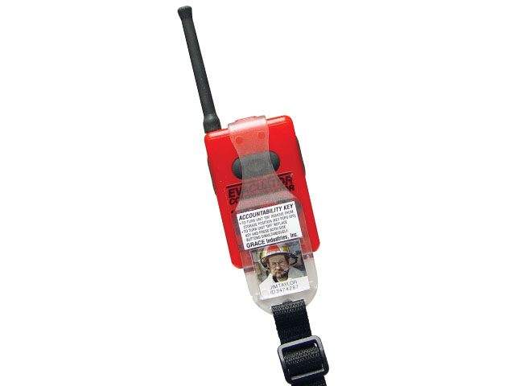
TPASS 3 Evacuate IS-R Two-Way Signaling Radio Transceiving Personal Alert Safety System (PASS) Device.

Slide 10
There is no Independent Research on the Effectiveness of Duress Alarm Systems
Identification/Location alarms are viewed as the current “state of the art” but the cost of purchasing these systems is much higher than the cost of the other two systems.
No independent evaluation findings can be found to validate vendor claims of the effectiveness of these 3 duress systems in in reducing officer injuries and deaths.
New Duress systems are being designed to incorporate both GPS and RFID technology.

Slide 11
3.Language Translation Devices for use within prisons

Slide 12
Types of Language Translation Devices
Voice Response Translators (VRT): a portable electronic translation device that emits short, prerecorded phrases in several languages.
CopTrans: a two-way translation software that allows two users to speak, each in his or her own language,and then translates into the other language.
Phraselator: a handheld, one-way, voice-to-voice translation system that translates English into one or more target languages.
SYSTRAN Software: offers desktop products, client/server systems, and Internet services that may be applicable to law enforcement and corrections in translating website content, documents, letters, e-mails, and other text into 36 languages.

Slide 13
Voice Response Translators
The Voice Response Translator (VRT) is currently being tested in both military and various CJ environments.
The U.S. Department of Defense’s Special Operations Command and the Coast Guard have placed orders for the VRT, which costs $3,000 per unit and includes a 5-year warranty, training, and technical support.
The VRT user selects a language and speaks a trigger phrase in English into the VRT.
The VRT uses voice recognition technology to determine which phrase to emit in response to the spoken command.
http://www.au.af.mil/au/awc/awcgate/nij/nothlostfall03.pdf

Slide 14
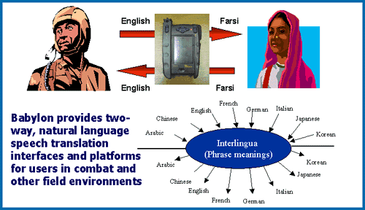

Slide 15
4.Remote Monitoring of inmate movements in cells and throughout prison

Slide 16
Three Types of Remote Monitoring Technology
1.Radio Frequency Identification Devices (RFID): used to track inmate movements within prison.
RFID systems are wireless; inmates wear transmitters that communicate real time prisoner location data to a central information center
Extent of Use: implemented in several large state prison systems, including California, Illinois, Michigan, and Ohio
2.Biometric Monitoring Systems, using hand geometry or fingerprint detection devices to allow/restrict access to locations within prison.
Extent of Use: No large scale use to date
3. Smart Card Systems, using credit card sized smart cards that contain the inmate’s photo and a circuit chip that stores info about each inmate.
Extent of Use: No large scale use to date

Slide 17
Pinpointing Prison Hotspots: RFID Technology
One potentially promising approach involves radio frequency identification (RFID) technology, which uses small transponders called “tags” to track movements.
RFID tags can be attached to or incorporated into a variety of objects, such as wristbands.
Each tag has an integrated circuit and a tiny antenna to handle radio signals and can be used with a network of sensors — called RFID readers — to track movements.

Slide 18
Offender Location, Movement and Prison Management: Research Findings
Extent of Use: RFID technology has been used to track inventory in warehouses, but its use in correctional facilities is relatively new.
A few correctional institutions have used the systems to provide information on prisoners’ movements and to alert staff if there is an unusual concentration of people in a certain area.
Movement information may prove useful in investigations to determine who was present in a certain part of a building at a particular time.

Slide 19
Expected RFID Outcomes : Short Term Detection Increase
RFID makes possible closer and continuous monitoring of inmates and, thus, is expected to increase the detection of prohibited behaviors.
Many authorized movements, even when they result in inmate-on-inmate assaults, may have previously gone undetected or at least undocumented.
With RFID, these movements should result in a documented alarm, triggering protocols for officer response and documentation in facility incident data.
The short-term outcome of RFID introduction is an expected increase, rather than decrease, in the number of inmate behavior-related incidents tracked in facility data .

Slide 20
Expected RFID Outcomes : Long Term Deterrence
Indicators of unauthorized inmate activities are expected to “peak” early in the period following full implementation, (i.e., the point at which RFID reaches its maximum ability to detect previously undetected activities).
Subsequently, indicators of unauthorized inmate activities would begin to decline (as a result of deterrence).
This would be expected as
(1) inmates become more certain that such activities will be detected and negative consequences will result and (2) staff response protocols are adjusted for certain types of RFID alarms.
http://www.ncjrs.gov/pdffiles1/nij/grants/225449.pdf

Slide 21
5.New Perimeter Security
Correctional facilities should always have a security technology enhancement plan (STEP).A STEP has several operational segments:
• Perimeter security. Includes lighting, fencing materials, electronic detection of movement on the perimeter, equipment for staff duty stations (sally ports, towers and vehicles) and electronic contraband detection.
• Staff and inmate communication. Involves technology related to intercoms, radios, telephones, emergency callback systems, pagers and cell phones.
• Contraband detection. Entails metal detectors, x-ray
machines and technologies such as ion scanners.
http://www.justnet.org/TechBeat%20Files/STEP%20Up%20to%20Prison%20Security%20Planning.pdf

Slide 22
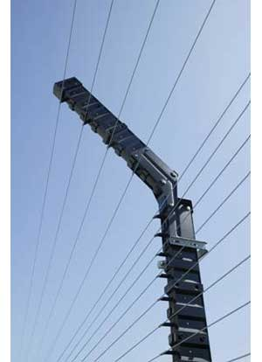
Perimeter security technology
Intended to deter escape and prevent intrusion into prison environments, Oldcastle Security's Guardtower solution is a non-lethal electric fence that can detect wire movement in any direction.

Slide 23
Effectiveness of Perimeter Security Technology
Perimeter Security works: Escape Attempts are rare; successful escapes are even rarer. We do not know what works best, however.
New Technologies have not been evaluated:
1.Additional video cameras and increased lighting have been introduced in several large prison systems, but no independent evaluation of the cost effectiveness of these new investments have been conducted to date.
2.Sensor fences are also being implemented with claims of low cost, low maintenance, and low false alarm rates; but no research can back up these claims

Slide 24
6.New Cell Extraction Technology

Slide 25
7.Less than Lethal Force in Prison
Three Types of Non-Lethal Force Technology in Federal and State Prisons:
Oleoresin capsicum (pepper spray)
Diversionary (flash bang) devices
Impact Munitions( bean bags, plastic, or rubber, bullets)
Evaluation Research on the use of these weapons in prison is not available.
Issue :Private Prisons and Non-Lethal Force
http://law.rightpundits.com/?p=705

Slide 26
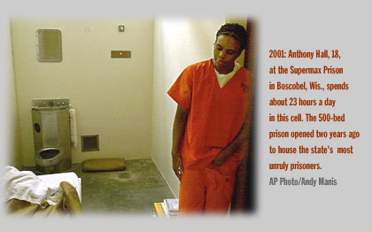

Slide 27
8.New Prison Design: The Supermax Prison
What is a Supermax? A New prison designed to control inmates defined as high violence risk, or who require special management due to their crime type( e.g. serial killers and terrorists)
Extent of Use: 1% of all prisoners( about 20,000 inmates) are currently housed in a super-max facility, where they are confined to their cell for up to 23 hours each day.
Evidence of Effectiveness: mixed; Prison Wardens like it, but questions can be raised on the use of this level of social isolation.

Slide 28
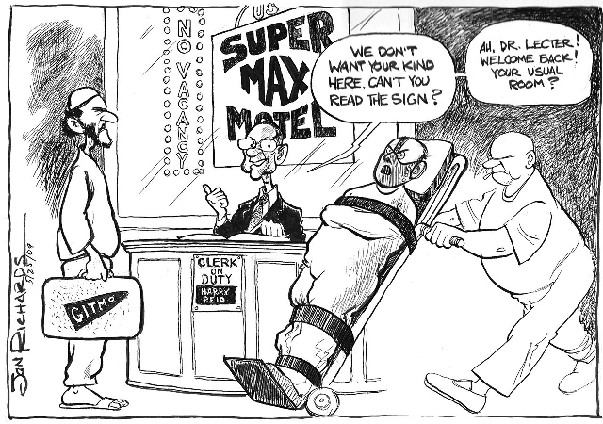

Slide 29
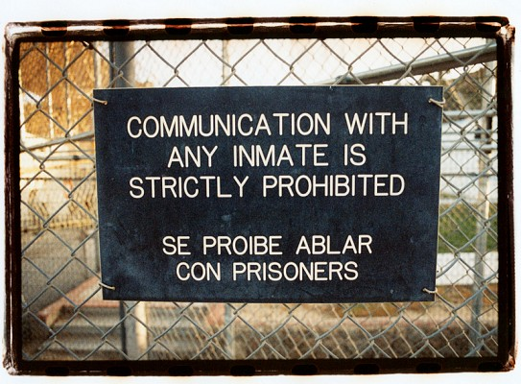

Slide 30
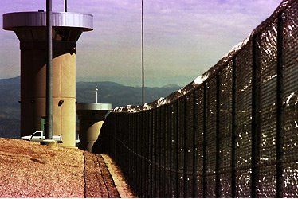

Slide 31
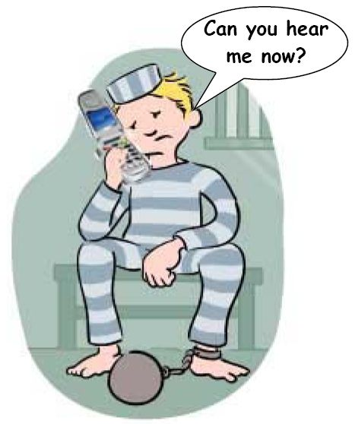
9.The Problem of Cell Phones in Prison: Detection Technology

Slide 32
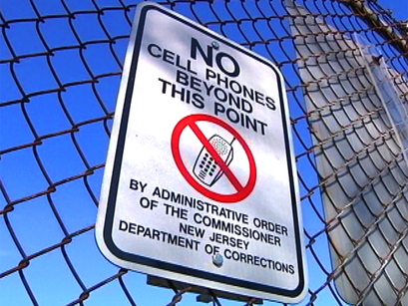

Slide 33
Cell Phone Detection: New Technology
At the New Jersey State Prison inmate check-in starts with a seat on the B.O.S.S. chair.
The "Bodily Orifice Security Scanner“( BOSS) detects any contraband prisoners may be hiding, anywhere inside themselves.
In the past corrections officers were looking for drugs and weapons but now they focus more and more on cell phones.
Across the country mobile phones are finding a way into prisoner's hands.
Nearly 400 cell phones were confiscated from prisoners in New Jersey last year.

Slide 34
Why Do Prisoners Need Cell Phones? 3 Reasons
To Facilitate the commission of crimes on the outside,
To Help plan escapes,
To Tell friends on the outside to retaliate against witnesses who are going to testify at trial against some of the inmates in jail.

Slide 35
Dogs and Cell Phone Detection
NJ Department of Corrections developed a new program to sniff out cell phones once they get inside of prisons, and prisoners: Dogs.
New Jersey is one of the only states where the dogs are both trained and used by corrections officers.
"The [phone] odor is a little bit different from bomb training and narcotics training. [It] carries differently than those odors so we had to train the dogs how to get in there closer and a little tighter.”
The dogs, mostly Labradors, have found the phones where corrections officers cannot: inside shoes, electrical outlets, behind plumbing, even in toilets.
http://www.nbcnewyork.com/news/local-beat/Prison-Cell-Phones-70402262.html

Slide 36
Effectiveness of Hard Technology: A Summary
Contraband detection devices: positive preliminary research at one prison site
Duress alarm systems: no evaluation research
Language translation devices : no evaluation research
Remote monitoring : ongoing evaluation, not yet completed
Perimeter security technology: no evaluation research
New cell extraction technology: no evaluation research
Less than lethal force in prison: no evaluation research
Supermax prison: limited and mixed evaluation research findings
Cell phone Detection Technology: in development

