Slide 1
Criminal Violence: Patterns, Causes, and Prevention Riedel and Welsh, Ch. 5 “Robbery”

Slide 2
OUTLINE
PATTERNS AND TRENDS
EXPLANATIONS
Strain Theory & Differential Opportunity
Control Theory
Differential Association
Symbolic Interaction
Routine Activities Theory
INTERVENTIONS
Criminal Justice Approaches
Opportunity Reduction Approaches

Slide 3
Definition
Robbery: theft or attempted theft, in a direct confrontation with the victim, by force or the threat of force

Slide 4
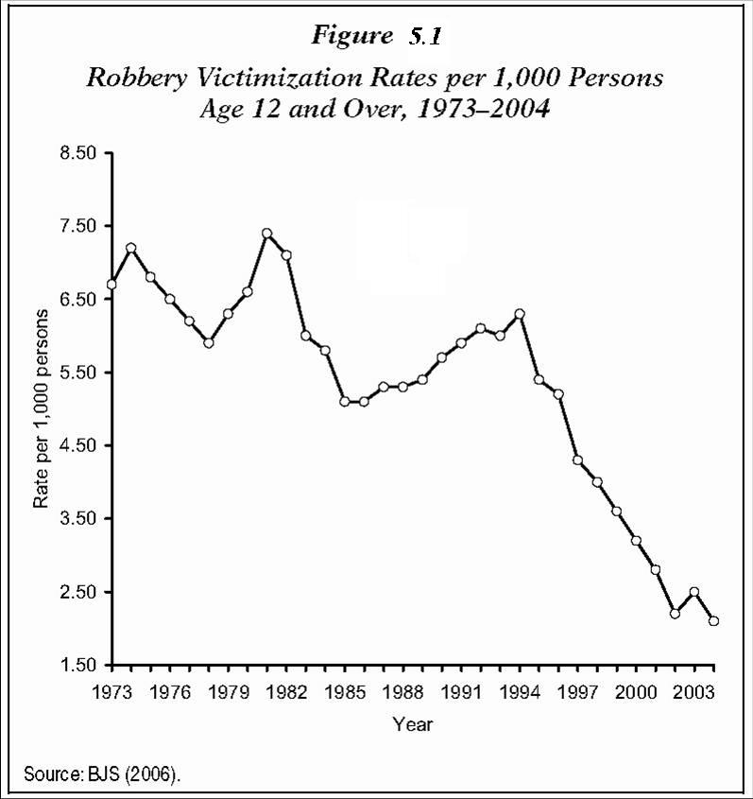
Robbery rates began to decrease sharply after 1994, and have continued to decrease every year since.
Figure 5.1. Robbery victimization rates, NCVS, 1973-2004

Slide 5
Robbery Patterns
Q: How many robberies result in the death of the victim?
A: 2.5 per 1,000
Q: How often does injury result from a robbery?
A: Some injury – 26%;
Requiring hospitalization – 10.6%
Q: Does risk of injury increase with victim resistance?
A: Probably … (see next slide)

Slide 6
Q: Does risk of injury increase with victim resistance?
Completed robberies: 65.2% of victims suffering injury reported taking some form of self-protection, while only 44.2% of victims reporting no injury took self-protective measures.
Attempted robberies: victims suffering injury were equally as likely as those avoiding injury to take self-protective measures (77.9% v. 80.4%)

Slide 7
Robbery Patterns (cont.)
Q: What are the most common offender motivations for using a weapon?
A: “Intimidate the victim;” “Protect myself;” “Get away”
Q: How many robberies involve the use of a weapon?
A: Any weapon – 40%. Gun – 24%.
Q: What is the average "take"?
Median loss: $140.00 (<$50 in 23% of cases)
Q: Who are the offenders?
Young (<25), Male (90%), Black (53%)
Q: Who are the victims?
Largely the same as offenders
Q: Do most robbers "specialize" in robbery?
No. Most do not, but “specialists” are very active.

Slide 8
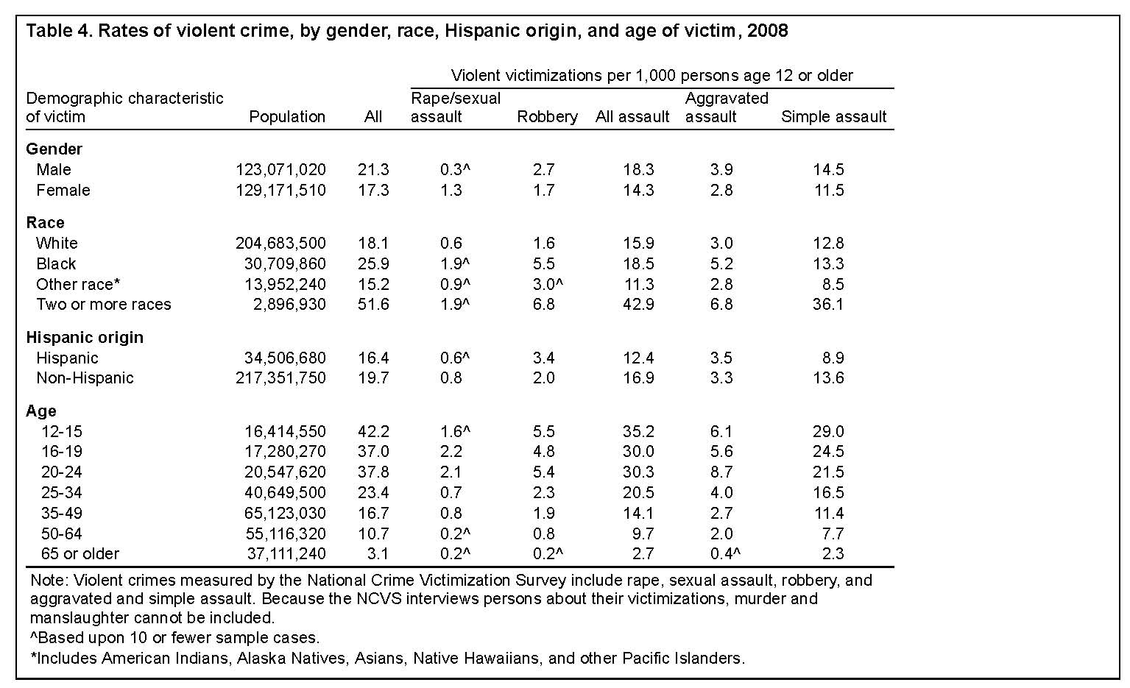
Robbery Victimization Risk Factors: 2008

Slide 9
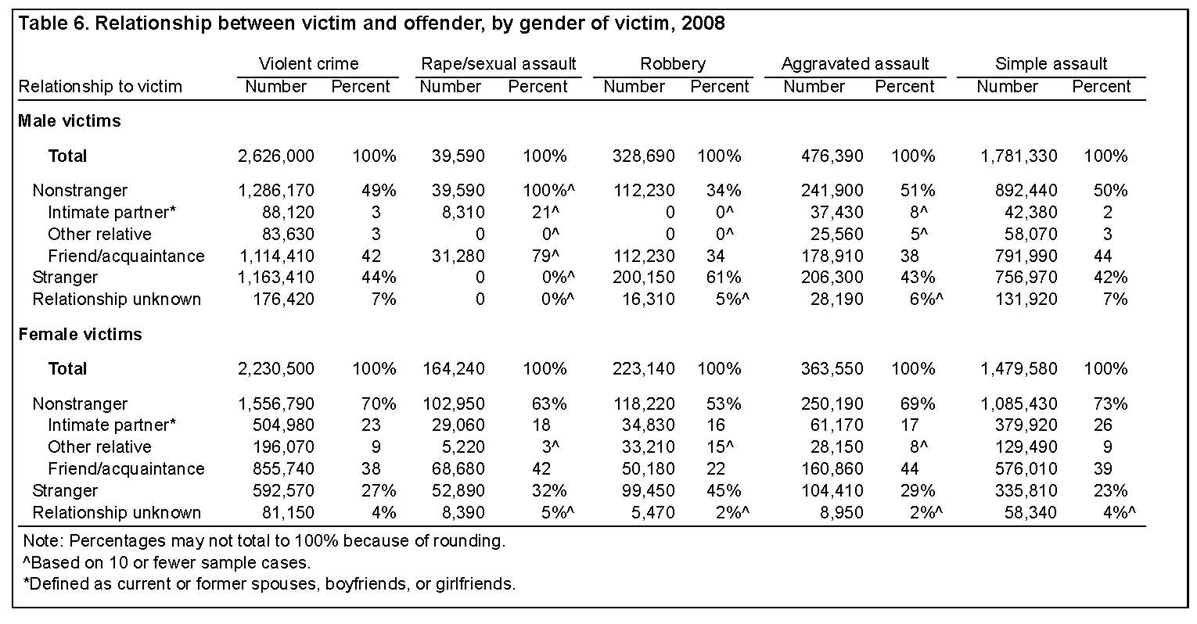
Victim/Offender Relationship: NCVS, 2008

Slide 10
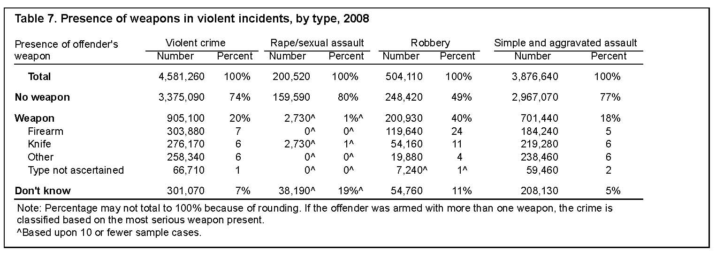
Presence of Weapons in Robbery: NCVS, 2008

Slide 11
Examples Q: How “typical” is each example of robbery, based on common patterns?
http://video.google.com/videoplay?docid=3121344824985856958&q=carjacking&total=2256&start=10&num=10&so=0&type=search&plindex=7
http://www.youtube.com/watch?v=mZy8tTznLDA
http://www.vidoemo.com/yvideo.php?i=cDctNDJtcWuRpc0R5N0U&marina-police-searching-for-atm-robbery-suspect=

Slide 12
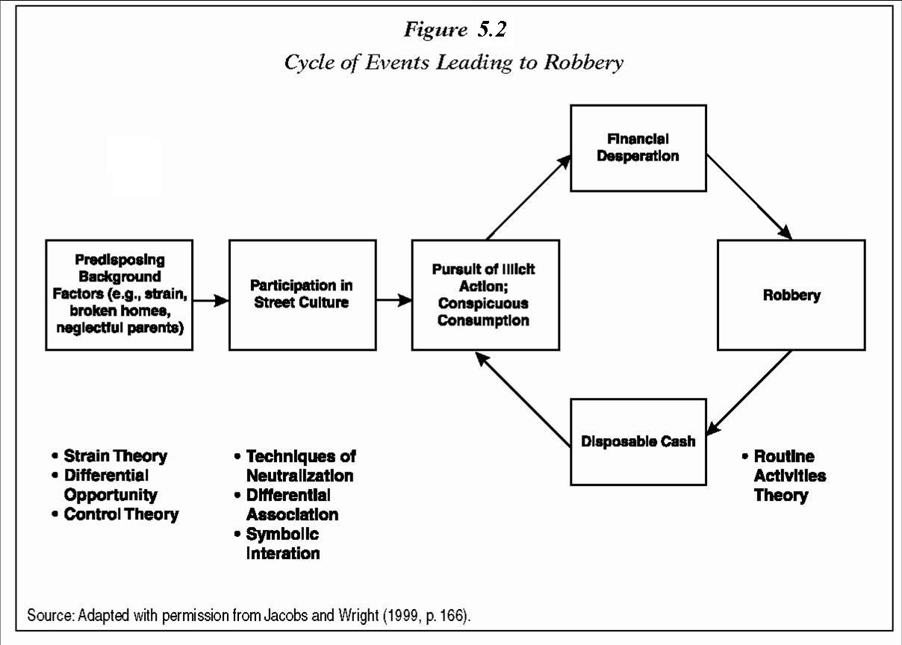

Slide 13
Strain Theory: Adaptations to strain (discrepancy between cultural goals and institutionalized means) include: (1) innovation (economically motivated crime); (2) Retreatism (e.g., withdrawal into alcohol or drugs), and (3) rebellion (e.g., Cohen’s “Reaction Formation”). Each might explain some robberies.

Slide 14
Differential Opportunity: Legitimate opportunities may be blocked, but illegitimate ones must be available before the individual can choose one or the other. According to one juvenile offender: "You either become a drug dealer or a stickup person."
Characteristics of Area | Type of Gang
Legitimate and illegitimate opportunities are closely connected. | Criminal gangs (criminal subcultures)
High transience, instability | Conflict gangs (status, toughness)
Few opportunities, either legitimate or illegitimate | Retreatist subculture (heavy use of drugs, alcohol)

Slide 15
Control Theory: Control theorists argue that delinquency is the result of weakened social and cultural constraints, especially via transmission of values through institutions such as the family and the school.
Weak social bonds (attachment, commitment, involvement, belief in rules)
Most young offenders did not grow up in two-parent families, and most had poor family lives: "Mom's using drugs, Pop's not around, so they bring up their own selves."
School is not taken seriously: "I wasn't much interested in learning," "School wasn't happening. I'd go to advisory, check in and leave."
Techniques of Neutralization
Reduce constraints on deviant behavior.
Robbers are often young males who express justifications for their actions by blaming their victims.
In 57 cases examined by the Inquirer, teenagers felt little remorse.

Slide 16
Differential Association Theory: Criminal behavior is learned through interaction with others, primarily within intimate personal groups. Learning involves techniques for committing the crime, as well as motives, drives, attitudes, and rationalizations.
Robberies are often committed by young males, acting in groups of two or more, often in response to peer influence.
Juvenile offenders tend to report expressive needs for committing robberies (thrills, peer influence). They were less likely to plan their crimes, and more likely to use partners.
Adult offenders tend more often to report motivations of financial need and the desire for high living (drugs, alcohol, women). Adults were more likely to plan their offenses, and were much less likely to use partners as they got older.

Slide 17
Symbolic Interaction Theories: focus on the meaning of events as perceived by participants in interaction with others. Those meanings have implications for understanding the motives of robbers.
JACK KATZ –
“Persistent offenders”: a small group of criminals commit a large share of robberies and assaults. Persistent robbers continue criminal careers despite lengthy periods of incarceration in their youth.
Purely materialistic explanations for robbery are limited. Although legitimate opportunities may be lacking, the rewards of street robbery are minimal.
Katz: we should focus on how persistent robbers perceive the attractions of robbery, considering the low gain, high risk, and lengthy periods of incarceration it brings.
Katz argues that persistent robbers begin to perfect “badass” identities beginning in adolescence, showing that one is willing and ready to use violence beyond any calculation of legal, material, and physical costs to oneself.
Persistent offenders report using violence to silence insults of peers, to avoid being made a fool of, and to dominate a threatening environment.

Slide 18
Routine Activities Theory: Predatory crimes require the convergence in space and time of three necessary elements: (1) motivated offenders, (2) suitable targets, and (3) the absence of capable guardians.
Places that have unusually high rates of robbery or other predatory crime can be called “hot spots.”
In Minneapolis, 4,166 robbery calls occurred in only 2.2% of all definable “places” in the city. There were 113 places with more than five robberies in one year.
The five hottest hot spots were: (1) an intersection that included bars, a liquor store, and a park, (2) a bus depot, (3) an intersection that included homeless shelters and bars, (4) a downtown mall, and (5) an intersection that included an adult bookstore and several bars.
Such places are busy (high number of potential targets) and provide a clientele that may be engaged in legal (alcohol consumption) or illegal activities (e.g., prostitution, drug use or sales) that increase their vulnerability and decrease their likelihood of reporting crimes to the police.

Slide 19
Interventions
CRIMINAL JUSTICE APPROACHES
Targeted Law Enforcement
NY subways -- Increased police presence reduced robberies, but displacement to surface streets occurred.
Sentencing
Bartley-Fox Gun Law (MA: 1975) provided a 1-year mandatory sentence for anyone convicted of carrying a firearm in public without a proper license and permit.
After 2 years, researchers found fewer gun assaults, gun robberies, and gun homicides.
After 3 years, there was still a significant decrease in gun robberies, but an increase in non-gun robberies.
Implications: (1) deterrent effects are temporary, and (2) discretion by police, prosecutors, and judges may have undercut the intent of laws (e.g., plea bargaining).

Slide 20
OPPORTUNITY REDUCTION STRATEGIES
According to routine activities theory, robbery can be reduced via reducing opportunities (i.e., decreasing suitability of targets or increasing capable guardianship).
Crime Prevention Through Environmental Design (CPTED):
Physical characteristics of stores, buildings, and other places can be manipulated to decrease the risk of robbery.
CPTED has had an enormous influence on crime control policy and security.
http://www.cpted.net/
http://www.thecptedpage.wsu.edu/

Slide 21
Four Main Strategies of CPTED
Natural Surveillance - A design concept directed primarily at keeping intruders easily observable. Promoted by features that maximize visibility of people, parking areas, and building entrances: doors and windows that look out on to streets and parking areas; pedestrian-friendly sidewalks and streets; front porches; adequate nighttime lighting.
Territorial Reinforcement - Physical design can create or extend a sphere of influence. Users then develop a sense of territorial control while potential offenders, perceiving this control, are discouraged. Promoted by features that define property lines and distinguish private spaces from public spaces using landscape plantings, pavement designs, gateway treatments, and "CPTED" fences.
Natural Access Control - denying access to crime targets and creating in offenders a perception of risk. Gained by designing streets, sidewalks, building entrances, and neighborhood gateways to clearly indicate public routes and discouraging access to private areas.
Target Hardening - features that prohibit entry or access: window locks, dead bolts for doors, interior door hinges.
http://www.cptedsecurity.com/cpted_video.htm

Slide 22
CPTED
Hunter and Jeffery: examined efforts to reduce robberies at convenience stores.
Robbery was reduced most strongly by four measures:
Two or more clerks on duty (employee surveillance)
Cash handling techniques (target removal)
Access control
Natural surveillance (e.g., enhanced visibility and less obstruction of windows)

Slide 23
Convenience Store Legislation
1986: Gainesville ordinances required limitation of cash, security safes, parking lot lighting, removal of visual obstructions, robbery detection cameras, and training of clerks. Robberies continued.
1987: Stores either had to close between 8:00 p.m. and 4:00 am, or else utilize two clerks on duty. Afterwards, a decline in robberies began.
1990: Florida passed the Convenience Store Security Act – comprehensive package of measures.
However, the success of prevention still depends mostly on voluntary compliance.
A "contradiction" results from industry's need to provide protection while holding operating costs to a minimum.

