Slide 1
Criminal Violence: Patterns, Causes, and Prevention Riedel and Welsh, Ch. 6 “Rape and Sexual Assaults”

Slide 2
OUTLINE
I. PATTERNS AND TRENDS
II. EXPLANATIONS
Psychoanalytic Theories
Feminist Theories
Social Learning Theories
III. INTERVENTIONS
Rape Law Reform
Incarceration
Sex Offender Notification Laws
Victim Resistance
Victim Counseling and Assistance
Sex Offender Treatment

Slide 3
Definitions
NCVS: most detailed data on rape and sexual assaults
“Rape” is forced sexual intercourse; victim may be male or female; offender may be of the same sex or a different sex from the victim.
“Sexual Assault” refers to a wide range of victimizations involving unwanted sexual contact (e.g., grabbing, touching, fondling).

Slide 4
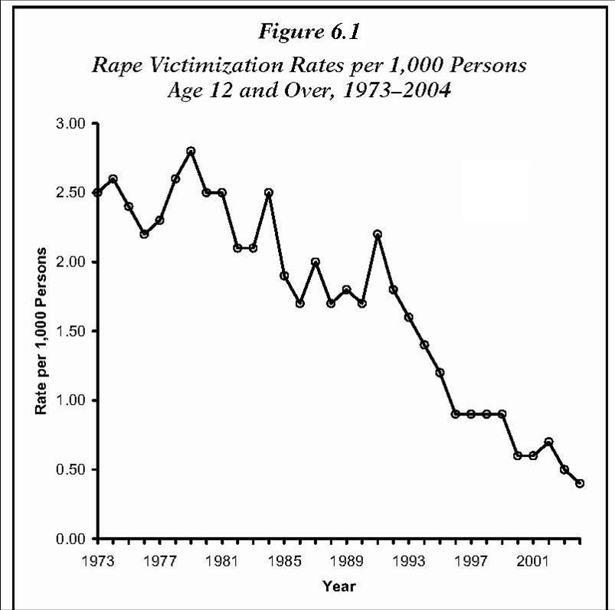
Figure 6.1. NCVS -- rape victimization rates have gradually decreased nearly every year since 1991.

Slide 5
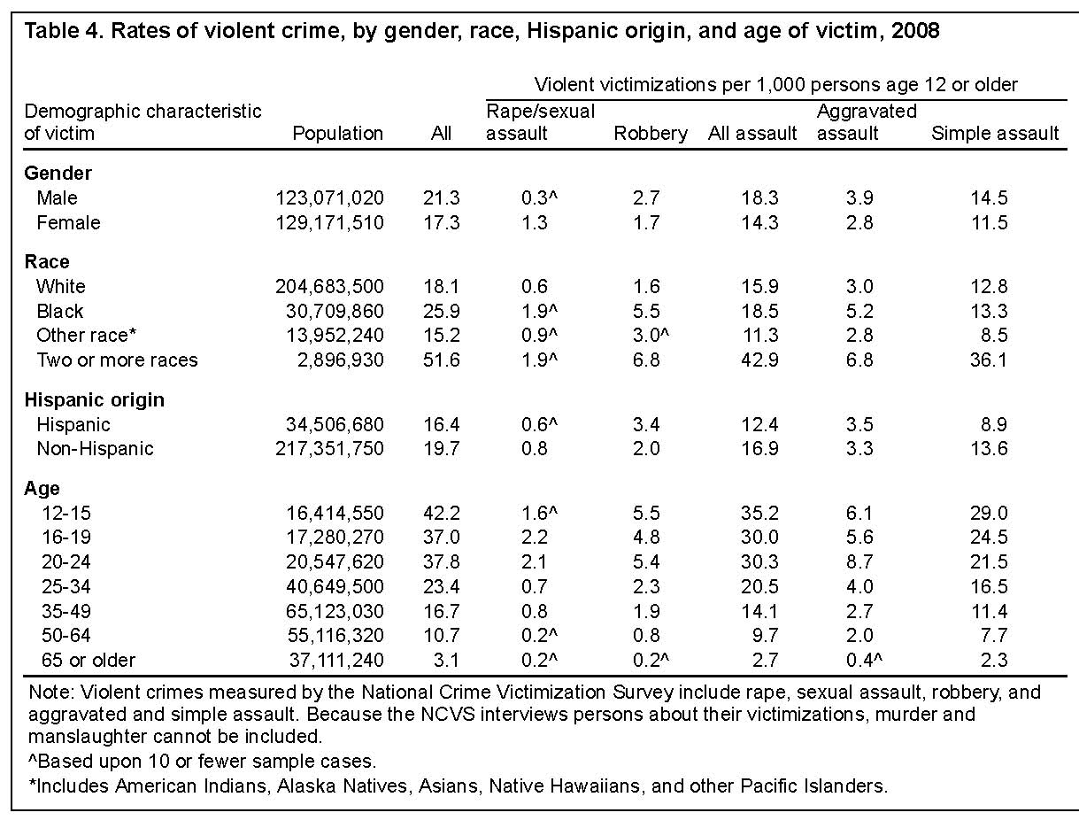
Rape/Sexual Assault Victimization Risk Factors

Slide 6
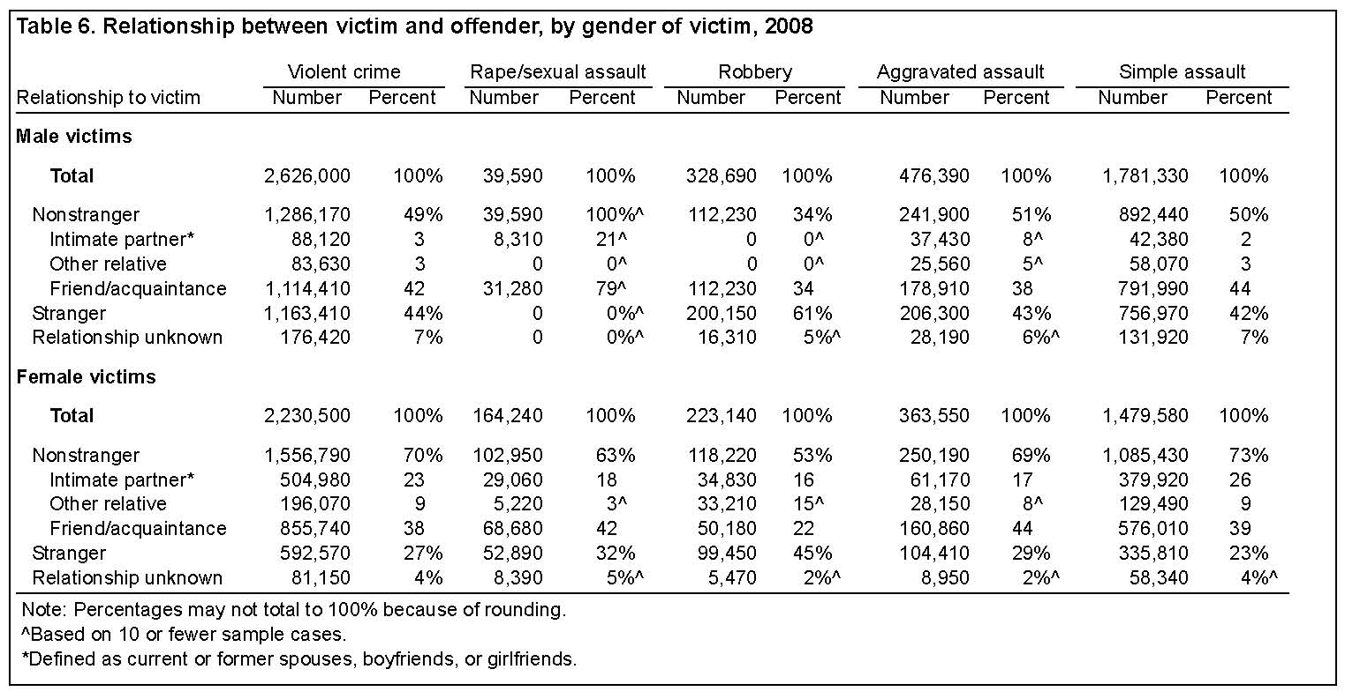
Victim/Offender Relationship: NCVS, 2008

Slide 7
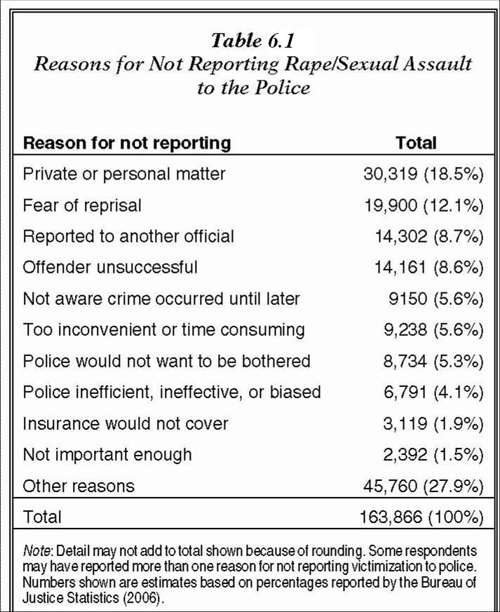
Patterns: Victims
Slightly more than 1/3 of victims (38%) reported the offense to a law enforcement agency in 2005.

Slide 8
Patterns: Offenders
Gender: 99 in 100 rapists are male.
Race: 66% of rapists are white. Other sex offenses: 74% of arrestees are white.
Age: Average age is the early 30s. About 69% of offenders were 21+ at the time of the offense; 31% were under 21.
But: A majority of adult rapists committed their first offense by the age of 16. Most went undetected; others weren't treated as serious, violent crimes.

Slide 9
Patterns: Offenses
Clearance Rates: Only about 42% of reported rapes were cleared by an arrest.
Place: Rape occurs more frequently at times and places where potential offenders and victims converge in the absence of capable guardians (i.e., routine activities theory).
More rapes occur in summer; people are outdoors and moving around.
Rape is more likely to occur during times when people are off work. About 2/3 of rapes/sexual assaults occur from 6 p.m. to 6 a.m.
Nearly 5 out of 10 rape/sexual assault incidents occurred in victim’s own home or at the home of a friend, relative, or neighbor.

Slide 10
Explanations: Psychoanalytic Theories
Sexual Trauma: Some offenders (not all) experienced sexual trauma/victimization as a child.
Sex offenders were substantially more likely than any other category of offenders to report having been abused physically or sexually while growing up, although only one third of offenders report that they had ever been physically or sexually abused.
Alcohol and drug use: common, but symptomatic of those unable to cope with the demands and stresses of adult life (both lower inhibitions, but are not necessarily causal factors)
Early childhood development: “His unfulfilled needs for acceptance, affection, and intimacy result in depression..." (Groth)
Poor social relationships; poor social skills, high anxiety in dealing with other people. The rapist has often failed to develop successful interpersonal relationships.
Insecurity about masculine identity; failures in multiple areas of life

Slide 11
Psychoanalytic Theories: Typology of Rapists
1. Power Reassurance (Compensatory): suggests an underlying lack of confidence and inadequacy and a misguided belief that the sex act is consensual, expressed through minimal force and low confidence
2. Power Assertive (Exploitative): suggests an underlying lack of confidence and inadequacy, expressed through a need for control, mastery, and humiliation of the victim, while demonstrating authority

Slide 12
3. Anger Retaliatory: Offender behaviors suggest a great deal of displaced rage and violence, toward a specific person, group (women), institution or a symbol of either.
4. Anger Excitation (sadistic): The offender gets sexual gratification or excitement from inflicting pain and suffering on the victim.
5. Opportunistic: offender who is out to satisfy immediate sexual impulses, often while committing another crime such as burglary

Slide 13
Feminist Theories
Cultural aspects may contribute to rape (e.g., patriarchal culture dominated by male attitudes, values, and beliefs).
Brownmiller: Men have enjoyed a historical power advantage over women, resulting in the unequal status and unfair treatment of women.
Traditional socialization patterns have encouraged men to associate masculinity with power, dominance, strength, virility, and superiority, and femininity with submissiveness, passivity, and weakness.
Cultural expectations, including those embodied in male-dominated legislative and justice systems, historically viewed women as little more than male property.

Slide 14
Feminist Theories (cont.)
Research has largely supported feminist theories.
Sanday: cross-cultural study of 156 tribal societies existing between 1750 B.C. - 1960
Rape was rare or absent in 47% of the societies studied, but a frequent and accepted practice against women in 18% of the societies.
In rape-prone societies, female authority and power were low, and masculinity was often expressed by interpersonal violence and toughness.
Malamuth: studied views of males (mostly college students) associated with sexual aggression
He asked males to report the likelihood that they would commit a rape if they could be assured of not being caught and punished.
About 35% of respondents across samples indicated some likelihood of raping (LR).
High LR was associated with callous attitudes toward rape and belief in various rape myths (e.g., that women really enjoy rape in spite of their protests).

Slide 15
Social Learning Theories
Attitudes, beliefs, and behaviors supportive of rape can be learned and reinforced through social interactions with others.
Beliefs may be reinforced through socialization (in the family, school), membership in various groups, and/or witnessing media portrayals of coercive male-female relationships.
Rape Myths
Beliefs that rationalize, justify, or encourage acts of violence toward women
Belief in rape myths has been found in samples of convicted rapists and non-criminal adult and juvenile males.
Example: “No means yes”: the mistaken belief that women make initial protests, but “they never really mean it.”

Slide 16
Interventions: Rape Law Reform
Historically, rape has been inappropriately defined, investigated, prosecuted, and punished by male-dominated legislative and justice systems (feminist theory).
Rape law reform has proceeded vigorously since the 1970s. By 1980, almost every state in the U.S. had passed some form of rape law reform.
Rape and sexual offenses are defined in gender-neutral terms that describe the specific behavior involved [replacing outdated, confusing labels that failed to distinguish the actual behavior involved].
Rape shield laws: constrain the use of prior sexual history by defense attorneys attempting to establish victim consent
http://www.msnbc.msn.com/id/5861379/

Slide 17
Interventions: Rape Law Reform (cont.)
Examples: Michigan, California, Indiana
 | CA | MI | ID*
Arrest Rate | n.s. | ---
Charging Rate
Plea-bargaining Rate | --- | n.s.
Conviction Rate | n.s. | n.s.
Incarceration Rate |  | ---
*Note: LaFree (1989) studied 38 trials in the 3 years after passage of laws in ID. Rape shield law was almost totally ineffective.

Slide 18
Incarceration
Q: How often do convicted sex offenders recidivate?
A: Langan, Schmitt & Durose (2003) -- study of 9,691 male sex offenders released from prison in 15 states in 1994
The more prior arrests, the greater the likelihood of being rearrested for another sex crime after leaving prison.
During the three-year follow-up period, released sex offenders (5.3%) were four times more likely than non-sex offenders (1.3%) to be rearrested for a new sex crime.
However, sex offenders had a lower overall rearrest rate compared to non-sex offenders.
When rearrests for any type of crime (not just sex crimes) were counted, only 43% of the 9,691 released sex offenders were rearrested.
The overall rearrest rate for the 262,420 non-sex offenders was much higher, 68%.
Conclusion: Recidivism overall is high, but recidivism for rape or sexual assault is not especially high.

Slide 19
Sex Offender Notification and Registration Laws
These laws usually require released offenders to register with their local law enforcement agency upon their release from prison, and allow agencies to publish the addresses of sex offenders (e.g., Meagan’s Law).
http://www.pameganslaw.state.pa.us/
Goals: more closely monitor the whereabouts of convicted sex offenders in the community→ reduce sex offenses
Walker et al. (2006) examined the general deterrent effect of these laws on the number of sex offenses committed, as measured by the increase or decrease in the number of rapes in 10 states.
Most of the 10 states examined showed no significant difference in the average number of rapes committed before and after the passage of laws. But:
Need longer follow-up periods (at least 3 yr.)
Need to examine community-level effects of laws

Slide 20
Victim Resistance (Self-Defense)
Bart and O'Brien: Researchers interviewed victims about situational variables associated with the rape.
Six possible defense strategies: (1) flee or try to flee; (2) scream or yell; (3) begging or pleading; (4) "cognitive verbal" techniques: reason with offender, make him see her as a person; (5) take advantage of environmental intervention or opportunity; and (6) respond with physical force.
Those who avoided rape (N = 51) used a greater number of strategies than those who didn't (N = 43).
Avoiders were more likely to flee or try to flee, yell or scream, use physical force, or take advantage of environmental opportunity (e.g., bystander or car passes by).
There was no evidence that physical resistance increased the use of force by the rapist.
Similar results in NCVS. Among victims who took self-protective action, just over half felt that their actions helped the situation.
About 1 in 5 victims felt that their actions worsened the situation in some way.

Slide 21
Victim Counseling and Assistance
WOMEN ORGANIZED AGAINST RAPE (WOAR)
http://www.woar.org
Direct Service to Victims: Victims and families need specialized information, support, and counseling to deal with medical, legal, and personal aftermath of rape (e.g., crisis counseling, 24-hr. telephone hotline; hospital emergency room accompaniment; accompaniment and advocacy for survivors at court; and individual and group counseling for survivors and their families).
Community Education And Training. WOAR brings educational programs about sexual assault and personal safety to children and adults in classrooms, community centers, and workplaces throughout Philadelphia.
Advocacy. WOAR influenced landmark rulings such as the Pennsylvania Rape Shield Law in 1976, making prior sexual history inadmissible in rape trials.

Slide 22
Sex Offender Treatment Programs
Comprehensive treatment of sex offenders can significantly lower rates of reoffending, but stronger evaluation research is needed to determine the range and magnitude of treatment effects over time.
Successful treatment models: must address deviant sexual interests, social skills deficits, and cognitive distortions about sexual offending.
Examples:
Vermont Treatment Program for Sexual Aggressors
California’s Sex Offender Treatment and Evaluation Project (SOTEP)
http://www.youtube.com/watch?v=wTbpZsFVfIg

