Slide 1
Why Has Violent Crime Declined in the United States?
An Examination of Levitt’s Understanding Why Crime Fell in the 1990s: Four Factors that Explain the Decline and Six that Do Not

Slide 2
The 1990’s Great Crime Decline
Homicide rates plunged 43 percent from the peak in 1991 to 2001, reaching the lowest levels in 35 years.
The Federal Bureau of Investigation’s (FBI) violent and property crime indexes fell 34 and 29 percent, respectively, over that same period.
These declines occurred essentially without warning: leading experts were predicting an explosion in crime in the early and mid-1990s, precisely the point when crime rates began to plunge

Slide 3
The Downward Trend in Violence has Continued in the USA
In 2013, an estimated 1,163,146 violent crimes occurred nationwide, a decrease of 4.4 percent from the 2012 estimate.
When considering 5- and 10-year trends, the 2013 estimated violent crime total was 12.3 percent below the 2009 level and 14.5 percent below the 2004 level.
There were an estimated 367.9 violent crimes per 100,000 inhabitants in 2013, a rate that declined 5.1 percent when compared with the 2012 estimated rate.
Aggravated assaults accounted for 62.3 percent of violent crimes reported to law enforcement in 2013. Robbery offenses accounted for 29.7 percent of violent crime offenses; rape (legacy definition) accounted for 6.9 percent; and murder accounted for 1.2 percent.
Information collected regarding types of weapons used in violent crime showed that firearms were used in 69.0 percent of the nation’s murders, 40.0 percent of robberies, and 21.6 percent of aggravated assaults.

Slide 4
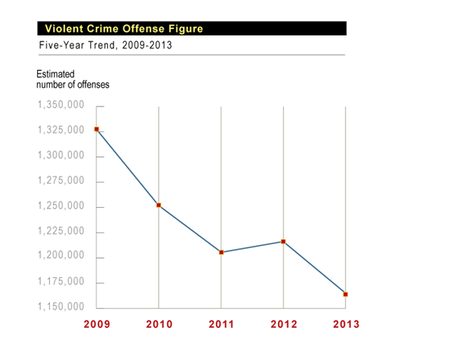
What Factors Explain the Recent Violent Crime Decline?

Slide 5
Let’s Take A Look at Steve Levitt’s Review of What Did NOT explain the 1990’s Crime Decline
Six Factors that Levitt Argued Played Little or No Role in the Crime Decline:
1) The Strong Economy of the 1990s
2) Changing Demographics
3) Better Policing Strategies
4) Gun Control Laws
5) Laws Allowing the Carrying of Concealed Weapons
6) Increased Use of Capital Punishment

Slide 6
Here are the Four Factors that Levitt Says DO Explain the Crime Decline
1) Increases in the Number of Police
2) The Rising Prison Population
3) The Receding Crack Epidemic
4) The Legalization of Abortion

Slide 7
Q:Is Levitt Correct? A. Lets See
1. Increases in the Number of Police: Do more cops mean less crime?
Police: Levitt (1997) found that a 10 percent increase in the size of a city’s police force was associated with an 11 percent lower violent crime rate and a 3 percent lower property crime rate (using county-level data);
however, other more recent analyses and reviews (Bradford, 2012) suggest that increasing police force size will have no impact on the violent crime rate, and only marginal improvement (1-3%) in property crime rates.

Slide 8
2. Does More Prison result in less Violent crime?
At the national level, a 10 percent increase in the rate of incarceration is estimated to result in about a 4 percent decrease in the rate of index crimes, with estimates of the impact on violent crimes between 3.8 and 4.4 percent. Studies claiming larger reductions in crime (between 9 and 22 percent) using national-level data did not include controls for simultaneity.
Based on state-level data, a 10 percent increase in the incarceration rate is associated with a decrease in the crime rate between 0.11 and 4 percent.
At the county level, a 10 percent increase in incarceration is associated with a 4 percent reduction in the crime rate (Stemen, 2007).
Tipping points: Incarceration reduces crime, but only up to a point. Once the incarceration rate hits a certain level—at the state level this tipping or inflection point appears to be about 325 inmates per 100, 000 population—crime rates actually increase (Liedka, Piehl, & Useem, 2006).

Slide 9
3. Did the War on Drugs reduce Violent Crime in the USA?
There is evidence that the receding crack epidemic was one factor in the lower violent crime rates in the 1990s.
There is disagreement over why crack’s popularity waned during this period.
Was it tougher sentences? Researchers have NOT found a specific deterrent effect supporting the use of mandatory minimum sentences to prison for drug crimes, but it is certainly possible that these policies had a general deterrent effect, perhaps on the drug of choice.

Slide 10
4. Did the legalization of abortion with Roe v. Wade in 1973 have an impact on violent crime in the 1990s?
Levitt argues it did have an impact, based on the following:
(1) unwanted children are at greater risk for crime, and
(2) legalized abortion leads to a reduction in the number of unwanted births.
Others( such as Pinker) strongly disagree for the following reasons:
in the years since 1973 the proportion of children born to women in the most vulnerable categories – poor, single, teenage, and African American – did not decrease, as the freakonomics theory would predict. It increased, and by a lot.
The availability of abortion thus may have led to a generation that is more prone to crime because it weeded out just the children who, whether through genes or environment, were most likely to exercise maturity and self-control.
In the studies that pit the effects of parenting against the effects of the children’s peer environment, holding genes constant, the peer environment almost always wins.
the crime decline began when the older cohorts, born well before Roe, laid down their guns and knives, and from them the lower homicide rates trickled down the age scale. http://uncertaintyblog.com/2013/08/15/fooled-again-pinker-puts-a-nail-in-the-coffin-of-the-freakonomics-crime-theory/comment-page-1/

Slide 11
What Other Factors that Might Explain Long term Violent Crime Reductions in the USA?
(1) More Employment: According to several studies, a 10 percent decrease in the state’s unemployment rate corresponded with a 10–16 percent reduction in property crime, but had no effect on violent crime (state and county-level data);
(2) More Income: a 10 percent increase in real wages was associated with a 13 percent lower index crime rate, a 12 percent lower property crime rate, and a 25 percent lower crime rate at the national level (Gould et al., 2002); state-level analyses identified a 16 percent lower violent crime rate (Raphael and Winter-Ebmer, 2001); and individual-level analyses reveal that a 10 percent increase in real wages is associated with a 10 percent decrease in crime participation(Grogger, 1998);
(3) More Education: a one-year increase in the average education level of citizens resulted in a 1.7 percent lower index crime rate, while a 10 percent increase in graduation rates resulted in a 9.4 percent reduction in the index crime rate and a 5-10 percent reduction in arrest rates, through the increased wages associated with graduation (Lochner & Moretti, 2004)

Slide 12
Theories of Crime Causation: A Brief Overview
Classically-based criminologists explain criminal behavior as a conscious choice by individuals based on an assessment of the costs and benefits of various forms of criminal activity.
Biologically-based criminologists explain criminal behavior as determined—in part—by the presence of certain inherited traits that may increase the likelihood of criminal behavior.
Psychologically-based criminologists explain criminal behavior as the consequence of individual factors, such as negative early childhood experiences, and inadequate socialization, which results in criminal thinking patterns and/or incomplete cognitive development.
Sociologically-based criminologists explain criminal behavior as primarily influenced by a variety of community-level factors that appear to be related—both directly and indirectly—to the high level of crime in some of our( often poorest) communities, including blocked legitimate opportunity, the existence of subcultural values that support criminal behavior, a breakdown of community-level informal social controls, and an unjust system of criminal laws and criminal justice .

