Slide 1
Based upon “Cosets and cayley-sudoku tables” by jennifer carmichael, keith schloeman, and michael ward in Mathematics magazine
Sudoku and group Theory
By Jodie Murphy

Slide 2
Rules of the game
A number can appear only once on each row, column, and region (block)
9 | 3 | 6 | 1 | 4 | 7 | 2 | 5 | 8
1 | 4 | 7 | 2 | 5 | 8 | 3 | 6 | 9
2 | 5 | 8 | 3 | 6 | 9 | 4 | 7 | 1
3 | 6 | 9 | 4 | 7 | 1 | 5 | 8 | 2
4 | 7 | 1 | 5 | 8 | 2 | 6 | 9 | 3
5 | 8 | 2 | 6 | 9 | 3 | 7 | 1 | 4
6 | 9 | 3 | 7 | 1 | 4 | 8 | 2 | 5
7 | 1 | 4 | 8 | 2 | 5 | 9 | 3 | 6
8 | 2 | 5 | 9 | 3 | 6 | 1 | 4 | 7
Sound like an operation table (a Cayley table)?

Slide 3
Rules of the game
A number can appear only once on each row, column, and region (block)
9 | 3 | 6 | 1 | 4 | 7 | 2 | 5 | 8
1 | 4 | 7 | 2 | 5 | 8 | 3 | 6 | 9
2 | 5 | 8 | 3 | 6 | 9 | 4 | 7 | 1
3 | 6 | 9 | 4 | 7 | 1 | 5 | 8 | 2
4 | 7 | 1 | 5 | 8 | 2 | 6 | 9 | 3
5 | 8 | 2 | 6 | 9 | 3 | 7 | 1 | 4
6 | 9 | 3 | 7 | 1 | 4 | 8 | 2 | 5
7 | 1 | 4 | 8 | 2 | 5 | 9 | 3 | 6
8 | 2 | 5 | 9 | 3 | 6 | 1 | 4 | 7
Sound like an operation table (a Cayley table)?

Slide 4
Goal: Construct a Cayley table or operation table preserving SUdoku rules.
The difference between a Cayley table and a Sudoku table resides in the regions.
Can the order of the rows and columns be altered to satisfy the rule that there is a unique group element (number) in each region?

Slide 5
Three constructions can create a cayley-Sudoku table

Slide 6
Construction 1
Put the left cosets as the column headings and the right coset representatives as the row headings. This partitions the table into sets of left cosets.
Alternatively you can flip the table and put the right cosets as the column headings and the left coset elements as the rows. This organization partitions the table into right cosets.

Slide 7
Using ℤ9 = {1,2,3,4,5,6,7,8,9} where 9 replaces 0
Examine cyclic subgroup generated by: <3>={9,3,6}
Right coset | = Set = | Left coset
<3>+1 | ={1,4,7}= | 1+<3>
<3>+2 | ={2,5,8}= | 2+<3>
<3>+3 | ={3,6,9}= | 3+<3>
Note: Generating more will start repeating these cosets.
For example: 4+<3>= {13, 7, 10} = {4, 7, 1} = <3>+4

Slide 8
Right Cosets
Each block
is a partition
containing
complete left coset
representations.
 | {9 3 6} |  |  | {1 4 7} |  |  | {2 5 8}
9 | 9 | 3 | 6 | 1 | 4 | 7 | 2 | 5 | 8
1 | 1 | 4 | 7 | 2 | 5 | 8 | 3 | 6 | 9
2 | 2 | 5 | 8 | 3 | 6 | 9 | 4 | 7 | 1
3 | 3 | 6 | 9 | 4 | 7 | 1 | 5 | 8 | 2
4 | 4 | 7 | 1 | 5 | 8 | 2 | 6 | 9 | 3
5 | 5 | 8 | 2 | 6 | 9 | 3 | 7 | 1 | 4
6 | 6 | 9 | 3 | 7 | 1 | 4 | 8 | 2 | 5
7 | 7 | 1 | 4 | 8 | 2 | 5 | 9 | 3 | 6
8 | 8 | 2 | 5 | 9 | 3 | 6 | 1 | 4 | 7

Slide 9
Right Cosets
 | {9 3 6} |  |  | {1 4 7} |  |  | {2 5 8}
9 | 9 | 3 | 6 | 1 | 4 | 7 | 2 | 5 | 8
1 | 1 | 4 | 7 | 2 | 5 | 8 | 3 | 6 | 9
2 | 2 | 5 | 8 | 3 | 6 | 9 | 4 | 7 | 1
3 | 3 | 6 | 9 | 4 | 7 | 1 | 5 | 8 | 2
4 | 4 | 7 | 1 | 5 | 8 | 2 | 6 | 9 | 3
5 | 5 | 8 | 2 | 6 | 9 | 3 | 7 | 1 | 4
6 | 6 | 9 | 3 | 7 | 1 | 4 | 8 | 2 | 5
7 | 7 | 1 | 4 | 8 | 2 | 5 | 9 | 3 | 6
8 | 8 | 2 | 5 | 9 | 3 | 6 | 1 | 4 | 7
This table fits the Sudoku rules!

Slide 10
Can other groups be constructed into sudoku-cayley tables?
Let’s examine : A4 and the subgroup generated by <(12)(34)>={(1), (12)(34)}
We can construct a Cayley-Sudoku using the right cosets as the columns and the blocks are complete left coset partitions of the group A4

Slide 11
Using A4
Examine cyclic subgroup generated by: H=<(12)(34)>={(1),(12)(34)}
Right coset | = Set = | Representative Name
H(1) | ={(1),(12)(34)}= | Hg₁
H(13)(24) H(14)(23) | ={(13)(24),(14)(23)}= ={(14)(23),(13)(24)}= | Hg₂
H(123) H(243) | ={(123),(243)}= ={(243),(123)}= | Hg₃
H(142) H(134) | ={(142),(134)}= ={(134),(142)}= | Hg₄
H(132) H(143) | ={(132),(143)}= ={(143),(132)}= | Hg₅
H(243) H(124) | ={(243),(124)}= ={(124),(243)}= | Hg₆

Slide 12
Using A4
Examine cyclic subgroup generated by: <(12)(34)>={(1),(12)(34)}
Left coset | = Set | Representative Name
(1) H | ={(1),(12)(34)}= | y₁H
(13)(24)H (14)(23) H | ={(13)(24),(14)(23)}= ={(14)(23),(13)(24)}= | y₂H
(123) H (134) H | ={(123),(134)}= ={(134),(123)}= | y₃H
(142) H (243) H | ={(142),(243)}= ={(243),(142)}= | y₄H
(132) H (234) H | ={(132),(234)}= ={(234),(132)}= | y₅H
(143) H (124) H | ={(143),(124)}= ={(124),(143)}= | y₆H

Slide 13
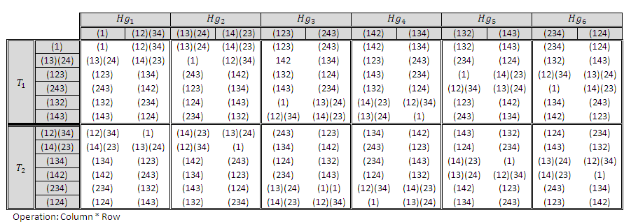
Construction 1
Left Coset Partitions

Slide 14
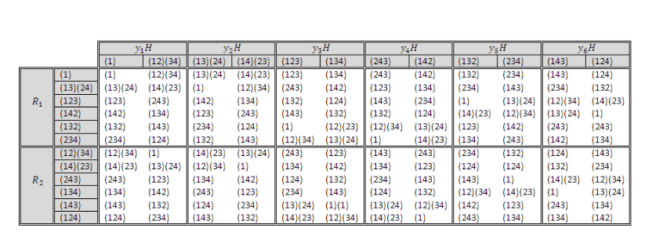
Construction 1
Right Coset Partitions

Slide 15
Construction 2 – Left and Right Handed
Put the left cosets as the column headings and the left coset representatives as the row headings.
Alternatively you can flip the table and put the right cosets as the column headings and the right coset elements as the rows.

Slide 16
Construction 2
Left Coset to Left Coset Representatives

Slide 17
Construction 3 – Extending Table to include entire group
By using complete sets of left and right cosets, the entire table can be mapped into a Cayley-Sudoku table.

Slide 18
Construction 3
Left Coset to Right Coset
Operation: Row * Column

Slide 19
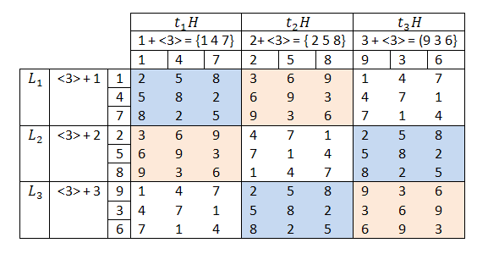
Revisiting the original table in ℤ9 using construction 3 …
Since ℤ9 is abelian the right and left cosets are the same. These subgroups are normal.

