Slide 1
Chapter 23 Lecture presentation
Transition Metals and Coordination Compounds
Catherine E. MacGowan
Armstrong Atlantic State University

Slide 2
Properties and Electron Configuration of Transition Metals
The properties of the transition metals are similar to each other.
And very different from the properties of the main group metals
High melting points, high densities, moderate to very hard, and very good electrical conductors
The similarities in properties come from similarities in valence electron configuration; they generally have two valence electrons.

Slide 3
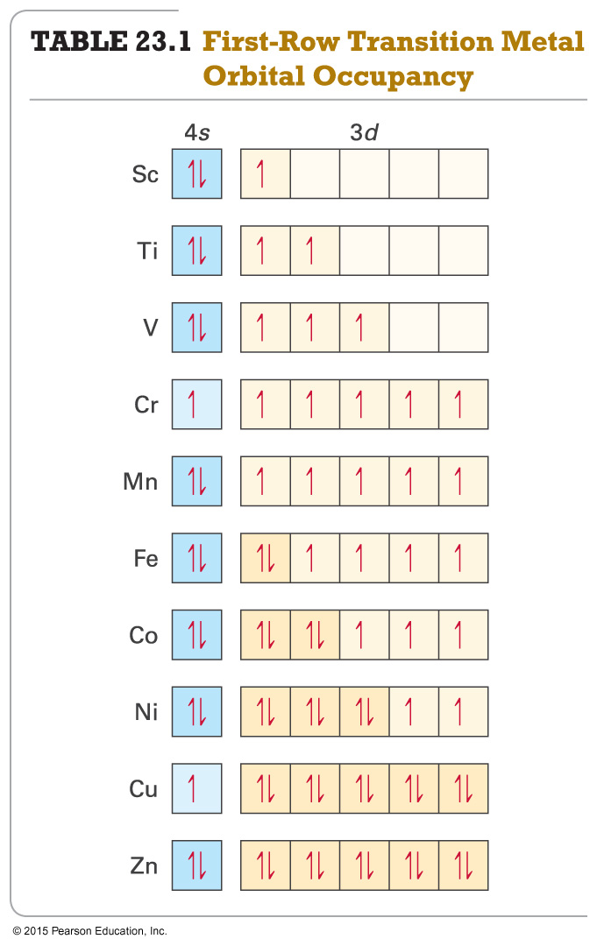
Electron Configuration
For first and second transition series, ns²(n − 1)d^{x}
First = [Ar]4s²3d^{x}; second = [Kr]5s²4d^{x}
For third and fourth transition series, ns²(n − 2)f¹⁴(n − 1)d^{x}
Some individuals deviate from the general pattern by “promoting” one or more s electrons into the underlying d to complete the subshell.
Group 1B
Form ions by losing the ns electrons first, then the (n – 1)d electrons

Slide 4
Irregular Electron Configurations
Because of sublevel splitting, the 4s sublevel is lower in energy than the 3d; therefore, the 4s fills before the 3d.
However, the difference in energy is not large.
Some of the transition metals have irregular electron configurations in which the ns only partially fills before the (n − 1)d or doesn’t fill at all.
Therefore, their electron configuration must be found experimentally.
Expected Found Experimentally
Cr = [Ar]4s²3d⁴ Cr = [Ar]4s¹3d⁵
Cu = [Ar]4s²3d⁹ Cu = [Ar]4s¹3d¹⁰
Mo = [Kr]5s²4d⁴ Mo = [Kr]5s¹4d⁵
Ru = [Kr]5s²4d⁶ Ru = [Kr]5s¹4d⁷
Pd = [Kr]5s²4d⁸ Pd = [Kr]5s⁰4d¹⁰

Slide 5
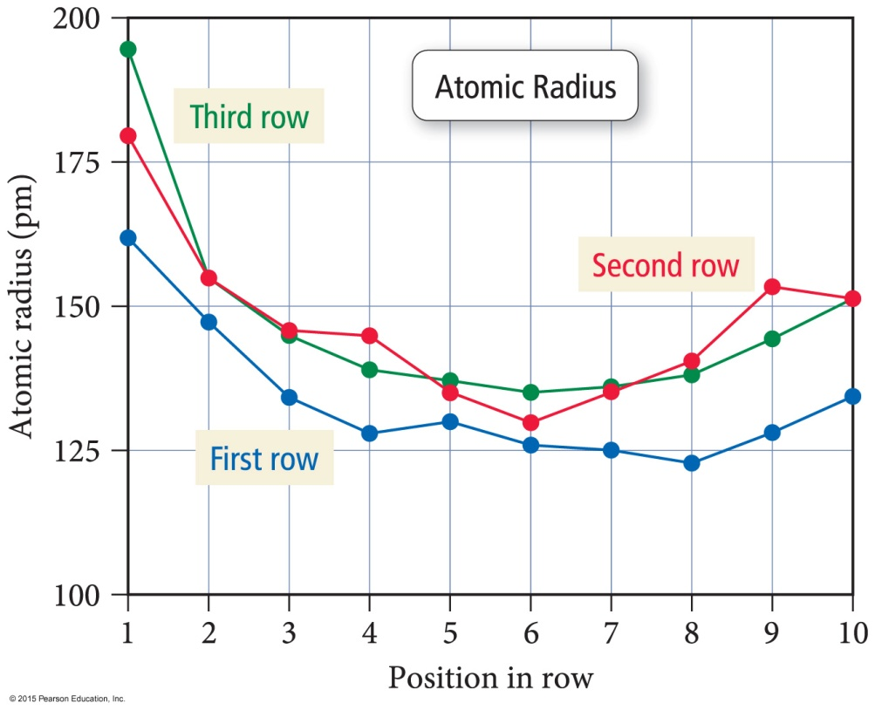
Atomic Size
The atomic radii of all the transition metals are very similar.
There is a small increase in size down a column.
The third transition series atoms are about the same size as the second.
The lanthanide contraction is the decrease in expected atomic size for the third transition series atoms that come after the lanthanides.

Slide 6
Why Aren’t the Third Transition Series Atoms Bigger?
Fourteen of the added 32 electrons between the second and third series go into 4f orbitals.
Electrons in f orbitals are not as good at shielding the valence electrons from the pull of the nucleus.
The result is a greater effective nuclear charge increase and therefore a stronger pull on the valence electrons: the lanthanide contraction.

Slide 7
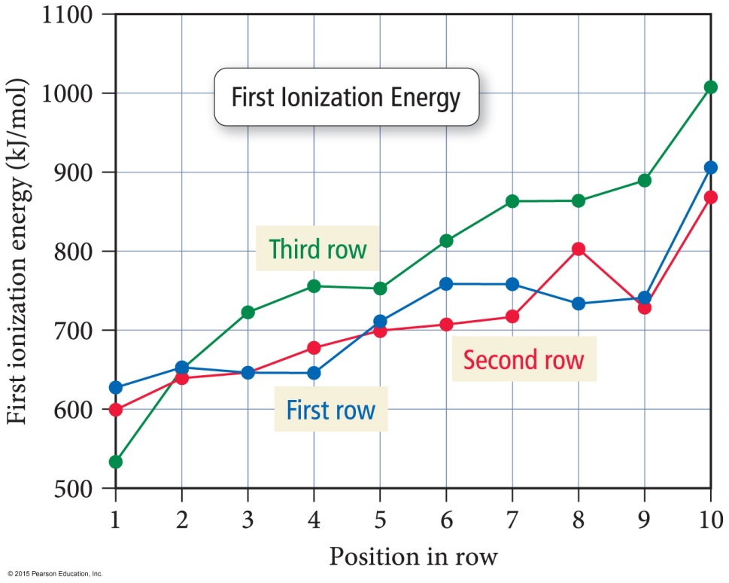
Ionization Energy
The first IE of the transition metals slowly increases across a series.
The first IE of the third transition series is generally higher than those of the first and second series.
Indicating the valence electrons are held more tightly—why?
Trend opposite to that of main-group elements

Slide 8
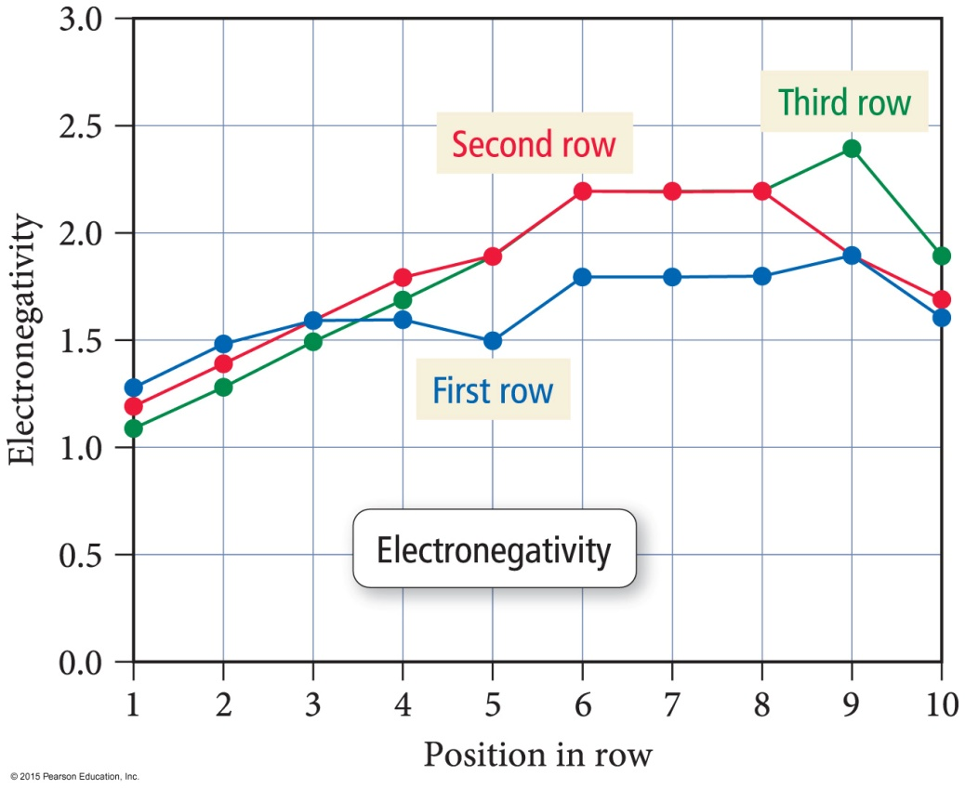
Electronegativity
The electronegativity of the transition metals slowly increases across a series.
Except for last element in the series
Electronegativity slightly increases between first and second series, but the third transition series atoms are about the same as the second.
Trend opposite to that of main-group elements

Slide 9
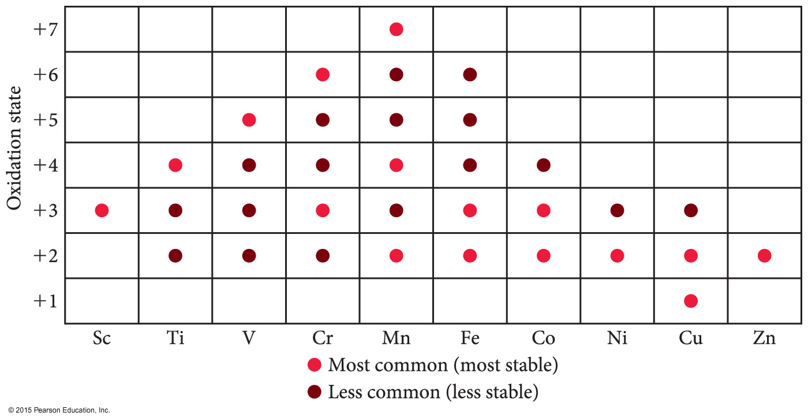
Oxidation States
Unlike main-group metals, transition metals often exhibit multiple oxidation states.
They vary by 1.
Highest oxidation state is the same as the group number for groups 3B to 7B.

Slide 10
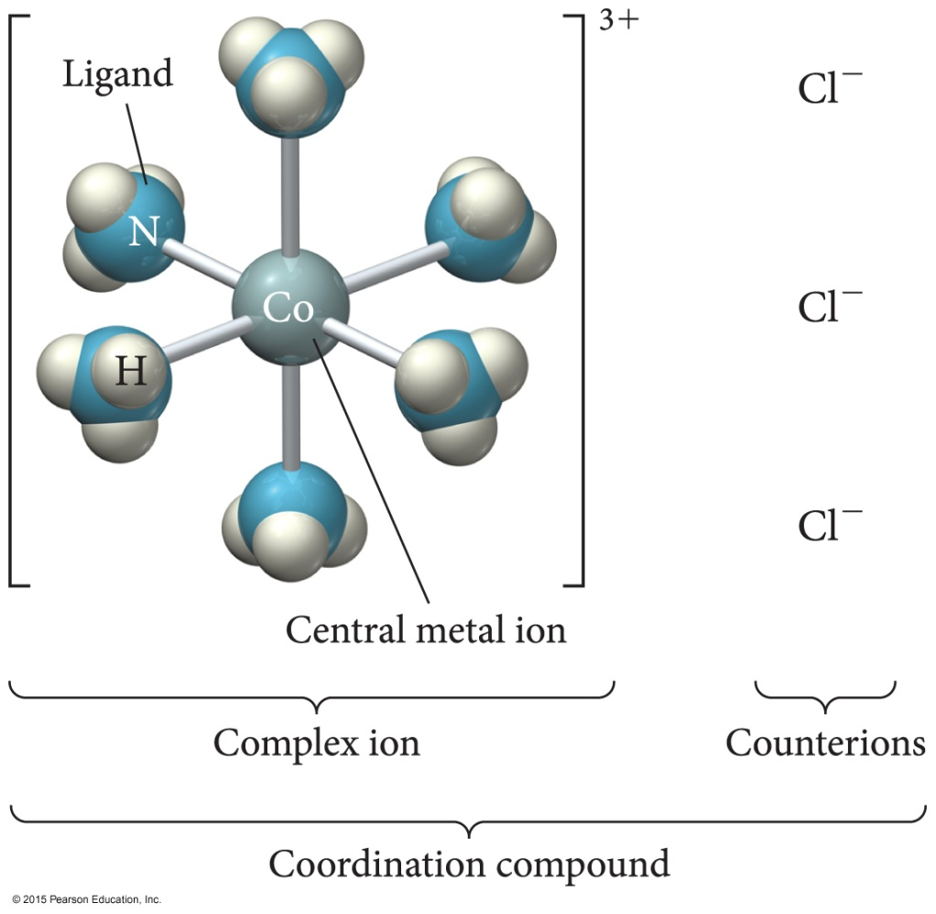
Complex Ions
When a monatomic cation combines with multiple monatomic anions or neutral molecules it makes a complex ion.
The attached anions or neutral molecules are called ligands.
The charge on the complex ion can then be positive or negative, depending on the numbers and types of ligands attached.

Slide 11
Coordination Compounds
When a complex ion combines with counterions to make a neutral compound, it is called a coordination compound.
The primary valence is the oxidation number of the metal.
The secondary valence is the number of ligands bonded to the metal.
Coordination number
Coordination numbers range from 2 to 12, with the most common being 6 and 4.
CoCl₃ • 6H₂O = [Co(H₂O)₆]Cl₃

Slide 12
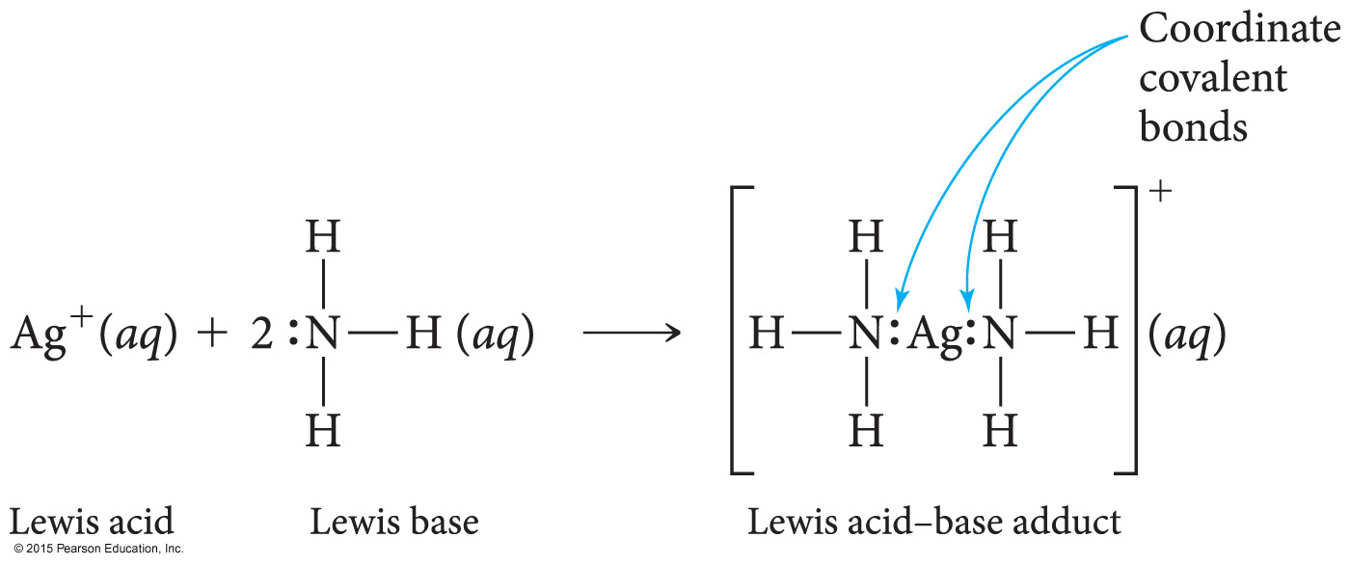
Complex Ion Formation
Complex ion formation is a type of Lewis acid–base reaction.
A bond that forms when the pair of electrons is donated by one atom is called a coordinate covalent bond.

Slide 13
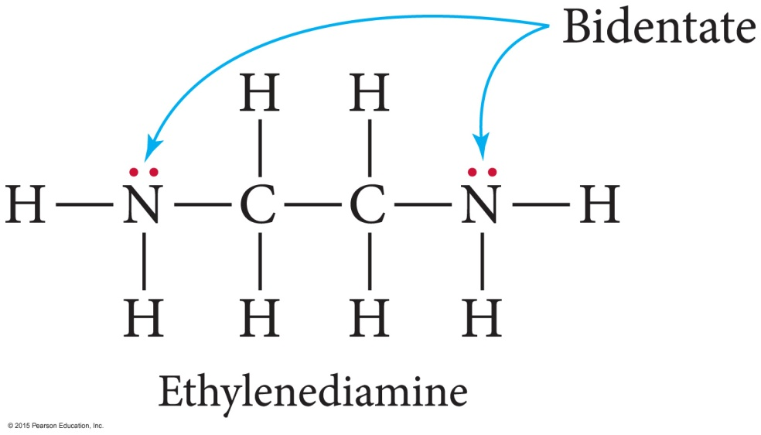
Ligands that Grab
Some ligands can form more than one coordinate covalent bond with the metal atom.
Lone pairs on different atoms that are separated enough so that both can bond to the metal.
A chelate is a complex ion containing a multidentate ligand.
The ligand is called the chelating agent.

Slide 14
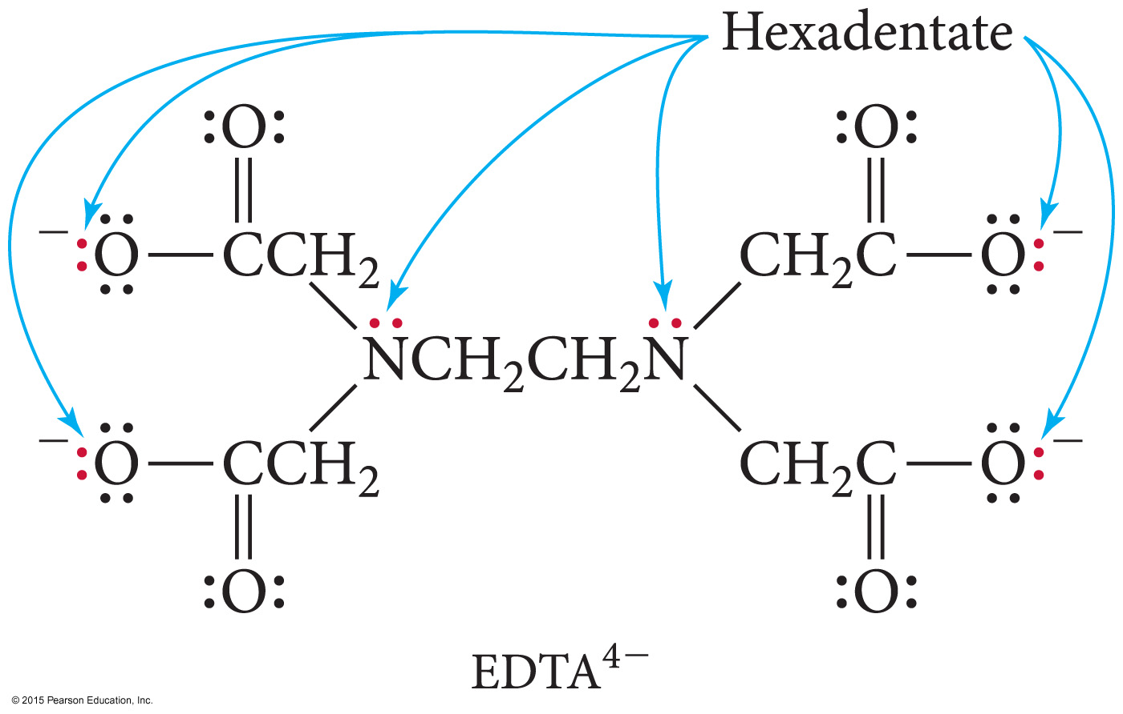
EDTA Is a Polydentate Ligand

Slide 15
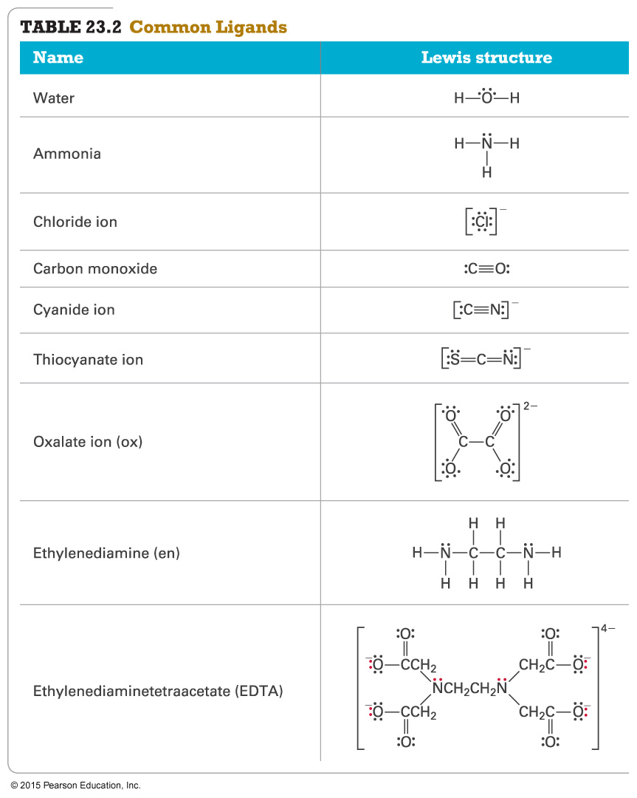
Ligands

Slide 16
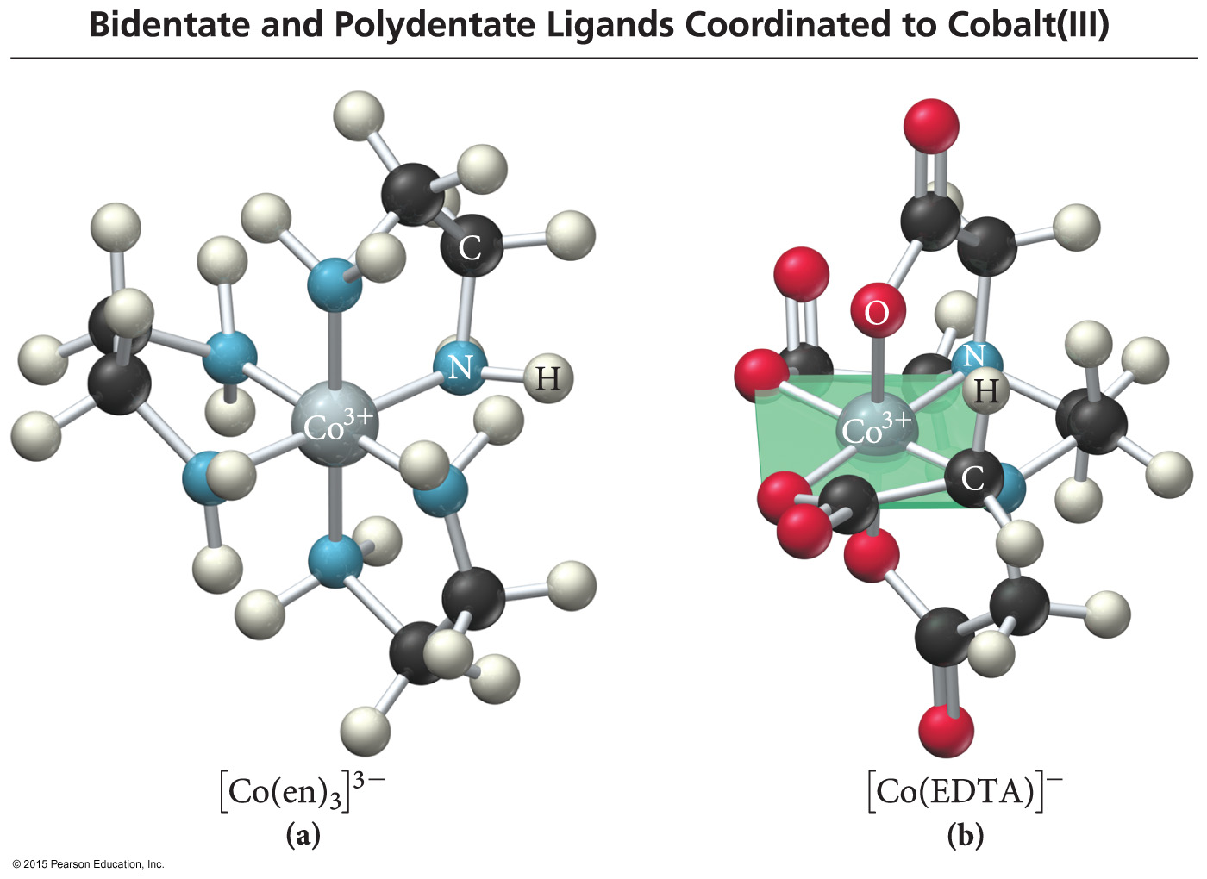
Complex Ions with Polydentate Ligands

Slide 17
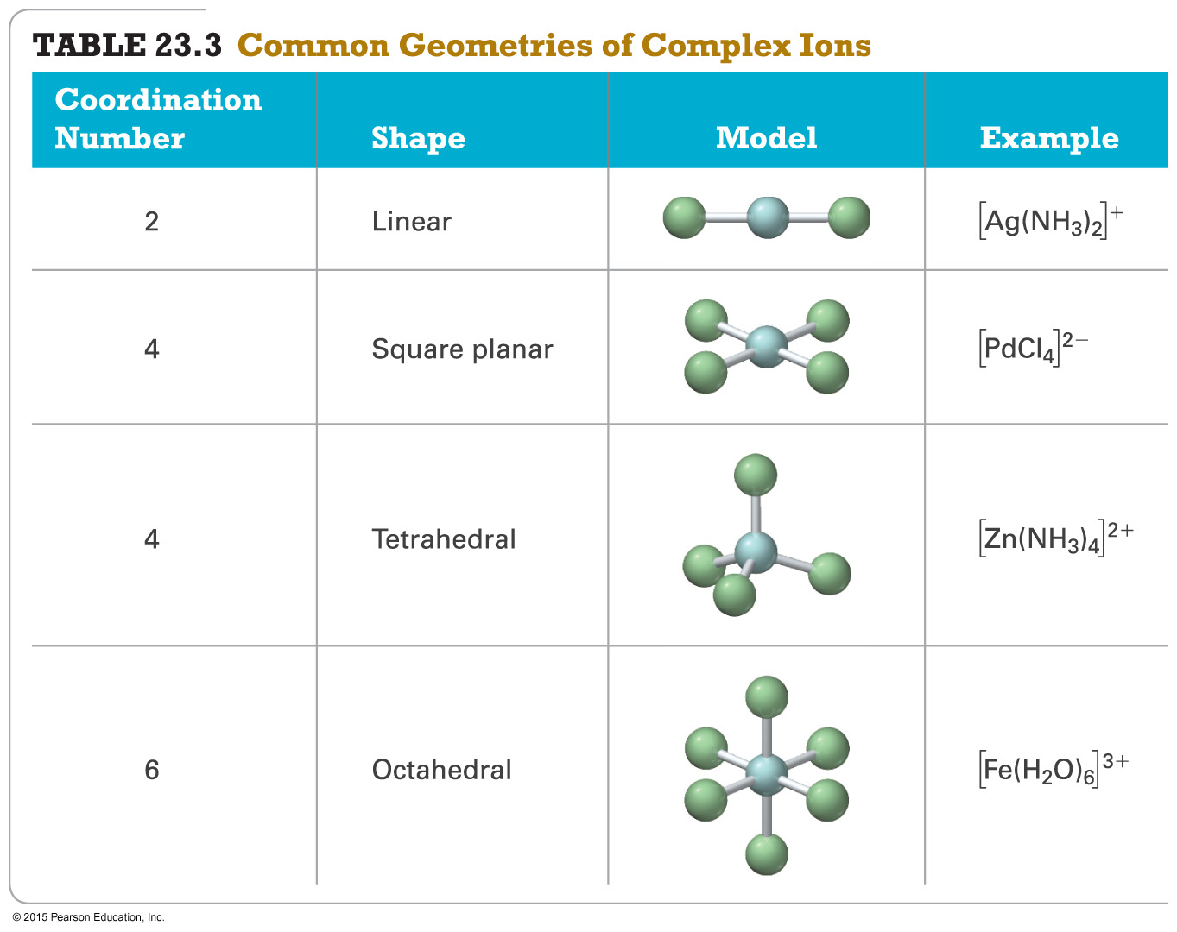
Geometries in Complex Ions

Slide 18
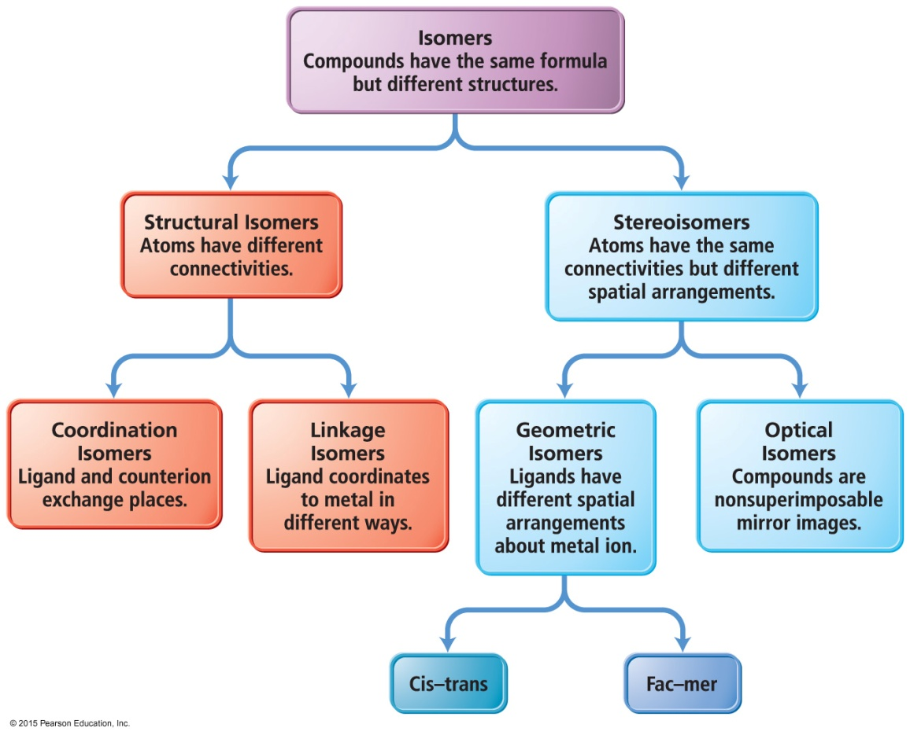
Isomers
Structural isomers are molecules that have the same number and type of atoms, but they are attached in a different order.
Stereoisomers are molecules that have the same number and type of atoms, and that are attached in the same order, but the atoms or groups of atoms point in a different spatial direction.

Slide 19
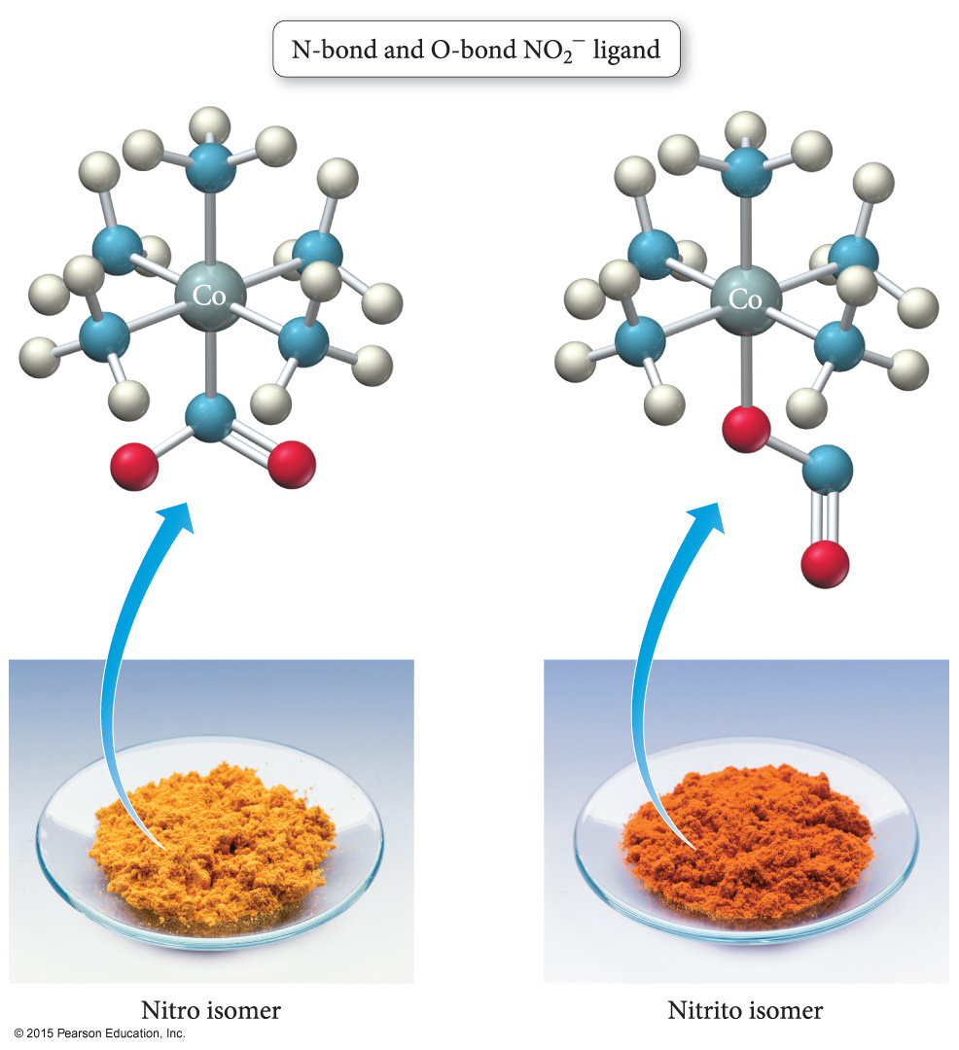
Linkage Isomers
Linkage isomers are structural isomers that have ligands attached to the central cation through different ends of the ligand structure.
Yellow complex = pentaamminenitrocobalt(III)
Red complex = pentaamminenitritocobalt(III)

Slide 20
Ligands Capable of Linkage Isomerization

Slide 21
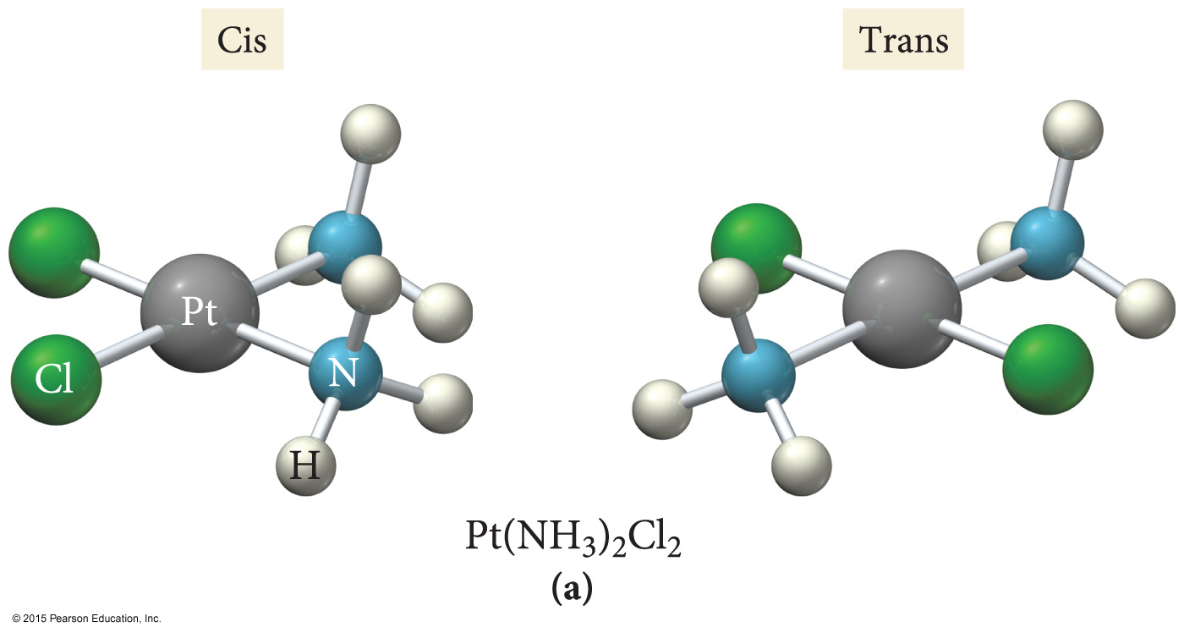
Geometric Isomers
Geometric isomers are stereoisomers that differ in the spatial orientation of ligands.
Cis–trans isomerism in square-planar complexes MA₂B₂

Slide 22
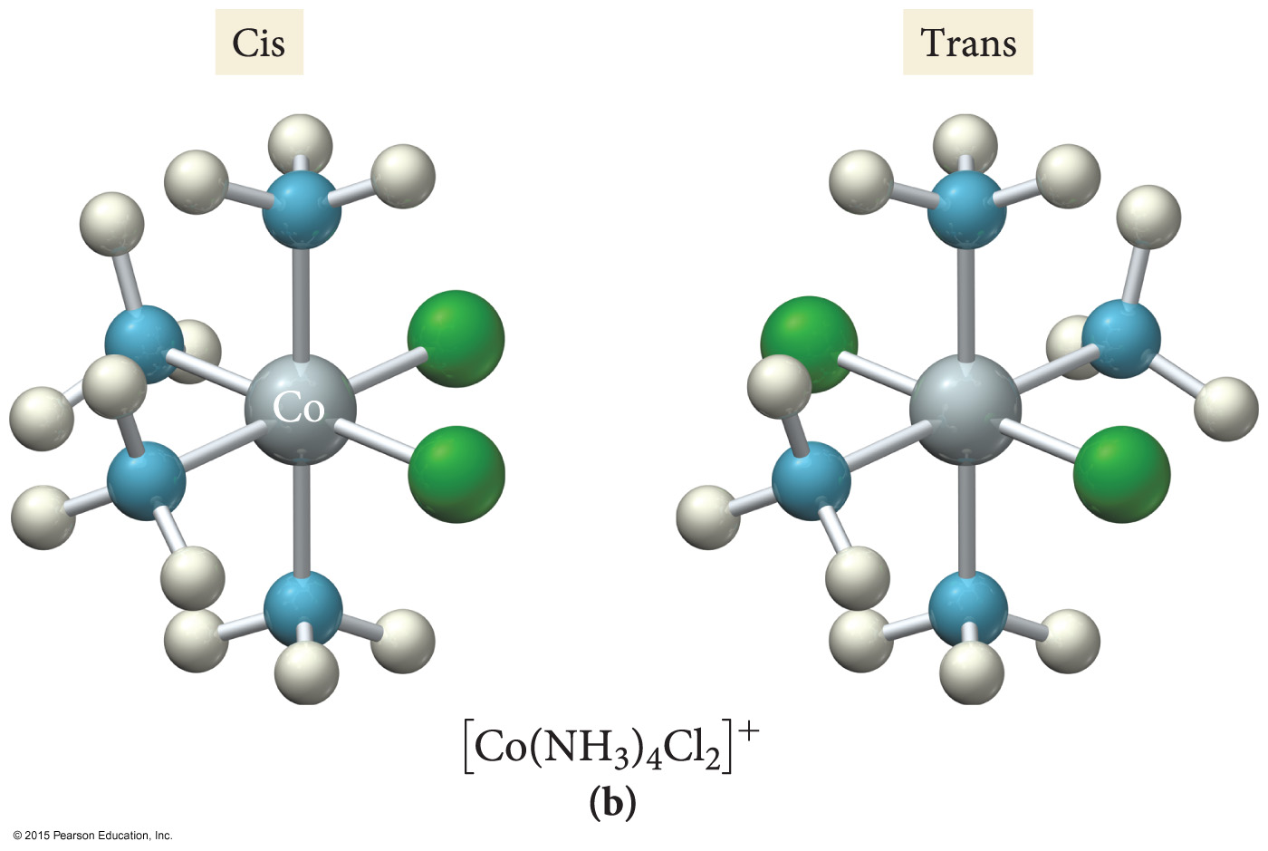
Geometric Isomers
In cis–trans isomerism, two identical ligands are either adjacent to each other (cis) or opposite to each other (trans) in the structure.
Cis–trans isomerism in octahedral complexes MA₄B₂

Slide 23
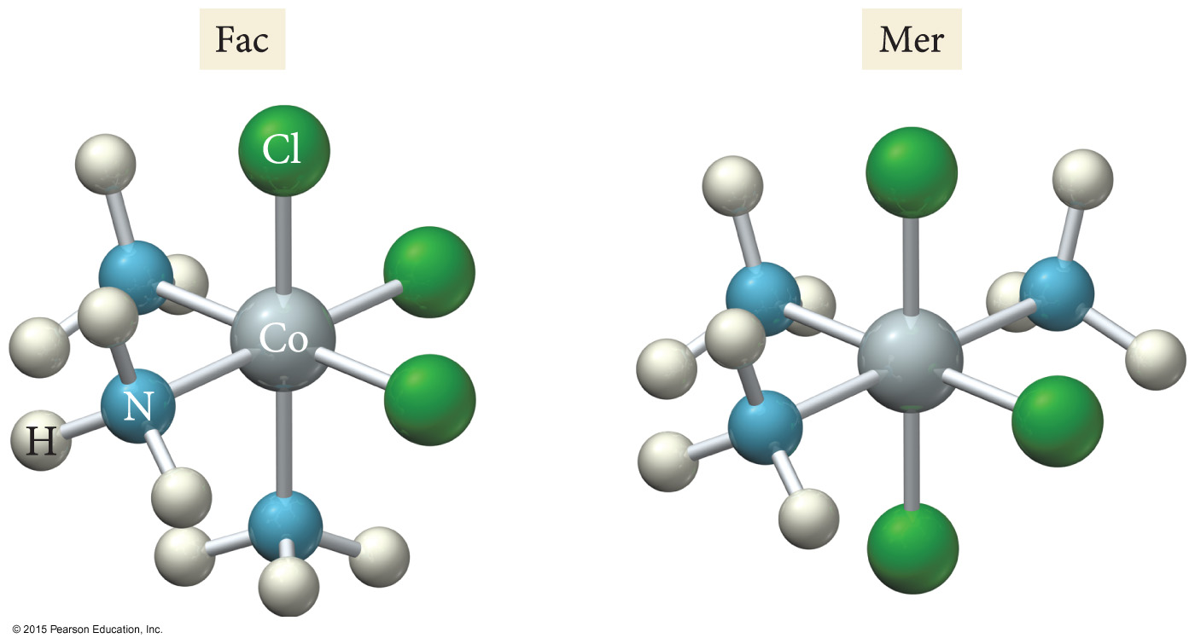
Geometric Isomers
In fac–mer isomerism, three identical ligands in an octahedral complex either are adjacent to each other making one face (fac) or form an arc around the center (mer) in the structure.
Fac–mer isomerism in octahedral complexes MA₃B₃

Slide 24
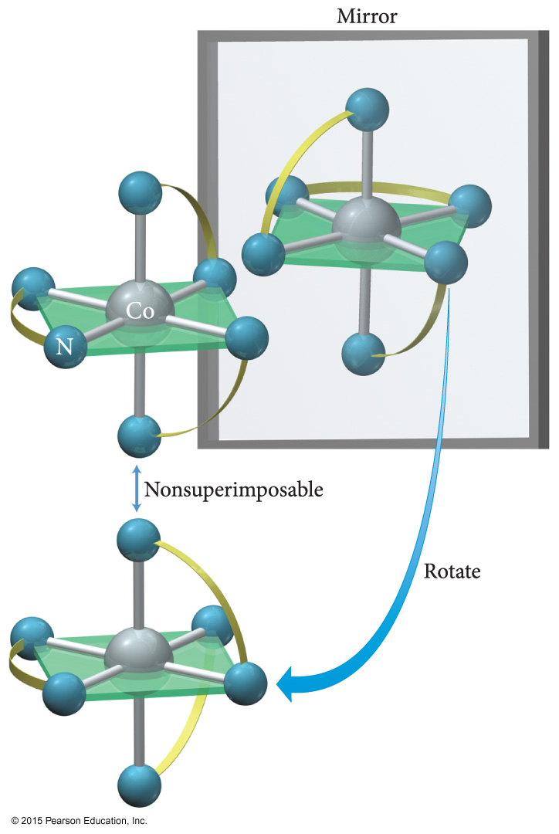
Optical Isomers
[Co(en)₃]³⁺
Optical isomers are stereoisomers that are nonsuperimposable mirror images of each other.

Slide 25
Bonding of Transition Metal Complexes
The bonding involves the d orbitals on the central metal atom or ion. The d orbitals are a set of five degenerate (having the same energy) orbitals.
Spatially, three of the orbitals point between the x, y and z axes. The other two primarily lie along the cartesian coordinates. As a result, in an octahedral complex, these two orbitals point directly towards the ligands.

Slide 26
d Orbitals

Slide 27
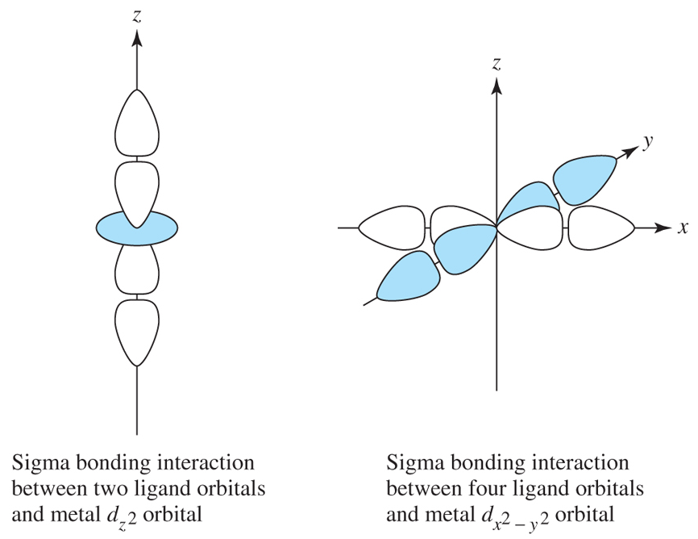

Slide 28
Bonding in Coordination Compounds: Crystal Field Theory
Bonds form due to the attraction of the electrons on the ligand for the charge on the metal cation.
Electrons on the ligands repel electrons in the unhybridized d orbitals of the metal ion.
The result is that the energies of the d orbitals are split.
The difference in energy depends on the complex formed and the kinds of ligands.
Crystal field splitting energy
Strong-field splitting and weak-field splitting

Slide 29
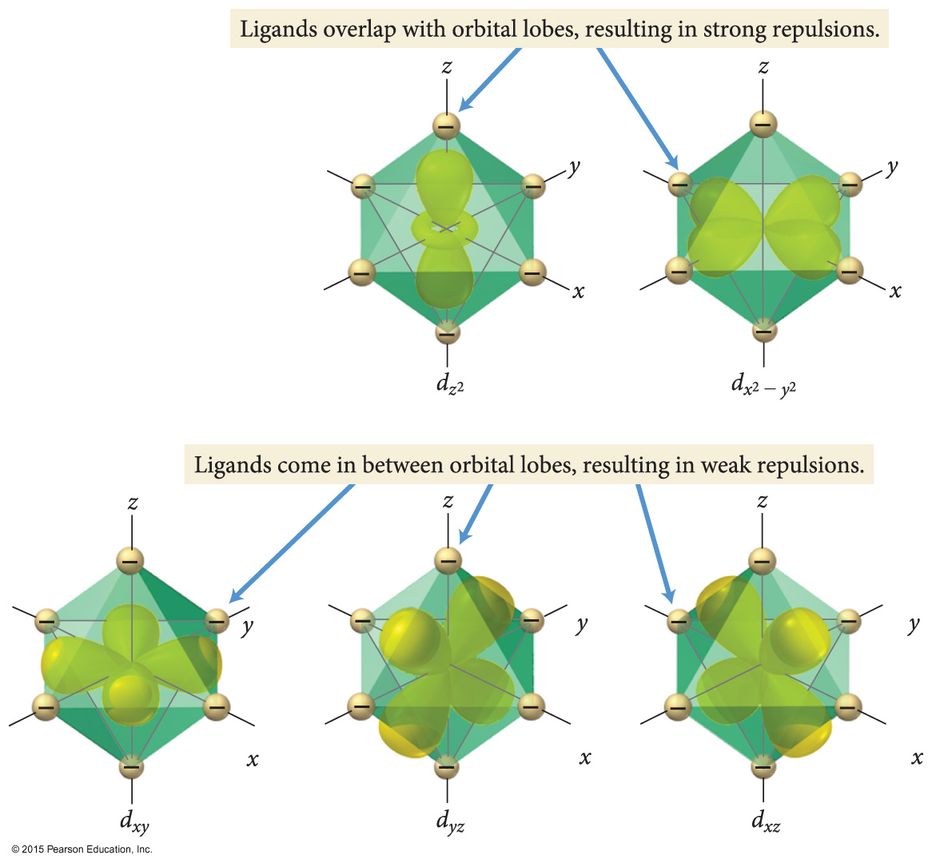
Crystal Field Splitting
The ligands in an octahedral complex are located in the same space as the lobes of the orbitals.
The repulsions between electron pairs in the ligands and any potential electrons in the d orbitals result in an increase in the energies of these orbitals.
The other d orbitals lie between the axes and have nodes directly on the axes, which results in less repulsion and lower energies for these three orbitals.

Slide 30
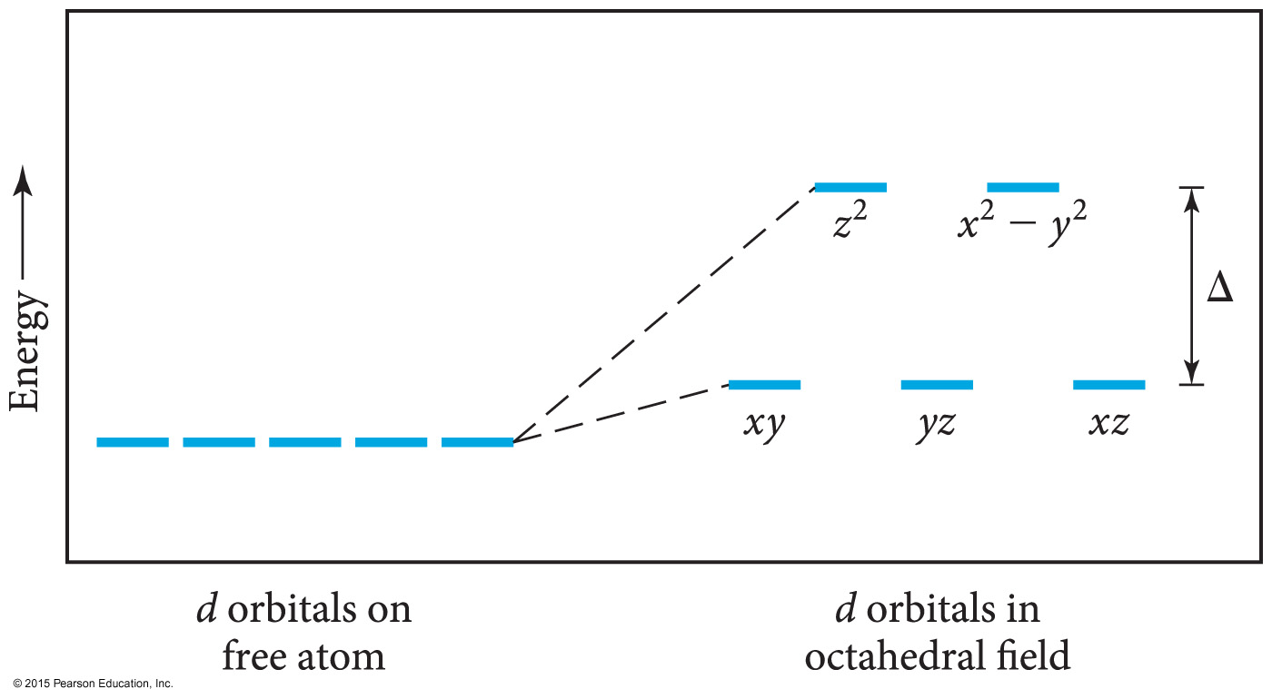
Splitting of d Orbital Energies Due to Ligands in an Octahedral Complex
The size of the crystal field splitting energy, Δ, depends on the kinds of ligands and their relative positions on the complex ion, as well as the kind of metal ion and its oxidation state.

Slide 31
Color and Complex Ions
Transition metal ions show many intense colors in host crystals or solution.
The color of light absorbed by the complexed ion is related to electronic energy changes in the structure of the complex.
The electron “leaping” from a lower energy state to a higher energy state

Slide 32
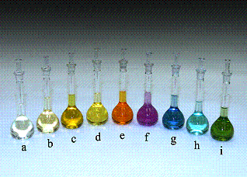
Color and Complex Ions
The complexes of cobalt (III) show the shift in color due to the ligand.
(a) CN–, (b) NO₂–, (c) phen, (d) en, (e) NH₃, (f) gly, (g) H₂O, (h) ox^{2–}, (i) CO₃ ^{2–}.

Slide 33
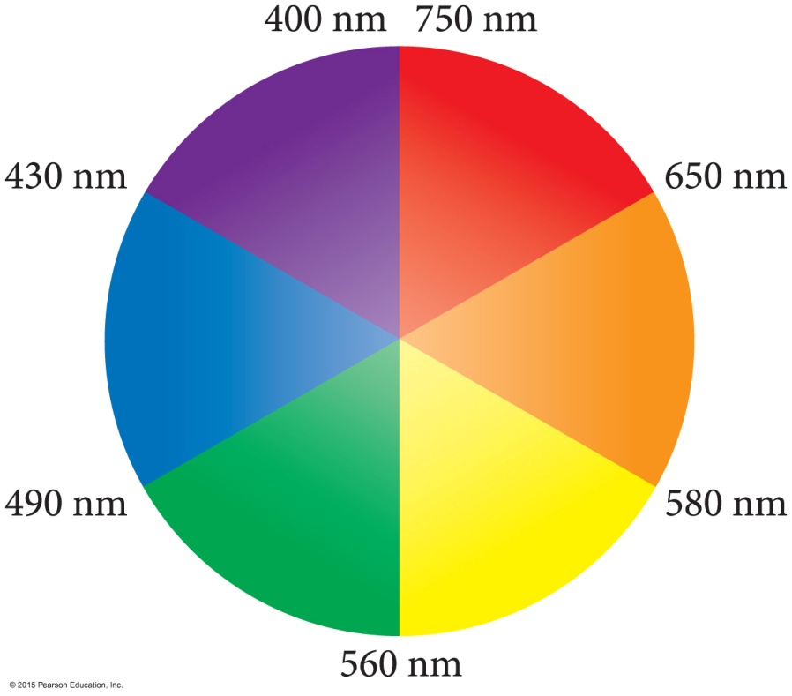
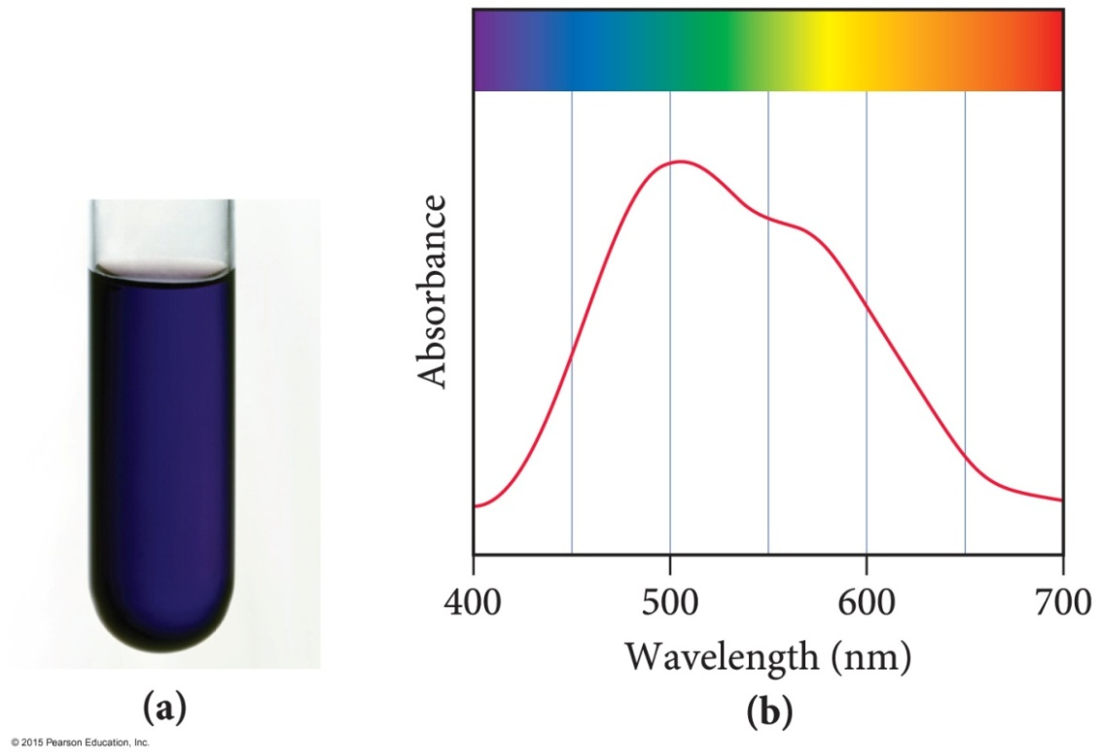
Complex Ion Color
The observed color is the complementary color of the one that is absorbed.

Slide 34
Complex Ion Color and Crystal Field Strength
The colors of complex ions are due to electronic transitions between the split d sublevel orbitals.
The wavelength of maximum absorbance can be used to determine the size of the energy gap between the split d sublevel orbitals.
E_{photon} = hυ = hc/λ = Δ

Slide 35
Ligands and Crystal Field Strength
The size of the energy gap depends on what kind of ligands are attached.
Strong-field ligands include CN─ > NO₂─ > en > NH₃.
Weak-field ligands include H₂O > OH─ > F─ > Cl─ > Br─ > I─.
The size of the energy gap also depends on the type of cation.
It increases as the charge on the metal cation increases.
Co³⁺ > Cr³⁺ > Fe³⁺ > Fe²⁺ > Co²⁺ > Ni²⁺ > Mn²⁺

Slide 36
Magnetic Properties and Crystal Field Strength
The electron configuration of the metal ion with split d orbitals depends on the strength of the crystal field.
The fourth and fifth electrons will go into the higher-energy d_{z2} and d_{x2 – y2} if the field is weak
and the energy gap is small, leading to unpaired electrons and a paramagnetic complex.
The fourth through sixth electrons will pair the electrons in the d_{xy}, d_{yz}, and d_{xz} if the field is strong and the energy gap is large, leading to paired electrons and a diamagnetic complex.

Slide 37
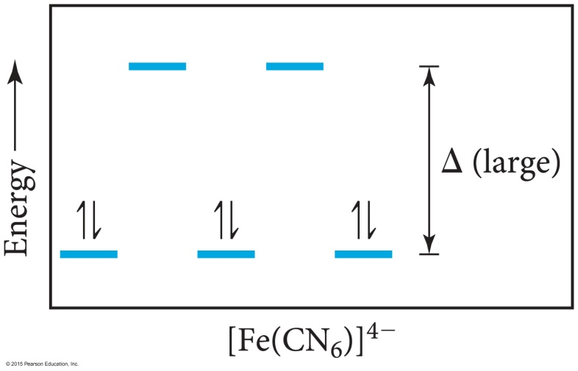
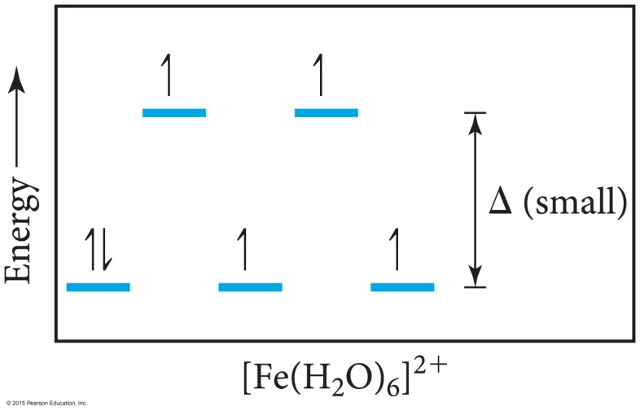
Low-Spin and High-Spin Complexes
Diamagnetic
Low-spin complex
Paramagnetic
High-spin complex
Only electron configurations d⁴, d⁵, d⁶, or d⁷ can have low or high spin.

Slide 38
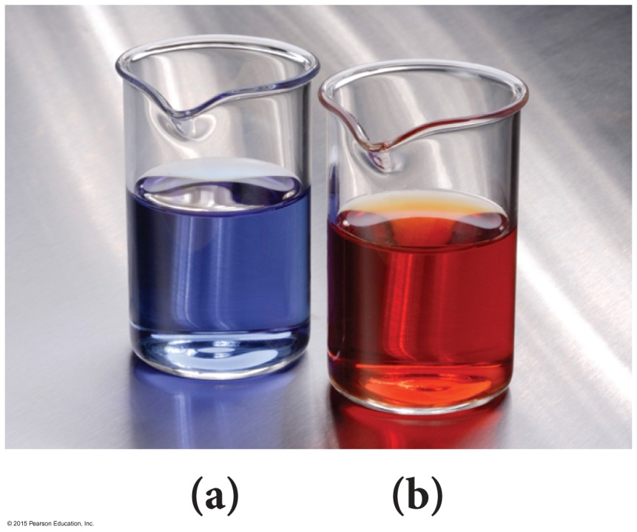
Applications of Coordination Compounds
Extraction of metals from ores
Silver and gold as cyanide complexes
Nickel as Ni(CO)₄(g)
Use of chelating agents in heavy metal poisoning
EDTA for Pb poisoning
Chemical analysis
Qualitative analysis for metal ions
Blue = CoSCN⁺
Red = FeSCN²⁺
Ni²⁺ and Pd²⁺ form insoluble colored precipitates with dimethylglyoxime.
Commercial coloring agents
Prussian blue = mixture of hexacyano complexes of Fe(II) and Fe(III)
Inks, blueprinting, cosmetics, paints

Slide 39
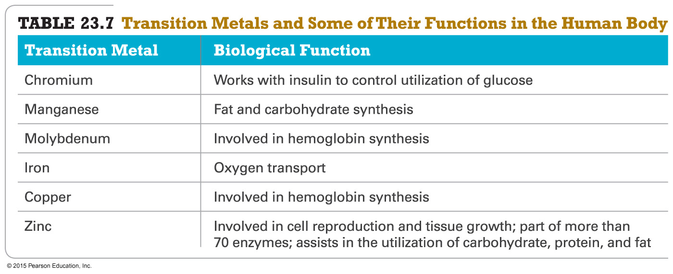
Biomolecules

Slide 40
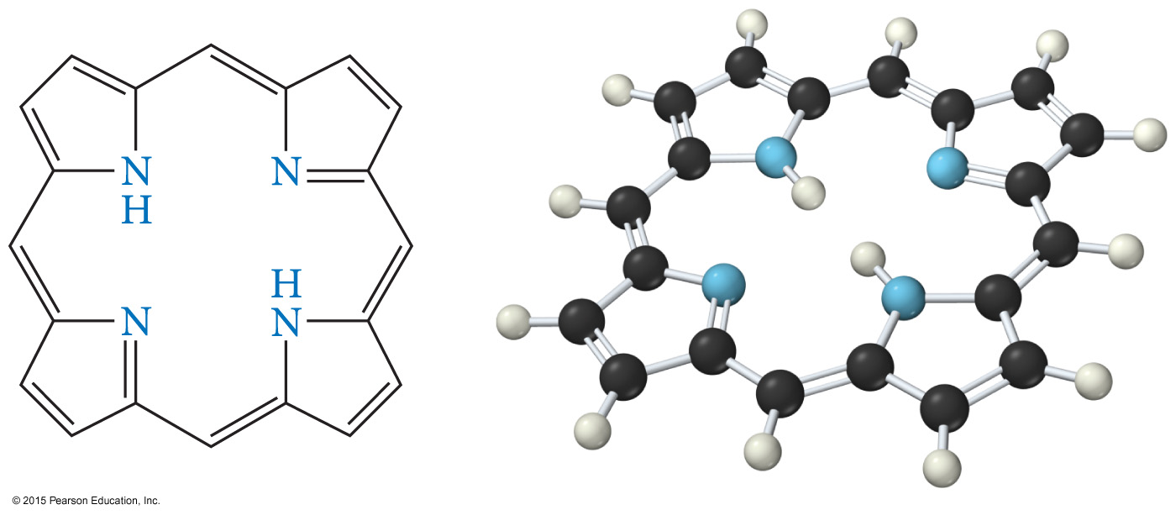
Applications of Coordination Compounds
Biomolecules
Porphyrin ring

Slide 41
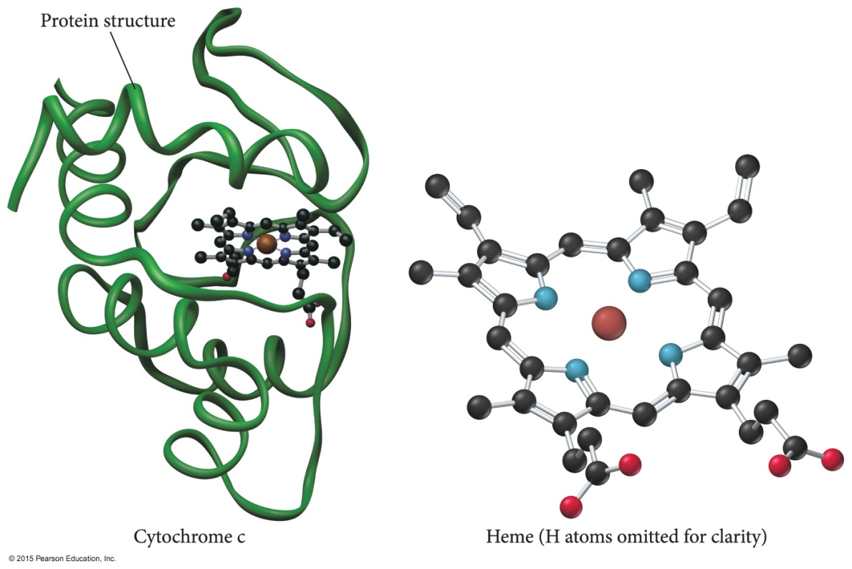
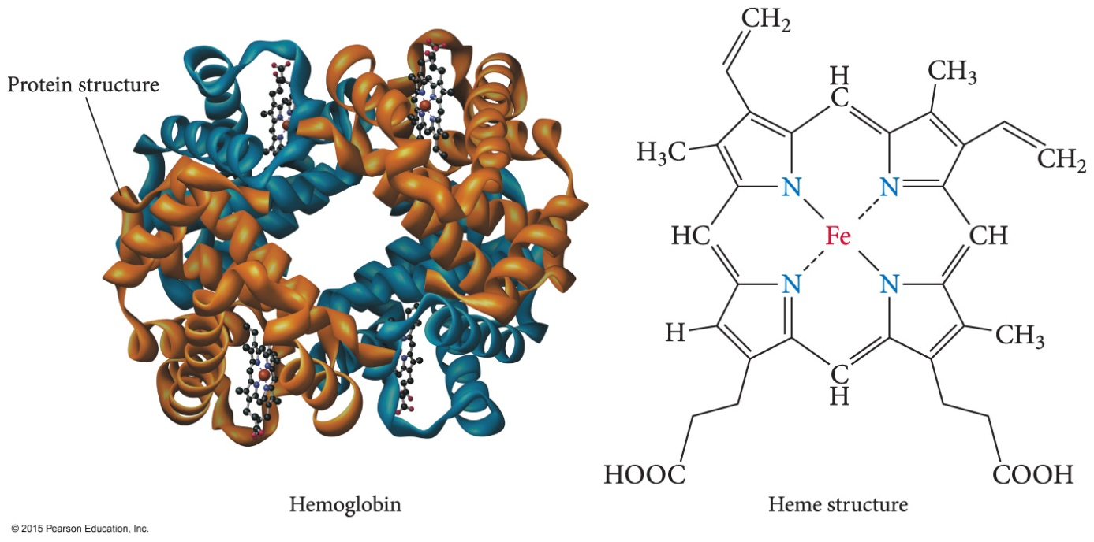
Applications of Coordination Compounds
Biomolecules
Cytochrome C
Hemoglobin

Slide 42
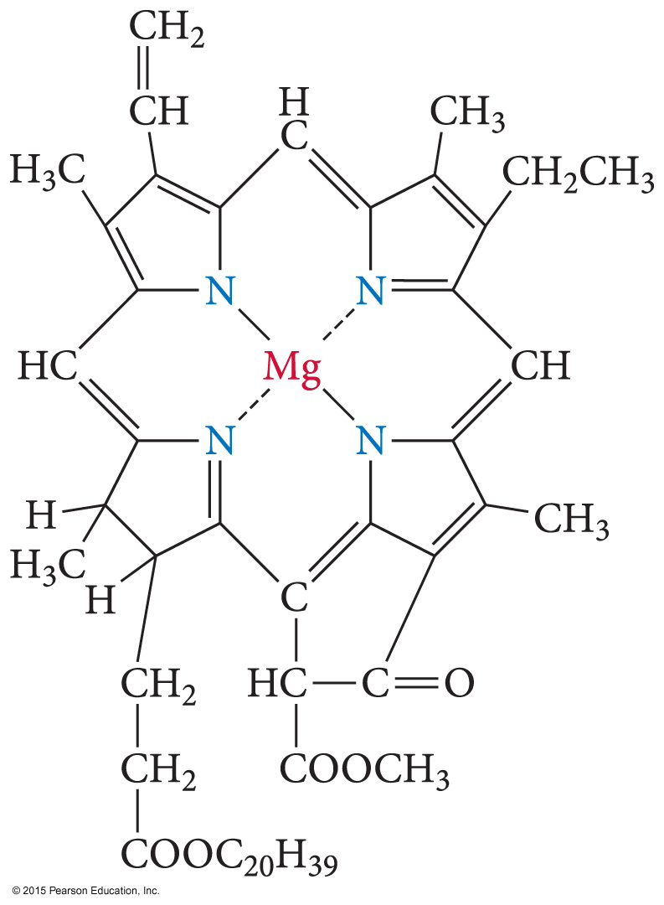
Applications of Coordination Compounds
Biomolecules
Chlorophyll

Slide 43
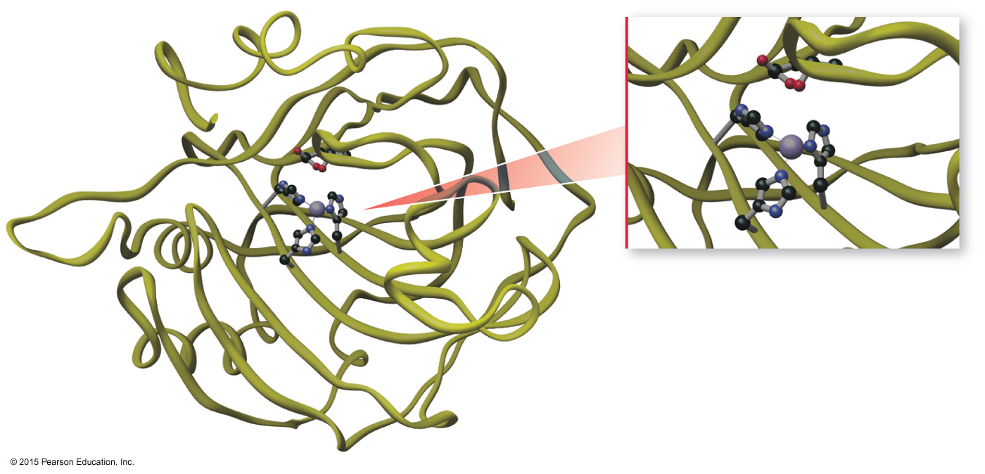
Applications of Coordination Compounds
Carbonic anhydrase
Catalyzes the reaction between water and CO₂
Contains tetrahedrally complexed Zn²⁺

Slide 44
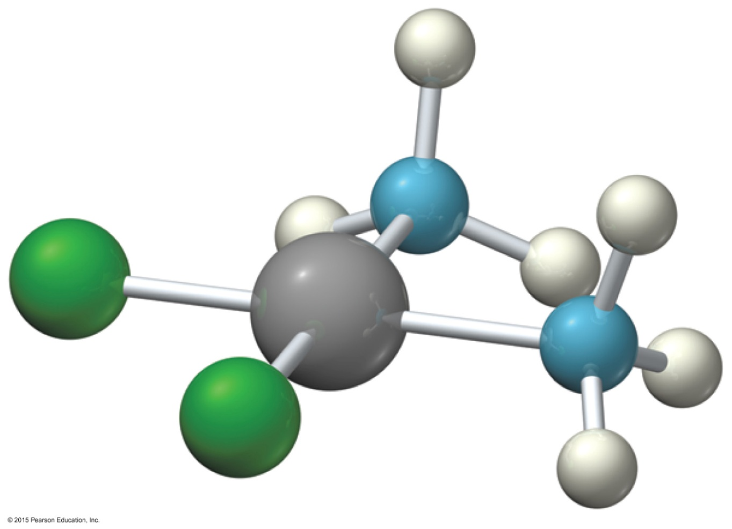
Applications of Coordination Compounds
Drugs and therapeutic agents
Cisplatin
Anticancer drug

