Slide 1
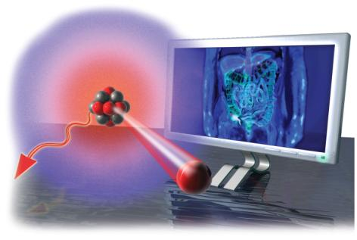
Chapter 21 Lecture presentation
Radioactivity
and Nuclear Chemistry
Catherine E. MacGowan
Armstrong Atlantic State University

Slide 2
What Is Radioactivity?
Radioactivity is the release of tiny, high-energy particles or high-energy electromagnetic radiation from the nucleus of an atom.
Atoms that eject particles and/or energy from their nucleus are referred to as being radioactive.

Slide 3
Radioactivity
Radioactive nuclei spontaneously decompose into smaller nuclei. This process is referred to as radioactive decay.
Radioactive nuclei are unstable.
Decomposing involves the nuclide emitting a particle and/or energy.
The parent nuclide is the nucleus that is undergoing radioactive decay.
The daughter nuclide is the new nucleus that is made.
All nuclides with 84 or more protons are radioactive.

Slide 4
Properties of Radioactivity
Radioactive rays can ionize matter.
They cause uncharged matter to become charged.
This is the basis of how a Geiger counter and electroscope work.
Radioactive rays
have high energy;
can penetrate matter; and
cause phosphorescent chemicals to glow.

Slide 5
Types of Radioactive Decay
Natural radioactivity can be categorized by the type of decay (particles or energy rays).
Rutherford discovered three types of rays:
Alpha (α) rays
Have a charge of +2 and a mass of 4 amu
What we now know to be helium nucleus
Beta (β) rays
Have a charge of −1 and negligible mass
Electron-like
Gamma (γ) rays
Form of light energy (not a particle like α and β)
In addition, some unstable nuclei emit positrons.
Like a positively charged electron
Some unstable nuclei will undergo electron capture.
A low-energy electron is pulled into the nucleus.

Slide 6
Nuclear Equations
Nuclear processes are described with nuclear equations.
Atomic numbers and mass numbers are conserved in a nuclear equation.
The sum of the atomic numbers on both sides must be equal.
The sum of the mass numbers on both sides must be equal.
This conservation can be used to determine the identity of a daughter nuclide if the parent nuclide and mode of decay are known.

Slide 7
What Causes Nuclei to Decompose?
The particles in the nucleus are held together by a very strong attractive force found only in the nucleus called the strong force.
Strong forces act only over very short distances.
The neutrons play an important role in stabilizing the nucleus as they add to the strong force but don’t repel each other like the protons do.

Slide 8
N/Z (Neutrons/Protons) Ratio
The ratio of neutrons to protons (N/Z) is an important measure of the stability of the nucleus.
If the N/Z ratio is too high, neutrons are converted to protons via beta decay.
If the N/Z ratio is too low, protons are converted to neutrons via positron emission or electron capture.
Or via alpha decay, though not as efficiently

Slide 9
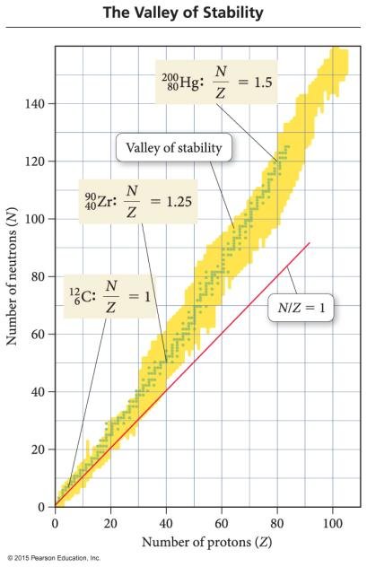
Valley of Stability
For Z = 1 → 20, stable N/Z ≈ 1.
For Z = 20 → 40, stable N/Z approaches 1.25.
For Z = 40 → 80, stable N/Z approaches 1.5.
For Z > 83, there are no stable nuclei.

Slide 10
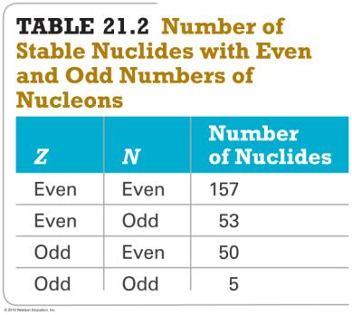
Magic Numbers
Besides the N/Z ratio, the actual numbers of protons and neutrons affect stability.
Most stable nuclei have even numbers of protons and neutrons.
Only a few have odd numbers of protons and neutrons.
If the total number of nucleons adds to a magic number, the nucleus is more stable.
Same principle as stability of the noble gas electron configuration
Most stable when N or Z = 2, 8, 20, 28, 50, 82; or N = 126

Slide 11
Alpha (α) Decay
An alpha particle is a ⁴₂He nucleus.
Alpha decay occurs when an unstable nucleus emits a particle composed of two protons and two neutrons.
It is the most ionizing but least penetrating of the types of radioactivity.
Protection from alpha decay: paper or light cloth
Loss of an alpha particle means that
the atomic number increases by 2; and
the mass number decreases by 4.

Slide 12
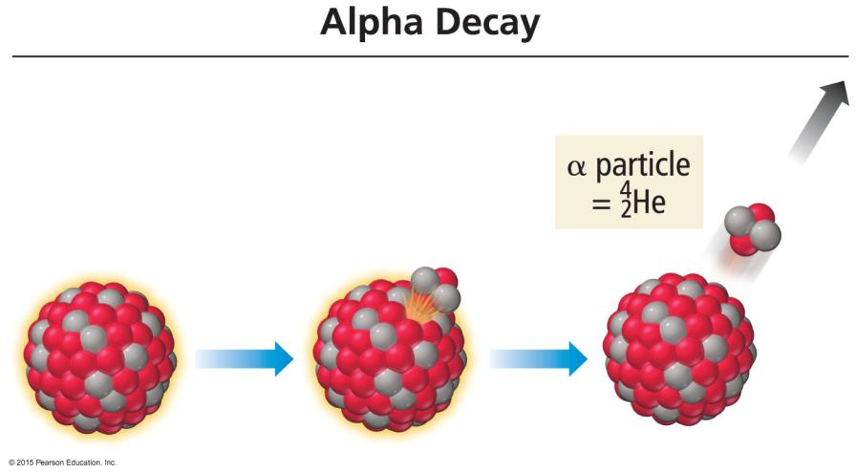
Alpha (α) Decay Illustration

Slide 13
Beta (β) Decay
A beta particle is an electron-like particle that is emitted from the nucleus when a neutron in the nucleus transmutes into a proton (remains in the nucleus) and a beta particle (emitted from the nucleus).
Beta decay occurs when an unstable nucleus emits an electron-like particle.
A beta particle is about 10 times more penetrating than an alpha particle but has only about half the ionizing ability.
Protection: heavy cloth
When an atom loses a beta particle,
its atomic number increases by 1; and
its mass number remains the same.
¹₀ neutron → –⁰₁ β + ¹₁ proton

Slide 14
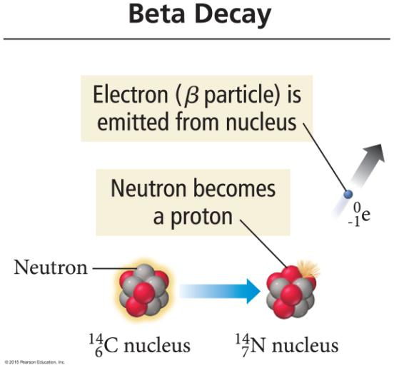
Beta (β) Decay Illustration

Slide 15
Gamma (γ) Emission
Gamma (γ) rays are high-energy photons.
With gamma emission there is no loss of particles from the nucleus.
There is no change in the composition of the nucleus.
Same atomic number and mass number
Symbol:
⁰₀ γ
Gamma rays are the least ionizing but have the most penetration.
Protection: lead plates and thick cement walls
Gamma emission generally occurs after the nucleus undergoes some other type of decay and the remaining particles rearrange.

Slide 16
Positron Emission (₊⁰₁ e)
A positron has a charge of +1 and a negligible mass.
It is the antielectron.
Has the mass of an electron but opposite charge
Positrons are similar to beta particles in their ionizing and penetrating abilities.
A positron is formed and ejected from the nucleus when a proton transmutes to a neutron.
When an atom loses a positron from the nucleus,
its mass number remains the same; and
its atomic number decreases by 1.
¹₁ proton → ₊⁰₁ e + ¹₀ neutron

Slide 17
Positron Emission Illustration

Slide 18
Electron Capture (–⁰₁ e)
It occurs when an electron from an inner orbital is pulled into the nucleus.
There is no particle emission, but the atom changes because the inner electron combines with a proton in the nucleus to form a neutron.
When a proton combines with the electron to make a neutron,
its mass number stays the same; and
its atomic number decreases by 1.
¹₁ proton + –⁰₁ e → ¹₀ neutron

Slide 19
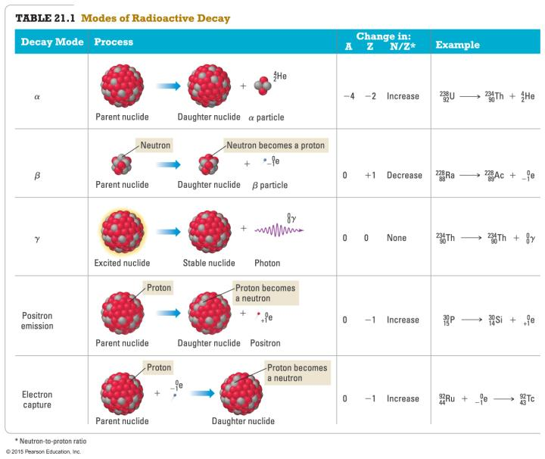
Table of Radioactive Particles and Rays

Slide 20
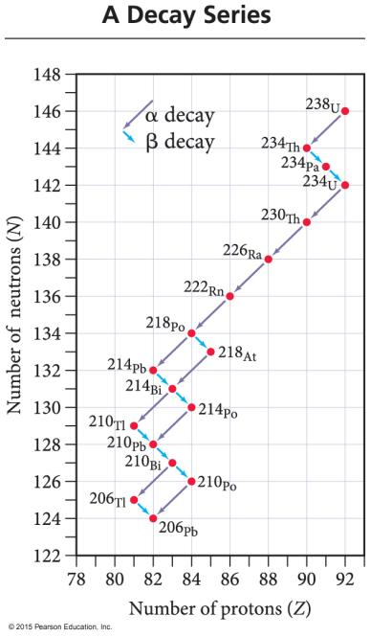
Decay Series
In nature, often one radioactive nuclide changes into another radioactive nuclide.
That is, the daughter nuclide is also radioactive.
All atoms with Z > 83 are radioactive.
All of the radioactive nuclides that are produced one after the other until a stable nuclide is made constitute a decay series.

Slide 21
Natural Radioactivity
There are small amounts of radioactive minerals in the air, ground, and water.
They are even in the food you eat!
The radiation you are exposed to from natural sources is called background radiation.

Slide 22
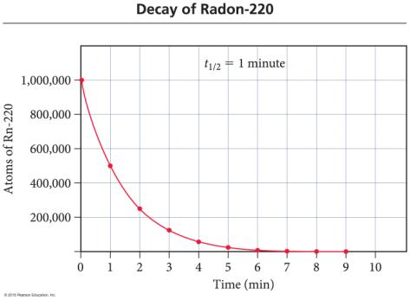
Rate of Radioactive Decay Is First-Order Kinetics
The rate of change in the amount of radioactivity is constant and is different for each radioactive isotope.
A particular length of time—a constant half-life—is required for each radionuclide to lose half its radioactivity.
The shorter the half-life, the more nuclei decay every second; therefore, the “hotter” the sample, the more radioactive it is.
The rate of radioactive change is not affected by temperature.
In other words, radioactivity is not a chemical reaction!

Slide 23
Rate of Radioactive Decay Is First-Order Kinetics
Radioactive decay follows first-order kinetics.
Rate law: Rate = kN
Integrated rate law:
Where
N_{t} = number of radioactive nuclei at time t
N₀ = initial number of radioactive nuclei
Half life: t_{1/2} = 0.693/k or ln(2)/k
N_{t}
ln
= –kt
N₀

Slide 24
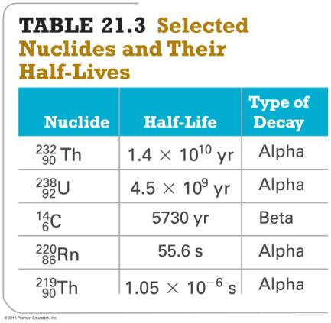
Half-Lives of Various Nuclides

Slide 25
Radiometric Dating
The change in the amount of radioactivity of a particular radionuclide is predictable and not affected by environmental factors.
By measuring and comparing the amount of a parent radioactive isotope and its stable daughter, we can determine the age of the object.
Using the half-life and the previous equations
Mineral (geological) dating: U to Pb
Compares the amount of U-238 to the amount of Pb-206 in volcanic rocks and meteorites
Dates Earth to between 4.0 and 4.5 billion years old
Compares amount of K-40 to amount of Ar-40

Slide 26
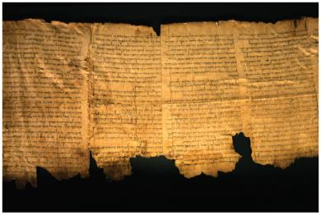
Radiocarbon Dating
All things that are alive or were once alive contain carbon.
Three isotopes of carbon exist in nature, one of which, C-14, is radioactive.
C-14 radioactive with half-life = 5730 years
Atmospheric chemistry keeps producing C-14 at nearly the same rate it decays.

Slide 27
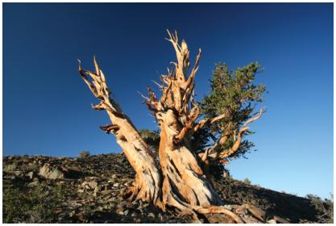
Radiocarbon Dating
While an organism is still living, C-14/ C-12 is constant because the organism replenishes its supply of carbon.
CO₂ in air is the ultimate source of all C in an organism.
Once the organism dies the C-14/C-12 ratio decreases.
By measuring the C-14/C-12 ratio in a once-living artifact and comparing it to the C-14/C-12 ratio in a living organism, we can tell how long ago the organism was alive.
The limit for this technique is 50,000 years old.
About 9 half-lives, after which radioactivity from C-14 will be below the background radiation

Slide 28
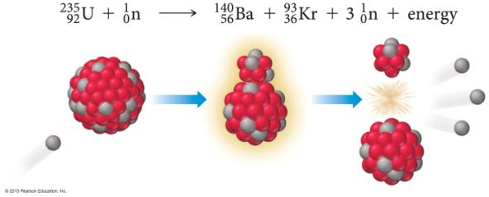
Nonradioactive Nuclear Changes
Fission
The large nucleus splits into two smaller nuclei.
Fusion
Small nuclei can be accelerated to smash together to make a larger nucleus.
Both fission and fusion release enormous amounts of energy.
Fusion releases more energy per gram than fission does.

Slide 29
Fission Chain Reaction
A chain reaction occurs when a reactant in the process is also a product of the process.
In the fission process it is the neutrons.
So, you need only a small amount of neutrons to start the chain.
Many of the neutrons produced in fission are either ejected from the uranium before they hit another U-235 or absorbed by the surrounding U-238.
The minimum amount of fissionable isotope needed to sustain the chain reaction is called the critical mass.

Slide 30
Fissionable Material
Fissionable isotopes include U-235, Pu-239, and Pu-240.
Natural uranium is less than 1% U-235.
The rest is mostly U-238.
There is not enough U-235 to sustain chain reaction.
To produce fissionable uranium, the natural uranium must be enriched in U-235.
To about 7% for “weapons grade”
To about 3% for reactor grade

Slide 31
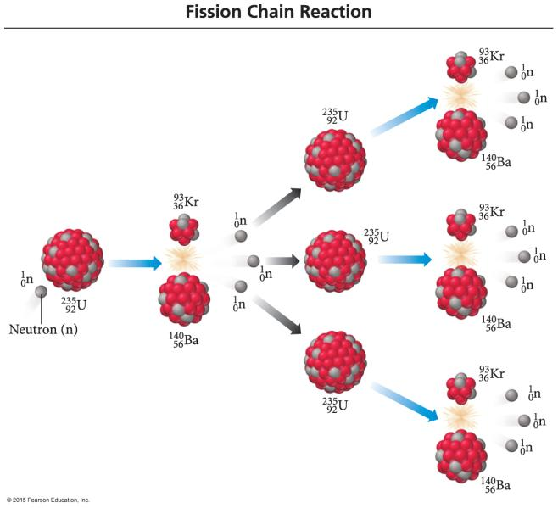
Fission Chain Reaction Illustration

Slide 32
Nuclear Power
Nuclear reactors use fission to generate electricity.
About 20% of U.S. electricity is generated this way.
Nuclear reactors use the fission of U-235 to produce heat.
The heat boils water, turning it to steam.
The steam turns a turbine, generating electricity.

Slide 33
Nuclear Power Plants versus Coal-Burning Power Plants
Nuclear Power Plants
Use about 50 kg of fuel to generate enough electricity for 1 million people
No air pollution
Coal-Burning Power Plants
Use about 2 million kg of fuel to generate enough electricity for 1 million people
Produce NO₂ and SO_{x} that add to acid rain
Produce CO₂ that adds to the greenhouse effect

Slide 34
Nuclear Power Plants—Core
The fissionable material is stored in long tubes called fuel rods, which are arranged in a matrix.
Subcritical
Between the fuel rods are control rods made of neutron-absorbing material.
Boron and/or cadmium
Neutrons needed to sustain the chain reaction
The rods are placed in a material called a moderator to slow down the ejected neutrons.
Allows chain reaction to occur below critical mass

Slide 35
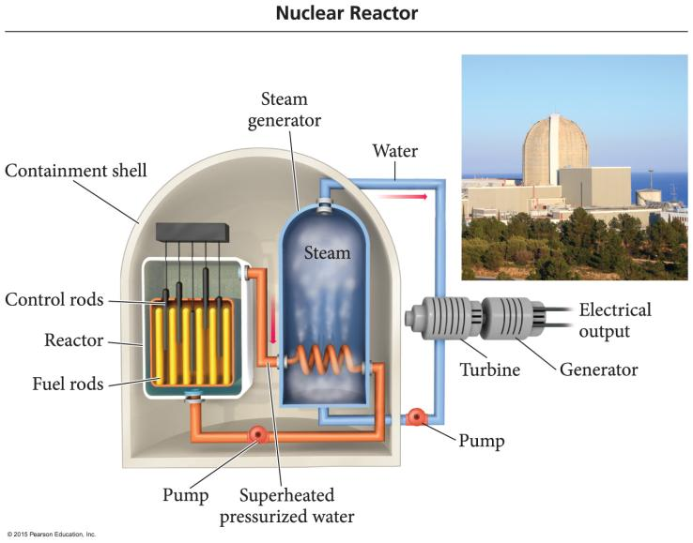
Nuclear Power Plant Reactor Core

Slide 36
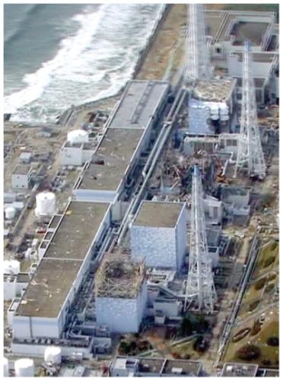
Concerns about Nuclear Power
Core meltdown
Water loss from core; heat melts core
Chernobyl and Fukushima Daiichi
Waste disposal
Waste highly radioactive
Reprocessing; underground storage?
Federal high-level radioactive waste storage facility at Yucca Mountain, Nevada
Transporting waste
Dealing with old, no longer safe nuclear power plants
Yankee Rowe in Massachusetts

Slide 37
Where Does the Energy from Fission Come From?
During nuclear fission, some of the mass of the nucleus is converted into energy.
E = mc²
Each mole of U-235 that fissions produces about 1.7 × 10¹³ J of energy.
A very exothermic chemical reaction produces 10⁶ J per mole.

Slide 38
Mass Defect and Binding Energy
When a nucleus forms, some of the mass of the separate nucleons is converted into energy.
The difference in mass between the separate nucleons and the combined nucleus is called the mass defect.
The energy that is released when the nucleus forms is called the binding energy.
1 MeV = 1.602 × 10⁻¹³ J
1 amu of mass defect = 931.5 MeV
The greater the binding energy per nucleon, the more stable the nucleus.

Slide 39
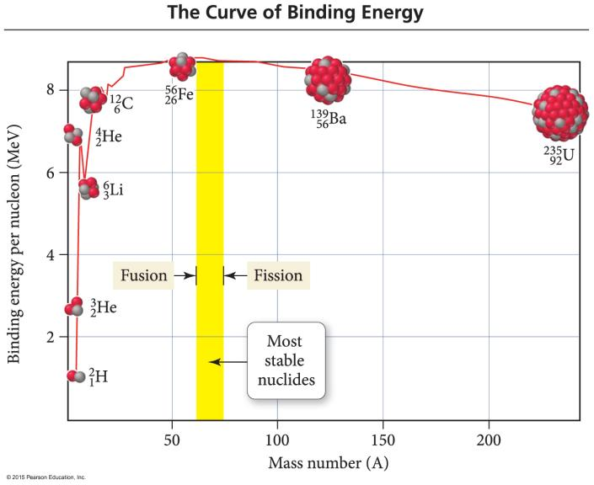
Binding Energy Curve

Slide 40
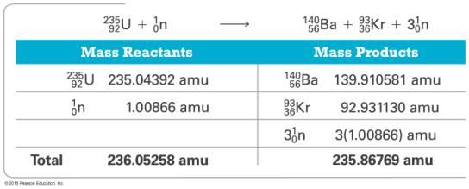
Mass Defect and Binding Energy: Conversion of Mass to Energy
Mass lost (m) = 236.05258 amu – 235.86769 amu = 0.18489 amu
0.18489 amu × (1.66054 × 10^{–27} kg/1 amu) = 3.0702 × 10^{–28} kg
Energy produced: E = mc²
E = 3.0702 × 10^{–28} kg (2.9979 × 10⁸ m/s)²
E = 2.7593 × 10^{–11} J

Slide 41
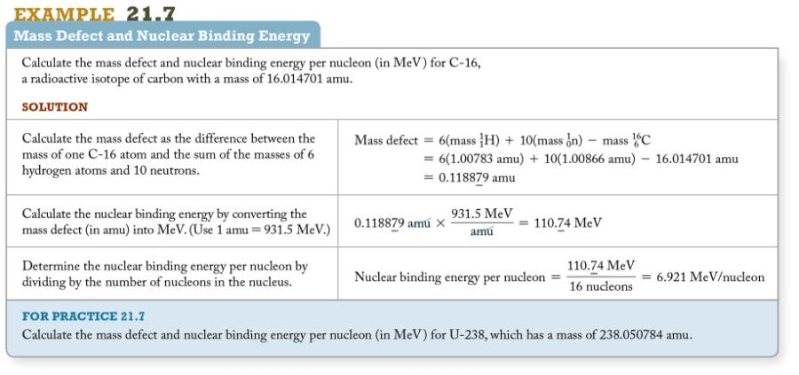
Practice Problem: Mass Defect and Nuclear Binding Energy

Slide 42
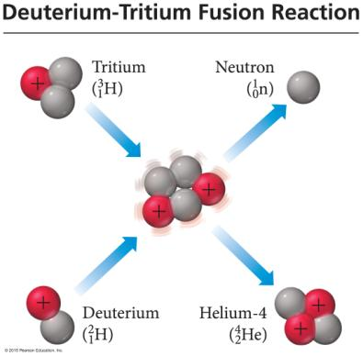
Nuclear Fusion
Fusion is the combining of light nuclei to make a heavier, more stable nuclide.
The sun uses the fusion of hydrogen isotopes to make helium as a power source.
It requires high input of energy to initiate the process.
Because it needs to overcome repulsion of positive nuclei
It produces 10 times the energy per gram as fission.
It produces no radioactive by-products.
Unfortunately, the only currently working application is the H bomb.

