Slide 1
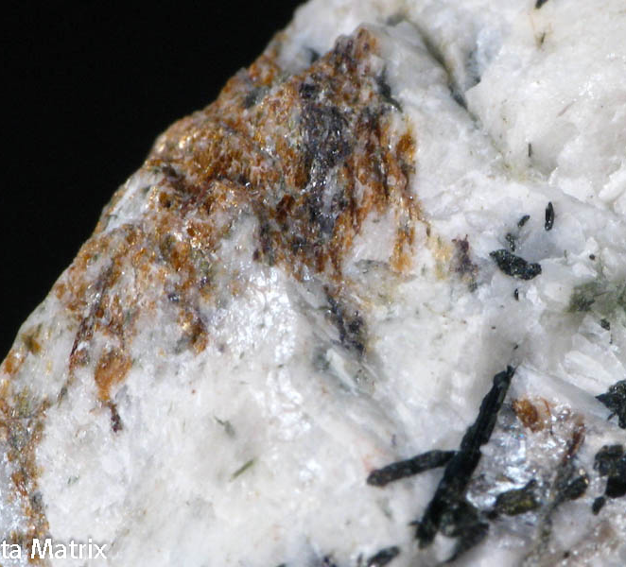
Nepheline
(Na,K)AlSiO₄
Mark Bambrick

Slide 2
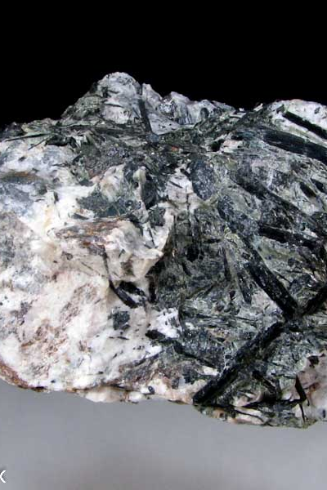
Nepheline
Nepheline was named after the Greek word “nephele” meaning cloud because it becomes cloudy in a strong acid.
Nepheline forms in alkali-rich, silica poor igneous rocks.
Nepheline is made up of Potassium (6.69%) Sodium (11.80%) Aluminum (18.47%) Silicon (19.23%) and Oxygen (43.81%).

Slide 3
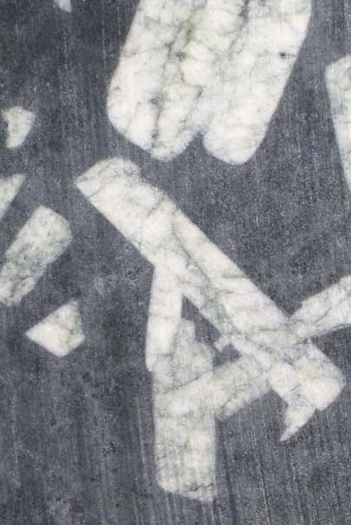
Nepheline
Nepheline can be difficult to distinguish between quarts, but they rarely occur together. Both Nepheline and quartz have a low refractory index and double refraction, but the sign of refraction in Nepheline is negative, while Quartz is positive.
Nepheline weathers easily and is dissolved by hydrochloric acid unlike Quartz and Feldspar.

Slide 4
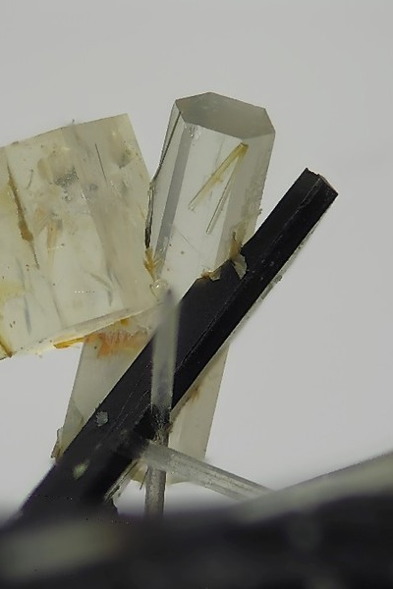
Nepheline
There are different varieties of Nepheline and have different characteristics.
Elaeolite- Massive, oily, and greasy Nepheline. Elaeolite is usually grey/green. It often forms in alkali rich plutonic rocks in Norway.
Glassy Nepheline- Small transparent crystals that form In Nepheline basalt, leucite basalt, and alkali volcanic rock. Mica and Garnet help form the best crystals.

Slide 5
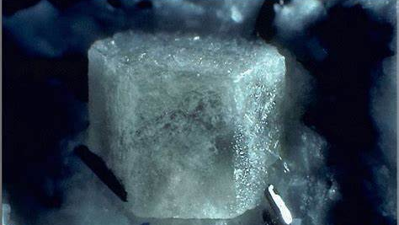
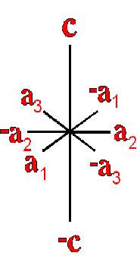
Crystal Structure
Crystal system: Nepheline belongs to the Hexagonal Pyramidal crystal system and has a P6₃ space group. The crystals for short stubby granular prisms.

Slide 6
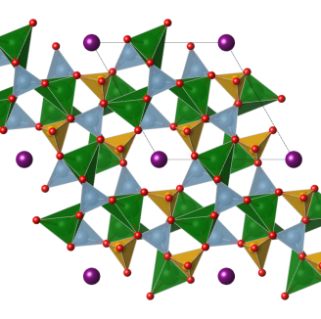
Chemistry (Na,K)AlSiO₄
Nepheline is Feldspathoidal and is made up of an alumino-silicate framework and is like Feldspar but with a more open structure and less silica.
K+ can substitute for Na+ and form a structure with one K+ for every three Na+
(Na₃ K)Al₄(SiO₄)₄.
The sites of K+ are hexagonal while the Na+ ions are irregular.

Slide 7
Physical Properties
Weight: Nepheline has a Molecular weight of 146.8 gm
Density: Nepheline has a density of about 2.59.
Fracture: Nepheline has a sub conchoidal fracture and breaks in brittle and curved surfaces.
Habit: Nepheline has a massive granular (common in igneous rock) to prismatic.

Slide 8
Physical Properties
Cleavage: Nepheline has poor cleavage on miller indices of {1010} {0001}
Hardness: Nepheline has a hardness of 6 like orthoclase.
Color: can be grey, white, brown, and yellowish with and reddish white.
Streak: White

Slide 9
Physical Properties
Luminescence: non fluorescent
Luster: Vitreous / Greasy
Specific gravity: 2.66 gm/cc
Nepheline twins on the {0101} {3365} {1122} indices.
X-Ray Diffraction: 3.069(1) 4.25(0.75) 4.015(0.7)

Slide 10
Optical Properties
Nepheline has a Uniaxial ( - ) optic axis.
Refractory index values:
nω = 1.529 – 1.546 nε = 1.526 – 1.542
The Birefringence range for Nepheline is from 0.0030 to 0.0050.
Nepheline has a low surface relief.

Slide 11
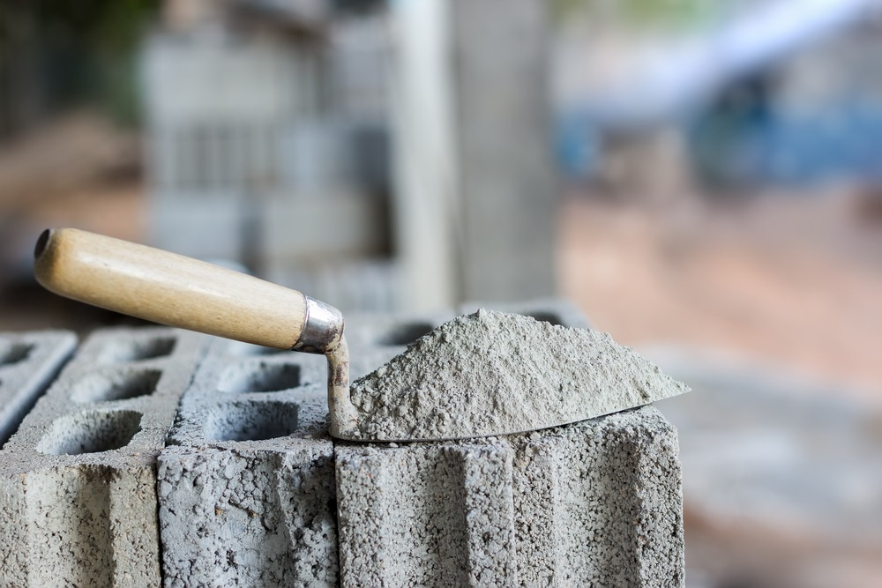
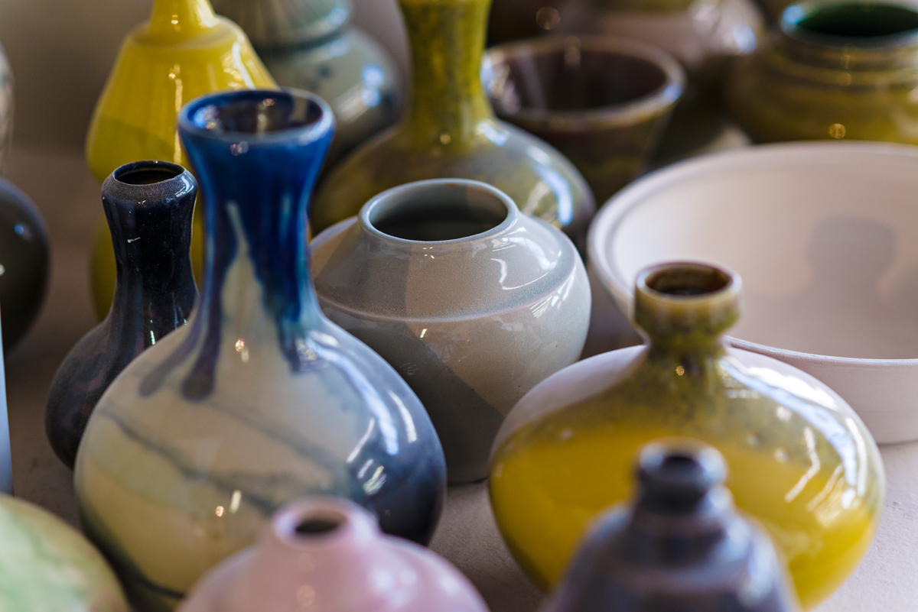
Importance and Uses
Nepheline syenite is used in place of feldspar in the glass and ceramics industry as well as many other industries.
It can be used in construction as dimensional stone, the production of natural cement and for road aggregate.
In Russia it is a by product of Apatite mining and is used by many different industries to produce leather, rubber, wood, textile and oil.

Slide 12
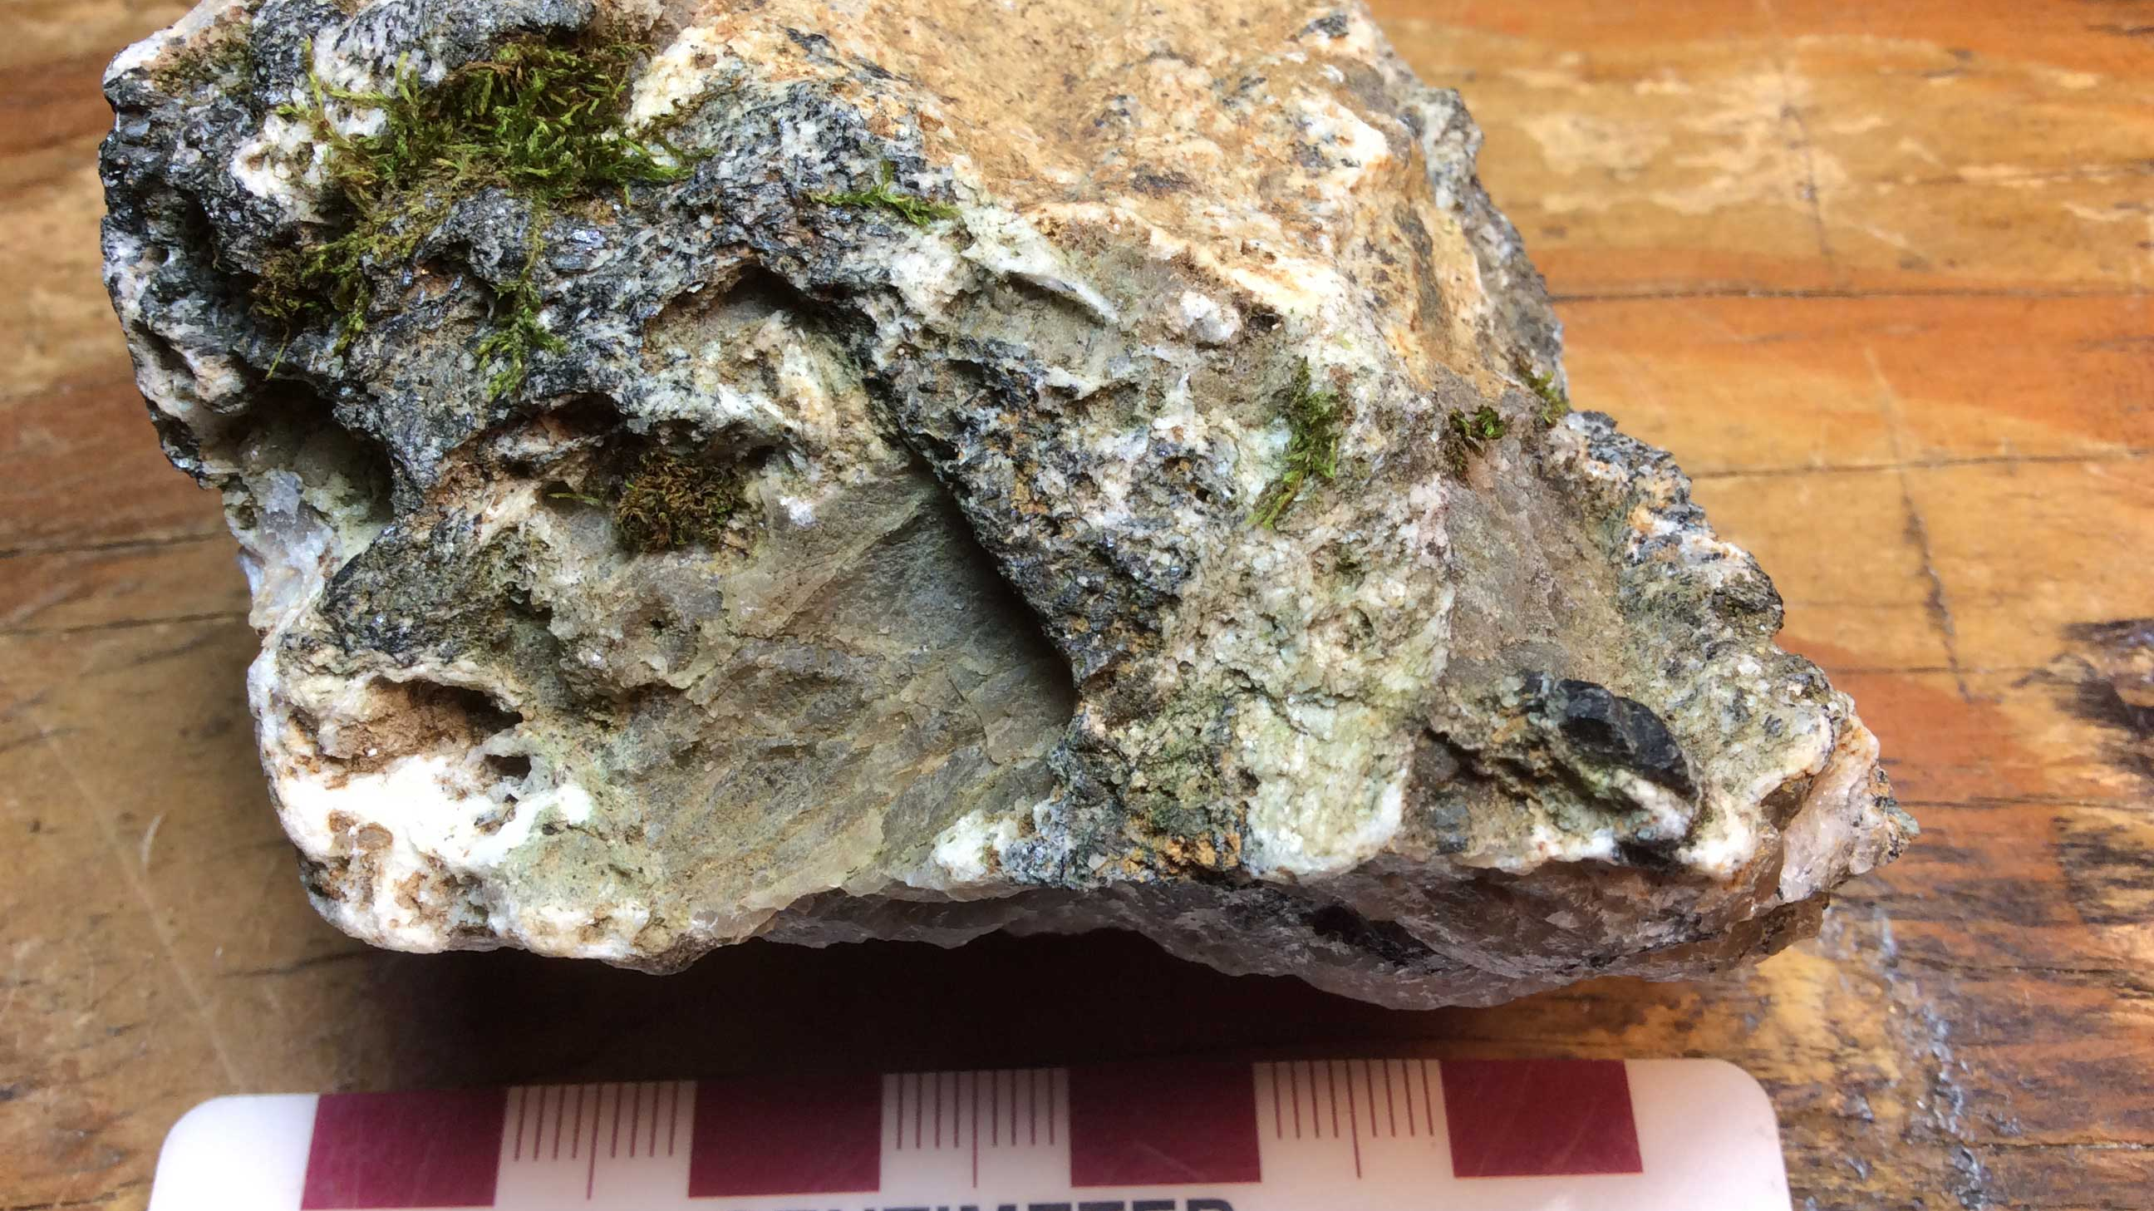
Environment
Nepheline rarely occurs in non-igneous rock and forms in lavas as glassy crystals. The crystals can even be found in the lavas of Vesuvius.
The largest deposit of Nepheline can be found in the Kola Peninsula in Russia. Other large masses are in Norway and South Africa.
In the U.S. deposits have been found in Maine, Arkansas, and New jersey.
The largest mass of almost pure Nepheline is located Ontario Canada.

Slide 13
References
“Nepheline.” Nepheline: Mineral Information, Data and Localities., www.mindat.org/min-2880.html.
Barthelmy, Dave. “Nepheline Mineral Data.” Nepheline Mineral Data, webmineral.com/data/Nepheline.shtml#.XeVcUndFzSH.
Geology Science. “Nepheline: Physical - Optical Properties, Uses, Occurrence & More..” Geology Science, 27 June 2019, geologyscience.com/minerals/nepheline/#Nepheline_Optical_Properties.
Klein, Cornelis, and Anthony R. Philpotts. Earth Materials: Introduction to Mineralogy and Petrology. Cambridge University Press, 2017.

