Slide 1
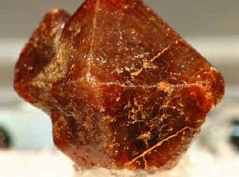
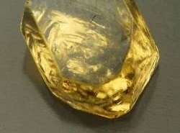
Zircon
By: Ericka Boudreau

Slide 2
Physical Characteristics
Chemical Formula – ZrSiO₄
Tetragonal Nesosilicate
Luster – Vitreous, adamantine
Hardness – 7.5
Color – Yellow, grey, colorless, reddish-brown, green, black
Specific Gravity – 4.6 to 4.7
Streak – White
Fracture – Uneven to conchoidal

Slide 3
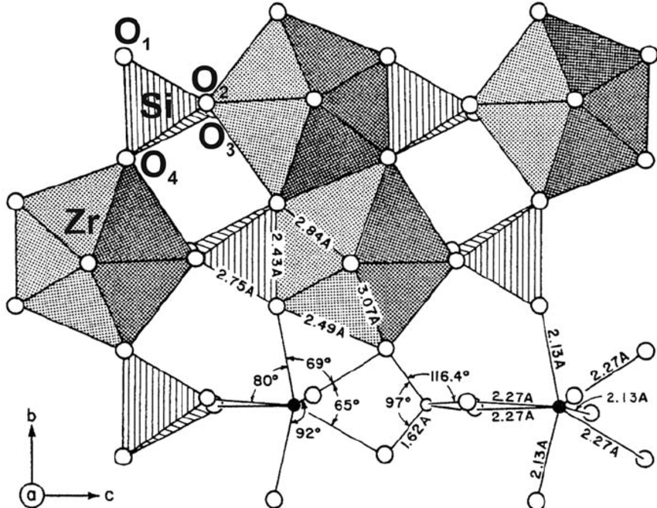
Zircon Structure
Isolated SiO₄ tetrahedra share corners and edges with ZrO₈ dodecahedra
Repulsion between Zr⁴⁺ and Si⁴⁺ cations causes distortion creating potential sites for elemental impurities

Slide 4
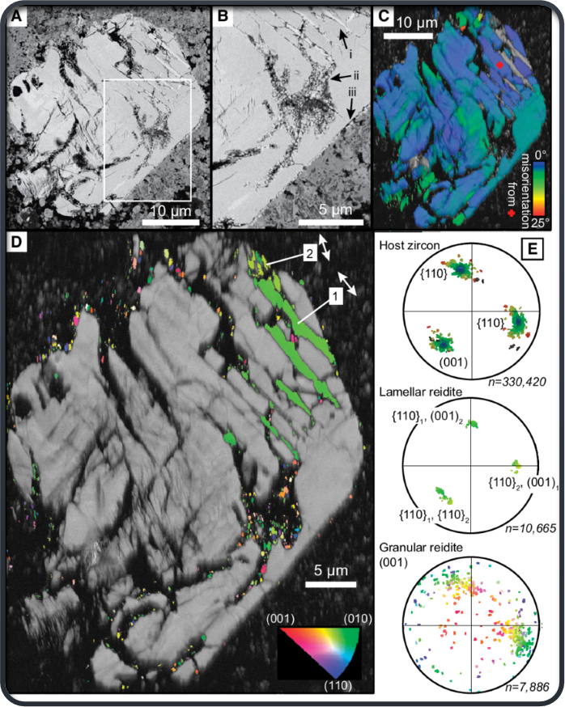
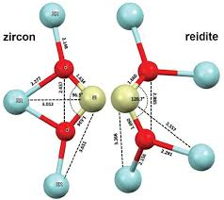
Zircon’s Polymorph: Reidite
Naturally occurring under very high pressures
Occurs as skeletal intergrowths within zircons
Was discovered in marine sediments in an impact ejecta layer off the coast of New Jersey

Slide 5
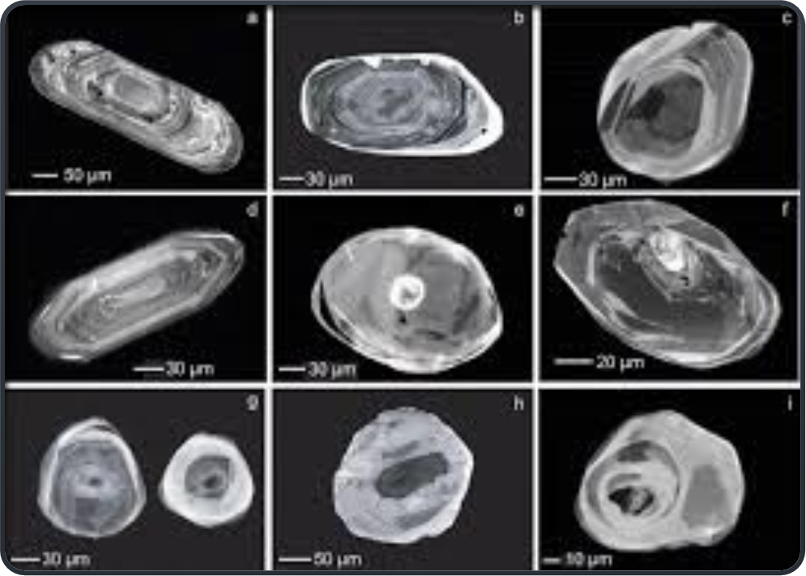
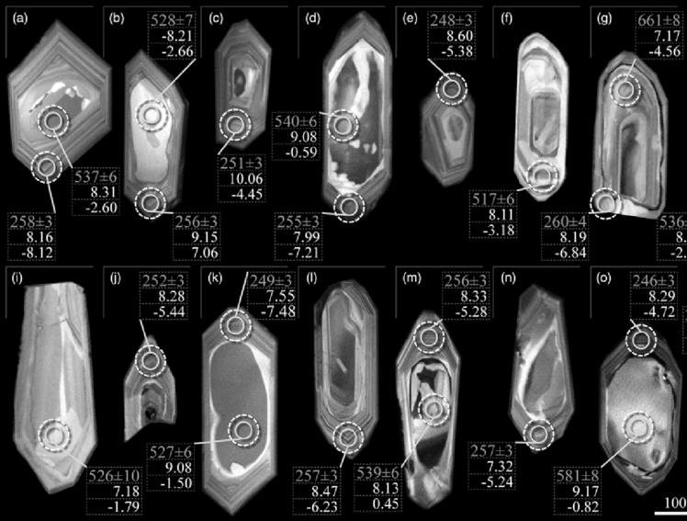
Igneous and Metamorphic Zircon
Common in igneous rocks of intermediate to felsic composition
Internal oscillatory zoning due to heterogenous distribution of trace elements
Metamorphic zircons can be recognized by recrystallization around a mineral inclusion

Slide 6
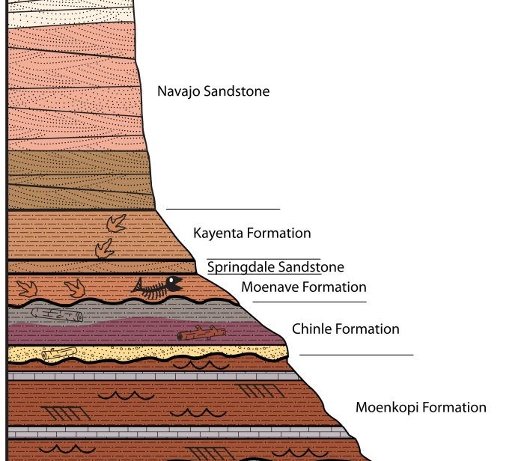
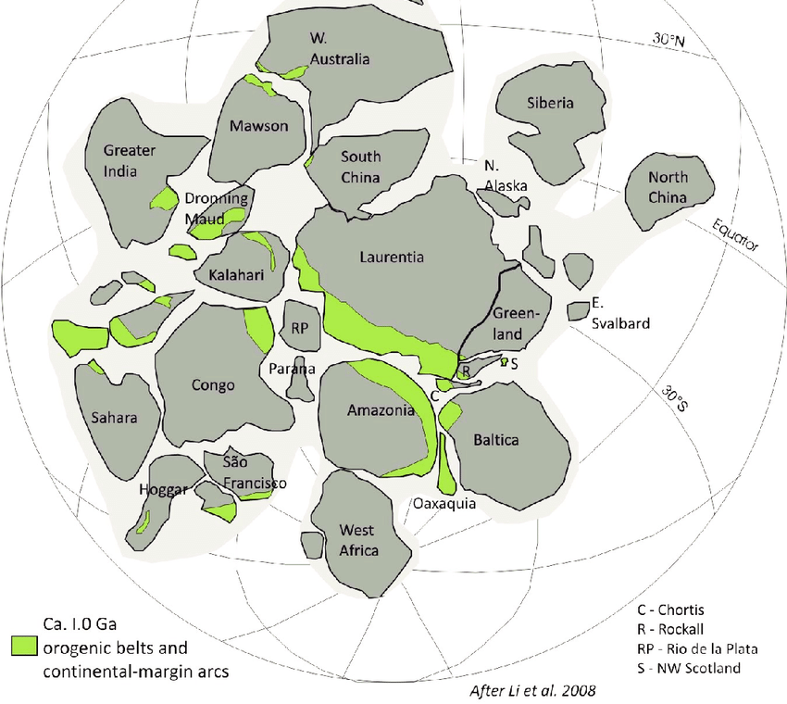
Detrital Zircon
Provenance studies – supercontinents
Can connect mountain ranges that stretch over continents by analyzing trace element concentrations
Used to constrain ages of layered sedimentary rocks
Stratigraphic columns show geological development of an area overtime

Slide 7
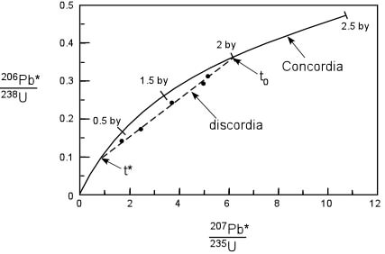
U-Pb Geochronology of Zircon
Zircons contain high concentrations of Uranium (U) and low concentrations of common Lead (Pb)
Radioactive isotopes of U decay to corresponding isotopes of radiogenic Pb*
The rate of decay and the ratios of U and Pb isotope concentrations can be used to calculate crystallization age using a Concordia diagram

Slide 8
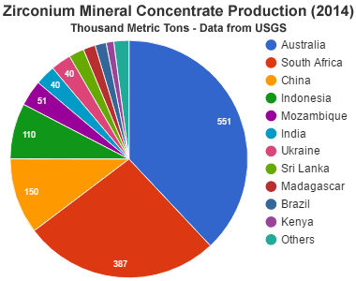
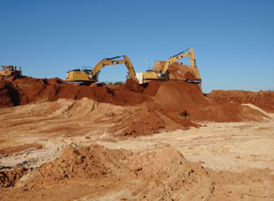
Zircon Mining
For over 2000 years zircon has been mined for its gemstone qualities in ancient gravel stream beds
Currently mined all over the world in continental and marine deposits of alluvial origin
Primary ore of Zirconium metal

Slide 9
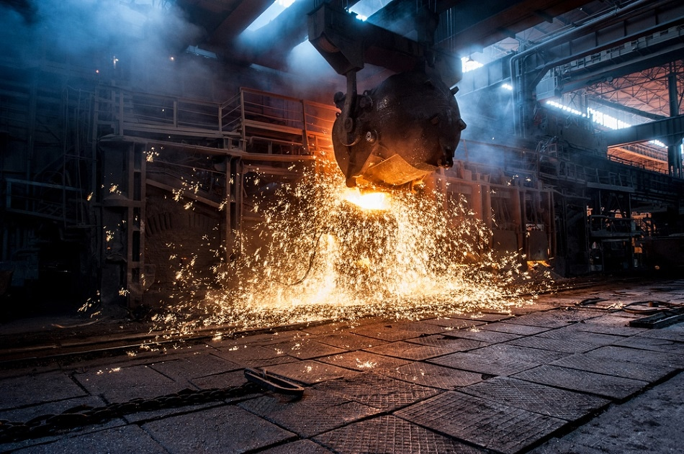
Industrial Applications
Zircon is a significant component of heavy-mineral beach sands (minerals > 2.8 g/cm³)
Zircon sand is used as a refractory product for lining high temperature furnaces and reactors
Zirconium is used in nuclear power station control rods, some superconductors, fuel cells, glass, deodorants, and ceramics

Slide 10
References:
Hanchar, J. M., & Hoskin, P. W. O. (2003). Zircon (Vol. 53). Washington, DC: Mineralogical Society of America.
King, H. M. (2005). Zircon. Retrieved December 5, 2019, from https://geology.com/minerals/zircon.shtml.
Mccarthy, T., & Cairncross, B. (2015). Understanding Minerals & Crystals. Struik Publishers (pty) Ltd.
Reidite. (n.d.). Retrieved December 1, 2019, from https://www.mindat.org/min-11467.html.
Zircon. (n.d.). Retrieved December 1, 2019, from https://www.mindat.org/min-4421.html.

Slide 11
Image References:
https://www.researchgate.net/figure/Representation-of-the-ideal-zircon-structure-depicting-the-lattice-positions-of-oxygen_fig2_272272114
https://www.researchgate.net/figure/Images-and-crystallographic-data-of-reidite-bearing-zircon-grain-9-shown-in-Fig-2B_fig3_276392751
https://pdfs.semanticscholar.org/cfca/f3417ffbc10392cbc4efecf30f77f17b589e.pdf?_ga=2.88084627.96725525.1574293987-1547696786.1574293987
https://www.sciencedirect.com/science/article/abs/pii/S0301926806000167
https://www.researchgate.net/figure/Representative-CL-images-of-igneous-zircons-from-Tierra-del-Fuego-samples-with-U-Pb_fig2_316713956
https://www.researchgate.net/figure/Rodinia-supercontinent-reconstruction-showing-the-1-Ga-orogenic-belts-and-continental_fig10_284542384
https://www.nps.gov/zion/learn/nature/rock-layers.htm
https://www.tulane.edu/~sanelson/eens212/radiometric_dating.htm
https://www.sciencedirect.com/science/article/abs/pii/S0892687514001873
https://www.mtixtl.com/1800c3270fhi-purityzirconiacoatingquart.aspx
https://www.azom.com/article.aspx?ArticleID=84
https://geology.com/minerals/zircon.shtml.

