Slide 1
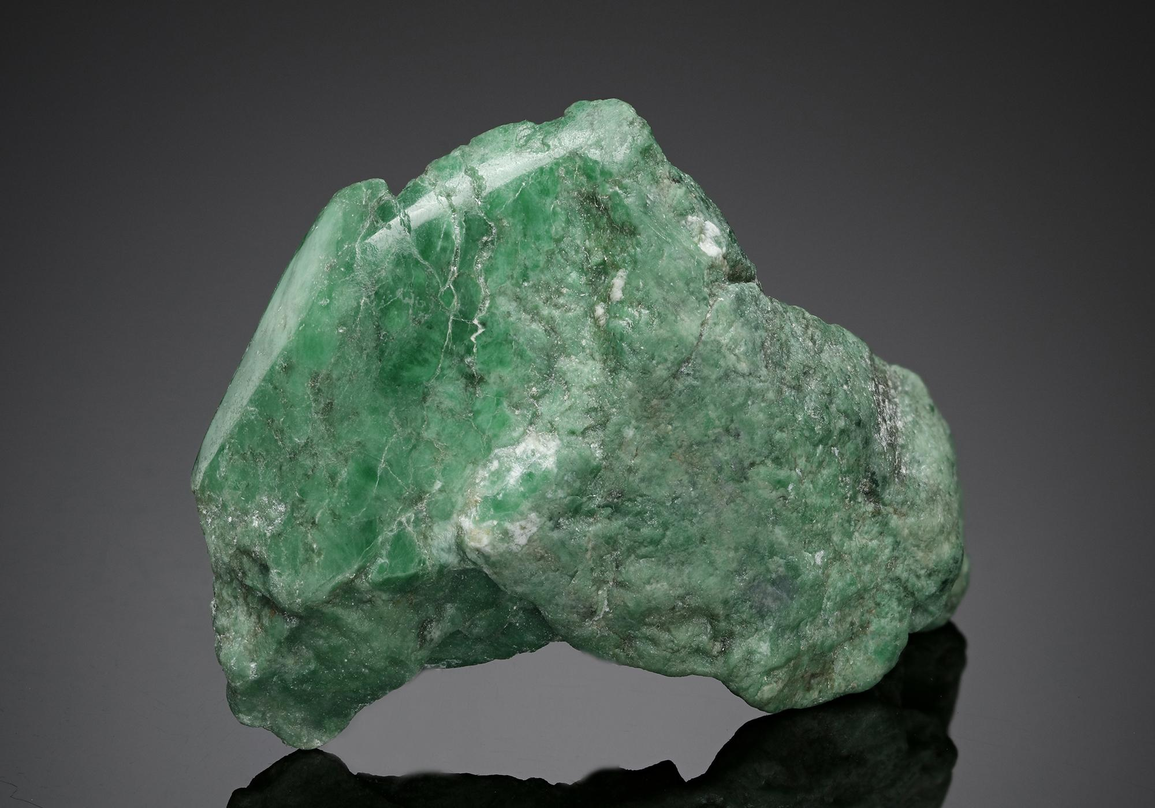
Jadeite - Properties and Practicality
Michael Burke - 2019

Slide 2
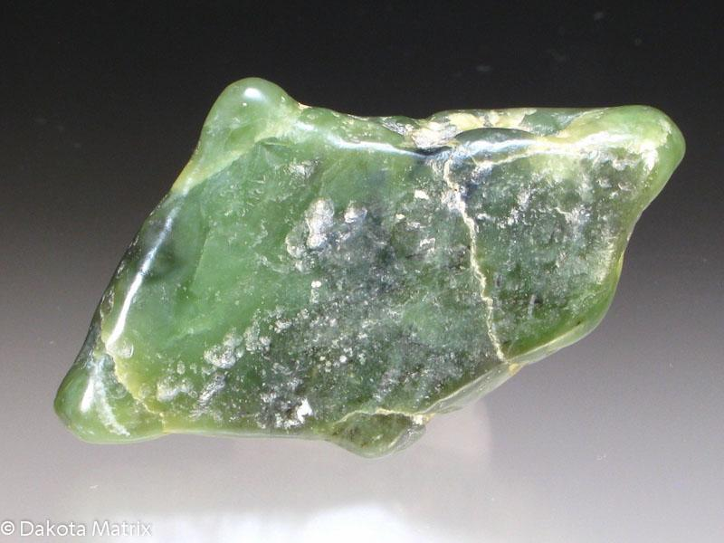
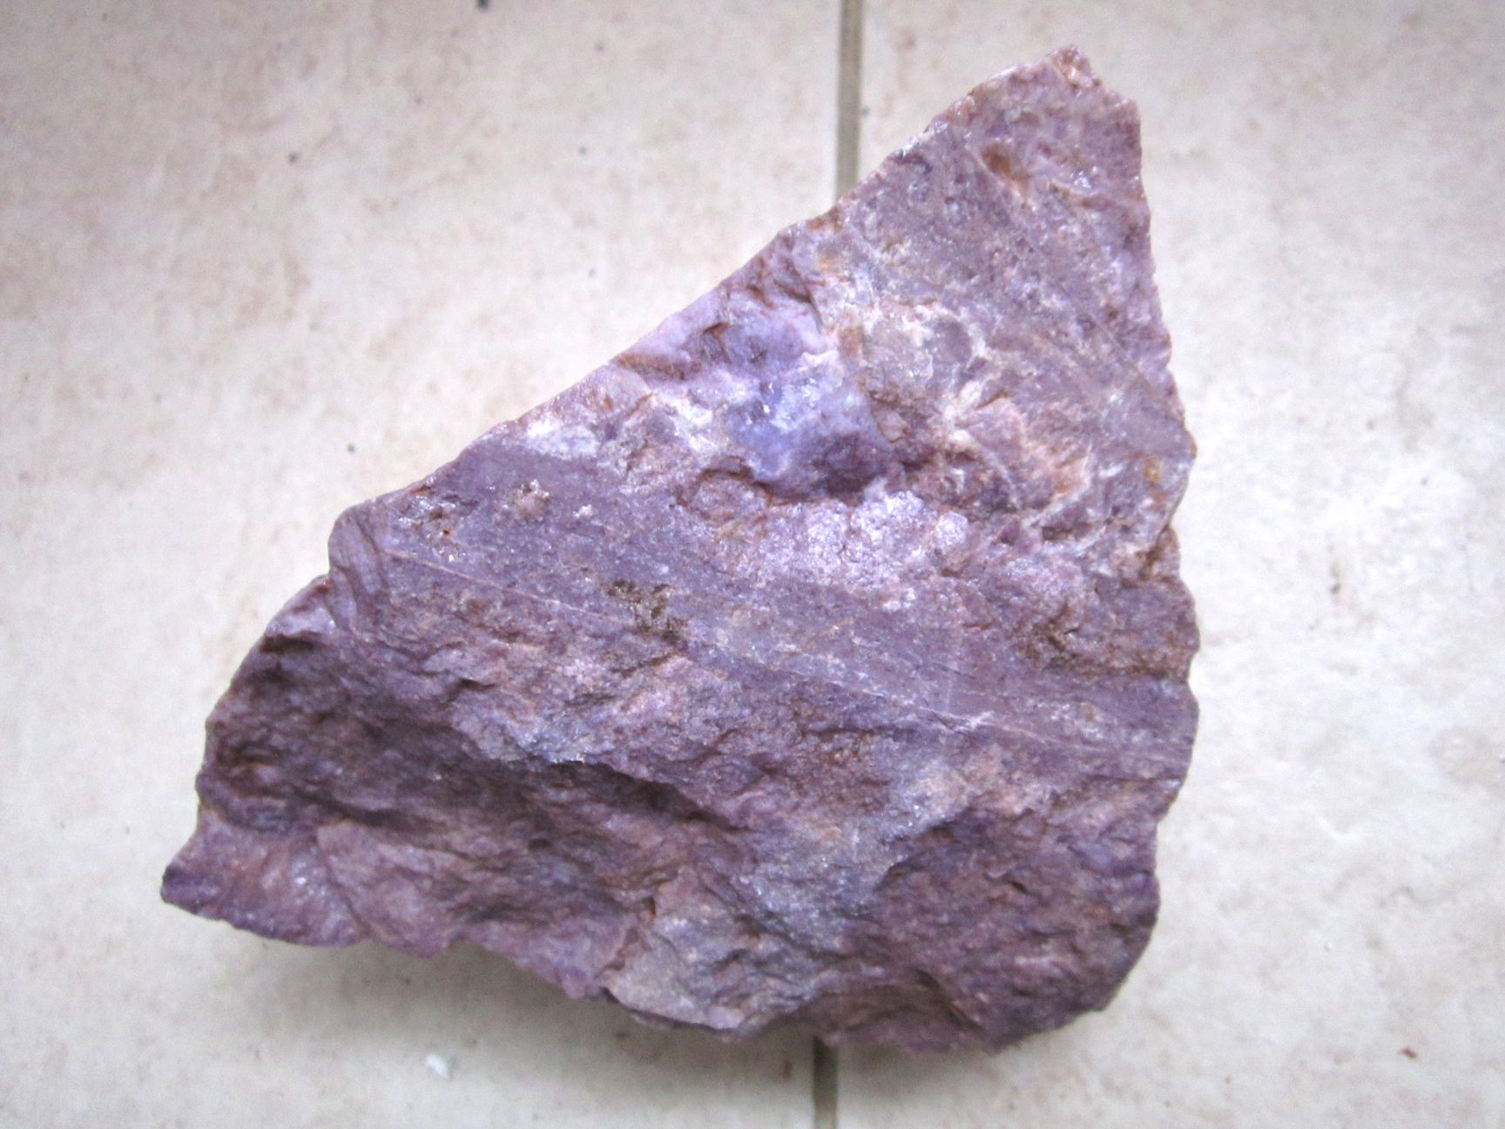
Physical Properties - Basics
Pyroxene mineral - Metamorphic formation
NaAlSi₂O₆ or NaFe³⁺Si₂O₆
Hardness: 6.5 - 7
Color: Green, rarely violet or blue
Specific Gravity: 3.24 - 3.43
Streak: White
Cleavage: Prismatic at 87º - 93º
Luster: Subvitreous
Crystal System: Monoclinic

Slide 3
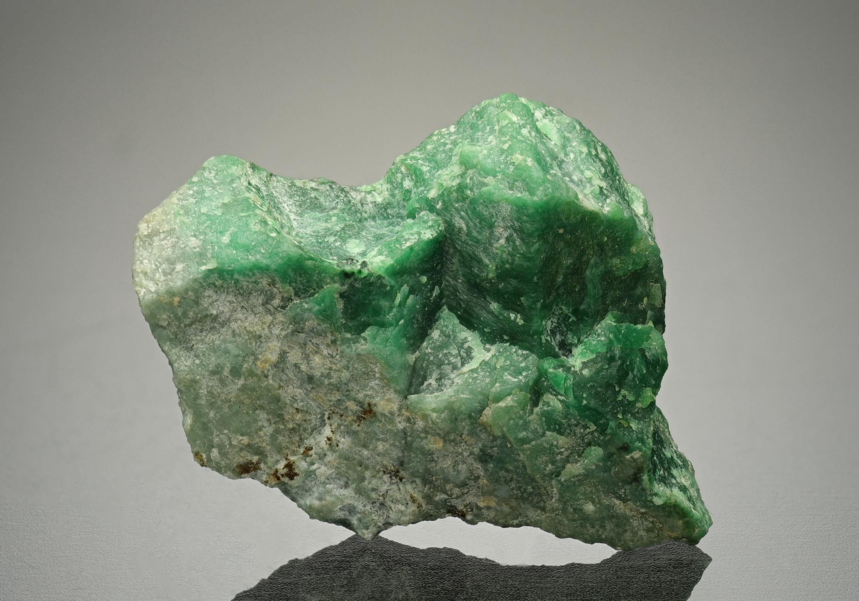
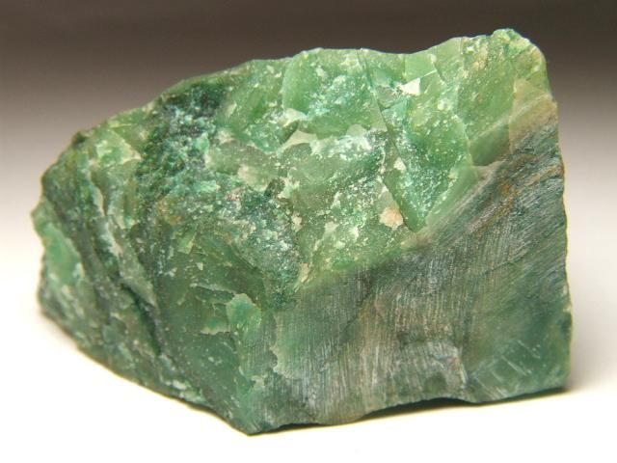
Jadeite vs Nephrite
Jadeite
JADEITE
6.5 to 7 Mohs Scale hardness
Sodium + Aluminum Silicate
3.03 - 3.38 density
NEPHRITE
6 - 6.5 Mohs Scale hardness
Calcium + Magnesium Silicate
2.90 - 3.03 density
Nephrite

Slide 4
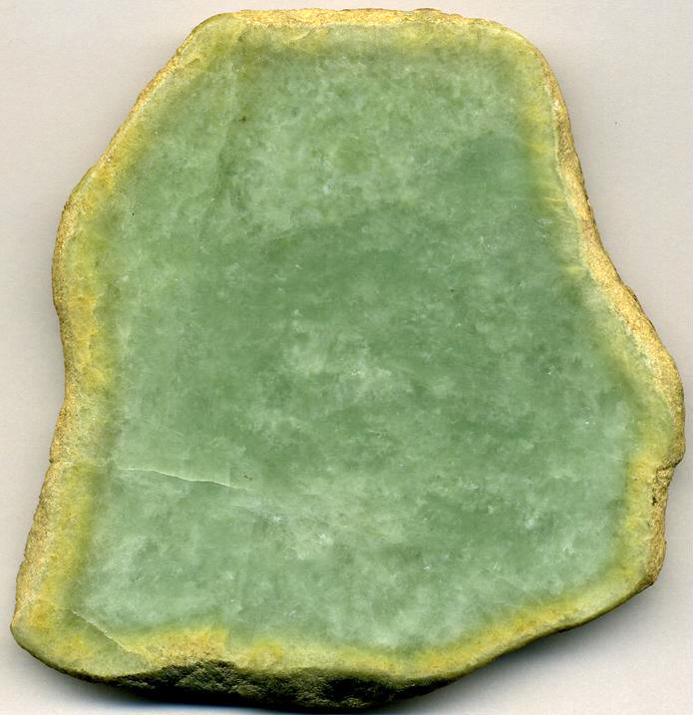
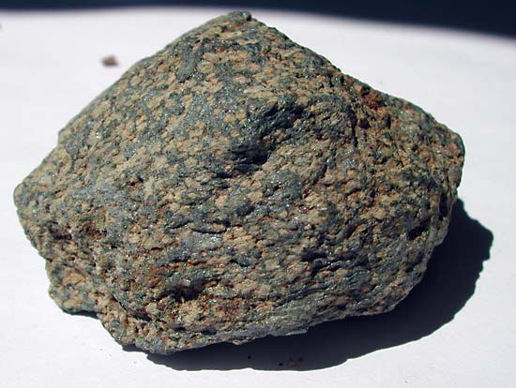
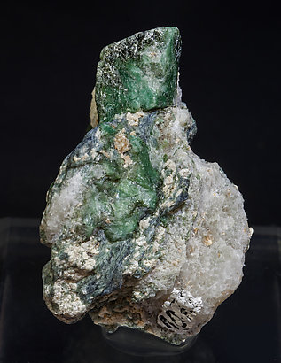
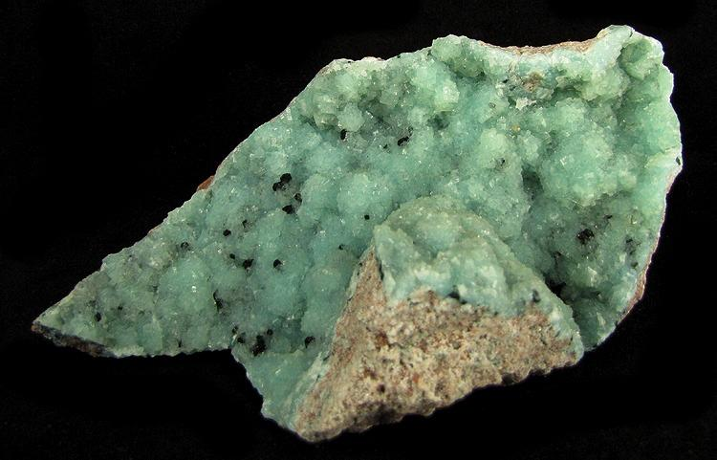
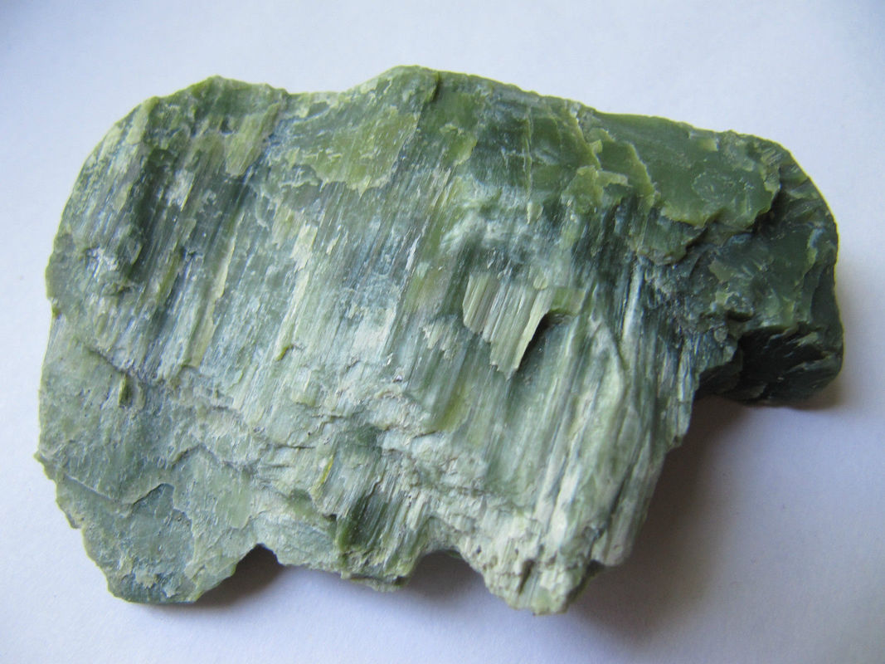
Mineral Formation
Metamorphic Rock - High Pressure + Low Temperature
Formed by the breakdown of Albite - Breaks via high pressure and forms Jadeite and Quartz
Jadeitite - Rock forms consisting of entirely Jadeite
MINERALS CLOSELY ASSOCIATED
Glaucophane
Lawsonite
Aragonite
Serpentine
Jadeitite

Slide 5
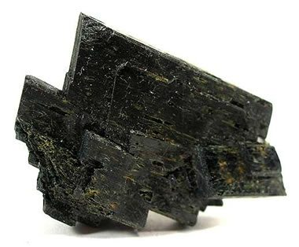
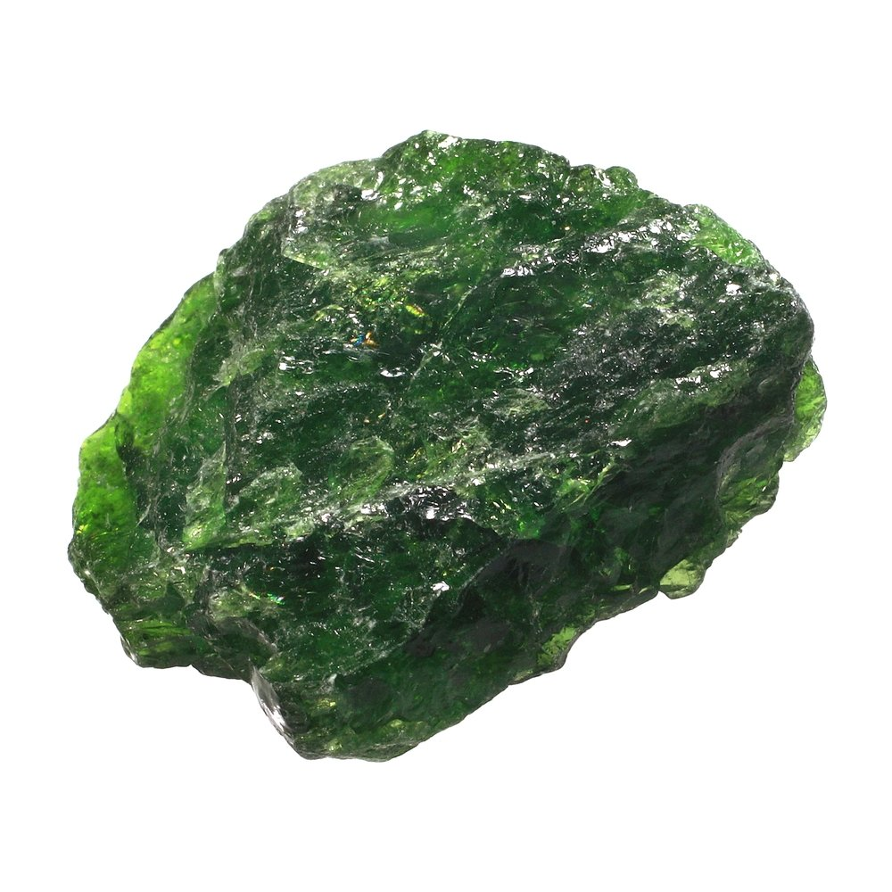
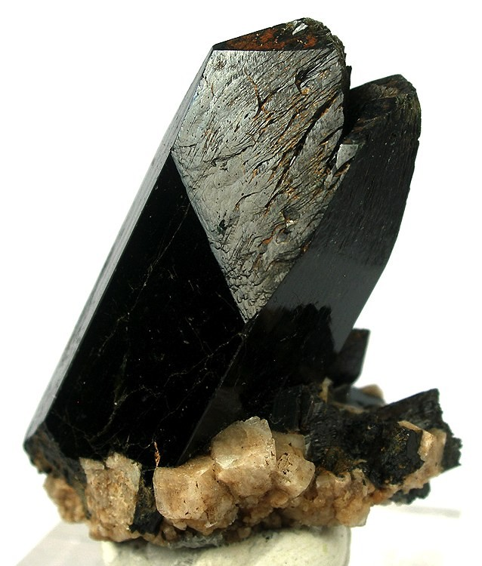
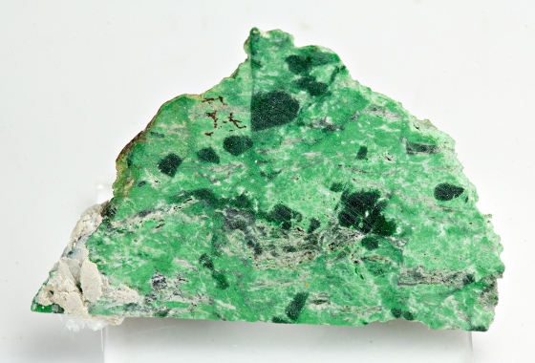
Jadeite’s Pyroxene Solid Solutions
Augite
Diopside
Aegirine
Kosmochlor
(CaMg)
(NaFe)
(NaCr)

Slide 6
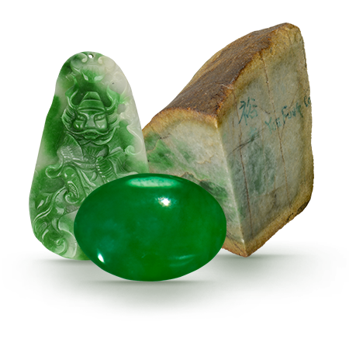
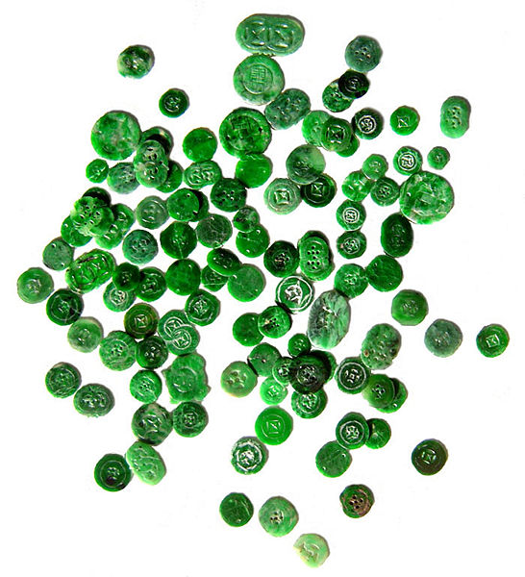
Jadeite and Jade’s Importance
Jadeite and Nephrite = Jade
Considered a gemstone, widely used as jewelry and decor
Translucent Jadeite - Imperial Jade (Chromium traces)

Slide 7
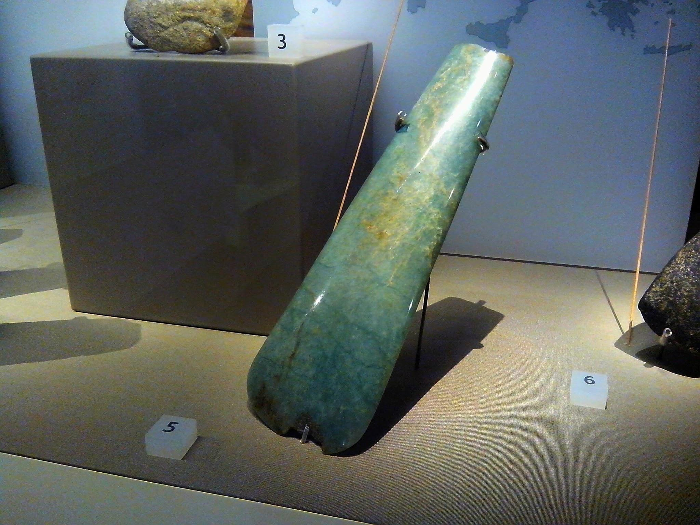
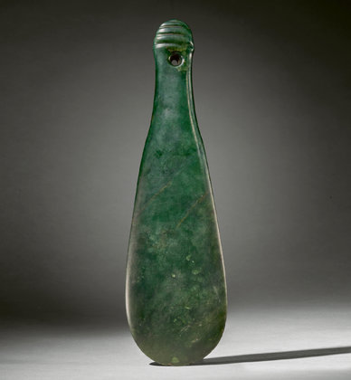
Other Uses
Jadeite found as Neolithic period axe heads
Speculated as currency rather than weaponry
Jade weaponry made of locally found Nephrite

Slide 8
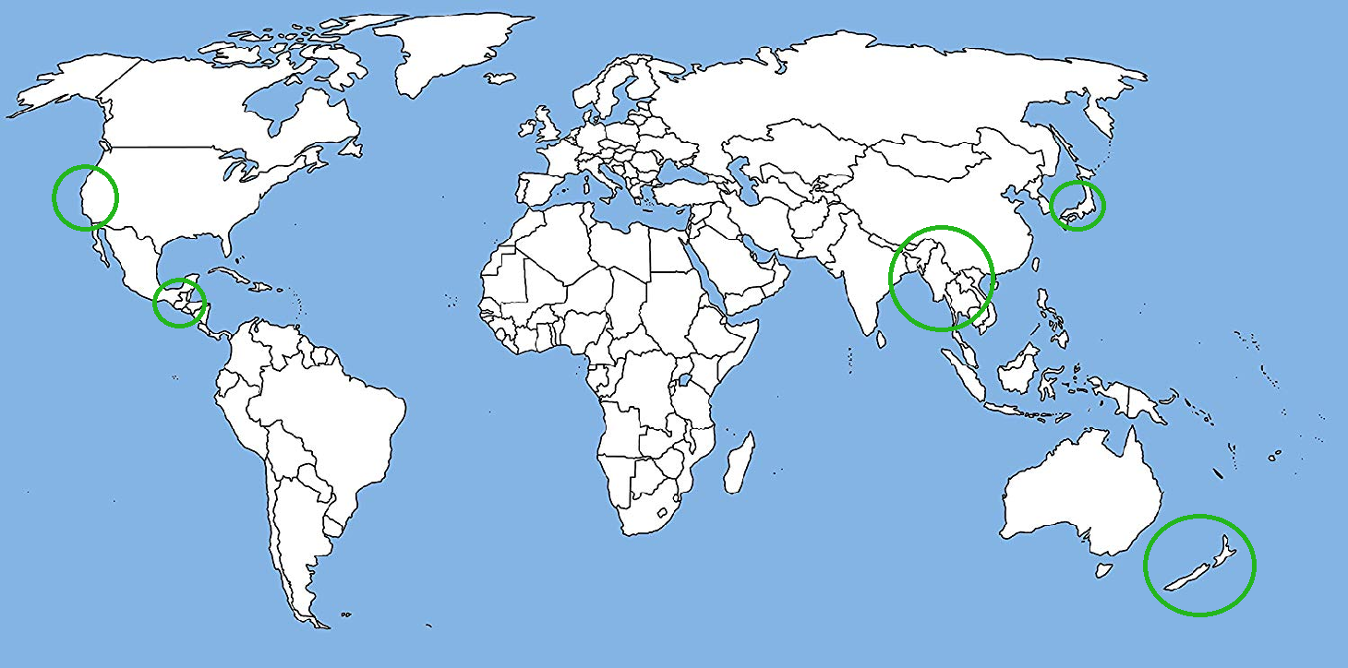
Geographical Deposits

Slide 9
Sources
Editors of Encyclopedia Britannica. (n.d.). Jadeite. Retrieved from https://www.britannica.com/science/jadeite
Jadeite Jade Quality Factors. (n.d.). Retrieved November 31, 2019, from https://www.gia.edu/jade-quality-factor.
King, H. M. (n.d.). What is Jade? Retrieved November 30, 2019, from https://geology.com/gemstones/jade/.

