Slide 1
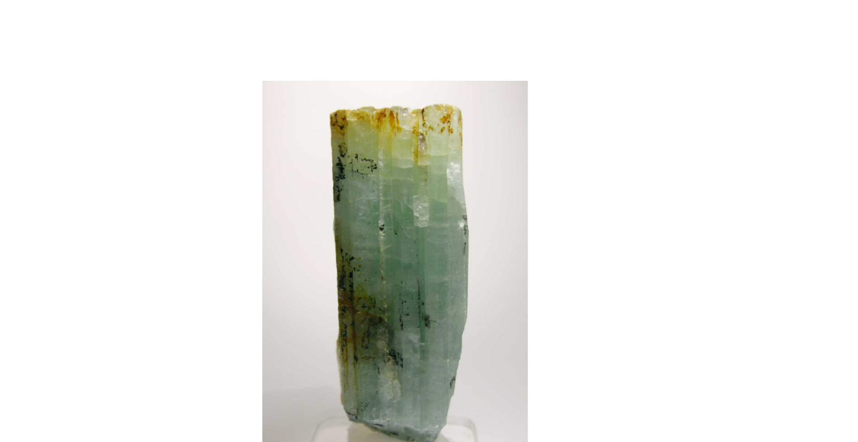
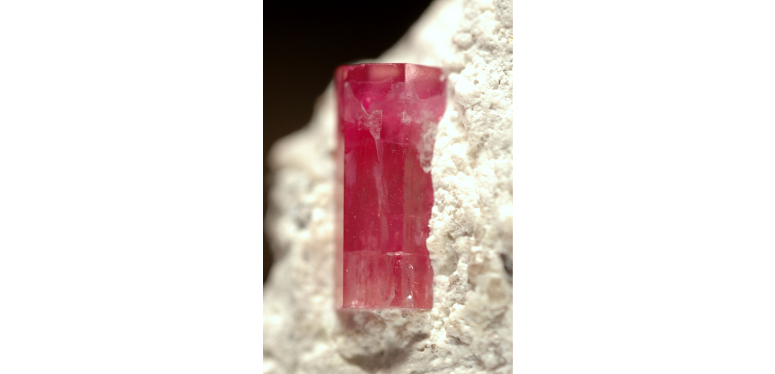
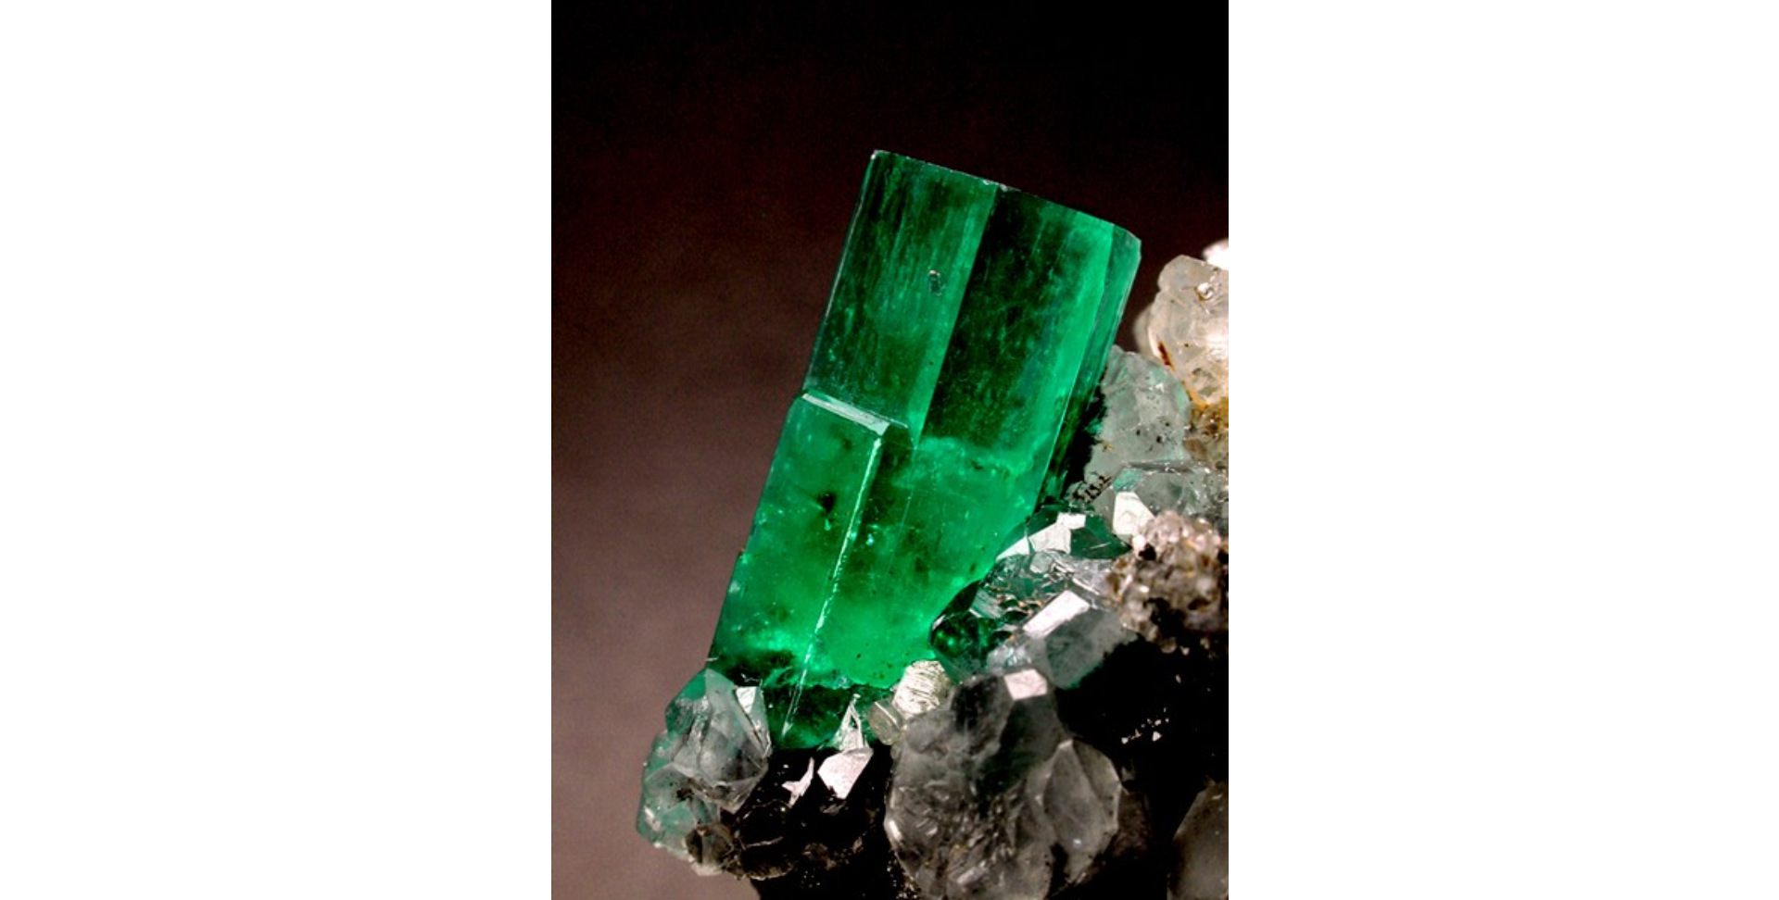
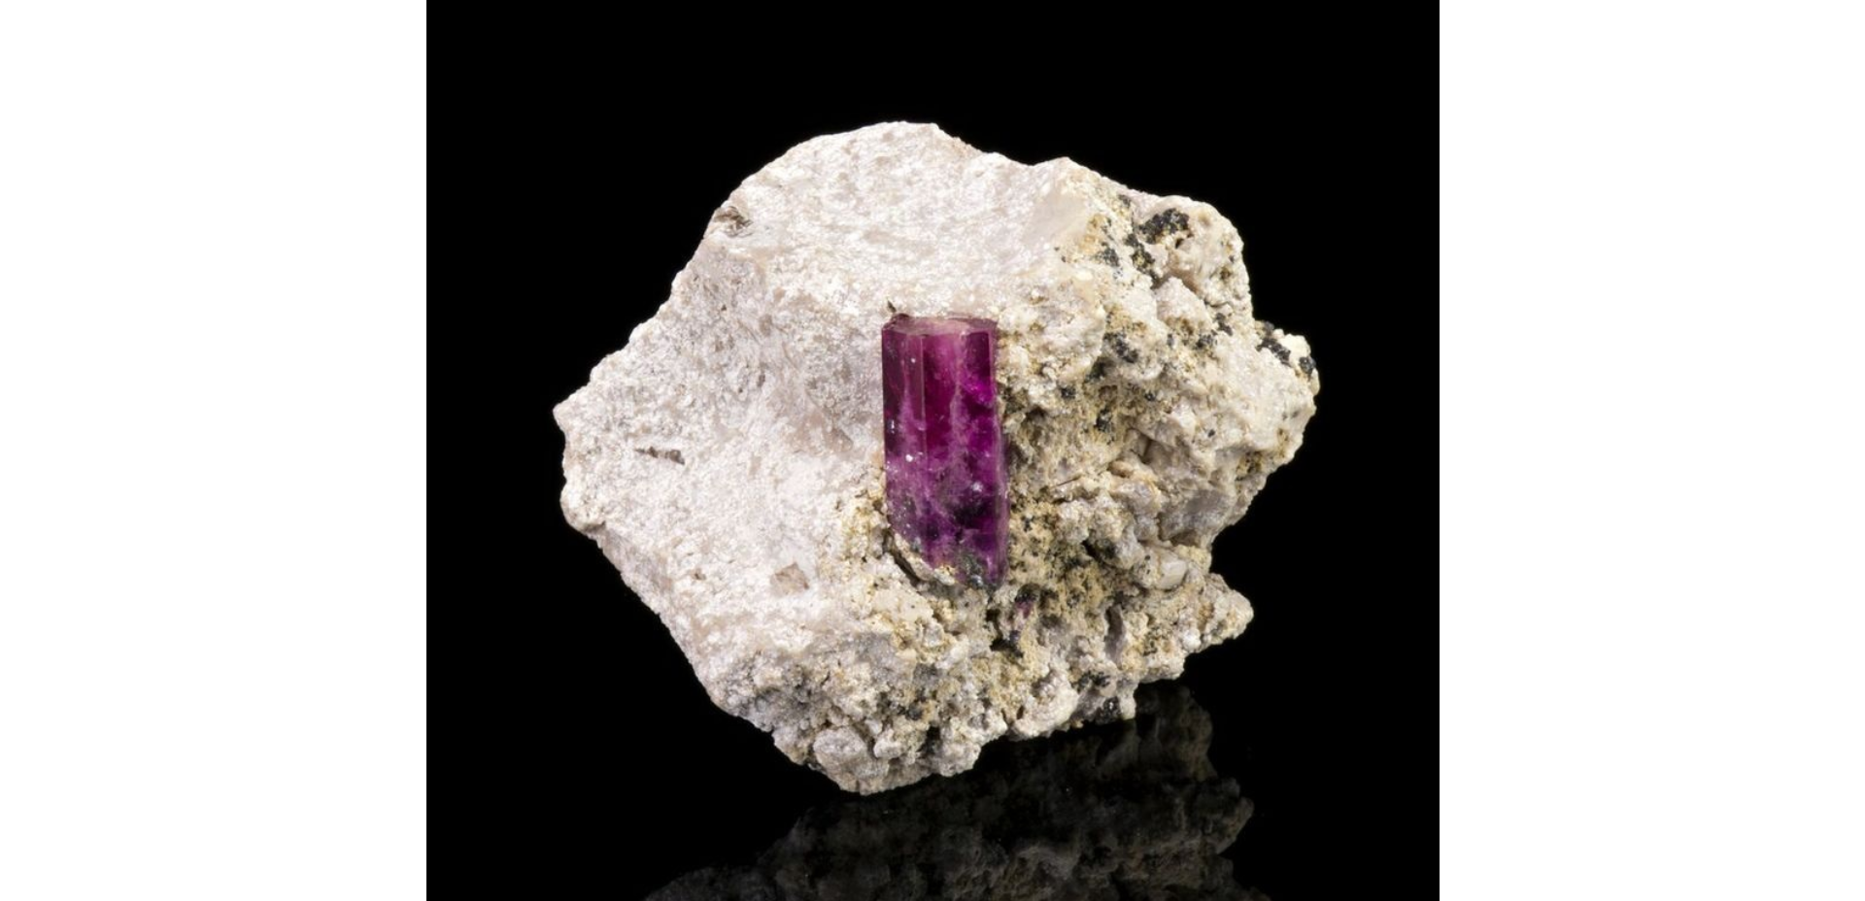
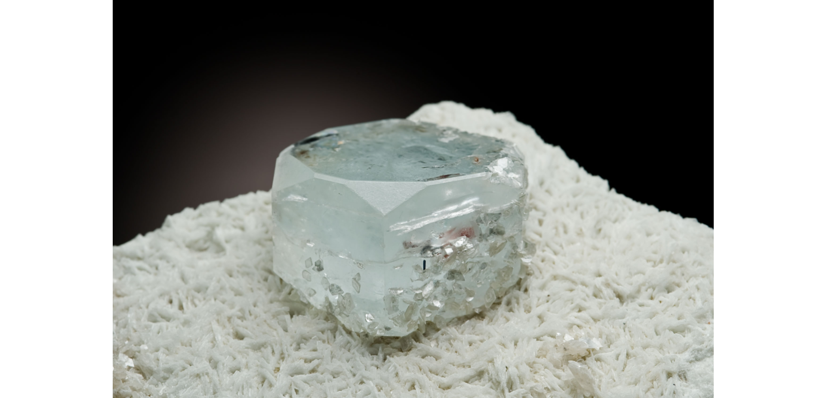
Beryl
Be₃Al₂(Si₆O₁₈)
By Sean Casey

Slide 2
Properties
Formula: Be₃Al₂(Si₆O₁₈)
Color: Colorless, green, blue, yellow, white, pink
Luster: Vitreous, Sub-Vitreous, Waxy, Greasy
Hardness: 8
Specific Gravity: 2.63 - 2.92 g/cm³
Cleavage: Fair on {0001}
Fracture: Conchoidal

Slide 3
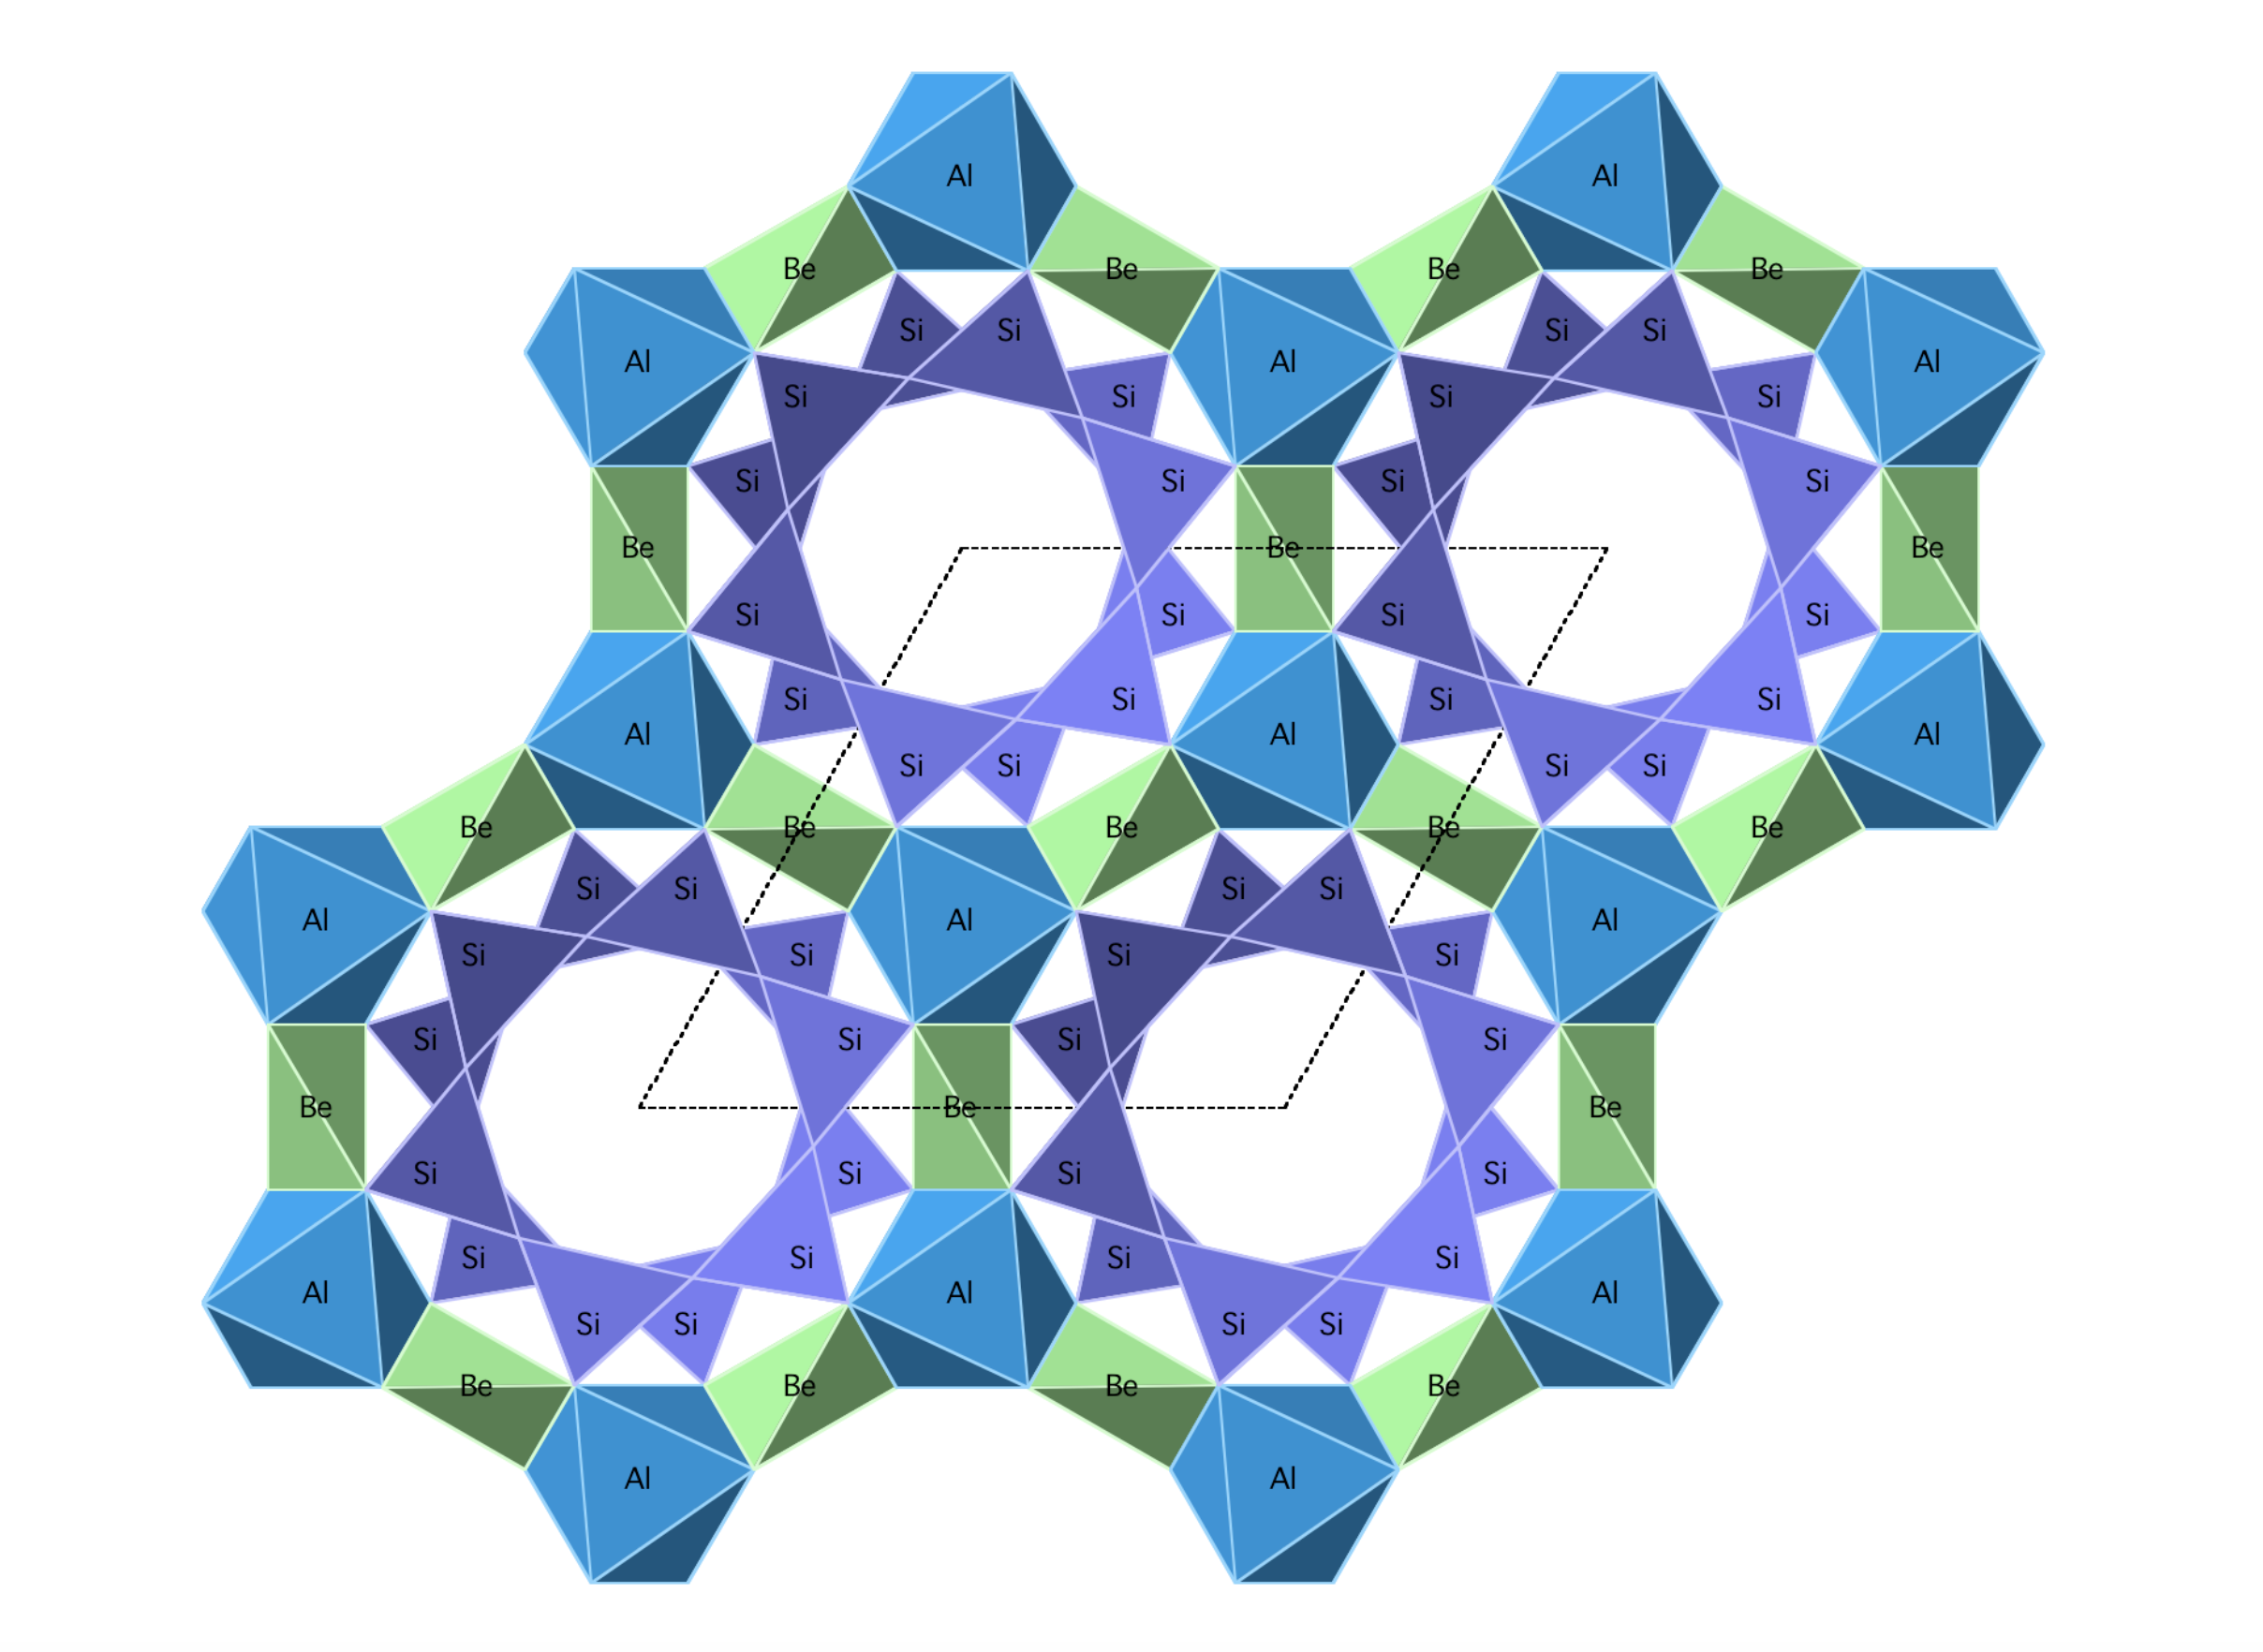
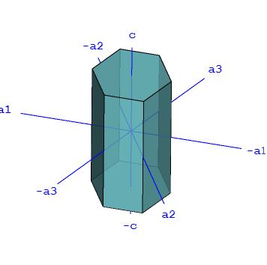
Crystal Structure and Habit
Crystal System: Hexagonal
Crystal Habit: Columnar
Cyclosilicate

Slide 4
Optical Properties
Optical Type: Uniaxial (-)
Optical Type: n_{ω} = 1.568 - 1.602 n_{ε} = 1.564 - 1.595

Slide 5
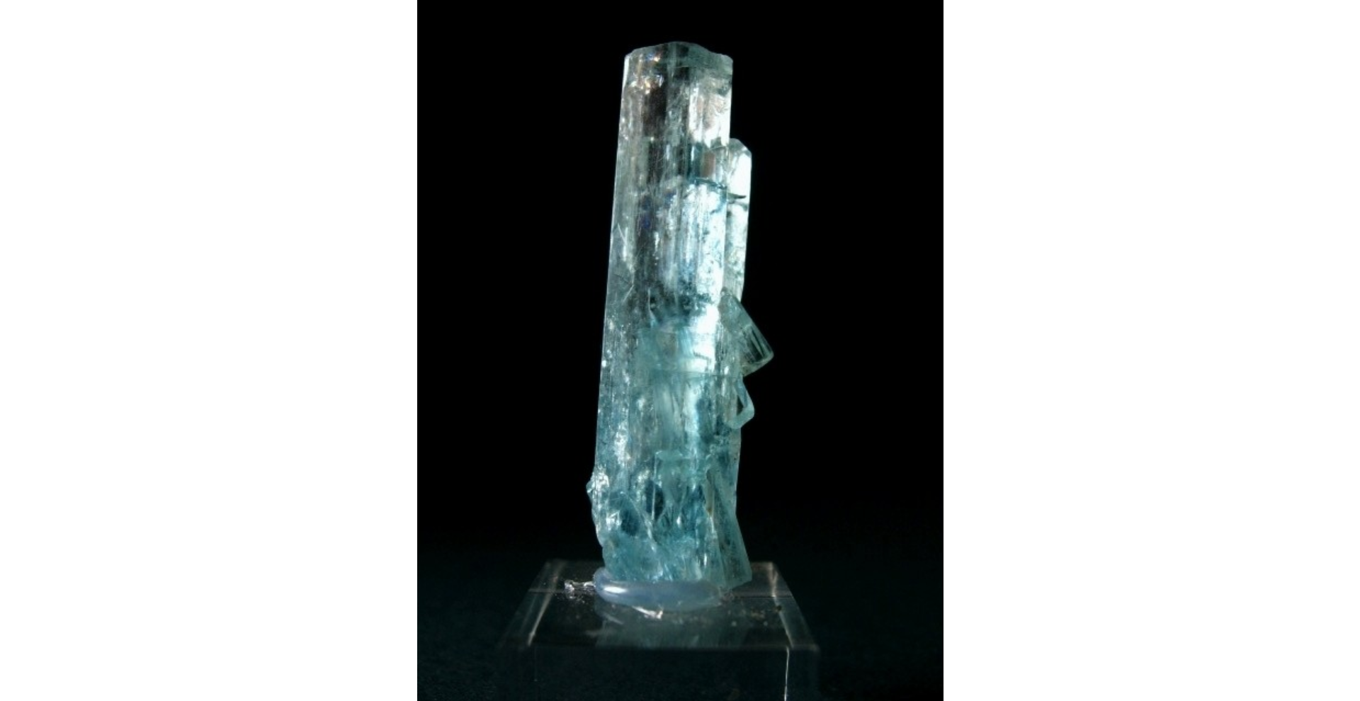
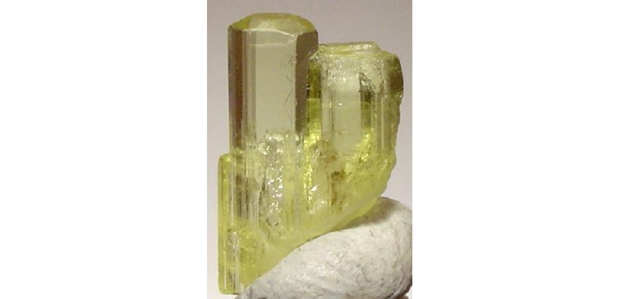
Varieties of Beryl
The crystal Structure of Beryl allows various ions to substitute into the center of its hexagonal rings, fostering further substations that cause a wide array of color variations. Typical Examples are as follows:
Aquamarine - Blue/green variety of beryl.
Color from Fe²⁺
Emerald - Deep green variety of a beryl.
Color from Chromium and Vanadium
Goshenite - Colorless variety of beryl.
Named for Goshen, MA
Heliodor - Yellow variety of beryl.
Color from Fe³⁺
Morganite - Pink variety of beryl.
Color from Mn²⁺

Slide 6
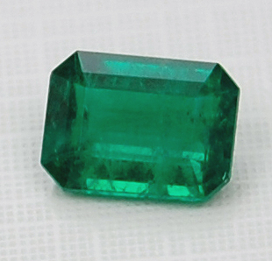
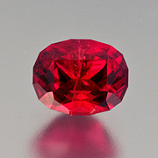
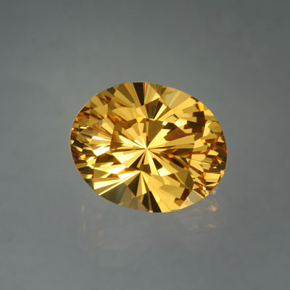
Uses of Beryl
Up until 1970 Beryl was a major source for Beryllium, which can be used to create high strength alloys, some of which are used by NASA for satellites.
The discovery of a large Beryllium supply eliminated the need to extract Beryllium from Beryl, as it is a very expensive process.
The primary use of beryl today is as a gemstone, the most common of which being cut emerald.

Slide 7
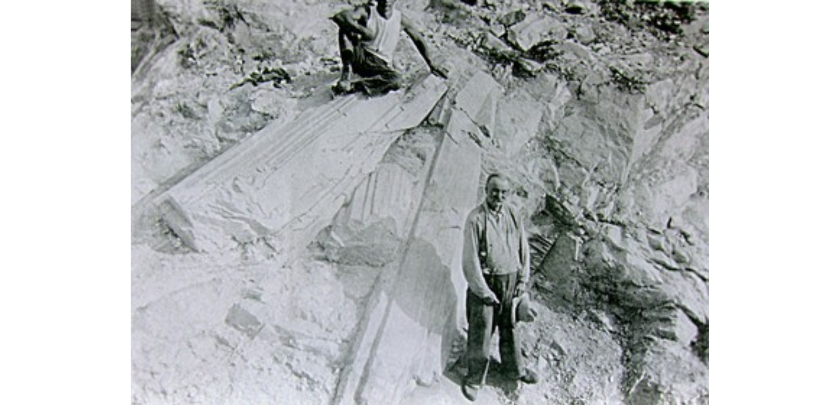
Fun Fact
Beryl is commonly found in granitic pegmatites, which in turn makes them common in the New England area.
One of the largest Beryl crystals was found at the Bumpus Quarry in Albany, Maine

Slide 8
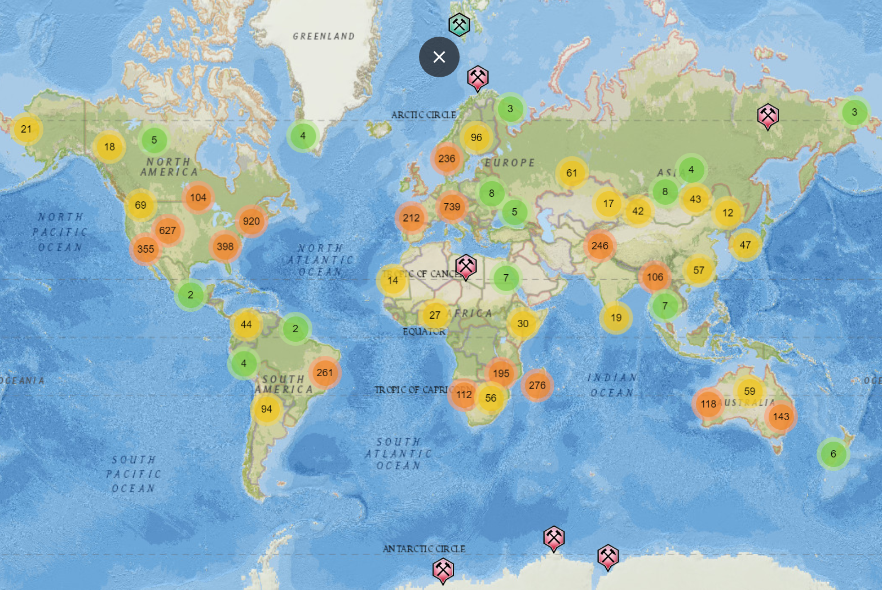
Locations

Slide 9
References
G. Cressey and I. F. Mercer, (1999) Crystals, London, Natural History Museum, page 58
Deer, W. A.; Howie, R. A.; Zussman, J. (2013). An introduction to the rock-forming minerals
(Third ed.). London.
Behmenburg, Christa; et al. (January 2002). Giuliani, Gaston; et al. (eds.). Emeralds of the World. ExtraLapis. 2. East Hampton, Connecticut: Lapis International. pp. 75–77
Arthur Thomas (2007). Gemstones. New Holland Publishers. p. 77

